Slide 1

Association of embryo transfer catheter maneuvers on clinical pregnancy and live birth
Jeremy Applebaum, MD; Sophia H Yin, MD; Elizabeth S Ginsburg, MD; Andrea Lanes, PhD
March 20, 2026
Notes:
Thank you to the Pacific Coast Reproductive Society for allowing me to present this research. My name is Jeremy Applebaum and I am a second year REI fellow at Brigham and Women’s Hospital. This work is on the association of embryo transfer catheter maneuvers on clinical pregnancy and live birth.

Slide 2
Disclosures
None
Notes:
We have no disclosures

Slide 3
Background
Notes:
I’ll begin with background.

Slide 4
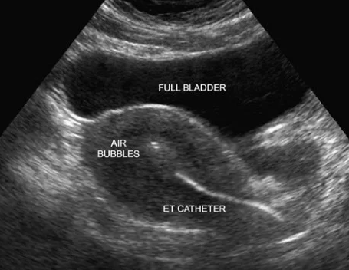

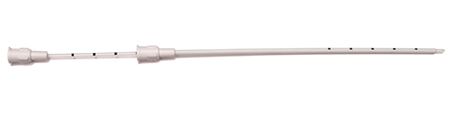
Certain embryo transfer techniques improve success
Ultrasound guidance
Soft catheter
Embryo deposition >1 cm from fundus
Penzias et al. Performing the embryo transfer: a guideline. Fertil Steril. 2017.
Notes:
The embryo transfer is arguably the most important step of the IVF process with the goal of delivering embryos to an optimal location in the uterus as atraumatically as possible to maximize the chance of pregnancy. Numerous studies have identified factors that influence embryo transfer success, such as the use of ultrasound guidance, use of a soft catheter, and depositing the embryos more than 1 cm away from the fundus.

Slide 5
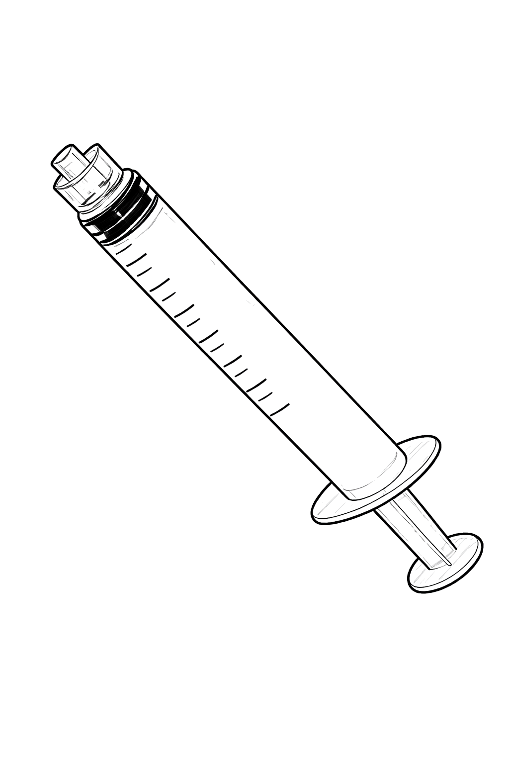


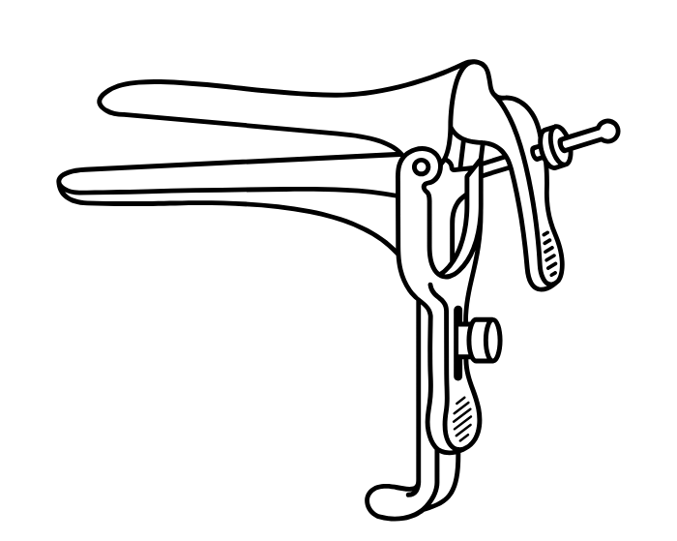
Performing an embryo transfer lacks standardization
34% lubricate speculum
26% embryologist pushes plunger
25% use
surgical scrub
89% wear
sterile gloves
Toth et al. Embryo transfer techniques: an American Society for Reproductive Medicine survey of current Society for Assisted Reproductive Technology practices. Fertil Steril. 2017.
Notes:
However, despite its importance, there are several aspects of the embryo transfer process that lack standardization. In a 2017 nationwide survey of IVF clinics, there is no universal acceptance as to certain components of the embryo transfer process such as whether to lubricate the speculum and who pushes the plunger. There isn’t even consensus as to how we should cleanse our hands or what type of gloves to wear.

Slide 6
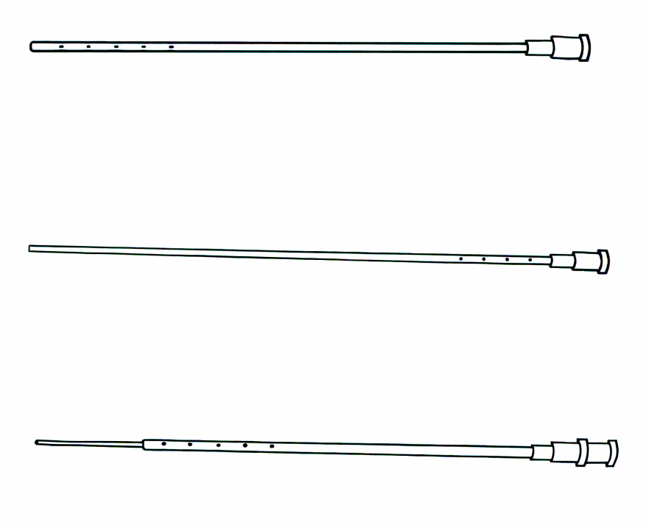
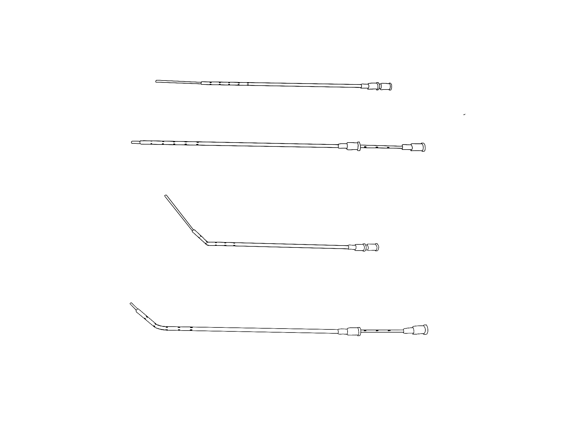
Embryo transfer catheter maneuvers lack standardization
32% bend catheter
22% extend outer sheath
31% afterload technique
Toth et al. Embryo transfer techniques: an American Society for Reproductive Medicine survey of current Society for Assisted Reproductive Technology practices. Fertil Steril. 2017.
Notes:
A very important aspect of the embryo transfer process that also lacks standardization is particular maneuvers that are performed with the embryo transfer catheter. In the same survey study, 32% of physicians routinely bend the catheter, 22% routinely extend the outer sheath over the inner catheter, and 31% routinely use an afterload technique in which the outer sheath is retained past the internal os, and an embryo loaded inner catheter is then threaded through the sheath. The effect of these catheter maneuvers on clinical pregnancy and live birth is unclear. With an increasing focus on embryo transfer procedural standardization, there is a need for establishing evidence-based guidelines to optimize outcomes.

Slide 7
Objective
Determine if specific embryo transfer catheter maneuvers are associated with clinical pregnancy and live birth
Notes:
The objective of this study is thus to determine if specific embryo transfer catheter maneuvers are associated with clinical pregnancy and live birth

Slide 8
Methods
Notes:
Now our methods

Slide 9
Methods
Retrospective study
All autologous/donor IVF/ICSI cycles with subsequent fresh/frozen transfer at Brigham and Women’s Hospital
1/2013 – 7/2024
Only first embryo transfer analyzed
Excluded gestational carriers
Notes:
This is a retrospective study including all autologous and donor egg IVF and ICSI cycles with a subsequent fresh or frozen embryo transfer at Brigham and Women’s Hospital between 2013 and 2024. We analyzed on the first embryo transfer. We excluded gestational carrier cycles.

Slide 10
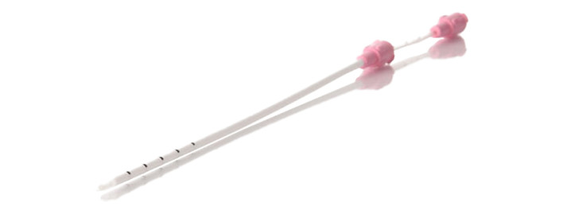
Methods
All patients undergo mock transfer
Wallace® (CooperSurgical) catheter
All transfers under ultrasound guidance
Trial followed by transfer
Physician documents if transfer is subjectively difficult
Catheter maneuvers categorized as non-afterload and afterload
Notes:
In out center, all patients undergo a mock embryo transfer in the proceeding cycle, or early in stimulation if no fresh transfer is planned. All transfers are performed with the Wallace catheter by cooper surgical seen here. All of our transfers are performed under ultrasound guidance. We employ a trial followed by transfer technique during embryo transfers --- this means that an empty catheter is maneuvered through the cervix past the internal os. If no difficulty is encountered, the catheter is removed and a second embryo loaded catheter is maneuvered through the cervical canal and into the uterus in the same fashion as the trial pass. If difficulty is encountered in the trial, the physician can retain the outer sheath in the cervical canal, and then an embryo loaded inner catheter is fed through the outer sheath for embryo deposition. The outer sheath can be left straight, curved, or extended over the inner catheter in this process. Fellows perform embryo transfers in our program after completing 100 mock transfers or IUIs.
After the embryo transfer, the physician documents the maneuvers used for the catheter and if the transfer was subjectively difficult. For analysis, we categorized catheter maneuvers as non-afterload and afterload.

Slide 11
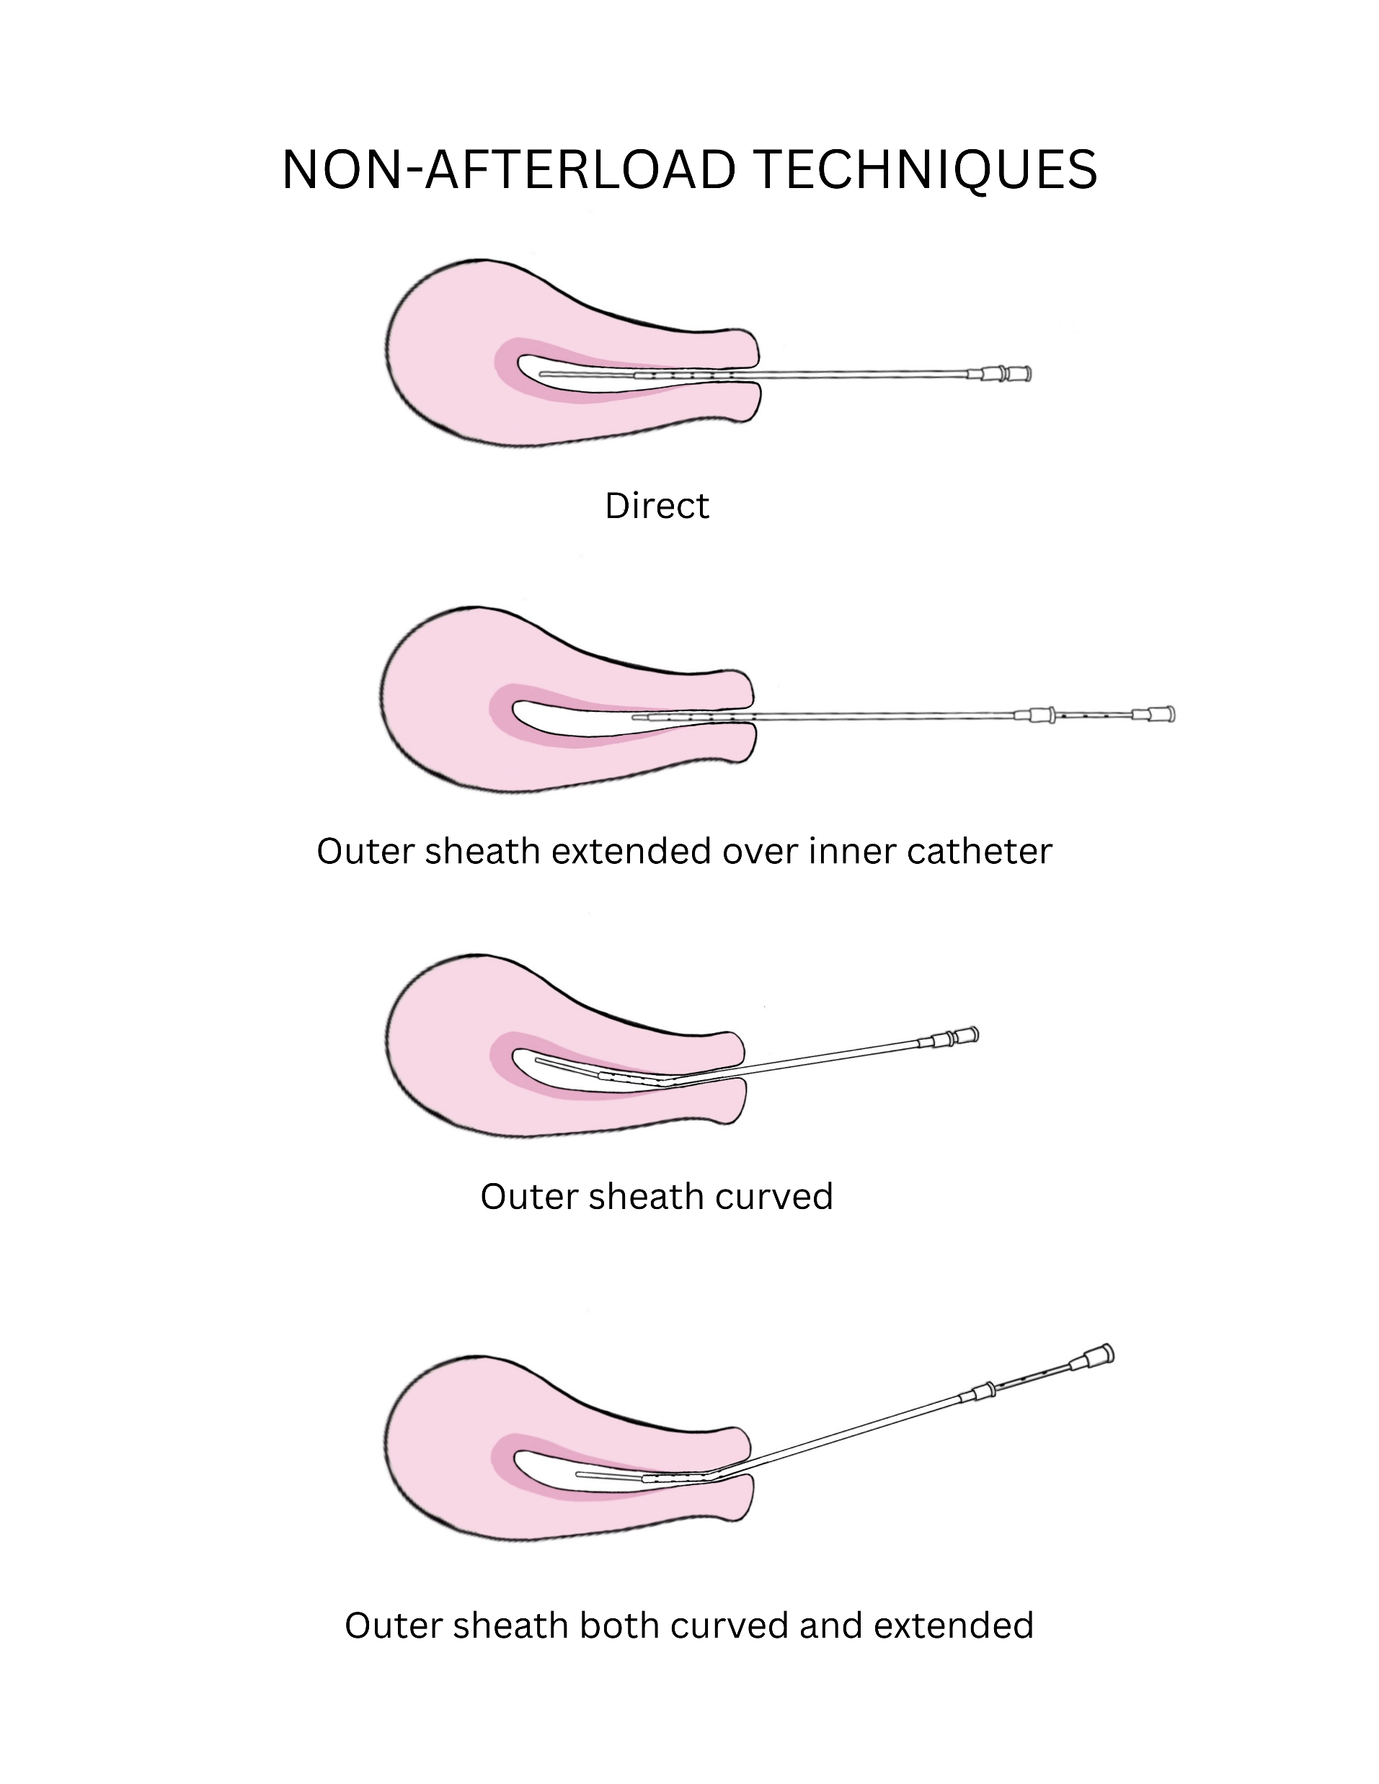

Non-afterload maneuvers
Notes:
Here are the non-afterload maneuvers. Starting on the left side, a direct technique is one in which the outer sheath and inner catheter are inserted together hubbed. Below, the outer sheath can be extended over the inner catheter.
Now on the right side, the outer sheath can also be curved
And then the outer sheath can also be both curved and extended over the inner catheter

Slide 12
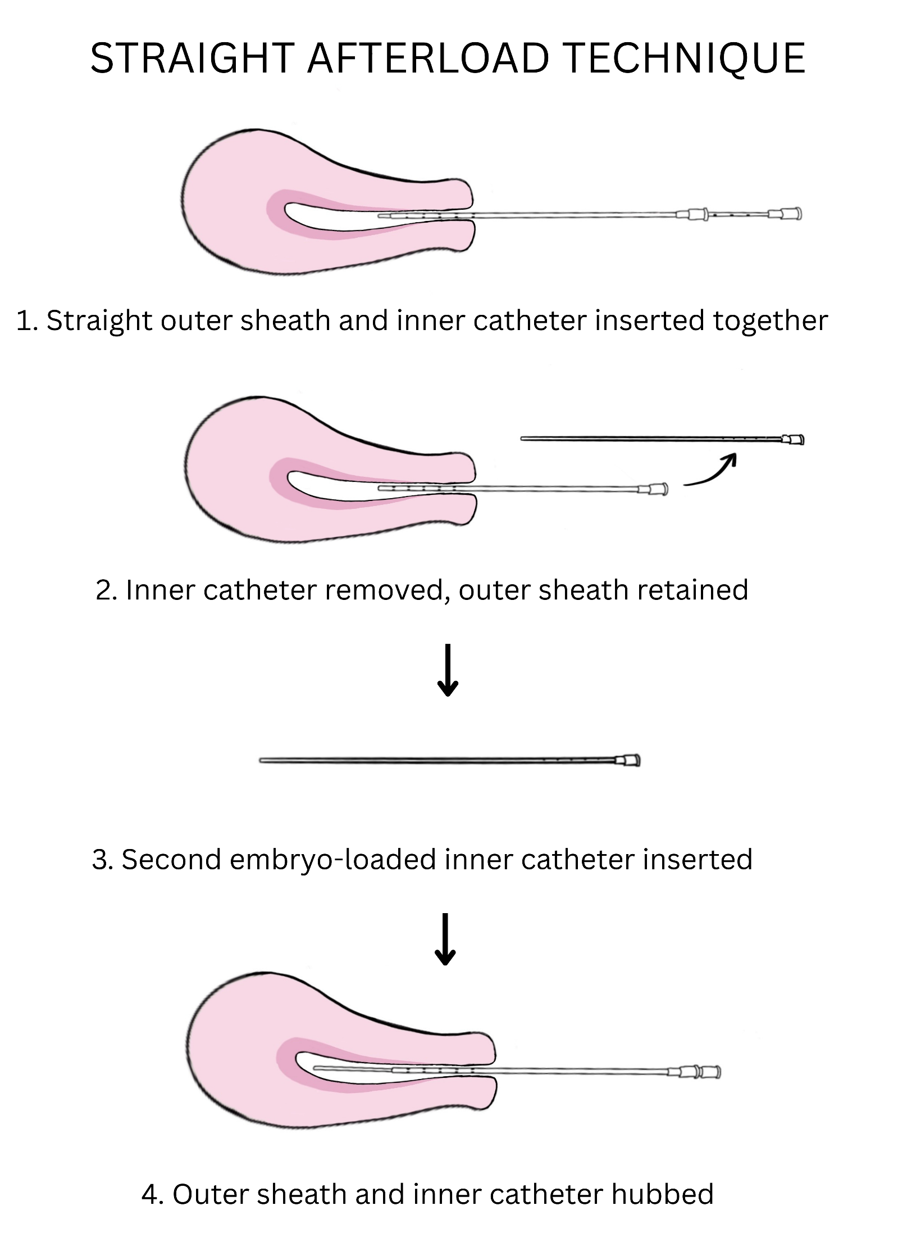
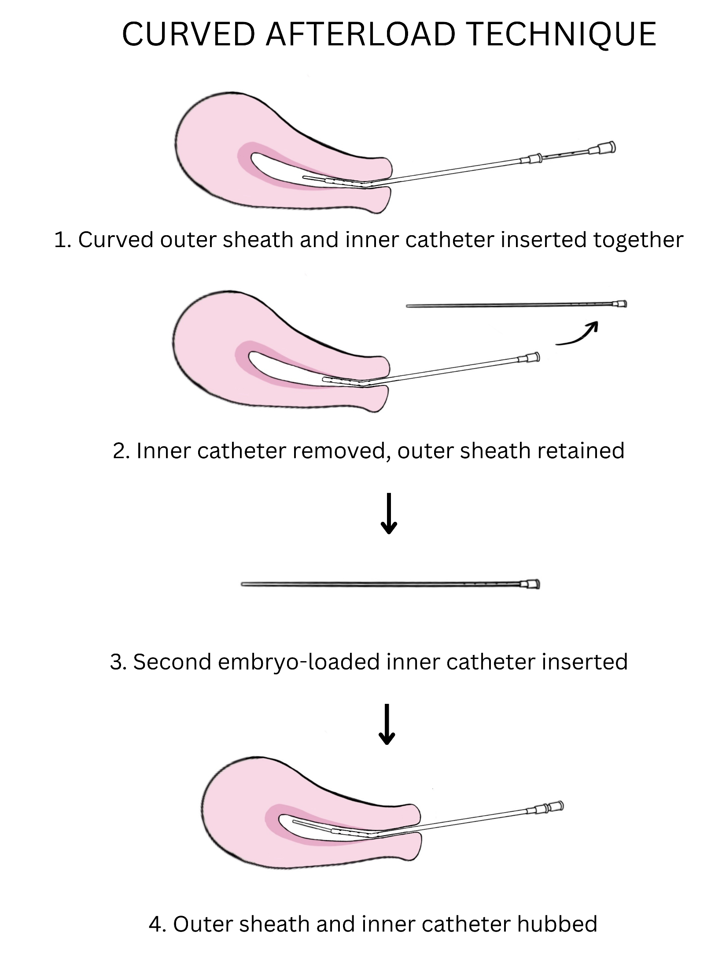
Afterload maneuvers
Notes:
Afterload techniques are shown here. First, straight afterload technique is one in which the outer sheath and inner catheter are inserted together. The outer sheath is retained and the inner catheter removed. Then a second embryo loaded inner catheter is inserted, and ultimately hubbed to the outer sheath for embryo deposition
For a curved afterload technique, a curved outer sheath and inner catheter are inserted together, the inner catheter removed and the outer sheath retained while curved. Then a second embryo loaded inner catheter is inserted, and ultimately hubbed to the curved outer sheath for embryo deposition

Slide 13
Methods
Exposure: embryo transfer catheter technique
Outcome: clinical pregnancy and live birth
Adjusted relative risk of clinical pregnancy and live birth generated with log binomial regression models
Adjusted for: oocyte age, BMI, uterine factor infertility, reported transfer difficulty, stylet, fresh/frozen, embryo stage, embryo quality, donor oocyte use, year
Notes:
For analyses, our exposure was embryo transfer catheter technique and our outcome was clinical pregnancy and live birth
We used log binmomal regression models to calculate the adjusted relative risk of clinical pregnancy and live birth. We adjusted for age, BMI, uterine factor infertility, reported transfer difficulty, stylet use, whether the transfer used fresh or frozen embryos, the embryo stage (blastocyst or cleavage), the embryo quality using internal scoring system, use of donor egg, and year.

Slide 14
Results
Notes:
Now our results

Slide 15
Results
7,881 embryo transfers
  5,268 (66.8%) non-afterload
  2,613 (33.6%) afterload
Notes:
We captured 7,811 embryo transfers. 66% in blue were non afterload, with most being direct. 33% were afterload techniques as seen in red, with most afterload techniques being curved afterload.

Slide 16
Baseline demographics and embryo transfer characteristics
 | Non-afterload N= 5268 | Afterload N = 2613
Age, mean (SD) | 35.6 (4.4) | 35.4 (4.5)
BMI, mean (SD) | 26.3 (6.8) | 27.0 (7.6)
Uterine factor, n(%) | 67 (1.3%) | 32 (0.9%)
Donor oocyte, n(%) | 231 (4.4%) | 94 (3.6%)
PGT, n(%) | 766 (14.9%) | 421 (16.1%)
Frozen transfer, n(%) | 1555 (29.6%) | 812 (31.0%)
Blastocyst transfer, n(%) | 2925 (55.6%) | 1678 (64.2%)
# Embryos transferred, mean (SD) | 1.6 (1.0) | 1.5 (1.0)
Attending transfer, n(%) | 2652 (50.3%) | 1127 (43.1%)
Stylet, n(%) | 1 (0.0%) | 125 (4.8%)
Difficulty, n(%) | 556 (10.6%) | 1512 (57.9%)
Mucus/blood, n(%)
Mucus | 381 (7.2%) | 277 (10.6%)
Blood | 232 (4.4%) | 394 (15.1%)
Excellent/good embryo quality, n(%) | 3598 (68.3%) | 1833 (70.1%)
Notes:
This table shows baseline differences between non-afterload and afterload techniques. There were no major differences except that use of a stylet was more common with afterload, there was more reported subjective difficulty with afterload techniques compared to non-afterload techniques, and a higher rate of blood on the catheter tip with afterload techniques than non afterload techniques.

Slide 17
Adjusted relative risk of clinical pregnancy and live birth
 | Non-afterload N= 5269 | Afterload N= 2613
Clinical pregnancy, n(%) | 2203 (41.8) | 975 (37.3)
Live birth, n(%) | 2039 (40.2) | 859 (35.2)
 | Non-afterload |  |  |  | Afterload
 | Direct N=3623 | Curved N=153 | Extended N=691 | Curved and extended N=802 | Straight afterload N=526 | Curved afterload N=2087
Clinical pregnancy, n(%) | 1522 (42.0) | 63 (41.2) | 274 (39.6) | 344 (42.9) | 205 (40.0) | 770 (36.9)
Live birth, n(%) | 1399 (40.4) | 58 (39.7) | 257 (38.2) | 325 (41.4) | 170 (34.8) | 689 (35.3)
Notes:
Here you can see that the clinical pregnancy rate and live birth rate was lower for afterload techniques compared to non-afterload techniques. The clinical pregnancy rate was 37% compared to 41% for non-afterload techniques. Live birth rate was 35.2% for afterload compared to 40.2% for non-afterload.
When looking at the clinical pregnancy and lvie birth rates for all the specific techniques, you can see that straight afterload and curved afterload both carried reduced clinical pregnancy and live birth rates, particularly when compared to a direct technique.

Slide 18
Adjusted relative risk of clinical pregnancy and live birth
 | Direct N= 3623 | Afterload N= 2613
Clinical pregnancy, aRR (95% CI) | Ref | 0.91 (0.85-0.98)
Live birth, aRR (95% CI) | Ref | 0.88 (0.86-0.99)
 | Non-afterload |  |  |  | Afterload
 | Direct N=3623 | Curved N=153 | Extended N=691 | Curved and extended N=802 | Straight afterload N=526 | Curved afterload N=2087
Clinical pregnancy, aRR (95% CI) | Ref | 0.99 (0.85-1.15) | 0.96 (0.80-1.05) | 1.03 (0.96-1.11) | 0.93 (0.85-1.02) | 0.91 (0.85-0.98)
Live birth, aRR (95% CI) | Ref | 1.00 (0.85-1.18) | 0.97 (0.89-1.06) | 1.04 (0.96-1.12) | 0.89 (0.80-0.99) | 0.92 (0.86-0.99)
Notes:
When looking ad adjusted relative risk, after load techniques were associated with reduced clinical pregnancy and live birth compared to a direct technique, with a 0.91 and a 0.88 risk respectively. When looking at specific techniques, a straight afterload was associated with reduced live birth compared to a direct technique at 0.89 but not clinical pregnancy. A curved after load technique was associated with reduced clinical pregnancy at 0.91 relative risk and live birth at 0.92 relative risk compared to a direct technique. Non-afterload techniques, including curving, extending, or both, of the outer sheath were not associated with reduced clinical pregnancy or live birth compared to a direct technique

Slide 19
Discussion
Notes:
Now for discussion

Slide 20
Discussion
Afterload techniques are associated with reduced likelihood of clinical pregnancy and live birth
Afterload techniques as a proxy for transfer difficulty
Longer time to perform afterload technique
Endocervical stimulation
Conduit for vaginal contaminants
Notes:
We note that afterload techniques are associated w/ reduced likelihood of clinical pregnancy and live birth compared to a direct technique.
There may be several reasons for this:
First, given that using an outright afterload technique on all patients is not standard practice at our institution, resorting to an afterload technique may be a proxy for transfer difficulty, which likely carries a poorer prognosis. However, we did adjust for perceived transfer difficulty, but this is a subjective report that likely varies between physicians.
Afterload techniques likely take longer to perform, particularly in threading the inner catheter, and it may be that the embryo is subjected to cooler temperatures during this time.
Retaining the outer sheath in the cervical canal may cause endocervical stimulation resulting in inadvertent broader uterine contractility
Retaining the outer sheath may also serve as a conduit for vaginal contaminants, or may result in multiple passes that may lead to intrauterine contamination.

Slide 21
Limitations
Lack of objective measures of difficulty
Trial followed by transfer
Unmeasured confounders
Notes:
Our study is not without limitations
We lack objective measures of difficulty, such as the number of passes made or the time it took to complete the transfer
The trial by transfer method results in only performing afterload transfers when they are clinically necessary, which may result in them being reserved for patients with baseline decreased likelihood of success
Given this is a retrospective study, we also cannot account for unmeasured confounders that may influence results, such as the distance of the embryo deposition to the fundus, the endometrial thickness, or history of prior cesarean section.

Slide 22
Conclusions
Afterload techniques should only be utilized when indicated by patient anatomy
There is a need for establishing evidence-based guidelines with embryo transfer
Notes:
In conclusion, these results demonstrate that afterload techniques should only be utilized when indicated by patient anatomy as their routine application may reduce success. With an increasing focus on embryo transfer procedural standardization, there is a continued need to establish evidence-based guidelines to optimize pregnancy outcomes.

Slide 23
Notes:
I am happy to take any questions

