Slide 1


Anxiety and Depression in Pregnancies Conceived with ART: A Secondary Analysis of the nuMoM2b Study
Stylianos Vagios¹, Christopher K. Arkfeld¹, Andriana H. Velmahos², Zeinab Kassem³, Michael House³
¹Massachusetts General Hospital-Harvard Medical School; ²Boston University, School of Medicine; ³Tufts Medical Center, Tufts Medicine

Slide 2
Disclosures
Neither I nor members of my immediate family have any actual or potential financial interests to disclose relating to the content of this presentation.

Slide 3
Background
ART use continues to rise in the United States
Infertility treatment is linked to increased anxiety & depression
Perinatal mental health disorders affect up to 20% of all pregnancies
Most literature on ART focuses on treatment & livebirth outcomes
Limited studies on the incidence of anxiety and depression in ART conceptions
Li N, Bai J, Wang L, Chen M, Zhu H, Dong J et al. Factors influencing the anxiety and depression status in patients undergoing in vitro fertilization-embryo transfer assisted pregnancy. Sci Rep 2025;15:16303; Terlizzi EP, Zlablotsky B. Symptoms of Anxiety and Depression Among Adults: United States, 2019 and 2022. National Health Statistics Reports. Number 213. November 7, 2024.

Slide 4
Objective
Evaluate whether ART is associated with perinatal
  Depression
  Perceived Stress
  Dispositional Anxiety

Slide 5
Materials and Methods
Nulliparous Pregnancy Outcomes Study: Monitoring Mothers-to-Be (nuMoM2B)
Exclusion criteria
Secondary Analysis
Prospective multicenter U.S. cohort (2010-2013)
Nulliparous singleton pregnancies
Recruitment GA: 6w0d to 13w6d
Age <13 yo
3+ SABs
Likely fatal fetal malformation
Fetal aneuploidy
Multifetal reduction
Donor oocyte
Plans for termination
Inability to provide consent

Slide 6
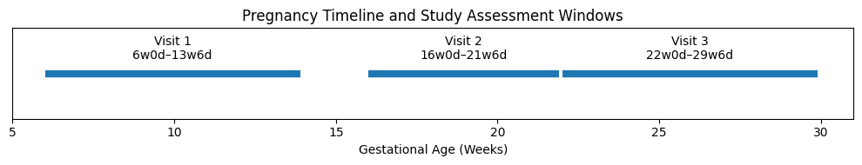
Materials and Methods

Slide 7
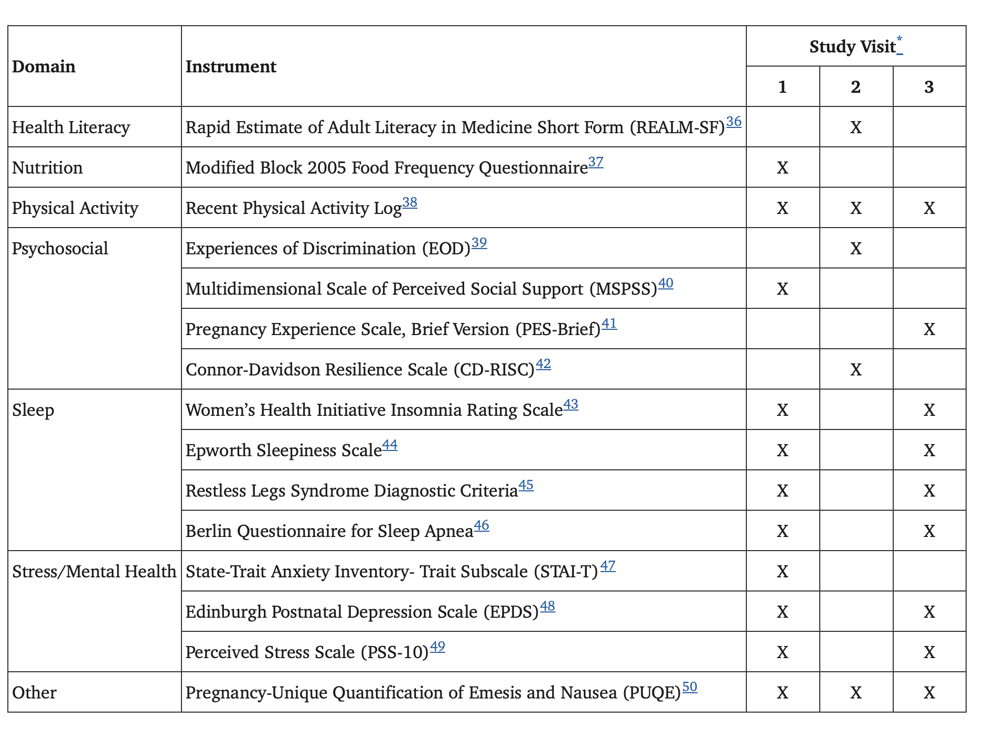
Psychometric Measures

Slide 8
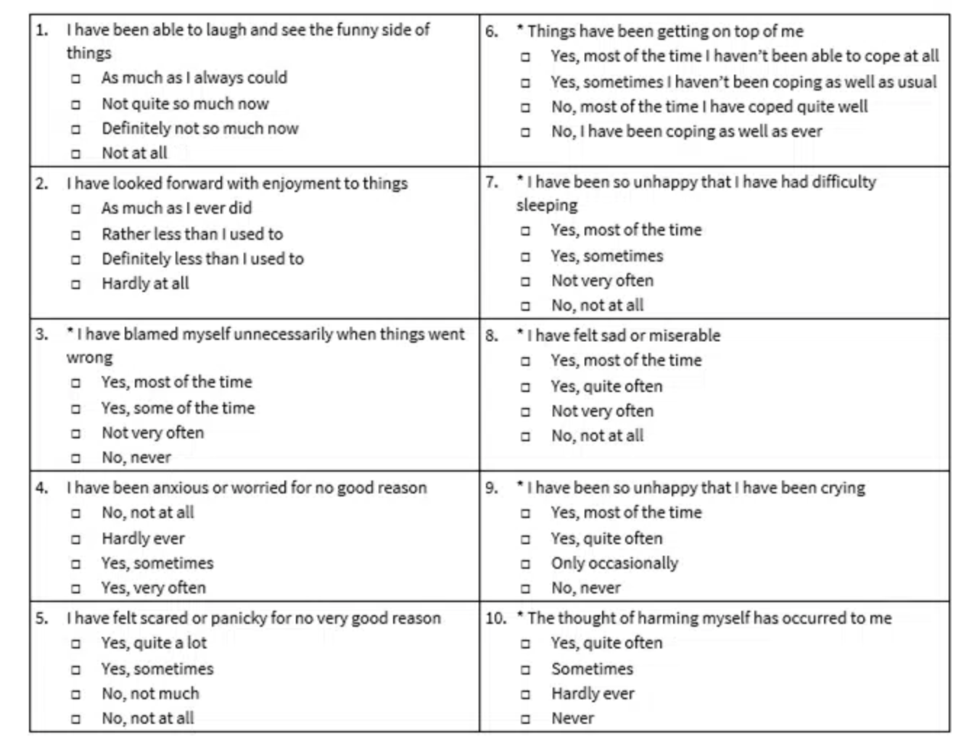
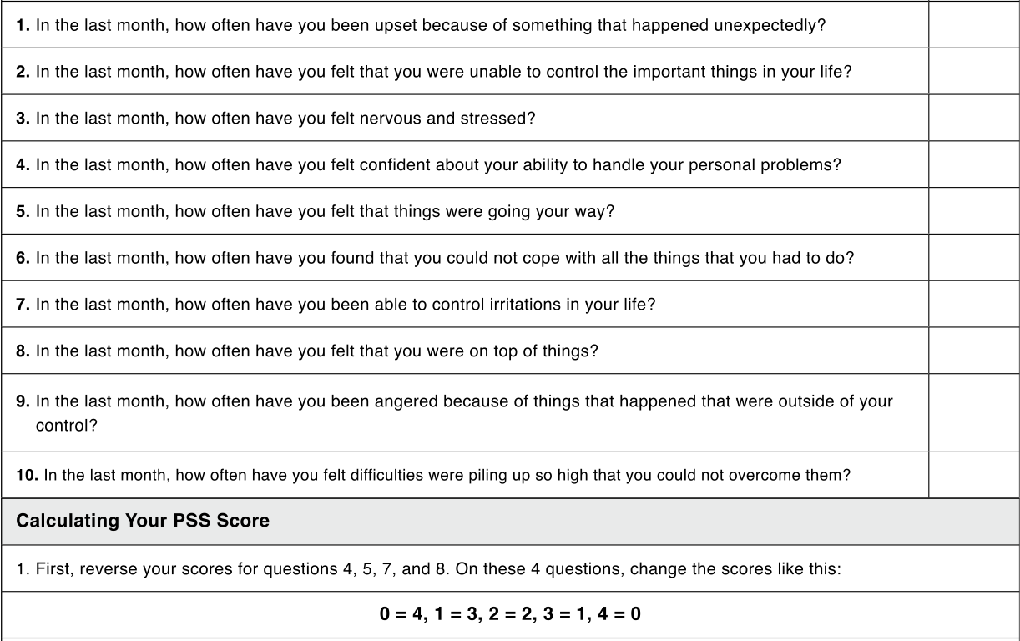
EPDS
PSS

Slide 9
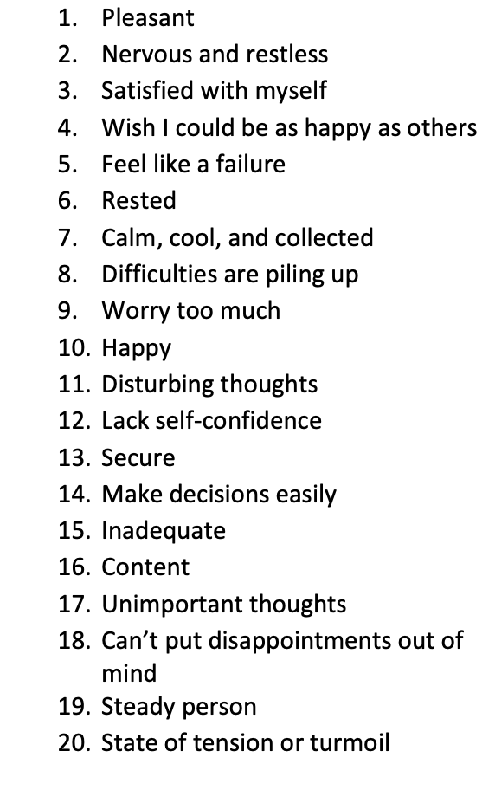
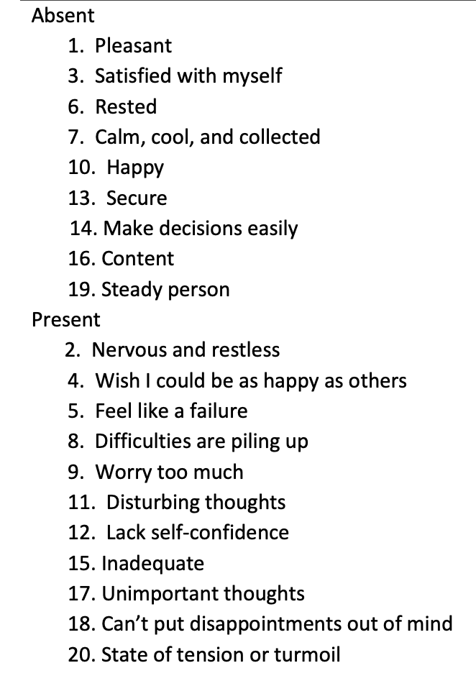
State Trait Anxiety Inventory- Trait Subscale (STAI-T)

Slide 10
Materials and Methods
Outcome measures: maternal depressive and anxiety symptoms
  Groups: ART (IVF/IUI): n=366 vs. unassisted conceptions: n=8,922
    EPDS (visits 1 & 3): interval and categorical variable (score ≥10)
    PSS (visits 1 & 3): interval and categorical variable (score ≥27)
    STAI-T: interval only
Statistics
  Parametric and non-parametric tests, as appropriate
  Linear and logistic regression models controlling for age, BMI, educational level, history of mental health condition, and treatment for anxiety or depression prior to pregnancy

Slide 11
Results
Table 1. Demographics and basic characteristics
 | ART (n=366) | Unassisted conception (n=8,922) | p-value
Age, mean (SD) | 33.0 (4.0) | 26.7 (5.6) | <0.001
BMI, mean (SD) | 26.3 (5.5) | 26.4 (6.4) | 0.769
Race, n (%) White Black Hispanic Asian Other | 288 (78.7%) 11 (3.0%) 29 (7.9%) 26 (7.1%) 12 (3.3%) | 5,306 (59.5%) 1,237 (13.9%) 1,570 (17.6%) 339 (3.8%) 460 (5.2%) | <0.001
Education, n (%) Less than high school High school diploma or GED Some college, no degree Associate degree of technology College degree Graduate or doctoral degree | 0 6 (1.6%) 29 (7.9%) 16 (4.4%) 139 (38.0%) 176 (48.1%) | 755 (8.5%) 1,089 (12.2%) 1,801 (20.2%) 918 (10.3%) 2,404 (27.0%) 1,937 (21.8%) | <0.001
Marital Status Single, never married Married Widowed Divorced Separated Refused (Missing n=16) | 30 (8.2%) 333 (91.0%) 0 3 (0.8%) 0 0 | 3,628 (40.7%) 5,159 (57.9%) 8 (0.1%) 83 (0.9%) 20 (0.2%) 9 (0.1%) | <0.001
History of pregnancy loss | 125 (34.2%) | 2,240 (25.1%) | <0.001
Mental Health Condition, (n%) (Missing n=271) | 52 (14.5%) | 1,237 (14.3%) | 0.916
Treatment for Depression prior to pregnancy | 33 (9.5%) | 1,003 (11.9%) | 0.168
Treatment for Anxiety prior to pregnancy | 32 (9.2%) | 715 (8.5%) | 0.646

Slide 12
Table 2. Crude analysis comparing symptoms of depression and anxiety between pregnancies conceived ART versus unassisted conceptions
Results
 | ART (n=366) | Unassisted conception (n=8,922) | p-value
EPDS visit 1 (total), mean (SD) | 5.0 (3.5) | 5.8 (4.3) | 0.003
EPDS ≥10 visit 1, n (%) | 29 (8.2%) | 1,577 (18.3%) | <0.001
EPDS visit 3 (total), mean (SD) | 4.8 (3.6) | 5.6 (4.2) | 0.005
EPDS ≥10 visit 3, n (%) | 29 (8.6%) | 1,327 (16.5%) | <0.001
PSS total visit 1 (total), mean (SD) | 11.1 (5.5) | 12.9 (6.7) | <0.001
PSS visit 1, n (%) Low stress Moderate stress High stress | 256 (70.3%) 106 (29.1%) 2 (0.5%) | 5,099 (57.6%) 3,419 (38.7%) 327 (3.7%) | <0.001
PSS total visit 3 (total), mean (SD) | 9.9 (5.8) | 11.5 (6.6) | <0.001
PSS visit 3, n (%) Low stress Moderate stress High stress | 263 (77.6%) 74 (21.8%) 2 (0.6%) | 5,366 (65.7%) 2,611 (32.0%) 195 (2.4%) | <0.001
STAI total, mean (SD) | 45.0 (3.5) | 44.8 (4.2) | 0.531

Slide 13
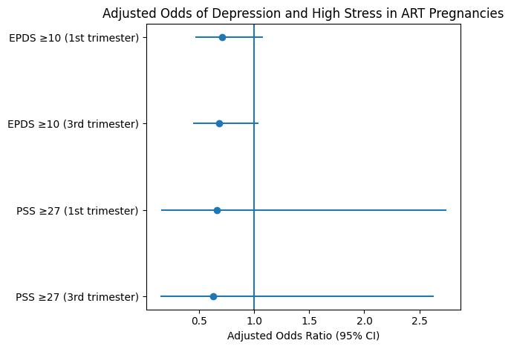
Results

Slide 14
Discussion
ART conception does not increase perinatal psychological risk
Possible relief after successful conception
Pregnancy stressors become universal

Slide 15
Limitations
The parent nuMoM2b study was not designed to assess specifically our study question
Data were collected between 2010 and 2013
No data on the State sub-scale of the STAI questionnaire
No data on post-partum anxiety and depression
Generalizability in Europe or other regions with different baseline rates of depression and anxiety.

Slide 16
Conclusion
ART show comparable mental health profiles
Important findings for patient counseling & stigma reduction
Supports reassurance during ART prenatal care
Prospective pre-conception & Post-partum studies needed
NICHD Data and Specimen Hub (DASH) is a centralized resource that allows researchers to share and access de-identified data from studies funded by NICHD
https://dash.nichd.nih.gov

Slide 17


