Slide 1




Slide 2
Semenogelin-Derived Peptides (RSIY-15 and SSIY-15) Enhance Motility in Asthenospermic Semen: A Potential Therapeutic Approach for Male Factor Infertility
Laveena Kondagari MD¹, Alexander Kucherov MD¹, Melissa Fazzari PhD², Amarnath Mukherjee PhD³, Sangita Jindal PhD¹, Lloyd Fricker PhD⁴, Kelvin P. Davies PhD^{3,4}
Affiliations: 1)Department of Obstetrics & Gynecology and Women’s Health, Albert Einstein College of Medicine (AECOM) / Montefiore’s Institute for Reproductive Medicine and Health, Bronx, NY, 2) Department of Epidemiology & Population Health, AECOM / Montefiore Medical Center (MMC), Bronx, NY, 3) Department of Urology, AECOM / MMC, Bronx, NY, 4) Department of Molecular Pharmacology, AECOM / MMC, Bronx, NY.
Oral Presentation O4

Slide 3
Disclosure Slide
Neither I nor members of my immediate family have any actual or potential financial interests to disclose relating to the content
of this presentation.

Slide 4
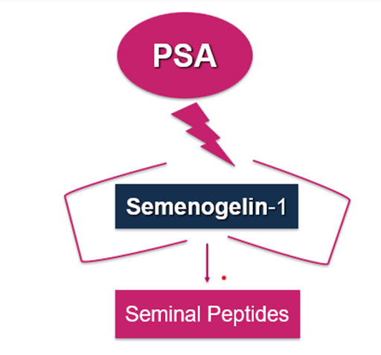
Background
Male factor infertility comprised 30.4% of ART cycles in 2017–2018.
Low sperm motility is a major cause, but the mechanisms effecting sperm motility are poorly defined.
Semen parameters strongly predict IVF and IUI success.
Semenogelin-1 and -2 are the major proteins found in semen, where they play a role in modulating motility.
Past studies show that RSIY-11, a semenogelin-derived peptide which acts as neutral endopeptidase (NEP) inhibitor, enhances sperm motility (Fritz, R. et al., 2019).
Peptidomic analysis of semen has identified several additional novel and uncharacterized semenogelin-derived peptides, including RSIY-15 and SSIY-15, predicted to be NEP inhibitors.
What is their role in motility?
Notes:
Infertility affects 13% of couples in the United States, with male factor infertility contributing to 30.4% of assisted reproductive technology (ART) cycles in 2017–2018 (1)
Semenogelin-1 and -2, the main proteins in semen, initially form a coagulum that restricts sperm movement but are later cleaved into bioactive peptides capable of modulating motility ( 2).
Since sperm motility parameters strongly predict IVF and IUI success, identifying factors that influence motility, such as semenogelin-derived peptides, is clinically important.
Using peptidomic analysis, we previously identified RSIY-11, a semenogelin-derived peptide that enhances motility by inhibiting neutral endopeptidase (NEP) (3). Subsequent studies revealed additional novel semenogelin-derived peptides that, based on sequence analysis, may also act as NEP inhibitors and influence sperm motility.

Slide 5
Objective
To identify if other semenogelin-derived peptides (RSIY-15 and SSIY-15):
1. Act as NEP inhibitors
2. Enhance sperm motility

Slide 6
Study Design and Population
IRB approved
Site: Einstein Lab & Hartsdale Andrology lab at Montefiore's Institute for Reproductive Medicine & Health
Study population:
Inclusion criteria -infertility workup - >18 yrs old
Exclusion criteria- < 18 yrs, azoospermia, prostate surgery, benign prostatic hyperplasia, exogenous androgen use, untreated thyroid disease, HIV, hyperprolactinemia, marijuana or opioid use, clomiphene or HCG use within last 90 days, kidney failure, cirrhosis, history of gonadotoxic chemotherapy or testicular or prostate cancer, cystic fibrosis, abnormal karyotype and history of cryptorchidism
75 semen samples (31 normal motility, 44 low motility as per WHO 5th edition)
Manual analysis and CASA ( Computer Assessed Sperm Analysis) machine
Notes:
Talking points – normal samples analyzed and low motility samples analysed –manual and CASA machine

Slide 7
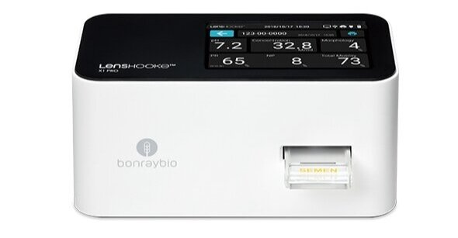
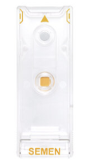
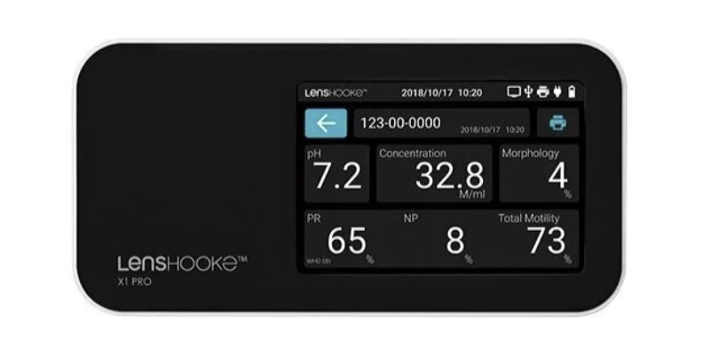
Study workflow
Peptide Identification: Seminal peptidomics performed using Liquid Chromatography-Mass Spectrometry (Einstein Lab)
Peptide Selection & Synthesis: Sequence analysis to identify potential NEP inhibitors; peptides synthesized (GenScript)
Enzyme Kinetics: Determination of inhibition type & strength (Einstein Lab)
Functional Testing: Peptide addition to semen samples followed by motility assessment using manual analysis & CASA (Hartsdale Andrology Lab)
Notes:
Peptides identified by LC-MS were screened as potential substrates/inhibitors of NEP through use of the MEROPS database (https://www.ebi.ac.uk/merops/)
•To avoid possibility of having a contaminating peptide, the three peptides under investigation (RSIY 11,RSIY15, SSIY 15) were synthesized by GenScript (Piscataway, NJ, USA) and used in the enzymatic and motility assays

Slide 8

NEP inhibition analysis
NEP Inhibition Assays
-Negative Control – Substrate only
-Positive Control – Substrate + Enzyme only
-RSIY-15 and SSIY-15
A fluorogenic assay to determine the nature of inhibition and NEP inhibition constants (Ki)
A Dixon plot was generated to determine the Ki of RSIY-15 & SSIY-15
Lineweaver-Burke plot was generated to evaluate the inhibitory nature of RSIY-15 & SSIY-15 (using GraphPad Prism, La Jolla, CA, USA)
Notes:
This is a cartoon of competitive inhibition – the peptide is the red triangle. The white triangle is the substrate. Green are the breakdown products
Ki (Inhibitory constant):Quantifies inhibitor potency =↓ Ki → stronger inhibitor

Slide 9
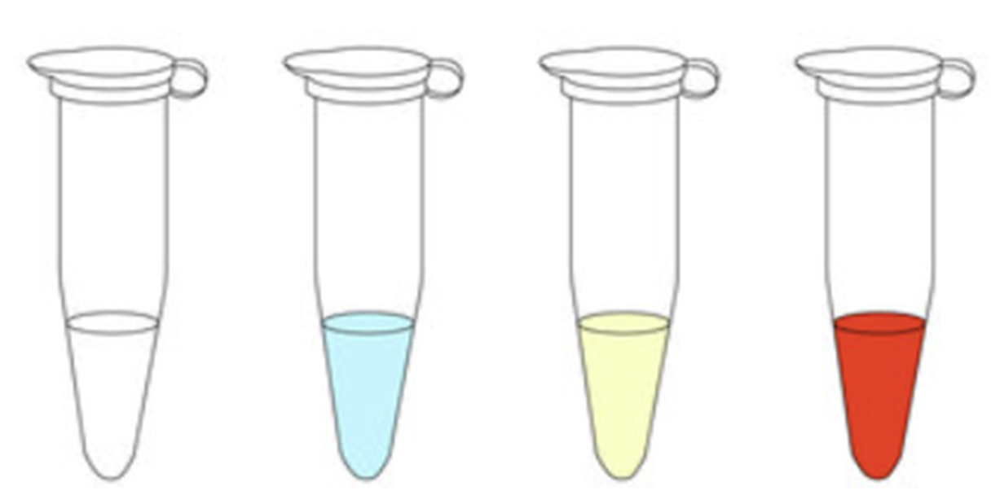
Semen sample preparation
Semen samples: liquefy at 37C for 30 min
4 aliquots: PBS (control), RSIY-11 (75 μM), RSIY-15 (75 μM), SSIY-15 (75 μM)
Motility parameters: at 0, 30 and 60 min
Manual method: Total Motility (TM) and Progressive Motility (PM)
Computer Assisted Sperm Analysis (CASA) method: TM, PM , Sperm motility kinematic analysis (VAP, VCL and VSL)
Mixed effects regression analysis was performed to assess difference in sperm motility parameters
PBS RSIY-11 (75 μM) RSIY-15 (75 μM) SSIY-15 (75 μM) ​

Slide 10
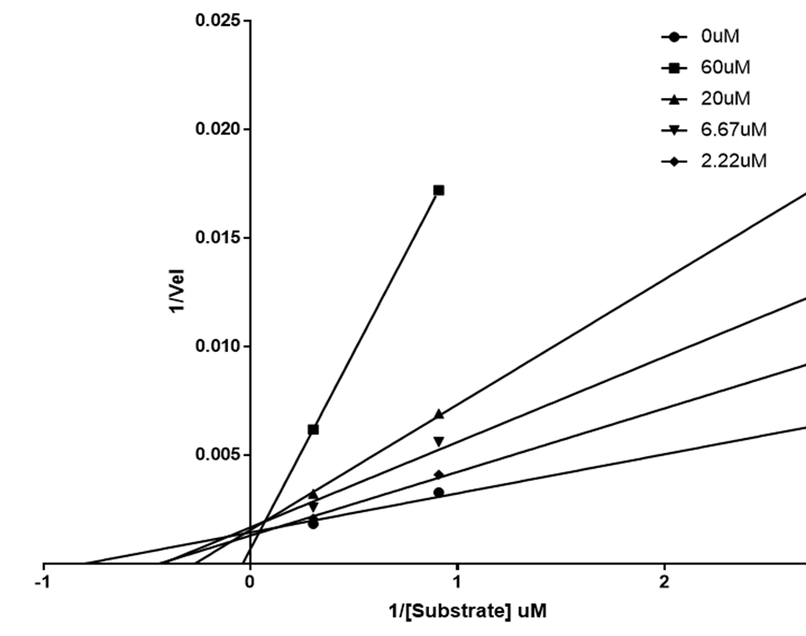
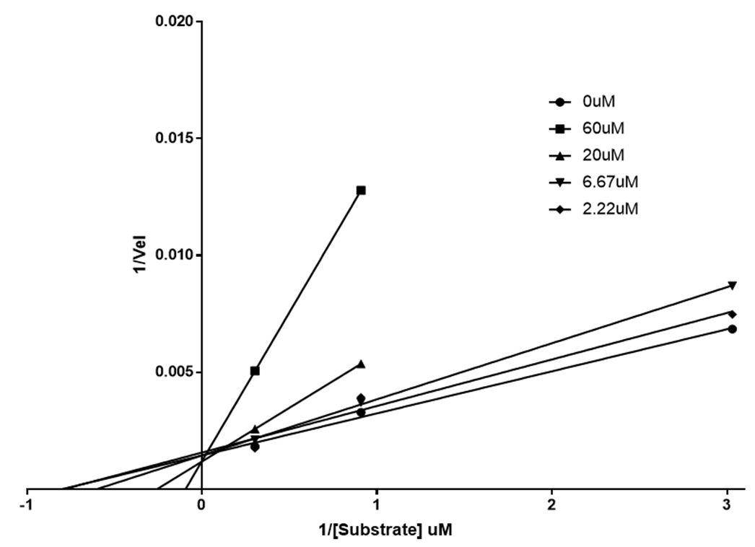
Lineweaver-Burke Plots
RSIY-15 Nature of Inhibition
SSIY-15 Nature of Inhibition
Notes:
Competitive inhibition – most obvious type, the inhibitor prevents the enzyme from binding to the substrate. The lines should all intersect at the Y axis
Non-competitive inhibition – the inhibitor binds to the enzyme itself and reduces its ability to bind to the substrate. The lines should all have different slopes, but then intersect at the same point on the X axis
Mixed – once the protein is cleaved by NEP, may become a different substrate which has different properties (competitive at first, then non-competitive after)
Hard to say what’s going on here, or if there is a different mechanism at different concentration of inhibitors
Lineweaver-Burk analysis showed RSIY-15 and SSIY-15 act as competitive NEPinhibitors.

Slide 11
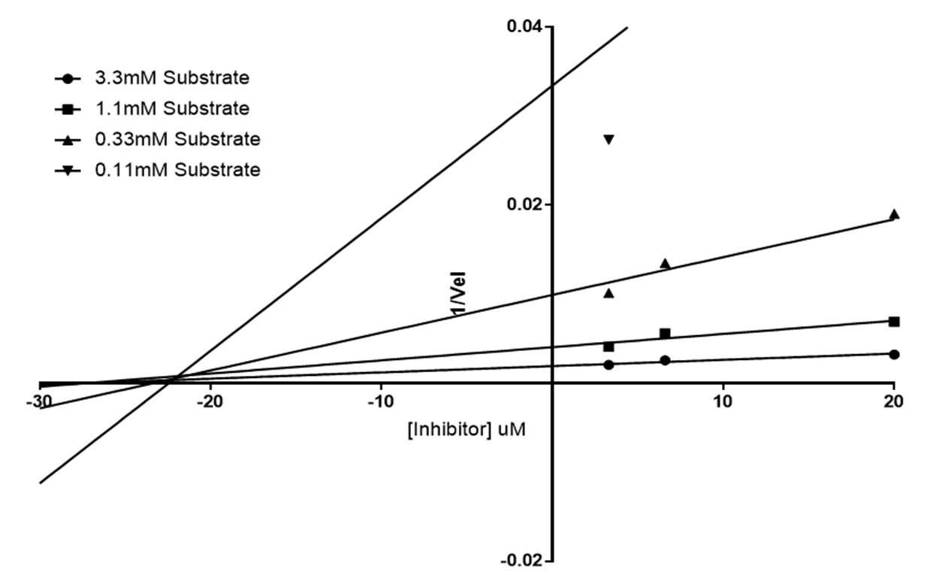
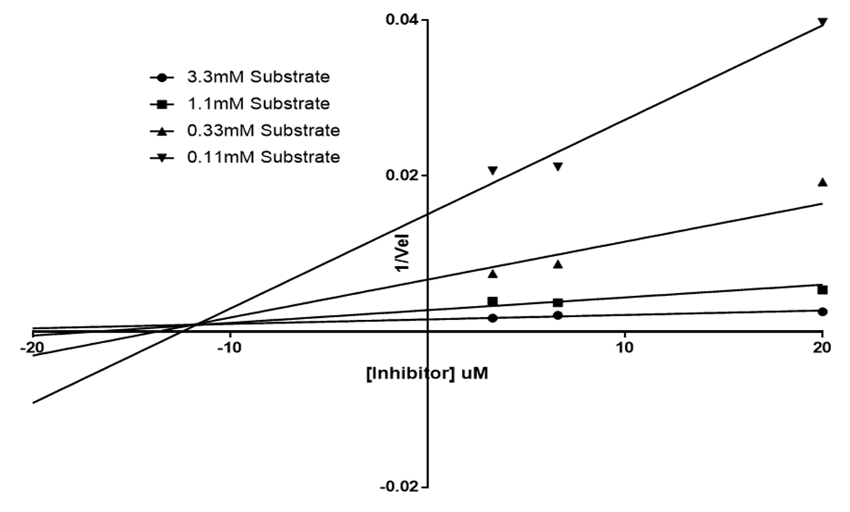
Dixon Plots
RSIY-15​
SSIY-15​
RSIY-11 and SSIY-15 act as competitive NEP inhibitors
Notes:
These plots are used to calculate the Ki of the peptide. In these cases, it is similar to RSIY-11. Within an order of magnitude of two or so is considered within the margin of error
The inhibitor constant, Ki, is an indication of how potent an inhibitor is; it is the concentration required to produce half maximum inhibition.
Dixon plots revealed Ki values of 12.58 ± 1.67 μM for RSIY-15 and13.69 ± 2.5 μM for SSIY-15, both lower than RSIY-11 (18.4 ± 1.6 μM).
Ki of RSIY-11 is about 15X more potent.
The inhibitor constant, Ki, is an indication of how potent an inhibitor is; it is the concentration required to produce half maximum inhibition.
Bottomline – RSIY-11 and SSIY-15 act as competitive NEP inhibitos

Slide 12
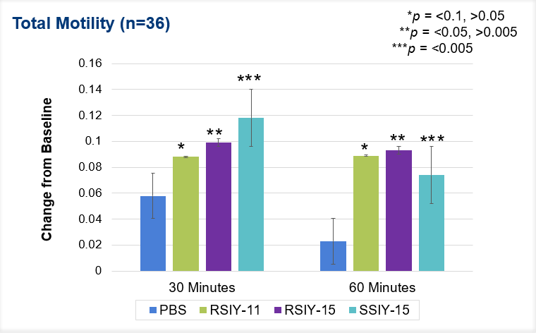
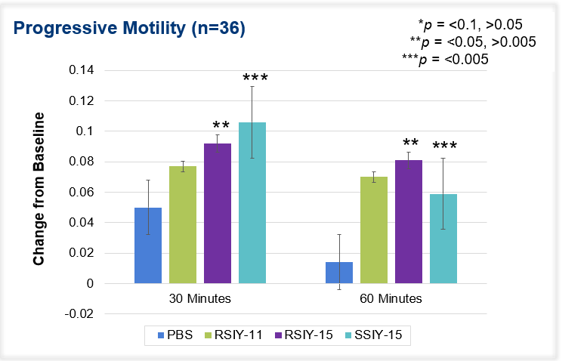
Manual Method - Total Motility(TM), Progressive Motility (PM) (n=36)
Mixed effects linear regression
Notes:
Significant SSIY15 increase total motility. Non-significant RSIY11 0.23, RSIY15 0.07. Mixed effects linear regression, adjusting for time, peptide, and time x peptide interaction. P-values presented correspond to the joint effect of peptide and time x peptide interaction terms.
Significant RSIY15 & SSIY15 increase progressive motility. Non-significant RSIY11 0.17 (looks like it would be based on 60 min mark, but very close at 30 minutes, so controlling for time etc, not significant). Mixed effects linear regression, adjusting for time, peptide, and time x peptide interaction. P-values presented correspond to the joint effect of peptide and time x peptide interaction terms.
So, a trend towards increasing motility, with significant increases in those who start off asthenospermic. Do these improvements lead to clinical significance? ie, how many who start off with low motility get above 40% motility after addition of peptides?

Slide 13
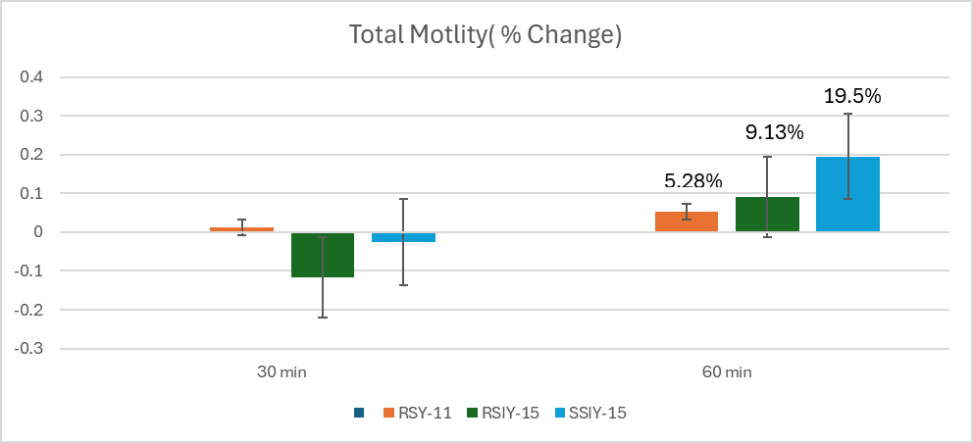
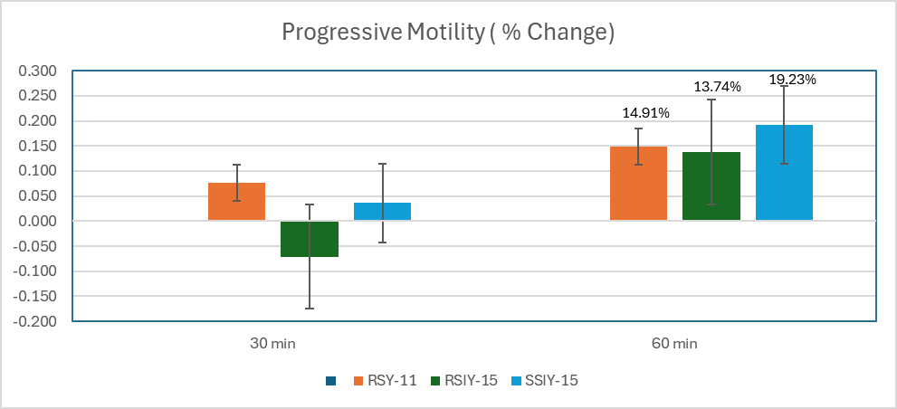
CASA: Total Motility, Progressive Motility (n=8)
Mixed effects linear regression- neither TM nor PM were significant
Notes:
CASA machine – equipment, takes away the subjective component of semen analysis and also allows to assess additional sperm kinetic parameters
Eventhough there is an increase in TM,PM, these changes were non significant in mixed effects linear regression due to small sample size ( n=8)

Slide 14
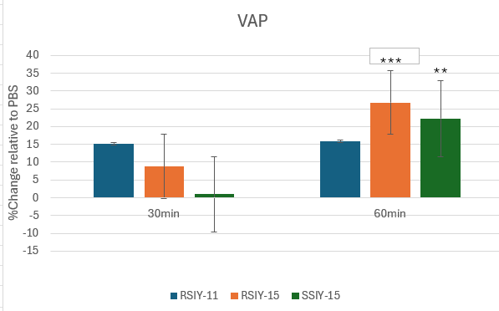

VAP: Velocity Along the Average Path (n=8)
VAP | p - value
 | 30min | 60min
RSIY-11 | 0.221 | 0.215
RSIY-15 | 0.532 | 0.042
SSIY-15 | 0.909 | 0.086
Mixed effects linear regression​
​

Slide 15
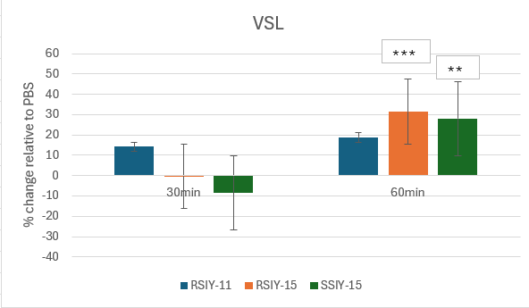
VSL: Velocity Along the Straight-Line Path (n=8)
VSL | p - value
 | 30min | 60min
RSIY-11 | 0.264 | 0.247
RSIY-15 | 0.982 | 0.059
SSIY-15 | 0.666 | 0.089
Mixed effects linear regression​
​

Slide 16
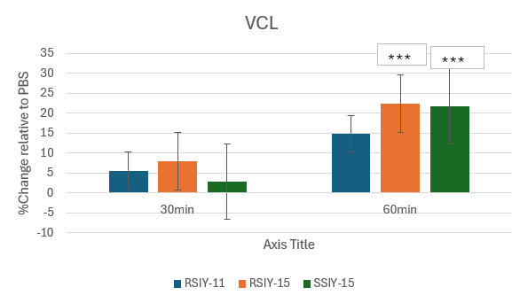
VCL: Velocity Along the Curvilinear Path
VCL | p - value
 | 30 min | 60min
RSIY-11 | 0.443 | 0.138
RSIY-15 | 0.275 | 0.033
SSIY-15 | 0.695 | 0.035
Mixed effects linear regression​
​

Slide 17
Conclusion
RSIY-15 and SSIY-15 -> act as competitive NEP inhibitors
They increased sperm motility in asthenospermic samples
This study uniquely confirms subjective visual assessment with objective CASA analysis
Insight into sperm kinematic parameters-Improvements in VAP and VCL (key indicators of fertilizing potential)
These findings support the potential clinical use of these peptides in improving ART outcomes

Slide 18
REFERENCES
Fritz R, Mukherjee A, Zaghi S, et al. Identification and characterization of RSIY-11, a novel seminal peptide derived from semenogelin-1, which acts as a neutral endopeptidase inhibitor modulating sperm motility. J Assist Reprod Genet. 2019;36(9):1891-1900. doi:10.1007/s10815-019-01524-8
Agarwal A, et al. Validation of LensHooke® X1 PRO and computer-assisted semen analyzer compared with laboratory-based manual semen analysis. World J Mens Health. 2021;39.
Mortimer, “CASA - Practical Aspects” Andrology Lab Corner (2000)
Björndahl L, Kirkman Brown J; other Editorial Board Members of the WHO Laboratory Manual for the Examination and Processing of Human Semen. The sixth edition of the WHO Laboratory Manual for the Examination and Processing of Human Semen: ensuring quality and standardization in basic examination of human ejaculates. Fertil Steril. 2022;117(2):246-251. doi:10.1016/j.fertnstert.2021.12.012

