Slide 1


Serum and Follicular Fluid Extracelluar Matrix (ECM) Fingerprints Reveal New Fibrotic Signatures of Ovarian Aging
Lydia Hughes, MD

Slide 2
Disclosures
ECM fingerprinting assays were performed by Nordic Bioscience (Denmark) as an in-kind scientific contribution
None of the authors or their immediate family members have financial relationships with Nordic Bioscience
No other disclosures

Slide 3
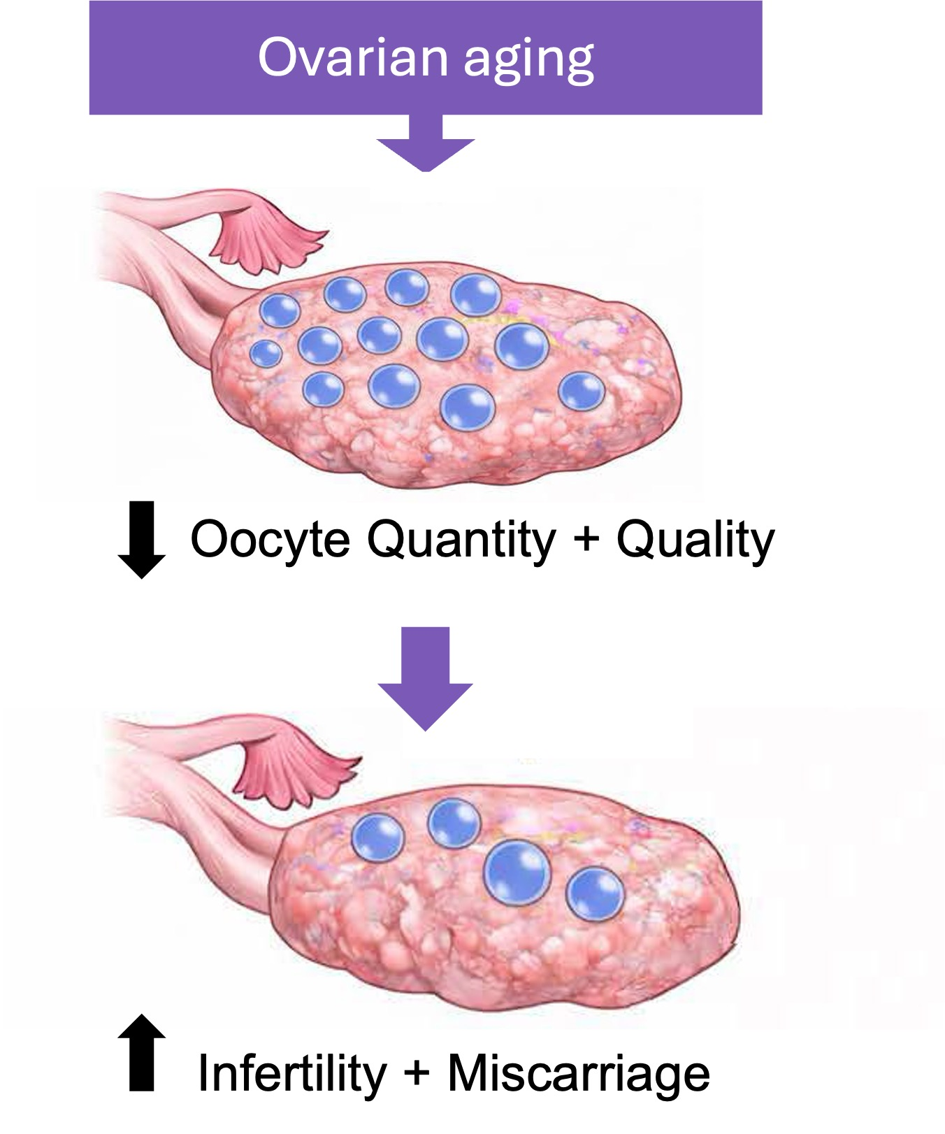
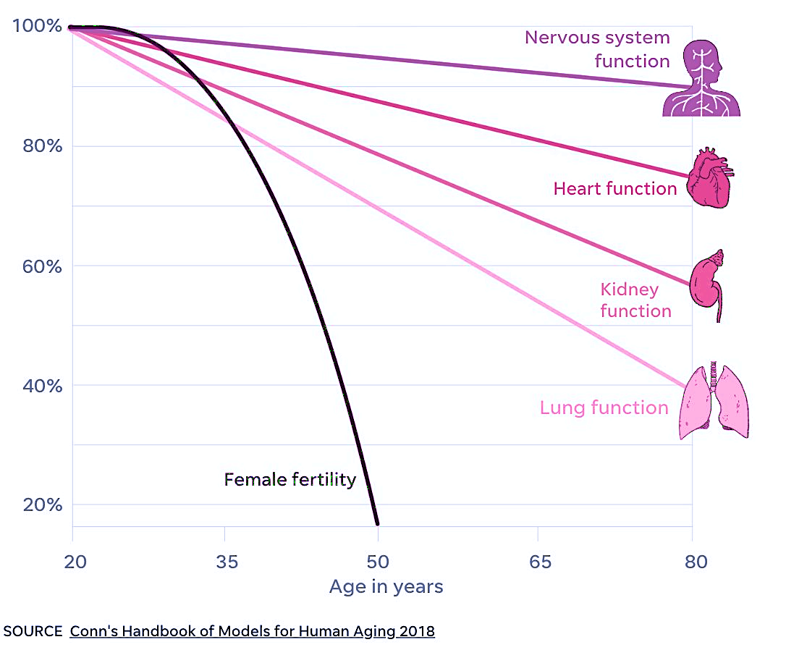
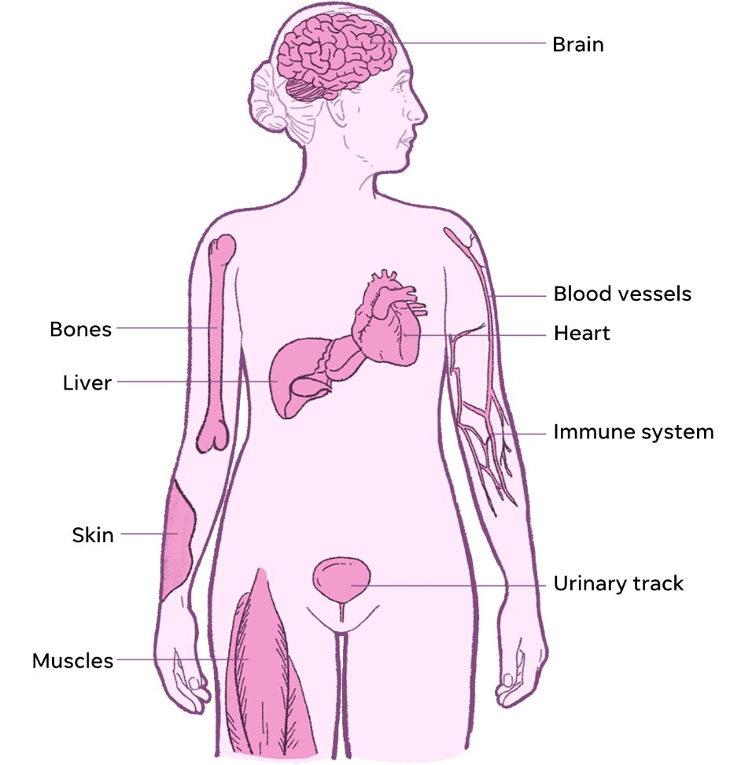
The ovary ages first and impacts reproductive and systemic health
↓ Estrogen
Duncan et al, Handbook on Model's for Human Aging, 2018, Image re-vised by USA Today ​
Notes:
The female reproductive first to age in humans, with functional decline occurring decades prior to other organs.
Fertility begins to decline in women in their mid-30s and reproductive function ceasing completely at the time of menopause.
Reproductive aging is characterized by a loss of gamete quantity and quality which contributes to infertility, spontaneous abortion, and birth defects.
Ovarian aging also impacts systemic health → due to decreasing ovarian follicular production of estrogen
The decline in estrogen with ovarian aging impacts bone, cardiovascular, metabolic, immune, and brain health → impacting quality of life and increasing risk of morbidity and mortality

Slide 4
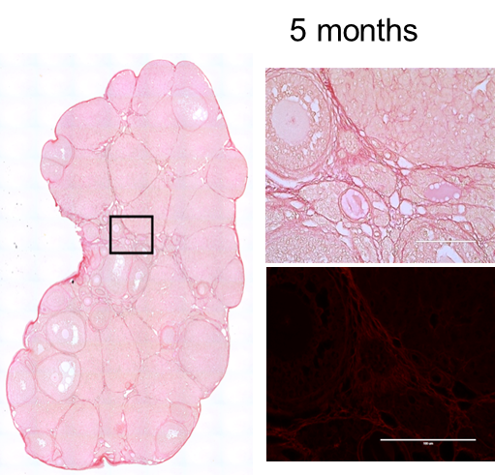
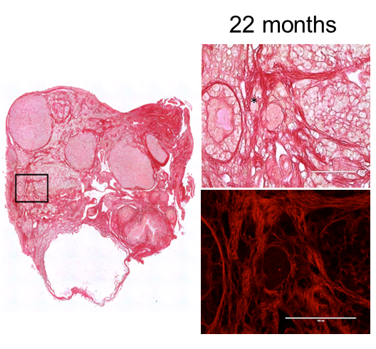
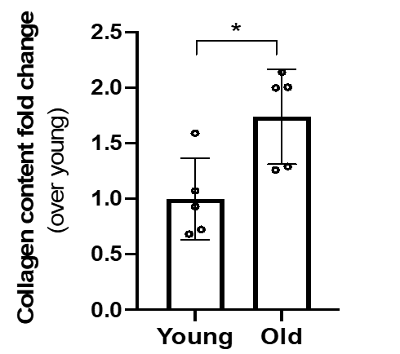

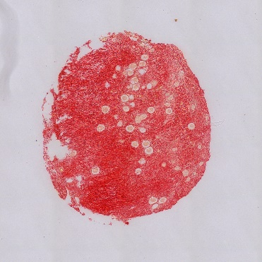
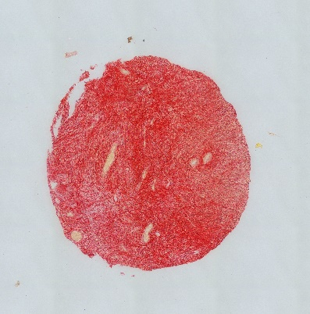
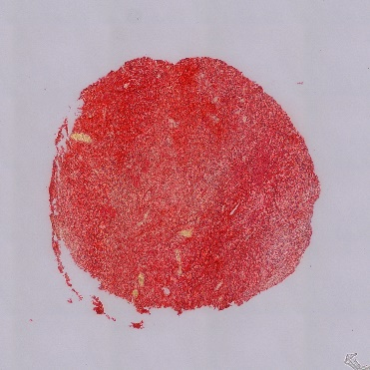

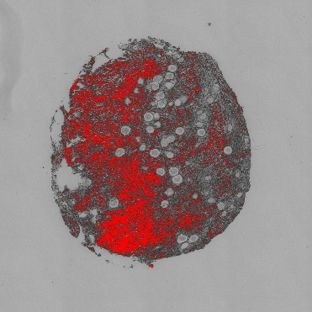
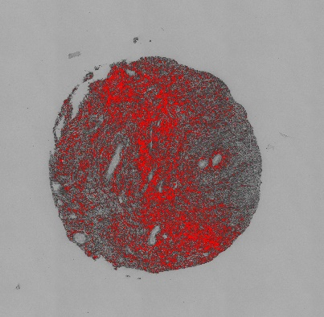
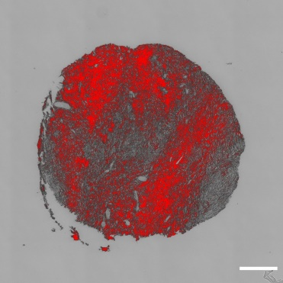
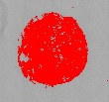


The ovary becomes fibrotic with age
17 years
45 years
58 years
19.5%
20.8%
27.8%
Collagen accumulation ➔ increased fibrosis ➔ decreased organ function
Briley SM, et al., Reproduction, 2016, Amargant F et al. Aging Cell, 2020
Notes:
In both human and mouse ex vivo models, increases in ECM collagen composition directly proportional to age
Picrosirius Red (PSR) specifically binds to collagen I and III fibrils with increasing staining noted with age.
In the mouse, there was a 1.7-fold increase in collagen in reproductively older versus younger mice
In the human, there was an about 8% increase in collagen over ~30 years of age
This accumulation of collagen I and III is considered fibrosis and is the hallmark of aging in other organ systems such as the lung, liver, and heart

Slide 5
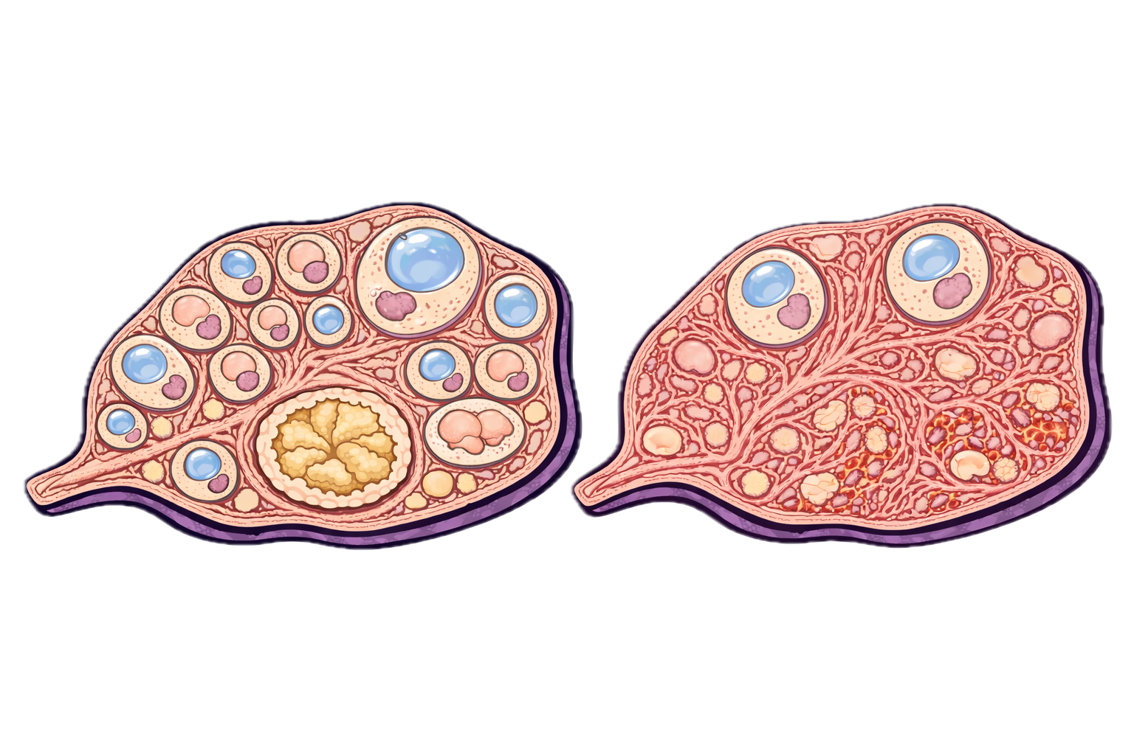

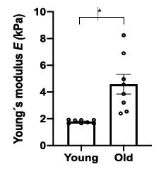
Age-related fibrosis leads to biomechanically stiffer ovaries
Healthy Young Ovary
Fibrotic Older Ovary
Non-invasive modalities to quantify
Stromal fibrosis
The stromal microenvironment is complex
The extracellular matrix (ECM) that is crucial for oocyte development, ovulation and hormone production
Impaired follicle activation and growth
Dysfunctional ovulation
Scaffold for carcinogenesis
Implicated in reproductive pathologies
Amargant F et al., Aging Cell, 2020; Mara et al., Aging, 2020, 2023; Zaniker et al. Biology of Reproduction, 2024
Notes:
The ovary contains follicles which house an oocyte,or egg.
Supporting these follicles is a complex and rich microenvironment called the stroma which is crucial for oocyte development, ovulation and hormone production is incredibly complex
Our group has demonstrated in ex vivo mouse ovaries that age related fibrosis leads to a physically stiffer ovary. To Instrumental indentation shows that ovaries from reproductively old mice are quantitatively stiffer. This method is used to determine the amount of force required to indent a tissue at a given distance, which is a readout of tissue stiffness in Young’s Modulus
The excessive age related accumulation of ECM, fibroblasts, or immune cells can adversely impact tissue function.
Research supports that ovarian fibrosis is pathologic has been implicated in ovarian cancer predeposition, impaired follicle development, impaired ovulation, and reproductive disorders such as PCOS and endometriosis
However currently there are no noninvasive modalities to assess ovarian fibrosis

Slide 6
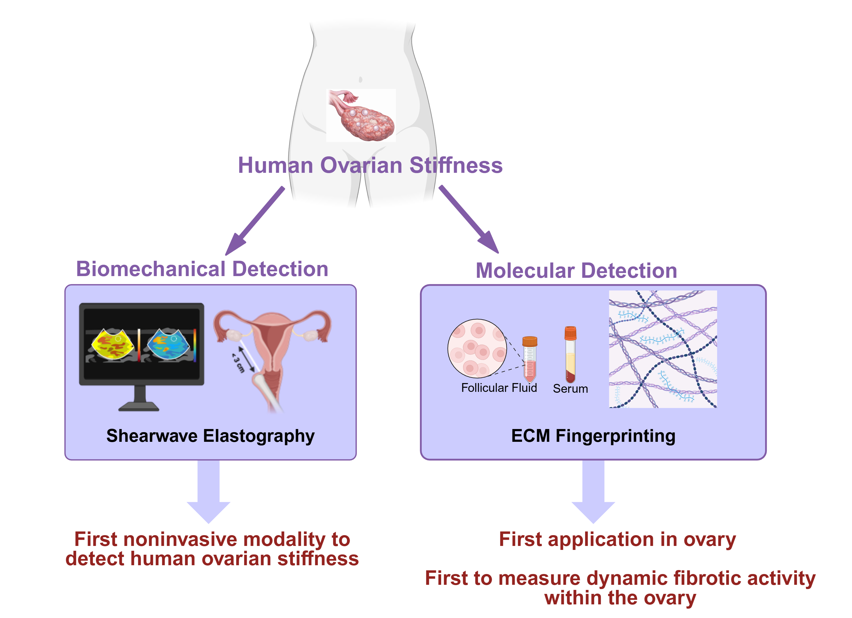
Novel multimodal approach to human reproductive aging
Current study
Notes:
First time approach to translate animal and histologic studies to human
1) demonstrate human ovarian stiffness
2) novel ways to detect fibrosis noninvasively
Never had biomechanical read out
Never had ECM dynamic profiling – first application in ovary, first capture of dynamic fibrotic activity /ECM remodeling

Slide 7
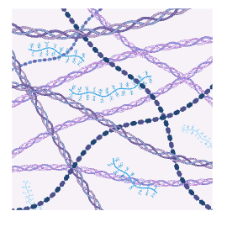
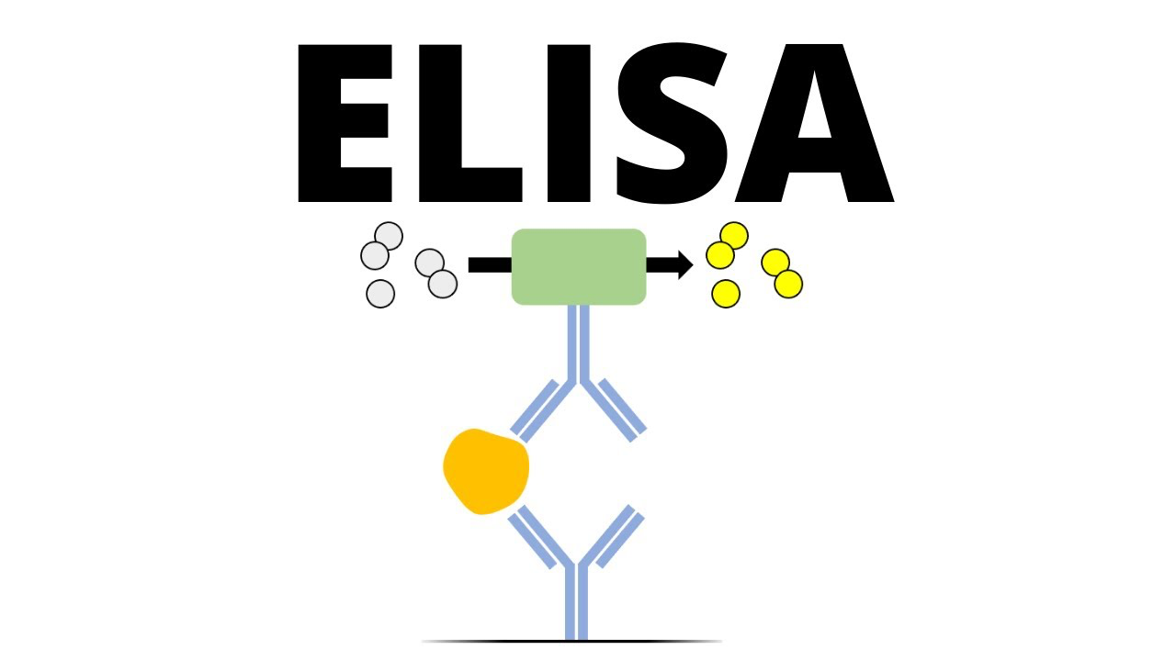
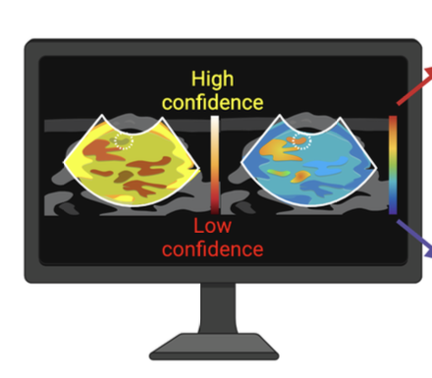
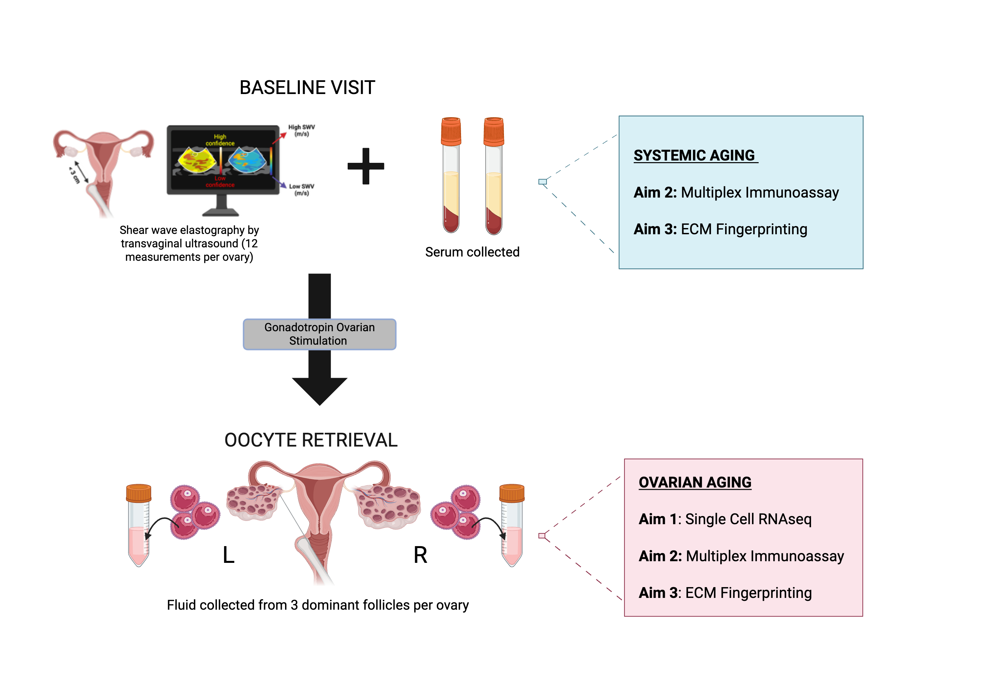
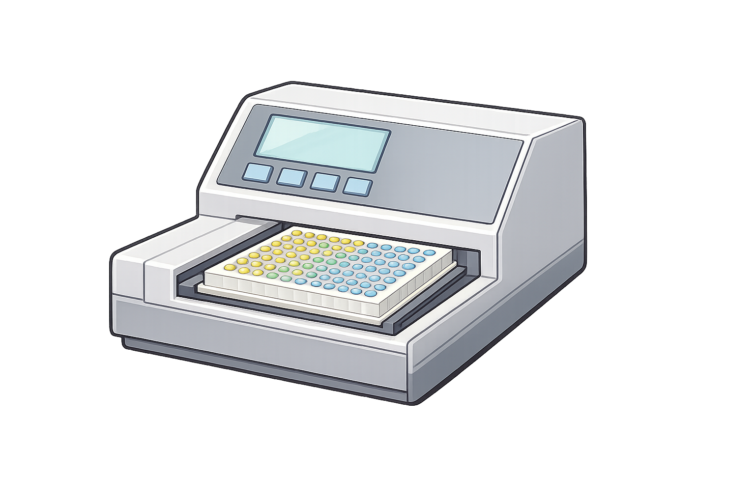
Objective: To characterize ovarian aging using a multimodal framework integrating tissue biomechanics and ECM fingerprinting in women undergoing fertility preservation or IVF
Study Design
Cycle Baseline Visit
Oocyte Retrieval
Reproductive Older
(≥39 years)
Reproductive Younger
(≤33 years)
ECM Fingerprinting
11 Neoepitopes
SWE performed
Serum collected
Follicular fluid collected
(3 dominant follicles per ovary)
Inclusion Criteria
Early follicular phase
Planned fertility cryopreservation
IVF for
Unexplained infertility, ≥37 years old
Male factor
Non-infertile reason (Same sex)
Diminished ovarian reserve (DOR)
BMI 19-29
First cycle or last oocyte retrieval >1 year ago
Exclusion Criteria
Random starts, Estrogen priming, or Provera
Longterm OCPs
Infertility related to ovarian pathology, <33 with unexplained infertility
History of ovarian surgery
Medical fertility preservation
Systemic disease
Smoking or substance use
ECM fingerprinting performed using ProteinFingerPrint Technology™, Nordic Bioscience (Denmark)

Slide 8
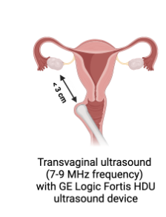
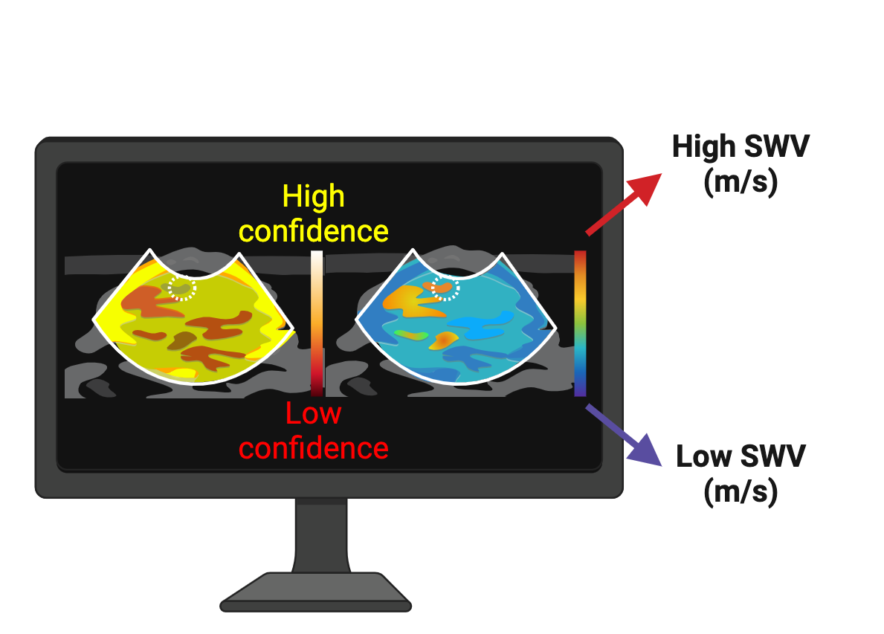
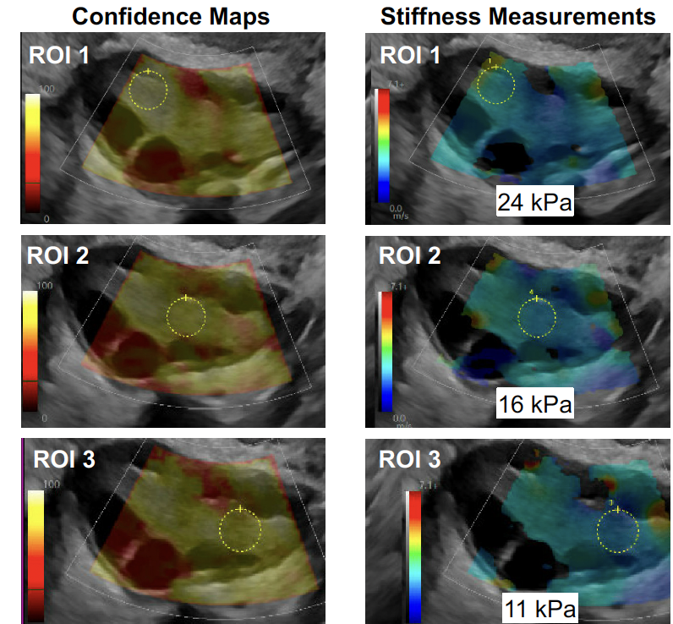
Shearwave Elastography (SWE) detects human ovarian stiffness
Unpublished, PCRS Poster#33
Notes:
Our team developed a transvaginal protocol for SWE where the target ovarian stroma is measured at a depth of <3cm.
This generates a confidence map of High confidence in YELLOW and low confidence in RED which then corresponds to stiffness measurements
12 stromal measurements obtained per ovary in repro younger vs. older cohort

Slide 9
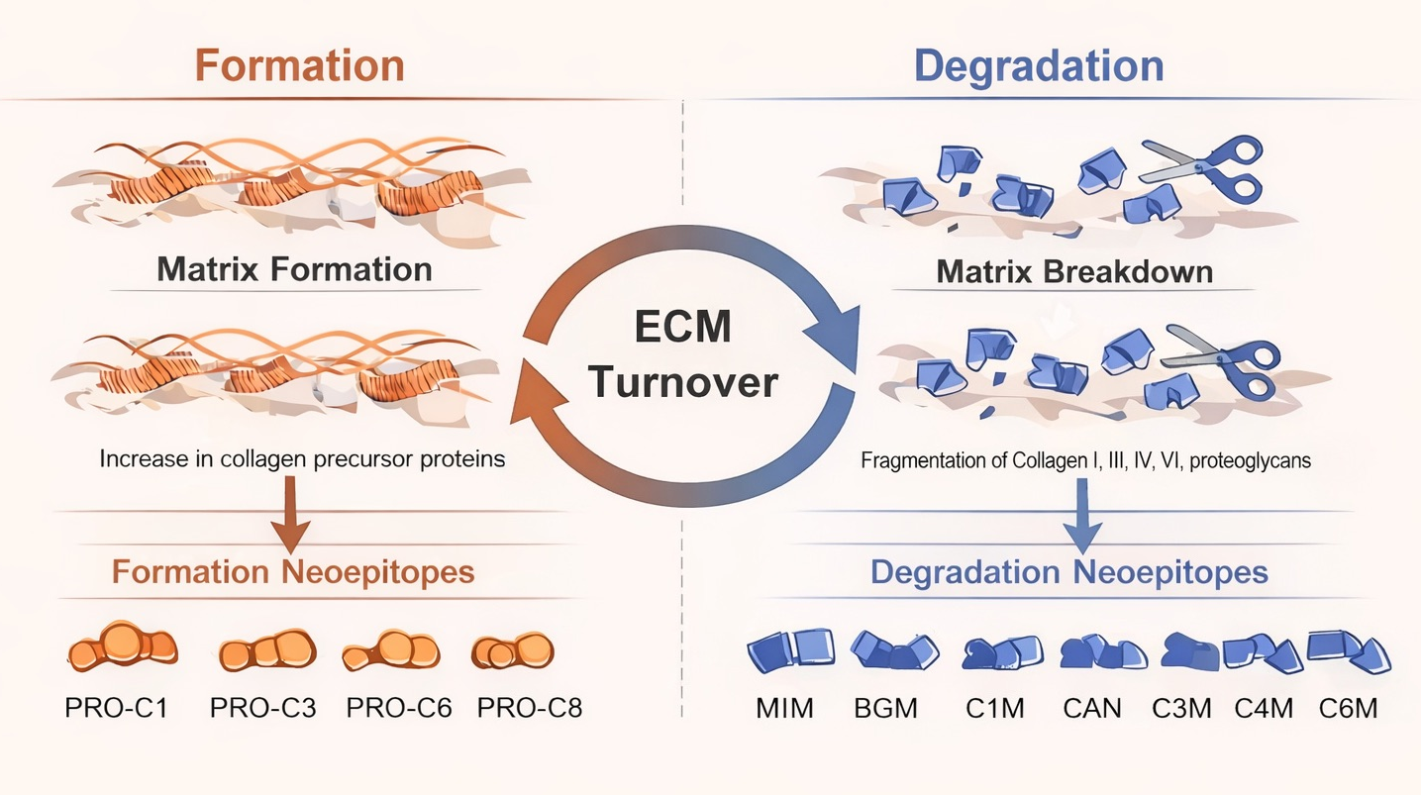
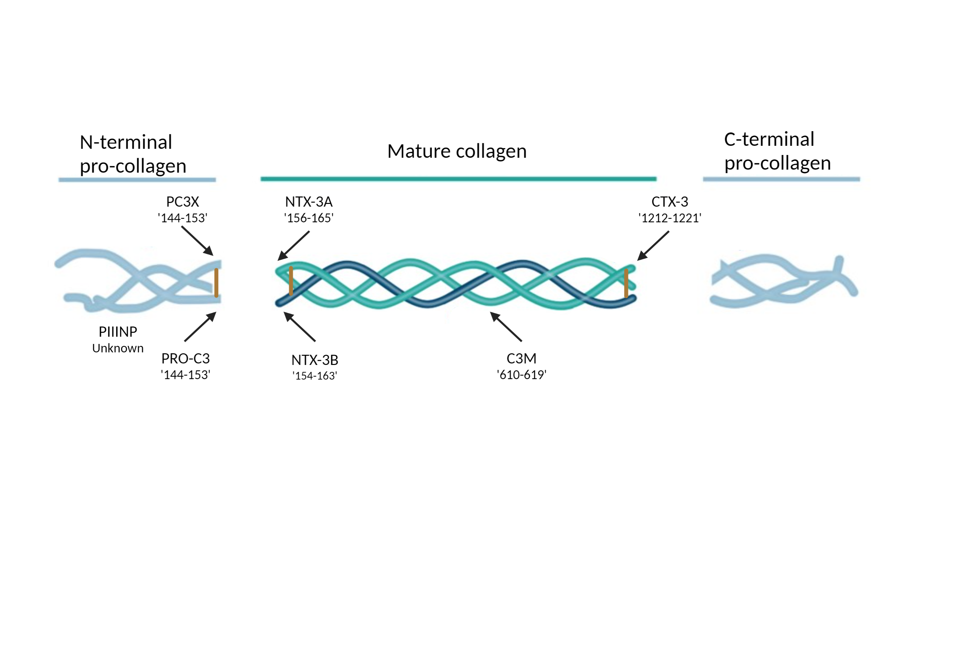
Molecular detection → Fibrosis is a dynamic process
“ECM Fingerprinting”
Novel fibrotic index of reproductive aging
Maryoca-Guiliani et al. Nature NPJ Metab Health Dis, 2025, Left diagram of ECM fingerprinting adapted from Nordic Bioscience
Notes:
The ECM is a complex and dynamic network of proteins and other molecules that provides essential structural and biochemical support to surrounding cells.
The ECM is constantly remodeling through formation and degradation of collagens and proteoglycans → dysregulation leads to fibrosis
Fibrosis underlying ovarian aging involves an imbalance in ECM turnover.
Fingerprinting allows researchers to move beyond simple histological staining to a more detailed molecular understanding of disease progression.
New immunoassay technology enables quantification of these neo-epitopes of collagen formation and degradation

Slide 10
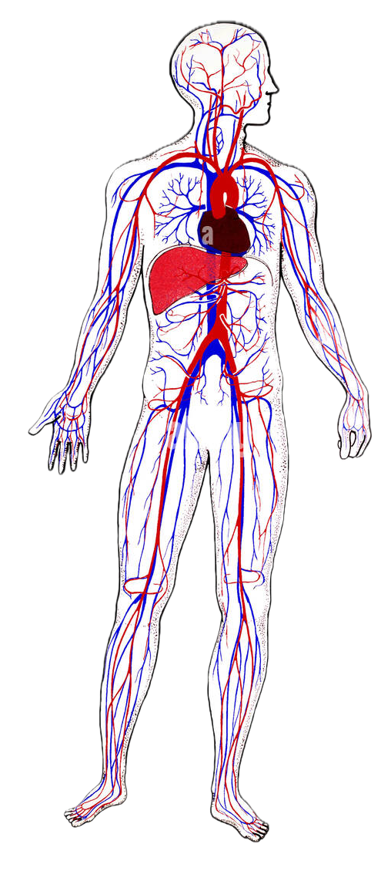
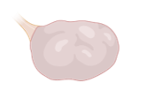
ECM Fingerprinting Custom Analytes:
Neoepitope | ECM Process | Source
MIM | Degradation | Mimican proteoglycan
BGM | Degradation | Biglycan proteoglycan
C1M | Degradation | Collagen type I
CAN | Degradation | Chondroitin sulfate proteoglycan
C4M | Degradation | Collagen type IV
C6M | Degradation | Collagen type VI
C3M | Degradation | Collagen type III
PRO-C1 | Formation | Collagen type I
PRO-C3 | Formation | Collagen type III
PRO-C6 | Formation | Collagen type VI
PRO-C8 | Formation | Collagen type VIII
Serum
Follicular fluid
Correlated inter and intra individual ECM profiles by age
Notes:
We measured 5 proteomic ECM fingerprints implicated in tissue fibrosis – Green = formation and red = degradation

Slide 11
Participant Demographics:
 | Younger Group, ≤33 (n = 10) | Older Group, ≥39 (n = 10) | P-value
Age (years) | 30.2 ± 1.9 | 40.9 ± 2.1 | *<0.0001
AMH (ng/mL) | 2.8 ± 1.6 | 1.6 ± 0.9 | 0.05
FSH (mI/ml) | 7.2 ± 1.9 | 7.2 ± 2.9 | 0.99
Total AFC | 21.8 ± 7.0 | 13.4 ± 2.4 | *<0.01
BMI (kg/m²) | 22.1 ± 1.8 | 25.4 ± 2.6 | *<0.01
Total FSH Dose (IU) | 4130 ± 1168 | 4538 ± 1074 | 0.45
Retrieved oocytes | 20.2 ± 13.2 | 10.8 ± 4.5 | 0.06
Mature (MII) oocytes | 15.4 ± 10.9 | 8.6 ± 4.2 | 0.10
Percent MII oocytes (%) | 75.4 ± 14.4 | 78.6 ± 13.1 | 0.63

Slide 12
Pooled Follicular Fluid
Trend towards higher Collagen VIII (PRO-C8) formation and lower Collagen VI degradation (C6M)
FORMATION
DEGRADATION
Serum
Mean ± SD (N=10 per group)
Notes:
When examined by reproductively age cohort….
Among the formation neoepitopes, there was a trend towards higher collagen VIII (ProC8) formation in the blood and follicular fluid.
There was also a significantly higher C6M in the younger patients suggesting higher collagen 6 turn over compared to older. In other words, may suggest a higher accumulation of type 6 in older patients

Slide 13
Representative ECM analytes demonstrate positive intra-individual associations between serum and follicular fluid
FORMATION
DEGRADATION
R= 0.48
P=0.03*
R= 0.32
P=0.06
These trends suggest a close relationship of ECM fragments between body fluids
Notes:
Here we examined intraindividual relationship of the neoepitopes serum and follicular fluid
This slide highlights two representative examples. We observed a positive association between compartments, suggesting that systemic and ovarian ECM dynamics may be biologically linked.
Notably, the formation marker PRO-C8 demonstrated a statistically significant correlation, while the degradation marker C6M showed a similar directional trend.
This supports that circulating ECM fragments may reflect aspects of the ovarian microenvironment, reinforcing the potential for minimally invasive assessment of ovarian tissue remodeling

Slide 14
Log₂ (Old/Young) Heatmap
MIM | -0.56 | -0.64
BGM | -0.1 | 0.03
CAN | -0.21 | -0.35
C4M | -0.03 | -0.23
C6M | -0.22 | -0.11
C3M | -0.04 | -0.27
C1M | 0.03 | -0.26
PRO-C1 | 0.01
PRO-C3 | 0.05 | 0.01
PRO-C6 | 0.15 | 0.09
PRO-C8 | 0.76 | 0.21
 | Follicular Fluid | Serum
ECM Degradation
ECM Formation
These reciprocal shifts indicate reduced ECM turnover and enhanced collagen VIII deposition in older patients, capturing a fibrotic ovarian microenvironment
Notes:
To better capture the magnitude and direction of multiple analytes highlight biological patterning, we created heatmap of Log2 fold change of (average old/average young) participants in FF (left) and serum (right)
This heatmap demonstrated that among all ECM markers, PRO-C8 showed the most pronounced age-related increase (≈ 1.7-fold in pooled follicular fluid), whereas collagen degradation markers (C3M, C6M) trended lower with age.
These reciprocal shifts indicate reduced ECM turnover and enhanced collagen VIII deposition in older patients, consistent with age-associated ovarian fibrosis.”

Slide 15
Conclusions
Ovarian aging exhibits a dynamic fibrotic ECM signature -trend towards ↑ collagen formation and ↓degradation
First paired circulating and ovarian ECM profile of reproductive aging
First paired biomechanical and fibrotic index in a single individual
PRO-C8 demonstrates the strongest age-related shift across biologic compartments
Larger sample size is needed for validation
Potential to serve as a composite score or in combination with SWE to monitor ovarian fibrosis and reproductive aging
Notes:
novel biologic patterns observed in our data ….
This study delivers the first paired circulating and ovarian ECM fingerprinting profile of reproductive aging, defining a molecular framework for quantifying ovarian fibrosis
PROC8 stands out as the strongest age-related shift but warrants validation in larger cohort studies
Future directions include validating our data in a larger cohort and exploring additional analytes for collagens upregulated with age in our scRNAseq data
Given biological patterning observed in our data → explore development of a composite score of ECM analytes + SWE stiffness →minimally invasive modality to monitor ovarian fibrosis and aging

Slide 16
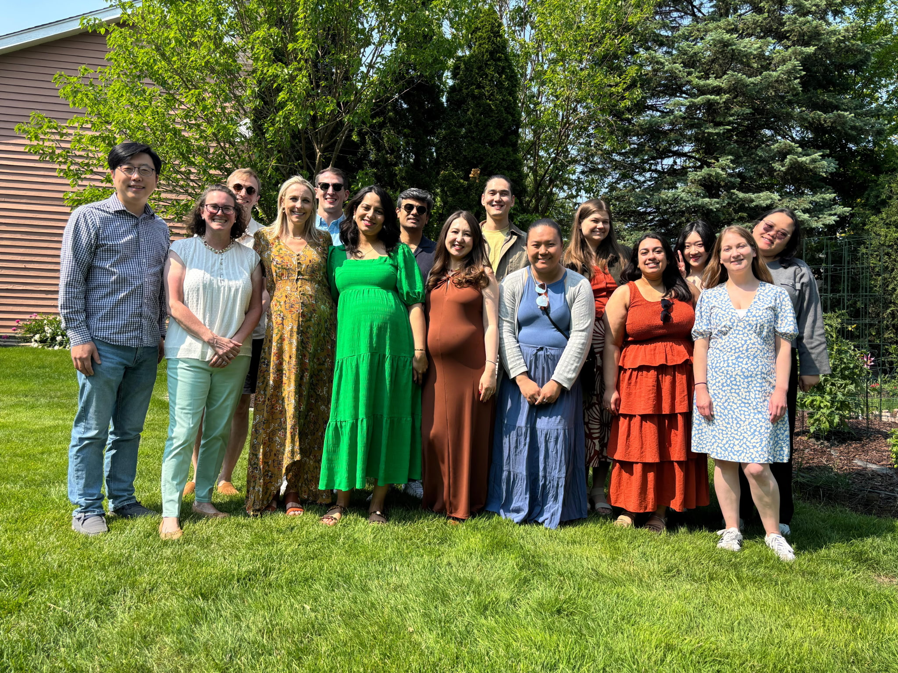
Acknowledgements
Francesca Duncan, PhD​​
Emily Gomez-Zaniker​, PhD
Tomiris Atazhanova, MD, MSc
Pooja Devrukhar, MBBS​​
Dilan Gokyer, MD
Aubrey Converse, PhD​​
Jeffery Pea, PhD​​
Hannes Campo, PhD​​
Victoria Zhu, MS​​
Prianka H. Hashim, BA/BS
Caroline Kratka​​, BA
Victoria Zhu, MS
Anna Heinrich, MS
Lauren Haky, MSc
Uyen Tran Hoi Chang Lee, PhD​​
Tania Milagros Castro Modesto
Reva Marwah
Desiree Franklin
Ireen Kooij, MS
Dylan Hakken
Elnur Babayev, MD, MSc
Northwestern FRM:
MaryEllen Pavone, MD
REI Faculty
Embryologists
Nordic Bioscience (Denmark):
Signe Holm Nielsen, PhD
Cecilie Møller Hausgaard
Funding:
Friends of Prentice
Thank you!

