Slide 1




Slide 2

Compromised Developmental Competence of Oocytes Matured Following Rescue In Vitro Maturation
Anne E. Kim, MD; Steven Wren, BA; Jonas Malmsten, DPS; Nikica Zaninovic, PhD; Zev Rosenwaks, MD; Mohamad Irani, MD
Notes:
Hi, my name is Anne Kim and I am a second year REI fellow at Cornell. On behalf of my team, I have the pleasure of presenting our study titled ..

Slide 3
Disclosures
Neither I nor members of my immediate family have any actual or potential financial interests to disclose relating to the content of this presentation
Notes:
I have no disclosures

Slide 4
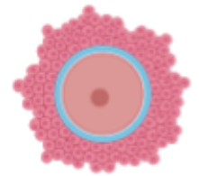
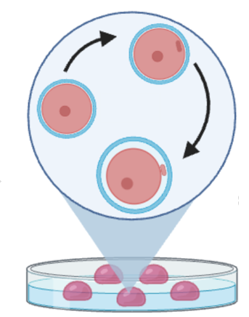
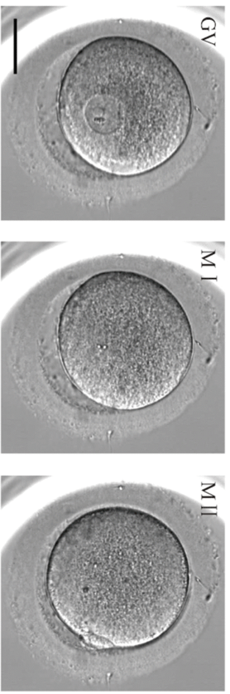
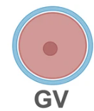


In Vitro Maturation
GV
CLINICAL IN VITRO MATURATION
Gonadotropins
Ovulatory trigger
MI
GV
MII
MI
Incubation duration
GV: 4-50 h
MI: 1.5-50 h
Gonadotropins
Ovulatory trigger
RESCUE IN VITRO MATURATION
ASRM IVM Committee Opinion, 2021; Coticchio et al., Fertil Steril, 2025
Notes:
Generally, patients who undergo ovarian stimulation with oocyte retrieval have a majority of mature, or MII, oocytes retrieved. However, approximately 15% of oocytes are immature at the time of retrieval, either at the germinal vesicle or metaphase I stage.
[click] A germinal vesicle oocyte is characterized by the presence of the nucleus, which is in prophase I of the first meiotic division.
[click] An MI oocyte is characterized by the absence of the nucleus and absence of a polar body in the perivitelline space.
[click] In vitro maturation refers to the maturation of immature oocytes in the lab after retrieval. In its classic form, cumulus-oocyte complexes are intentionally collected at the immature stage, typically with little to no gonadotropin stimulation and without the ovulatory trigger. This strategy was historically used for patients with PCOS.
[click] rescue IVM refers to prolonged incubation of immature oocytes after ovarian stimulation and administration of an ovulatory trigger, as a means to rescue oocytes that would have otherwise been discarded. Notably, the cumulus cells have been stripped from these oocytes.
Rescue IVM may increase the overall number of mature oocytes that are suitable for treatment. However, it is not time nor cost-effective to routinely apply rescue IVM to all immature oocytes.

Slide 5



Current Evidence
Reduced fertilization, cleavage, blastulation, and clinical pregnancy rates compared to sibling in vivo-matured oocytes
  Systematic review and meta-analysis of 24 retrospective studies
  Significant heterogeneity
Successful pregnancies have occurred after transferring embryos derived from IVM-MII oocytes
Unknown long-term safety
Bartolacci et al., JARG, 2024; ESHRE, Hum Reprod, 2023
Notes:
Overall, oocytes after rescue IVM have shown reduced fertilization, cleavage and blastulation rates compared to sibling in vivo-matured oocytes.
Furthermore, based on 3 studies, clinical pregnancy rate was reduced after rescue IVM. Notably, the 3 studies performed transfers of cleavage stage embryos.
Importantly, there is significant heterogeneity among these retrospective studies, that ranged from sample sizes of 18-896 patients. In particular, the rescue IVM protocols followed were highly variable, as well as their differences in study design and outcomes assessed.
[click] Nonetheless, successful pregnancies have occurred after transfer of these embryos despite poorer embryonic and transfer outcomes.
given the relatively low numbers of offspring born from rescue IVM, the long-term safety is unknown.
[click] Thus, as it stands, rescue IVM is not currently recommended for routine clinical use
--------------
Per ASRM: IVM should be offered by those with expertise gained by specific training, and should always be accompanied by appropriate counseling about expected results and informed consent. This technology is no longer considered experimental
Meta-analysis
- Fertilization rate (23 studies): MI to MII 0.49 (0.41, 0.59), GV to MII 0.53 (0.38, 0.74)
- Cleavage rate (16 studies): MI to MII 0.38 (0.23, 0.63), GV to MII 0.29 (0.18, 0.49)
- Blastulation rate (5 studies): MI to MII 0.27 (0.21, 0.34), GV to MII 0.23 (0.12, 0.48)
- Euploidy rate: not different
- Clinical pregnancy rate (3 studies): MI to MII 0.4 (0.18, 0.9)

Slide 6
Objective
To evaluate the developmental competence of oocytes matured following rescue in vitro maturation
Notes:
The objective of our study was…

Slide 7
Study Design
Retrospective cohort study
January 2022 to December 2024
Cycles performed at the Ronald O. Perelman and Claudia Cohen Center for Reproductive Medicine at Weill Cornell Medicine
INCLUSION
Patients with retrieval cycles resulting in immature oocytes that underwent rescue IVM ± subsequent embryo transfer
ICSI for fertilization
EXCLUSION
Mixed conventional insemination and ICSI for fertilization
Notes:
We conducted a retrospective cohort study of cycles performed at our institution between January 2022 to December 2024.
Our study included patients with retrieval cycles resulting in immature oocytes that underwent rescue IVM with or without subsequent embryo transfer as well as utilization of ICSI for fertilization
Cycles that utilized both conventional insemination and ICSI for fertilization were excluded from our sample

Slide 8
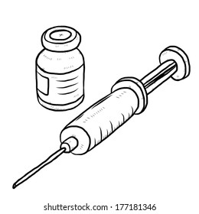
Clinical and Laboratory Protocols
CONTROLLED OVARIAN STIMULATION
OOCYTE RETRIEVAL
EMBRYO CULTURE
EMBRYO TRANSFER
Protocol selected by physician discretion
Protocols: GnRH antagonist, GnRH agonist, modified natural cycle
Trigger with hCG ± GnRH agonist
Notes:
Patients underwent controlled ovarian stimulation using a protocol that was selected by physician discretion, including a GnRH antagonist or agonist protocol or modified natural cycle.
All patients received an ovulatory trigger with hCG, GnRH agonist, or dual trigger. Retrievals occurred 35-37 hours after the trigger.

Slide 9
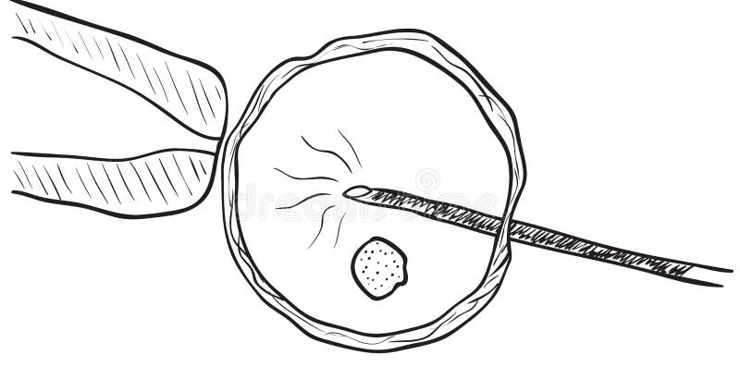
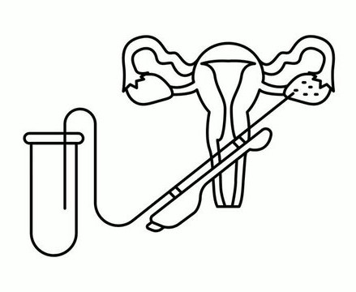
Clinical and Laboratory Protocols
CONTROLLED OVARIAN STIMULATION
OOCYTE RETRIEVAL
EMBRYO CULTURE
EMBRYO TRANSFER
MII oocytes
4-6 h
GV or MI oocytes
reassessed in
20-24 h
IVM-MII oocytes
If ≤2 fertilized
Notes:
After retrieval, the cumulus-oocyte complexes were identified and oocyte maturity was designated.
Mature oocytes were fertilized using ICSI about 4-6 hours after retrieval. Fertilization was confirmed 14-17 hours afterward.
All immature oocytes were incubated in culture media and maintained at 37 deg C in an atmosphere of 5% oxygen. They were reassessed in 20-24 hours. For cycles with 2 or less embryos fertilized, the IVM-matured oocytes subsequently underwent fertilization using ICSI.
-----------------------
After retrieval, the cumulus-oocyte complexes (COC) were identified in the follicular aspirates with HEPES-buffered media. Blood and debris were cleared from the COC. Oocyte maturity was evaluated based on the morphological appearance of the COC, with densely packed cumulus and coronal layers reflecting immature oocytes (germinal vesicle or metaphase I) and highly dispersed cumulus cells and a radiating coronal layer reflecting mature oocytes (metaphase II) (1). The COCs were transferred to one step culture media and maintained at 37 ̊C in an atmosphere of 5% oxygen.
Mature oocytes were prepared for fertilization with exposure to 40 IU recombinant hyaluronidase (Cumulase, Halozyme Therapeutics Inc., San Diego, CA). ICSI was performed on all mature oocytes 4-6 hours after oocyte retrieval (2) and fertilization was confirmed 14-17 hours afterward with the presence of two pronuclei (2PN).

Slide 10
Clinical and Laboratory Protocols
CONTROLLED OVARIAN STIMULATION
OOCYTE RETRIEVAL
EMBRYO CULTURE
EMBRYO TRANSFER
Cultured in one-step media using the Embryoscope time-lapse system (Vitrolife, Göteburg, Sweden)
Cleavage- or blastocyst-stage based on embryo quality and quantity, prior IVF history
Trophectoderm biopsies for blastocysts planned for PGT-A (NGS)
All biopsied embryos or good quality blastocysts in non-PGT cases were cryopreserved
Notes:
All embryos were cultured in one-step media using the Embryoscope time-lapse system.
The embryos were assessed at the cleavage stage by the embryologist on the morning of day 3. Embryos were pushed to the blastocyst stage based on embryo quality and quantity as well as the patient’s prior IVF history.
All biopsied embryos or good quality blastocysts in non-PGT cases were cryopreserved using vitrification.

Slide 11
Clinical and Laboratory Protocols
CONTROLLED OVARIAN STIMULATION
OOCYTE RETRIEVAL
EMBRYO CULTURE
EMBRYO TRANSFER
Fresh embryo transfer
Frozen embryo transfer
Natural FET
Programmed FET
Intramuscular P₄ ± E₂ patches
Vaginal P₄
E₂ patches + intramuscular P₄
dependent on prior IVF history, plan for PGT, clinical status, OHSS risk factors
Notes:
Patients underwent either fresh or frozen embryo transfer depending on their prior history, plan for PGT, overall clinical status, and presence of OHSS risk factors.
In general, patients underwent a fresh transfer of either a day 3 or day 5 embryo and received additional luteal support with estrogen patches and intramuscular progesterone.
For frozen embryo transfers, patients either underwent a natural or programmed cycle with luteal supplementation.
---------------
For natural FET cycles, patients underwent monitoring of their estradiol and LH levels as well as their endometrial thickness to determine their LH surge [day of LH >17 in context of >30% drop E2 the following day]. Transfer occurred 5 days after the determined surge. Additional luteal support was administered with vaginal progesterone.
For programmed FET cycles, patients were administered estrogen patches with or without suppression with leuprolide. After adequate endometrial thickness and approximately 14 days of e2 supplementation, daily IM progesterone was initiated and transfer occurred 6 days after P4 initiation.

Slide 12
Data Analysis
Outcomes: blastulation rate, % mature oocytes, % 2PN, % euploid embryos, clinical pregnancy rate, live birth rate
Comparisons between fertilization outcomes of embryos using MII and IVM-MII oocytes from the same retrieval cycle
  Paired t-tests
Comparisons between transfer outcomes of embryos using MII and IVM-MII oocytes
  Pearson’s chi-square or Fisher’s exact tests
Excluded from transfer outcome analyses:
  Transfer of embryos from both MII and IVM-MII oocytes (n = 52)
  Transfer of embryos from multiple retrieval cycles (n = 2)
  Gestational carrier or reciprocal transfer (n = 3)
Notes:
Our primary outcome was blastulation rate, which was defined as the proportion of fertilized embryos that developed to the blastocyst stage.
The secondary outcomes were the proportion of oocyte maturation, proportion of 2PN development, proportion of euploid embryos, clinical pregnancy rate per transfer, and live birth rate per transfer.
[click] comparisons between fertilization outcomes of embryos using in vitro matured oocytes and sibling in vivo matured oocytes were analyzed with paired t tests
Comparisons between transfer outcomes of embryos using in vitro matured and in vivo matured oocytes were analyzed using Pearson’s chi square or fisher exact tests.
[click] transfers that included embryos from both in vivo and in vitro matured oocytes, or embryos from multiple retrieval cycles were excluded from our analyses. Cycles using a gestational carrier or reciprocal transfer were also excluded
----------------------
% oocyte maturation: MII group = #MII/#retrieved; IVM-MII group = #IVM-MII/#attempted IVM
% 2PN = #2PN/#MII
% euploid = #euploid/#biopsied
CPR = #cycles with >=1 GS / # transfer cycles (including ectopic)
LBR = # live birth >24w / # transfer cycles

Slide 13
Sample Characteristics
 | n (%)
Age (years) <35.0 35.0-39.9 ≥40.0 | 225 (21.4) 373 (35.5) 454 (43.2)
Race Asian Black White Other or Unknown | 194 (18.4) 44 (4.2) 450 (42.8) 364 (34.6)
Body mass index (kg/m²) <18.5 18.5-24.9 25.0-29.9 ≥30.0 | 65 (6.2) 631 (60.0) 184 (17.5) 172 (6.4)
1052 retrieval cycles
10,261 oocytes retrieved
5927 MII oocytes
3922 oocytes attempted rescue IVM
1886 IVM-MII oocytes
834 patients
Notes:
We analyzed a total of 1052 retrieval cycles from 834 patients. Most were older than 40 years, white, and of normal BMI
-----------------
834 patients
Mean amh 1.38 +/- 1.4, min 0.015, max 9.62

Slide 14
Sample Characteristics
 | n (%)
Infertility diagnosis Diminished ovarian reserve Endometriosis Idiopathic Male Polycystic ovary syndrome Tubal Uterine | 643 (61.1) 52 (4.9) 29 (2.8) 183 (17.4) 31 (3.0) 81 (7.7) 45 (4.3)
Stimulation protocol type Agonist-based Antagonist-based Natural cycle | 169 (16.2) 869 (83.3) 5 (0.5)
1052 retrieval cycles
10,261 oocytes retrieved
5927 MII oocytes
3922 oocytes attempted rescue IVM
1886 IVM-MII oocytes
834 patients
Notes:
Most had a diagnosis of diminished ovarian reserve and underwent a GnRH antagonist-based protocol
--------------------
Mean amh 1.38 +/- 1.4, min 0.015, max 9.62

Slide 15
Sample Characteristics
1052 retrieval cycles
10,261 oocytes retrieved
5927 MII oocytes
3922 oocytes attempted rescue IVM
1886 IVM-MII oocytes
834 patients
Notes:
A total of 10,261 oocytes were retrieved in these cycles. There were 5927 in vivo matured oocytes.
Rescue IVM was attempted on 3922 immature oocytes, with approximately 50% that successfully matured
-------------
834 patients
5927 MI oocytes; 1886 IVM-MI oocytes
~50% matured with rescue IVM (38.8% MI to MII, 58.2% for GV to MII) – from Bartolacci systematic review
GV matured overnight
MI matured within 6 hours (36%), overnight 81.5%

Slide 16
Poorer Blastocyst Development with IVM-MII Oocytes
1052 Retrieval Cycles | MII Mean ± SD | IVM-MII Mean ± SD | P
% Mature oocytes | 55.5 ± 20.8 | 55.2 ± 36.7 | 0.8
% 2PN | 55.4 ± 32.4 | 53.0 ± 52.4 | 0.2
% Blast <40 years old at OPU ≥40 years old at OPU | 45.5 ± 40.3 50.2 ± 20.8 38.5 ± 40.1 | 16.0 ± 31.6 17.6 ± 32.2 13.2 ± 30.6 | <0.0001 <0.0001 <0.0001
834 Cycles (79.3%) with PGT
% Euploid | 31.8 ± 36.8 | 24.0 ± 38.3 | 0.3
P <0.05 by paired t-tests
Notes:
Here we compare mean proportions of mature oocytes, 2PN, and blastocysts.
[click] As you can see, blastulation rate was significantly lower in the in vitro matured group compared to the in vivo matured group.
This difference in mean proportion remained after stratifying by age at the time of oocyte retrieval
Of the cycles that underwent PGT, which was 79.3% of cycles, the mean euploid rates did not differ between the 2 groups
----------------
Mean proportions of outcomes when compared between MII and IVM-MII from 1052 retrieval cycles using paired t-tests
5927 MI oocytes; 1886 IVM-MI oocytes
% oocyte maturation: MII group = #MII/#retrieved; IVM-MII group = #IVM-MII/#attempted IVM
% 2PN = #2PN/#MII
% euploid = #euploid/#biopsied
CPR = #cycles with >=1 GS / # transfer cycles (including ectopic)
LBR = # live birth >24w / # transfer cycles

Slide 17
Transfer Outcomes
421 embryo transfers
227 fresh embryo transfers
194 frozen embryo transfers
206 MII ET
21 IVM-MII ET
184 MII ET
10 IVM-MII ET
327 embryos transferred
26 embryos transferred
191 embryos transferred
10 embryos transferred
Notes:
There were a total of 421 embryo transfers that occurred in our sample, of which 227 were fresh transfers and 194 were frozen transfers.
Among the fresh transfers, 206 cycles involved transfer of 1 or more embryos using in vivo matured oocytes, and 21 cycles using in vitro matured oocytes
Among the frozen transfers, 184 cycles involved transfer of 1 or more embryos using in vivo matured oocytes, and 10 cycles using in vitro matured oocytes
----------------------
% oocyte maturation: MII group = #MII/#retrieved; IVM-MII group = #IVM-MII/#attempted IVM
% 2PN = #2PN/#MII
% euploid = #euploid/#biopsied
CPR = #cycles with >=1 GS / # transfer cycles (including ectopic)
LBR = # live birth >24w / # transfer cycles

Slide 18
Transfer Outcomes
 | Fresh Embryo Transfers |  | Frozen Embryo Transfers
 | MII | IVM-MII | MII | IVM-MII
Number of transfers, n | 206 | 21 | 184 | 10
Transfers with PGT, n (%) | - | - | 156 | 7
Number of embryos transferred, n | 327 | 26 | 191 | 10
Number of embryos transferred, mean ± SD | 1.6 ± 0.8 | 1.2 ± 0.4 | 1.2 ± 0.5 | 1.1 ± 0.3
Stage of embryo at transfer, n (%) Cleavage Blastocyst | 185 (89.8) 21 (10.2) | 21 (100.0) 0 (0.0) | 3 (1.9) 153 (98.1) | 0 (0.0) 10 (100.0)
Live birth per transfer, n (%) | 38 (18.5)* | 0 (0.0)* | 71 (38.6) | 3 (30.0)
Clinical pregnancy per transfer, n (%) | 38 (18.5)* | 0 (0.0)* | 96 (52.2) | 3 (30.0)
Not pregnant, n (%) | 130 (63.1)* | 20 (95.2)* | 58 (31.5) | 5 (50.0)
*P <0.05 by Fisher’s exact or Pearson’s chi-square tests
Notes:
Among the fresh embryo transfers, the outcomes of the in vivo matured group are highlighted in green and the in vitro group in white
Most cycles included transfer of a cleavage stage embryo in both groups
Live birth and clinical pregnancy rates per transfer were higher in the in vivo matured group, though we saw lower pregnancy rates overall than expected
--------------
**lower pregnancy rates than expected for fresh cleavage stage (20-40% CPR)
% oocyte maturation: MII group = #MII/#retrieved; IVM-MII group = #IVM-MII/#attempted IVM
% 2PN = #2PN/#MII
% euploid = #euploid/#biopsied
CPR = #cycles with >=1 GS / # transfer cycles (including ectopic) proportion of transfer cycles resulting in a pregnancy diagnosed by ultrasound visualization of 1 or more gestational sacs
LBR = # live birth >24w / # transfer cycles proportion of transfer cycles resulting in a live birth beyond 24 weeks of gestation

Slide 19
Transfer Outcomes
 | Fresh Embryo Transfers |  | Frozen Embryo Transfers
 | MII | IVM-MII | MII | IVM-MII
Number of transfers, n | 206 | 21 | 184 | 10
Transfers with PGT, n (%) | - | - | 156 (84.8) | 7 (70.0)
Number of embryos transferred, n | 327 | 26 | 191 | 10
Number of embryos transferred, mean ± SD | 1.6 ± 0.8 | 1.2 ± 0.4 | 1.2 ± 0.5 | 1.1 ± 0.3
Stage of embryo at transfer, n (%) Cleavage Blastocyst | 185 (89.8) 21 (10.2) | 21 (100.0) 0 (0.0) | 3 (1.9) 153 (98.1) | 0 (0.0) 10 (100.0)
Live birth per transfer, n (%) | 38 (18.5)* | 0 (0.0)* | 71 (38.6) | 3 (30.0)
Clinical pregnancy per transfer, n (%) | 38 (18.5)* | 0 (0.0)* | 96 (52.2) | 3 (30.0)
Not pregnant, n (%) | 130 (63.1)* | 20 (95.2)* | 58 (31.5) | 5 (50.0)
*P <0.05 by Fisher’s exact or Pearson’s chi-square tests
Notes:
As for the frozen embryo transfers, the majority involved blastocyst transfer of euploid embryos.
Live birth and clinical pregnancy rates per transfer did not differ between the two groups.
-----------
156/184 (85%) MII FET were tested embryos
7/10 IVM (70%) FET were tested embryos
% oocyte maturation: MII group = #MII/#retrieved; IVM-MII group = #IVM-MII/#attempted IVM
% 2PN = #2PN/#MII
% euploid = #euploid/#biopsied
CPR = #cycles with >=1 GS / # transfer cycles (including ectopic) proportion of transfer cycles resulting in a pregnancy diagnosed by ultrasound visualization of 1 or more gestational sacs
LBR = # live birth >24w / # transfer cycles proportion of transfer cycles resulting in a live birth beyond 24 weeks of gestation

Slide 20
Conclusions
Embryos from oocytes matured with rescue IVM resulted in poorer blastocyst development despite preserved fertilization compared to embryos from sibling in vivo-matured oocytes
Live births have occurred after blastocyst transfer from IVM-MII oocytes
Consider freezing all embryos after rescue IVM for better synchronization given poorer outcomes with fresh transfer
Routine use of rescue IVM is not recommended; however, it may be a reasonable option for those lacking the availability of in vivo-matured oocytes at the time of retrieval
Notes:
We concluded that embryos from…
Live births have occurred after blastocyst transfer of embryos from oocytes matured with rescue IVM
[click] Given the poorer outcomes observed after fresh transfer, we may consider freezing all embryos after rescue IVM for better synchronization with the endometrial lining.
Thus, routine use of rescue IVM would not be recommended; however, it would still be a reasonable option for those who lack the availability of in vivo matured oocytes at the time of retrieval

Slide 21
STRENGTHS
Sibling analysis
Robust chart review
Both euploidy and live birth rates reported
Outcomes from fresh transfers
LIMITATIONS
Retrospective study
Limited sample size
Did not distinguish between GV and MI oocytes
Unanswered questions:
Can we identify “good-quality” immature oocytes?
Optimal or standardized rescue IVM protocol?
Long-term safety?
Notes:
The strengths of our study include the sibling oocyte analysis and robust chart review. We reported both euploidy and live birth rates, as well as outcomes from fresh embryo transfers.
Limitations include the retrospective nature of our study and overall limited sample size. We also did not distinguish the type of immature oocyte, whether GV or MI in origin.
[click] There still remains many unanswered questions regarding the use of rescue IVM clinically, including identification of a good-quality immature oocyte that may be worth pursuing rescue IVM, optimal or standardized lab protocols, and the overall long term safety of these offspring

Slide 22
Thank you
Notes:
Thank you so much for your attention. I am happy to answer any questions at this time.

Slide 24
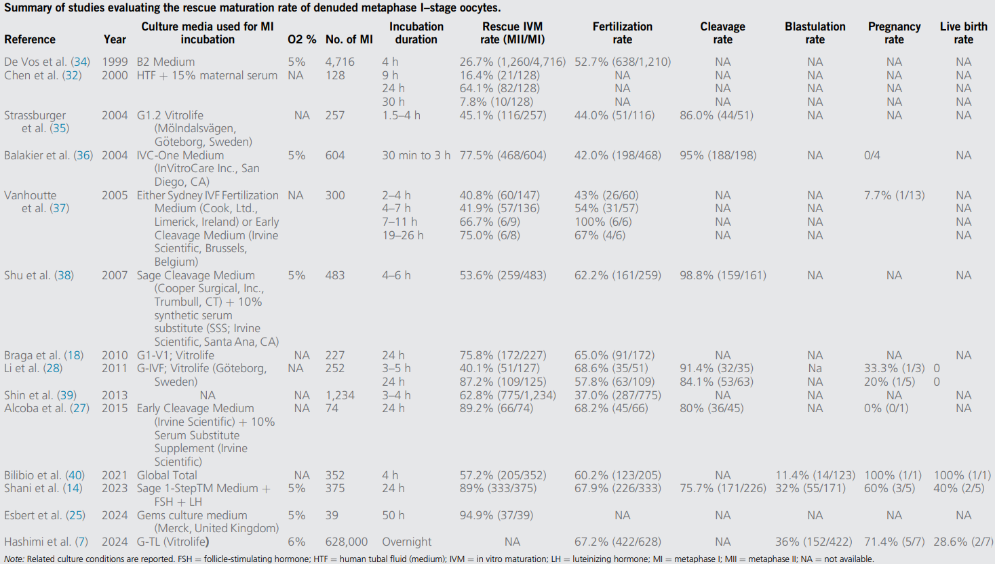
RESCUE IVM FOR METAPHASE I OOCYTES
Coticchio et al., Fertil Steril 2025
Notes:
Summary of studies evaluating the rescue maturation rate of denuded metaphase I-stage oocytes

Slide 25
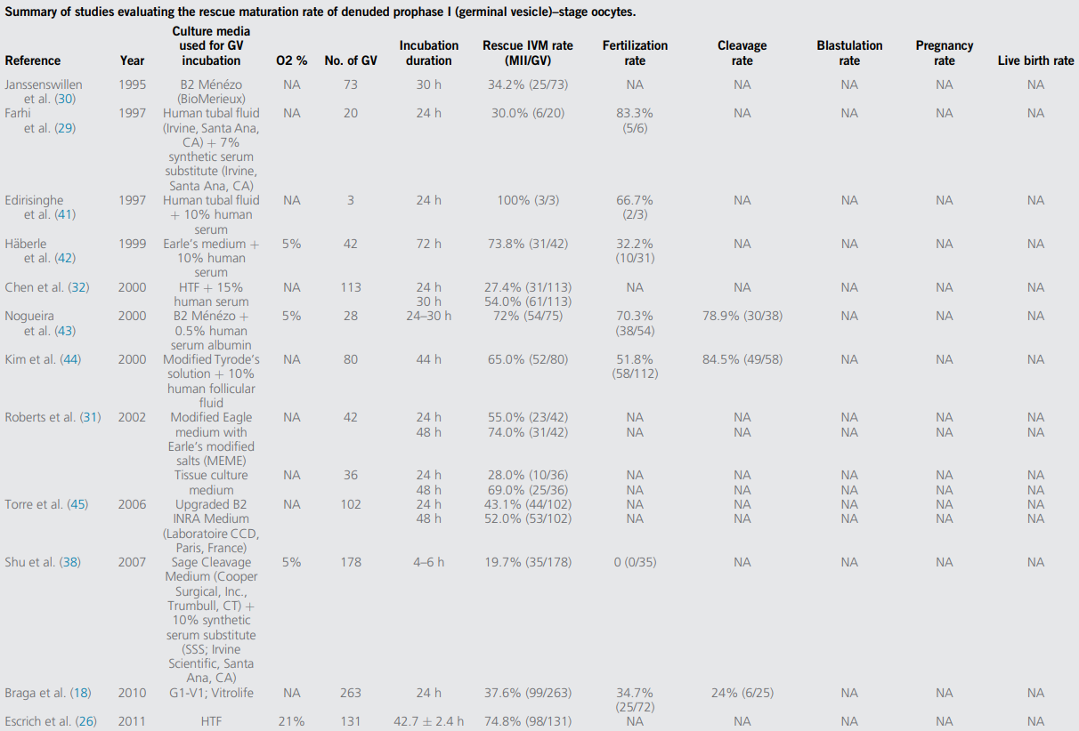
RESCUE IVM FOR GERMINAL VESICLE OOCYTES
Coticchio et al., Fertil Steril 2025
Notes:
Summary of studies evaluating the rescue maturation rate of denuded metaphase I-stage oocytes

