Slide 1




Slide 2
Cumulative Implantation and Live Birth Across Six Consecutive Single Euploid Embryo Transfers in Patients with Recurrent Implantation Failure
Emily A. Clarke, MD¹; Jennifer Chae-Kim, MD²; Miriam A. Andrusier, MD, MPH¹; Jing Wu, MD, MS³; Morgan Baird, MPH⁴; Joseph A. Lee, BA⁴; Benjamin S. Harris, MD, MPH⁵; Phillip A. Romanski, MD, MSc⁶; Alan B. Copperman, MD⁶; Micah J. Hill, DO⁷; Kate Devine, MD⁸.
(1) Icahn School of Medicine at Mount Sinai, New York, NY (2) National Institutes of Health, Bethesda, MD, (3 ) US Fertility, Rockville, MD, (4) Reproductive Medicine Associates of New York, New York, NY, (5) Shady Grove Fertility - Jones Institute, Norfolk, VA, (6) Icahn School of Medicine at Mount Sinai/Reproductive Medicine Associates of New York, New York, NY, (7) NIH-NICHD, Germantown, MD, (8) Shady Grove Fertility

Slide 3
Disclosure
I have no disclosures.

Slide 4
Background
Recurrent implantation failure (RIF) is one of the most challenging scenarios in reproductive medicine
Broadly defined as repeated failure to achieve sustained implantation despite transfer of good quality embryos

Slide 5
Background
RIF is uncommon, affecting fewer than 5% of IVF patients
Patients with RIF frequently undergo extensive diagnostic testing and empiric treatments lacking robust evidence of benefit

Slide 6
Background
Physical: intentional endometrial injury, “scratching”
Immunologic: corticosteroids, granulocyte colony-stimulating factor (G-CSF), intravenous intralipid infusion, intravenous immunoglobulin (IVIG), intrauterine autologous peripheral blood mononuclear cells (PBMCs), platelet-rich plasma (PRP), hCG infusion and GnRH agonist and aromatase inhibitor pretreatment
Infectious: Uterine and microbiome profiling
Hematologic: low molecular weight heparin

Slide 7
Background
Diagnostic criteria for RIF remains heterogenous across studies
Most investigations fail to control for embryonic ploidy, limiting interpretation of true implantation potential
RIF is most appropriately evaluated in the setting of single euploid embryo transfer

Slide 8
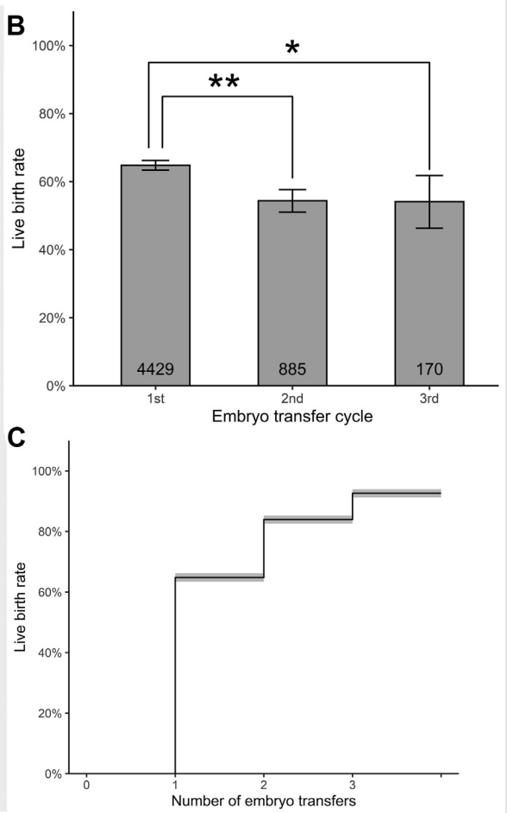
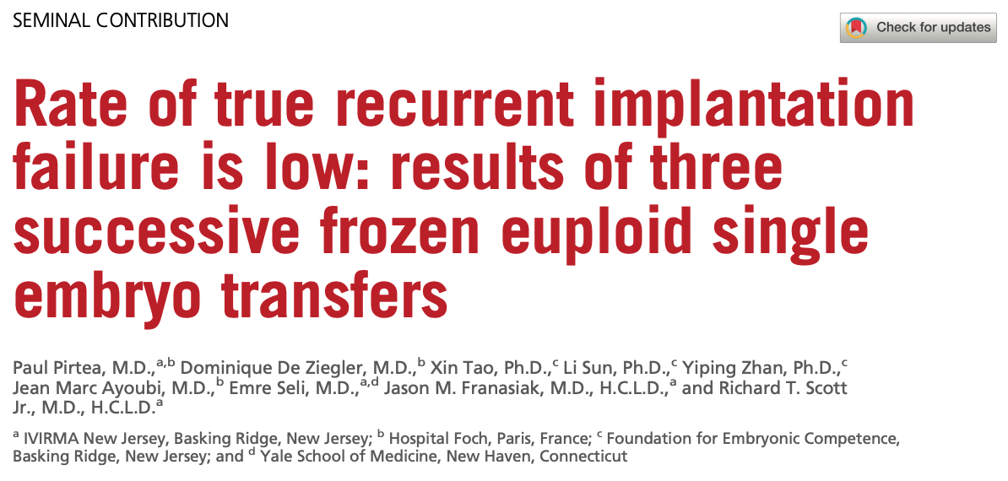
Sustained implantation and live birth remained relatively stable over three consecutive SEETs
Cumulative SI and LBR of 95.6% and 92.6% after up to three transfers

Slide 9
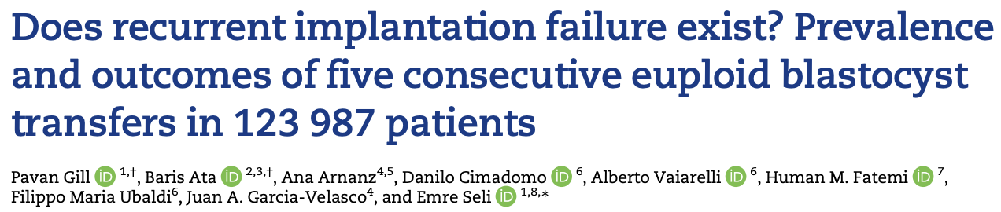
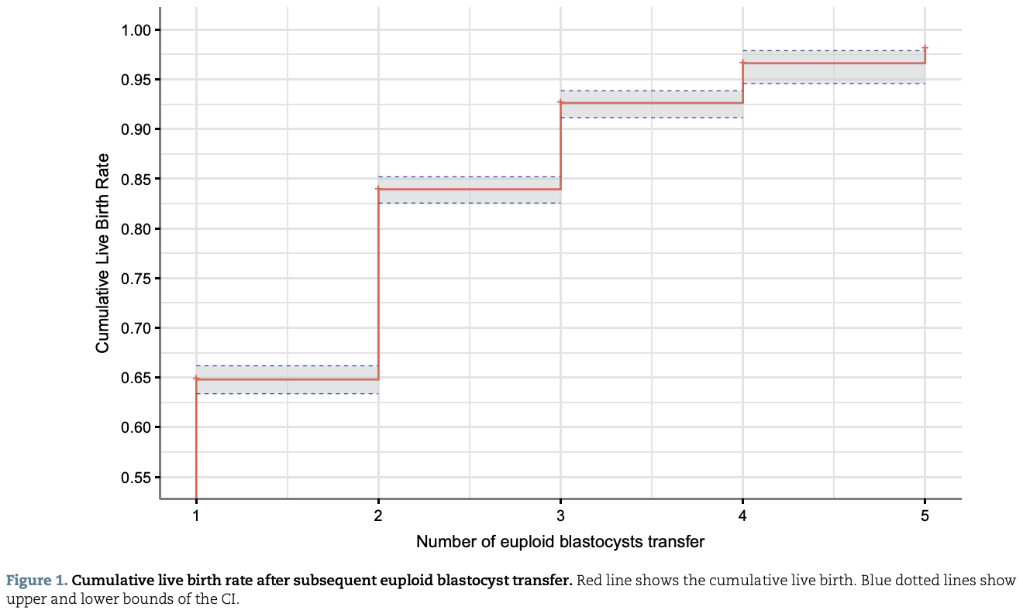
98.1% cumulative live birth rate after five euploid transfers
→ Both studies concluded that the true incidence of RIF is rare, affecting ~2% of patients

Slide 10
Background
Despite recent advances, important knowledge gaps remain
Outcomes beyond five SEETs are poorly described
Existing studies are limited by restrictive inclusion criteria, smaller number of patients undergoing ≥3 transfers, and inclusion of double embryo transfers
Unclear whether continued RIF reflects random variation or true biologic resistance to implantation

Slide 11
Objective
This study characterizes sustained implantation and live birth outcomes across up to six consecutive SEET cycles in patients with RIF

Slide 12
Methods – Study Design
Multi-center retrospective cohort study
Inclusion criteria:
  Patients who underwent up to six consecutive SEETs
  Aged 18-51 years; autologous and donor oocyte
  Treatment between January 2014 and December 2024
Exclusion criteria:
  Patients with uterine factor infertility, congenital uterine anomalies, uncorrected hydrosalpinx
  Gestational carrier use

Slide 13
Methods
Primary Outcomes
Sustained implantation
Cumulative sustained implantation
Secondary Outcomes
Live birth per embryo transfer
Cumulative live birth

Slide 14
Data Collection
Demographics
Age
Body mass index
Race
Infertility diagnosis
SEET Cycle Characteristics
Oocyte source (autologous or donor)
Day of blastocyst cryopreservation)
Endometrial thickness
Type of endometrial preparation

Slide 15
Statistical Analysis
Kruskal-Wallis and chi-square tests were used for comparative statistics
Generalized linear mixed-effects Poisson regression and Cox proportional hazards models were used to evaluate sustained implantation and live birth outcomes across successive SEETs
Kaplan-Meier survival curves generated for cumulative sustained implantation and live birth
P value of <0.05 was considered statistically significant

Slide 16
Results
28,165 SEET cycles
20,536 patients
Second
5,463 cycles
Third
1,562 cycles
Fourth
452 cycles
Fifth
120 cycles
Sixth
32 cycles

Slide 17
SEET Cycle Characteristics
 | First n=20,536 | Second n=5,463 | Third n=1,562 | Fourth n=452 | Fifth n=120 | Sixth n=32
Oocyte source Autologous (n,%) Donor (n,%) | 19,139 (93.2) 1,397 (6.8) | 4,983 (91.2) 480 (8.8) | 1,405 (90.0) 157 (10.0) | 393 (87.0) 59 (13.0) | 108 (90.0) 12 (10.0) | 28 (87.5) 4 (12.5)
Endometrial preparation Natural (n,%) Programmed (n,%) | 4,405 (21.5) 16,131 (78.5) | 1,075 (19.7) 4,388 (80.3) | 308 (19.7) 1,254 (80.3) | 110 (24.3) 342 (75.7) | 32 (26.7) 88 (73.3) | 14 (28.1) 23 (71.9)
Endometrial thickness (mm) | 9.9 ± 2.2 | 9.7 ± 2.2 | 9.6 ± 2.1 | 9.4 ± 2.2 | 9.3 ± 2.1 | 9.4 ± 1.9
Blastocyst biopsy day Day 5 (n, %) Day 6 (n, %) Day 7 (n, %) | 12,638 (61.5) 7,263 (35.4) 635 (3.1) | 2,969 (54.4) 2,269 (41.5) 225 (4.1) | 797 (51.0) 701 (44.9) 64 (4.1) | 232 (51.3) 193 (42.7) 27 (6.0) | 60 (50.0) 52 (43.3) 8 (6.7) | 15 (46.9) 13 (40.6) 4 (12.5)

Slide 18
 | aRR | 95% CI
First | - | -
Second | 0.86 | 0.82-0.90
Third | 0.74 | 0.69-0.81
Fourth | 0.75 | 0.65-0.87
Fifth | 0.64 | 0.47-0.87
Sixth | 0.52 | 0.27-0.99
*Adjusted for age, body mass index, endometrial thickness, and clinical site.

Slide 19
Cumulative Sustained Implantation
97.4%
98.7%
 | 95% CI
First | 56.1-57.4
Second | 78.7-80.0
Third | 88.1-90.1
Fourth | 94.3-95.6
Fifth | 96.7-98.0
Sixth | 97.8-99.2
95.0%
89.5%
79.3%
56.8%

Slide 20
 | aRR | 95% CI
First | - | -
Second | 0.86 | 0.82-0.90
Third | 0.75 | 0.69-0.81
Fourth | 0.73 | 0.62-0.85
Fifth | 0.60 | 0.43-0.84
Sixth | 0.50 | 0.25-0.99
*Adjusted for age, body mass index, endometrial thickness, and clinical site.

Slide 21
Cumulative Live Birth
 | 95% CI
First | 52.2-53.6
Second | 74.9-76.4
Third | 86.1-87.7
Fourth | 92.3-93.9
Fifth | 95.1-96.9
Sixth | 96.5-98.7

Slide 22
Effect of Age on SI and LB
Cumulative sustained implantation:
96% in >42 group
Range: 97-100%
Cumulative live birth:
90% in >42 group
Range: 95-100%
SART Age Group (years) | HR (SI) | 95% CI (SI) | HR (LB) | 95% CI (LB)
<35 (reference) | 1.00 | — | 1.00 | —
35–37 | 0.93 | 0.89–0.96 | 0.93 | 0.89–0.97
38–40 | 0.86 | 0.82–0.89 | 0.86 | 0.82–0.90
41–42 | 0.80 | 0.75–0.85 | 0.79 | 0.74–0.84
>42 | 0.73 | 0.68–0.78 | 0.74 | 0.69–0.80

Slide 23
Conclusion
While per cycle SI and LB decline with successive attempts, cumulative sustained implantation and live birth rates are exceptionally high (98.7% and 97.8%, respectively) after six consecutive transfers, irrespective of patient age

Slide 24
Strengths and Limitations
Strengths
First study to evaluate SEET outcomes after up to six consecutive transfers
Multicenter study with large number of subjects undergoing >3-5 transfers
Increased generalizability with broad inclusion criteria which included donor eggs, use of PGT-M, and all endometrial preparation types
Limitations
Retrospective design
Potential events between cycles, including reproductive surgery, were not captured
Analysis included patients who did not continue with additional SEET attempts after initial failure

Slide 25
Future Directions
Prospective multicenter data collection with larger cohorts undergoing a sixth single euploid embryo transfer
Elucidate patient factors that may influence recurrent implantation failure in those who did not achieve sustained implantation despite six transfers
Understand patient characteristics that are associated with the decision to pursue additional embryo transfers

Slide 26
References
Garneau AS, Young SL. Defining recurrent implantation failure: a profusion of confusion or simply an illusion? Fertil Steril. 2021;116(6):1432-1435. doi:10.1016/j.fertnstert.2021.10.023
Cimadomo D, de los Santos MJ, Griesinger G, et al. ESHRE good practice recommendations on recurrent implantation failure. Hum Reprod Open. 2023;2023(3). doi:10.1093/hropen/hoad023
Pirtea P, De Ziegler D, Tao X, et al. Rate of true recurrent implantation failure is low: results of three successive frozen euploid single embryo transfers. Fertil Steril. 2021;115(1):45-53. doi:10.1016/j.fertnstert.2020.07.002
Gill P, Ata B, Arnanz A, et al. Does recurrent implantation failure exist? Prevalence and outcomes of five consecutive euploid blastocyst transfers in 123 987 patients. Human Reproduction. 2024;39(5):974-980. doi:10.1093/humrep/deae040

Slide 27
Thank you

