Slide 1

De Novo Male Gametes Generated in a Novel 3D Organic Culture System
Kelly McCarter, MD
Pacific Coast Reproductive Society
March 21st, 2025
Notes:
Thank you so much for the introduction. and thank you to ferring for supporting my research

Slide 2
Disclosures
Ferring Pharmaceuticals - PCRS Grant
The institutional review board at Weill Cornell Medical College approved our study protocol (IRB 24-11028207 )
Notes:
my only disclosure is Ferring pharmaceuticals
the IRB at cornell approved our study protocol

Slide 3
Background
About 50% of cases of infertility can be attributed to male factors
Non-obstructive azoospermia (NOA) is the most severe form
Hormone treatment can increase total testosterone levels and promote spermatogenesis (Korbori et al 2015, Hussein et al 2014)
Treatment limited to patients with inadequate gonadotropin production
Less helpful for those with spermatogenic arrest and germ cell aplasia
Successful sperm retrieval with microscopic testicular sperm extraction (mTESE) is at best 65% (Ng et al 2025)
Notes:
To begin with some background, about 50% of ....
NOA - and it refers to the absence of sperm from the ejaculate It is typically caused by failure of spermatogenesis due to either inadequate gonadotropin production or intrinsic testicular impairment
Hormone treatment ....
While surgical sperm retrieval is almost always successful in obstructive azoospermia, success is at best 65% in those with NOA
Hormone treatment with recombinant FSH and hcg can increase testosterone and promote spermatogenesis
However this is limited to those with inadequate gonadotropin production.
It is less helpful in patients with spermatogenic arrest from an underlying genetic cause or germ cell aplasia given the spermatogenic cells are absent in the seminiferous tubules of those men
20-30% male factor alone
ICSI can overcome male factor even in azoospermic cases, as long as viable spermatozoa can be retrieved surgically

Slide 4
Background
Use of patient-derived stem cells to generate spermatozoa in vitro has been proposed as an ultimate solution to overcome NOA
Suggested models:
Generation of spermatogonial stem cells from iHSPCs (Xu et al, 2020)
In vitro testicular organogenesis from cultured fetal gonads (Yuan et al, 2020)
Development of testicular organoids (Zhang et al, 2024)
In vitro spermatogenesis on 3D bioprinted scaffolds (Richer et al, 2024)
Notes:
The use of patient-derived stem cells to generate spermatozoa in vitro has been proposed as an ultimate solution to overcome NOA
Much of the research thus far has focused on differentiating stem cells in a 3D model which would more closely resemble the testicular environment.
Some studies have done this by using an organoid model or 3D bioprinting
These studies have shown some success with in vitro spermatogenesis
Organoids - three-dimensional (3D) structures that resemble organs, which can be generated through the cultivation of single cells derived from a specific tissue

Slide 5
Historical Challenges
Current research:
Diverse animal models (Zhang et al, 2024; Richer et al, 2024)
Heterologous transplantation ((Zhang et al, 2024, Richer et al, 2024)
Xenograft into a host seminiferous tubule (Xu et al, 2020)
Inconsistent outcomes (Yuan et al, 2020)
Low reproducibility (Yuan et al, 2020; Richer et al, 2024; Zhang et al, 2024)
Notes:
While there has been success in generating haploid male gametes in vitro, current research is still overall limited.
Most research is done in animal models
Many also requires transplantation or xenograft into a host seminiferous tubule to test functionality of the generated gametes
Some promising studies have had successful fertilization however with inconsistent outcomes and low reproducibility
There is therefore a need for a more efficient system
testicular organogenesis-derived spermatids Fertilization rates of 12%

Slide 6
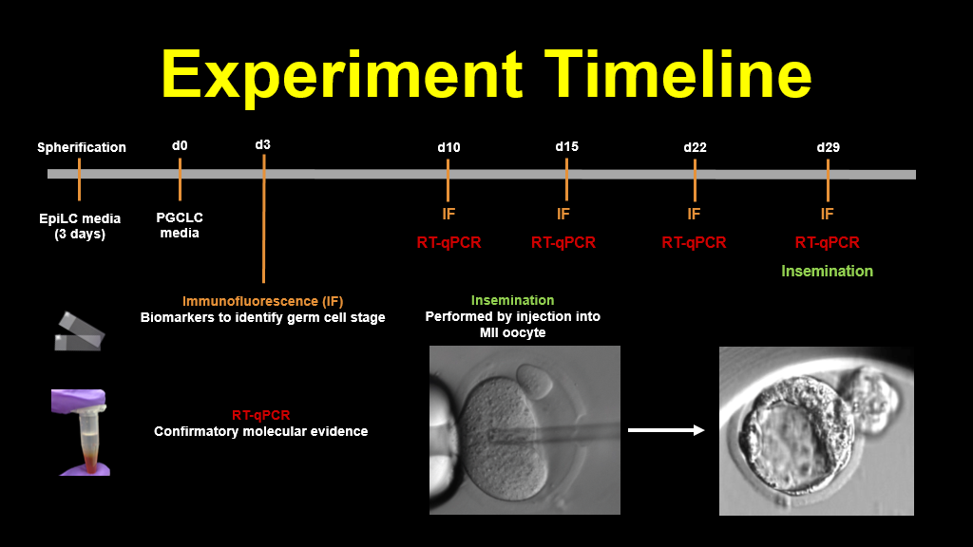
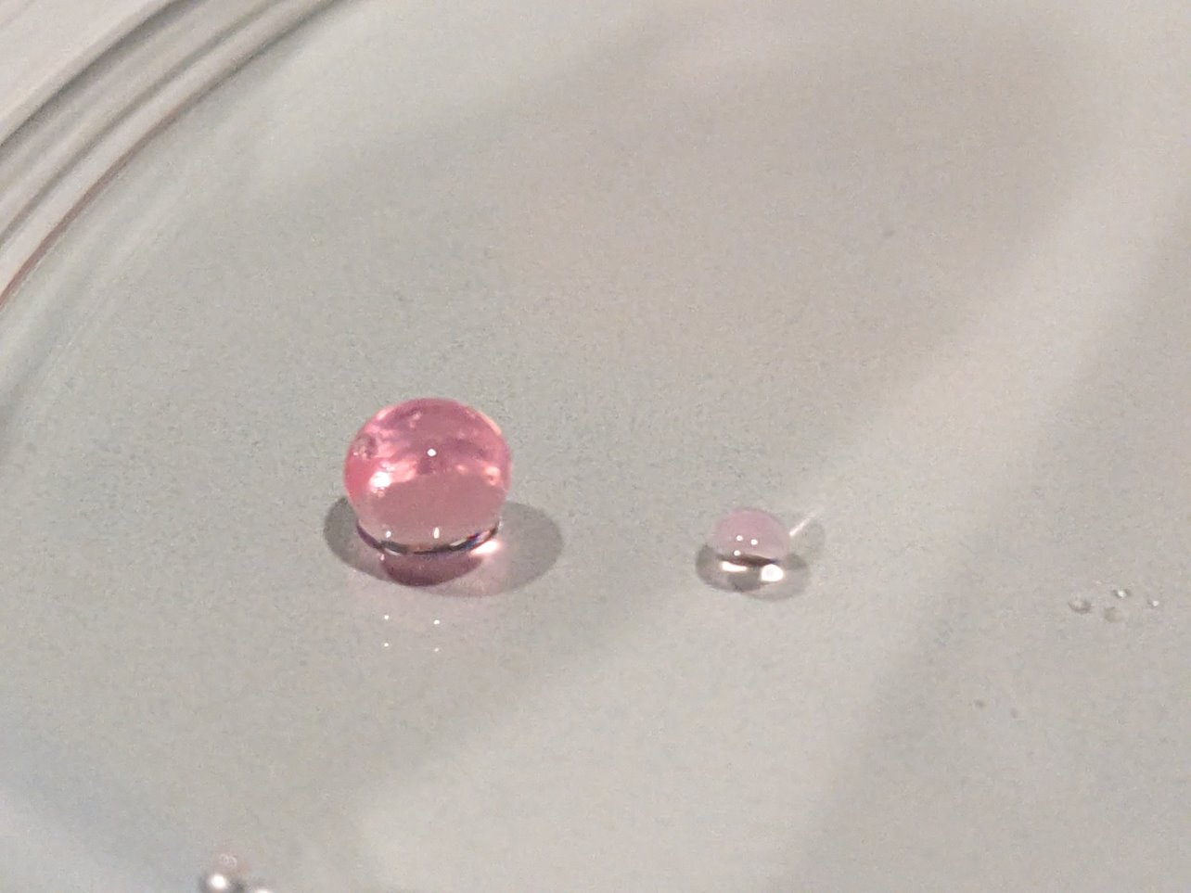
Spherification with Mouse Embryonic Stem Cells
Massad, P., Ng, L., Xie P, Rosenwaks Z, Palermo G. Male Neogametogenesis Induced in a Three-Dimensional Culture System Capable of Supporting Fertilization and Proper Embryo Development​. ESHRE 2024: Oral Presentation
Notes:
Our group has previously demonstrated an efficient system in which we differentiated murine embryonic stem cells into male gametes using a 3D spherification model. We will review spherification in further detail however briefly stem cells are differentiated within this sphere (shown here) to create an environment that more closely replicates the environment of the seminiferous tubule.
In this study were able to see progression of spermatogenesis into haploid sperm like cells. We then tested functionality of de novo gametes through injection into murine oocytes.
​

Slide 7
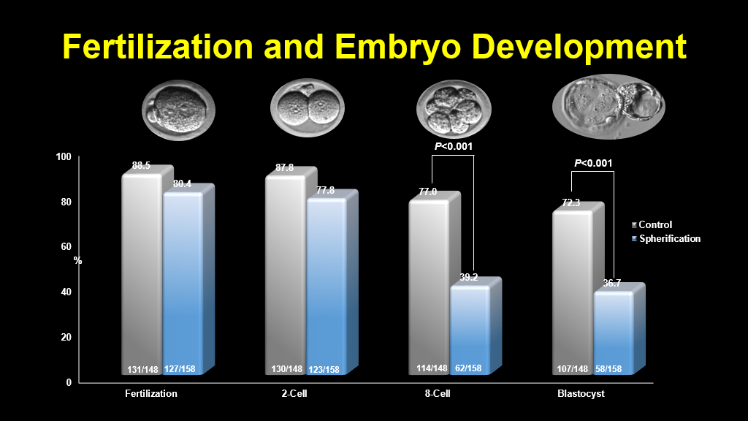
Fertilization and Embryo Development
Massad, P., Ng, L., Xie P, Rosenwaks Z, Palermo G. Male Neogametogenesis Induced in a Three-Dimensional Culture System Capable of Supporting Fertilization and Proper Embryo Development​. ESHRE 2024: Oral Presentation
Notes:
This yielded successful fertilization at 80% and also was able to support full pre-implantation development
Given the success of this study, we wanted to reproduce outcomes in a human model.
We were able to obtain similar fertilization rates compared to control which consisted of mouse sperm injected into oocytes
Blastocyst rates decreased compared to control, however 36.7% of fertilized oocytes became blastocysts in this 3D culture model.
Given the success in the murine model, we wanted to test this model using human cells.

Slide 8
Aims
1. Differentiate human induced pluripotent stem cells (HiPSCs) and human embryonic stem cells (HESCs) into male gametes in our 3D culture system
2. Assess for spermatogenic stage-specific biomarkers by immunofluorescence
3. Confirm haploidy of generated gametes via FISH
4. Inject differentiated haploid cells into donated human oocytes
5. PGT-A test the generated embryos
Notes:
In this study, we aim to facilitate differentiation of human induced pluripotent stem cells and human embryonic stem cells into de novo gametes
We will assess for spermatogenic biomarkers by immunofluroresence and confirm haploidy with FISH
We will assess functionality of haploid gametes by injecting into donated human oocytes
Lastly we will perform PGTA on any resulting embryos

Slide 9
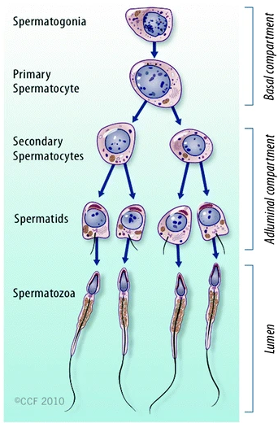
Spermatogenesis in Humans
Mitosis
Meiosis I
~70-74
days
Meiosis II
Spermiogenesis
~21-25
days
Sharma, R., Agarwal, A. (2011). Spermatogenesis: An Overview. In: Zini, A., Agarwal, A. (eds) Sperm Chromatin. Springer, New York, NY.
Notes:
To quickly review spermatogenesis in humans, it takes place in the seminiferous tubule
Within the seminiferous tubule, The diploid spermatogonia lie directly on the basement membrane and differentiate to haploid spermatids as they progress toward the lumen. This process takes about 70-74 days. The final maturation stage, known as spermiogenesis, takes about 21 to 25 days
Spermatogenesis takes about 70~74 days
Primary spermatocytes have the ­longest life span. Secondary spermatocytes undergo the second meiotic division to produce spermatids. Secondary spermatocytes are short-lived (1.1–1.7 days).
Spermiogenesis - complex process that ­transforms round spermatids after meiosis into a complex structure called the spermatozoon (6 stages of spermatid maturation - acrosome formation is completed, the intermediate piece is formed and the tail develops)
The spermatocyte takes 25.3 days to mature. Spermiogenesis occurs in 21.6 days, and the duration of the cycle is 16 days.

Slide 10
Experiment Timeline
Spherification
D1
D12
D14
D21
D24
D26
D28
D42
D2
D7
D18
D55
Pluristem media
⍺-MEM media
IF
IF
IF
Injection
IF
Injection
IF
IF
DMEM/F12 media #1
DMEM/F12 media #2
Human spermatogonial cell (hSSC) maintenance media
Immunofluorescence (IF)
Biomarkers to confirm germ cell stage
Injection
IF
Injection of putative spermatids into human oocytes
DMEM/F12 media #3
Experiment timeline adapted from: Xu, H., Yang, M., Tian, R. et al. Derivation and propagation of spermatogonial stem cells from human pluripotent cells. Stem Cell Res Ther 11, 408 (2020)
Notes:
This is the timeline of the experiment which I will go into further detail throughout this presentation.
Timeline for in vitro gametogenesis was adapted from our groups prior experiment in mice and also by a study by Xu et al who previously described in vitro spermatogenesis of human IPSCs and HESCs
(click) In brief, HiPSCs and HESCs were first spherified
(click) and then cultured in various media to induce differentiation into haploid sperm like cells
(click) Each week, cells were evaluated to assess for progression of spermatogenesis
This was done using immunofluorescence staining for spermatogenic biomarkers
(click) Lastly generated haploid cells were injected into donated human oocytes.
Of note the spermatogenesis cycle is shorter here than that seen in vivo, as the in vitro cycle ends with differentiation to haploid spermatids instead of progressing through further maturation to spermatozoa

Slide 11
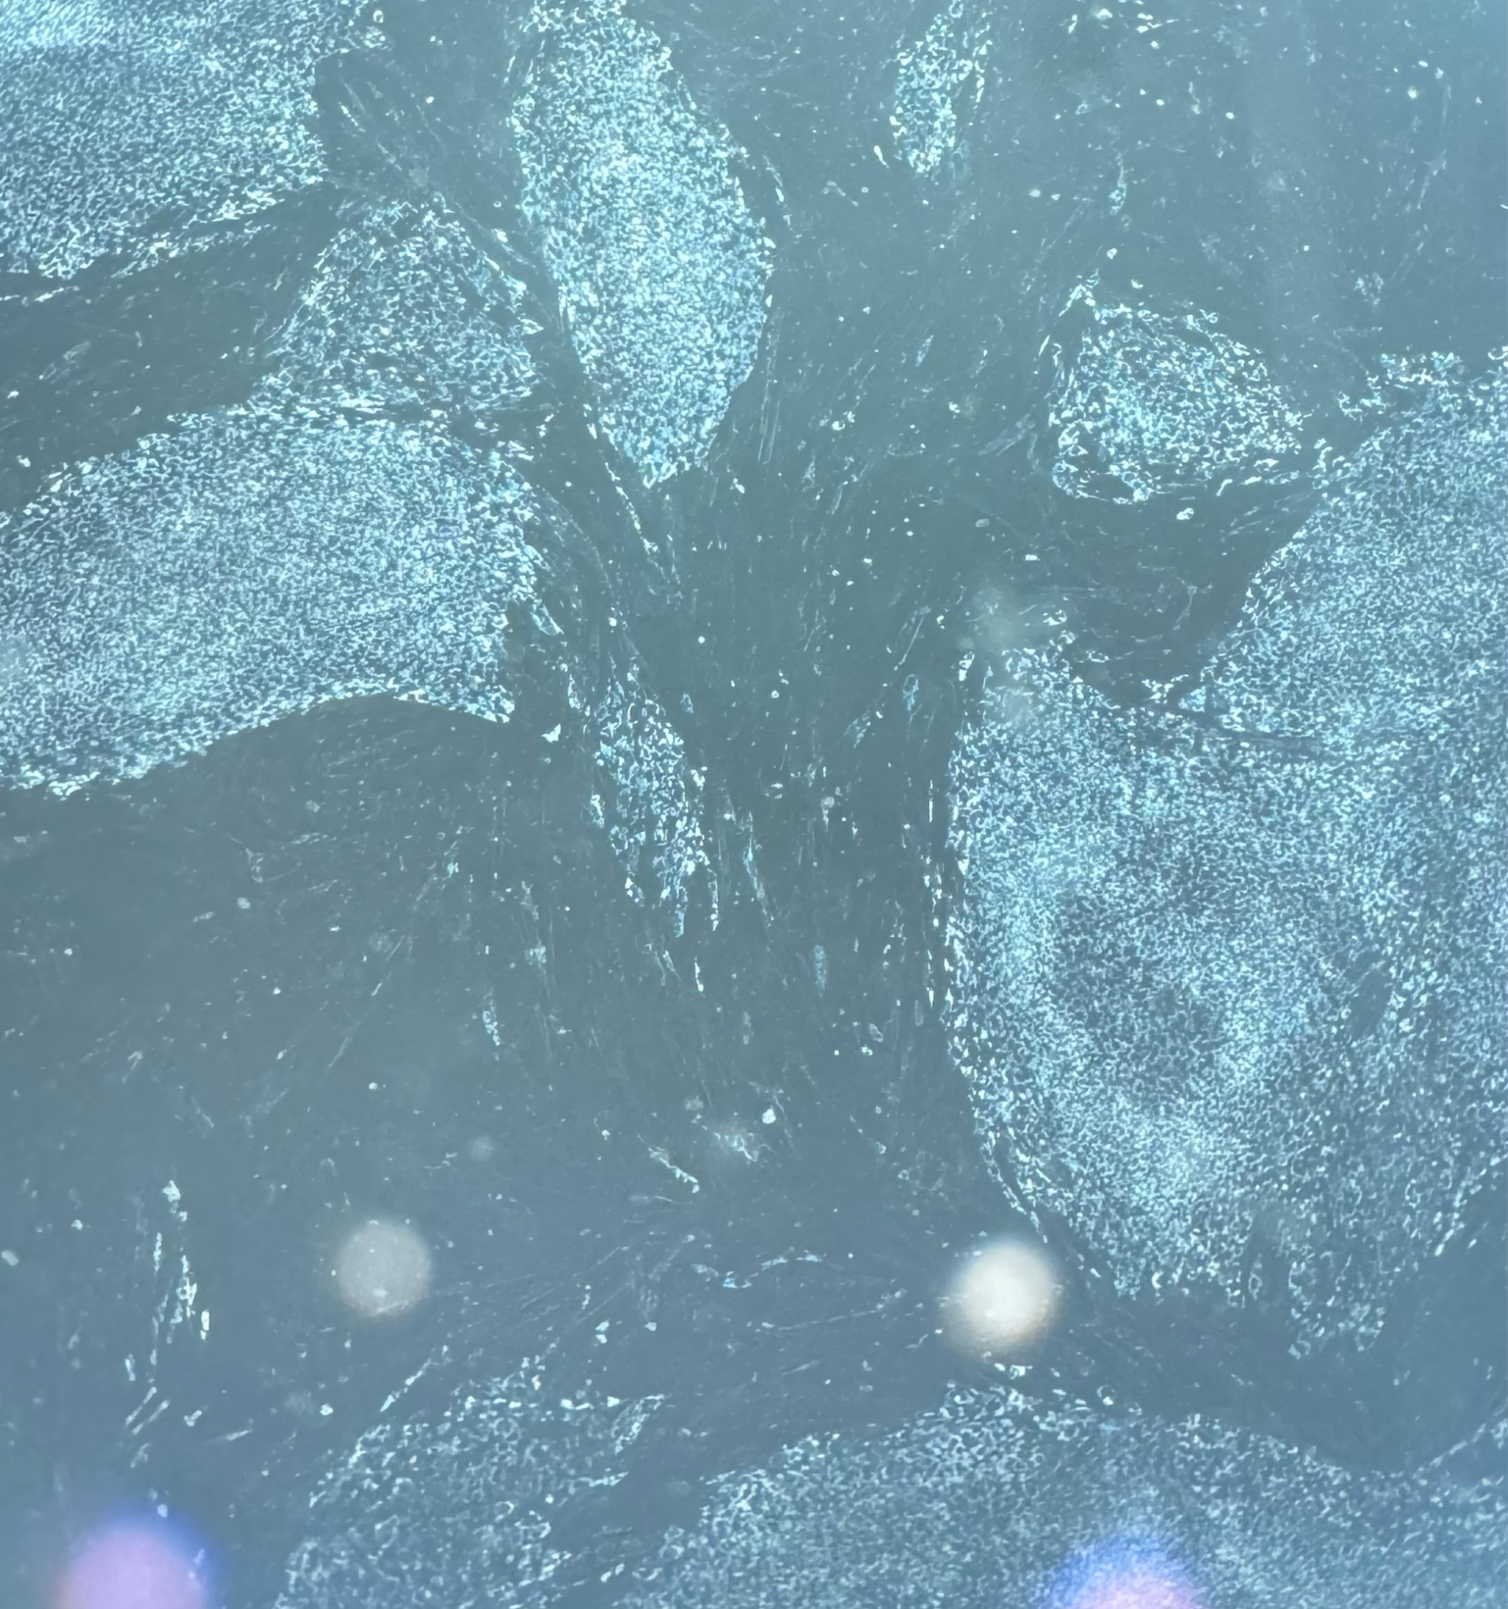
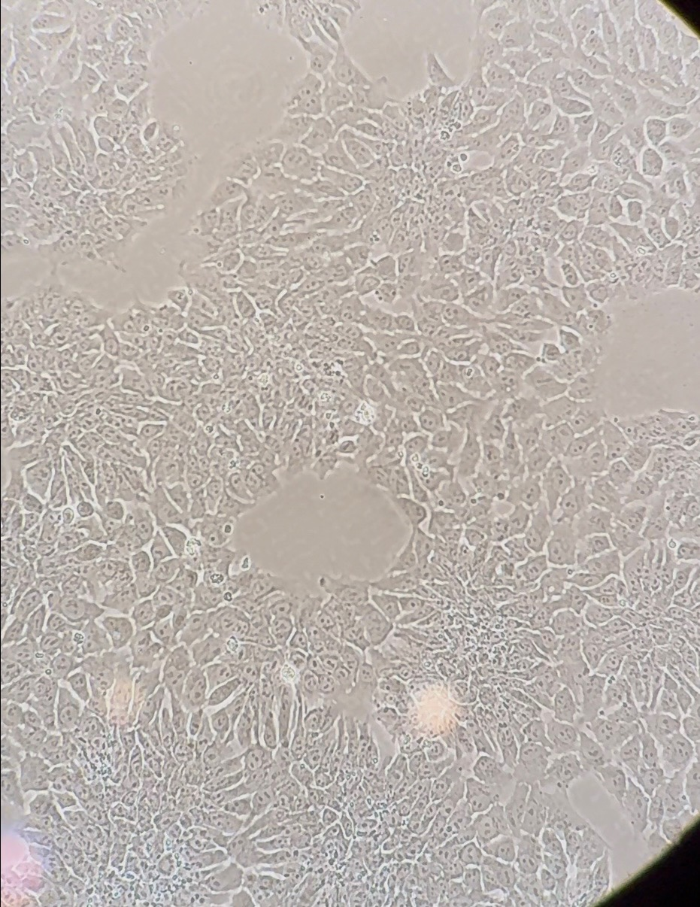
HiPSCs
HESCs
Notes:
To start, HiPSCs and HESCs were plated to form colonies
Colonies are shown here.

Slide 12
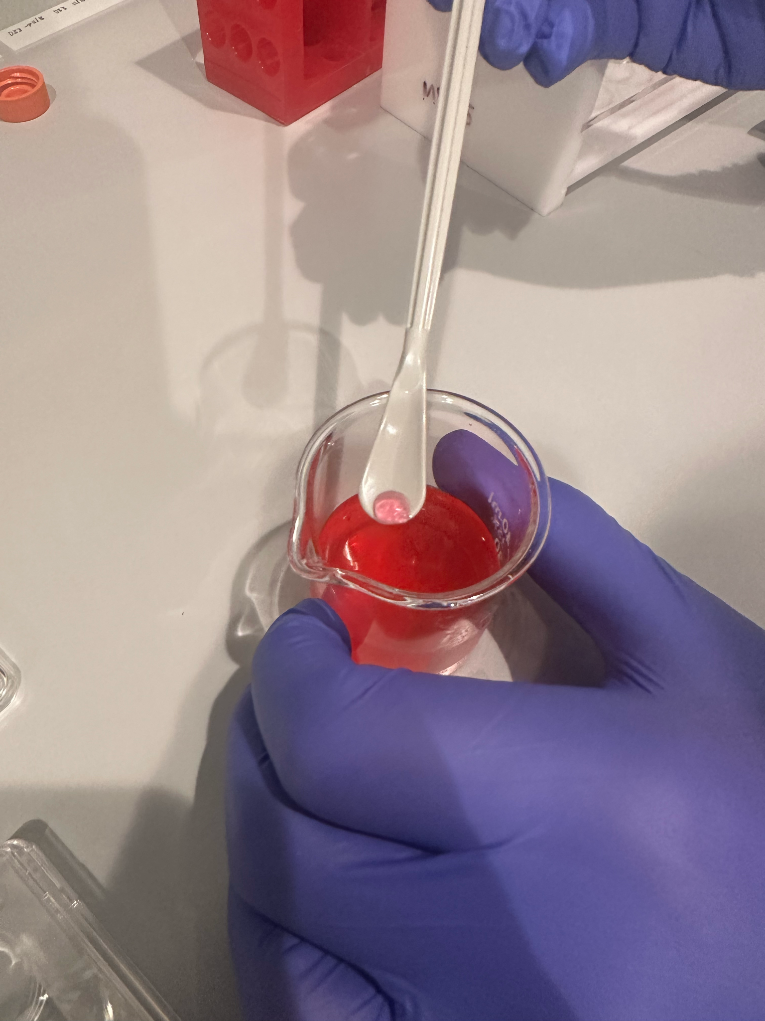

Spherification
Notes:
The stem cells were then spherified into a 3D culture
Spherification involves using a viscous media that contains sodium alginate (which is a thickening and emulsifying agent)
Undifferentatiated stem cells are then mixed with this media
This combination is then slowly pipetted into a solution containing calcium chloride which morphs the droplets into spheres (click)
This creates a 3D environment and attempts to replicate the seminiferous tubule

Slide 13
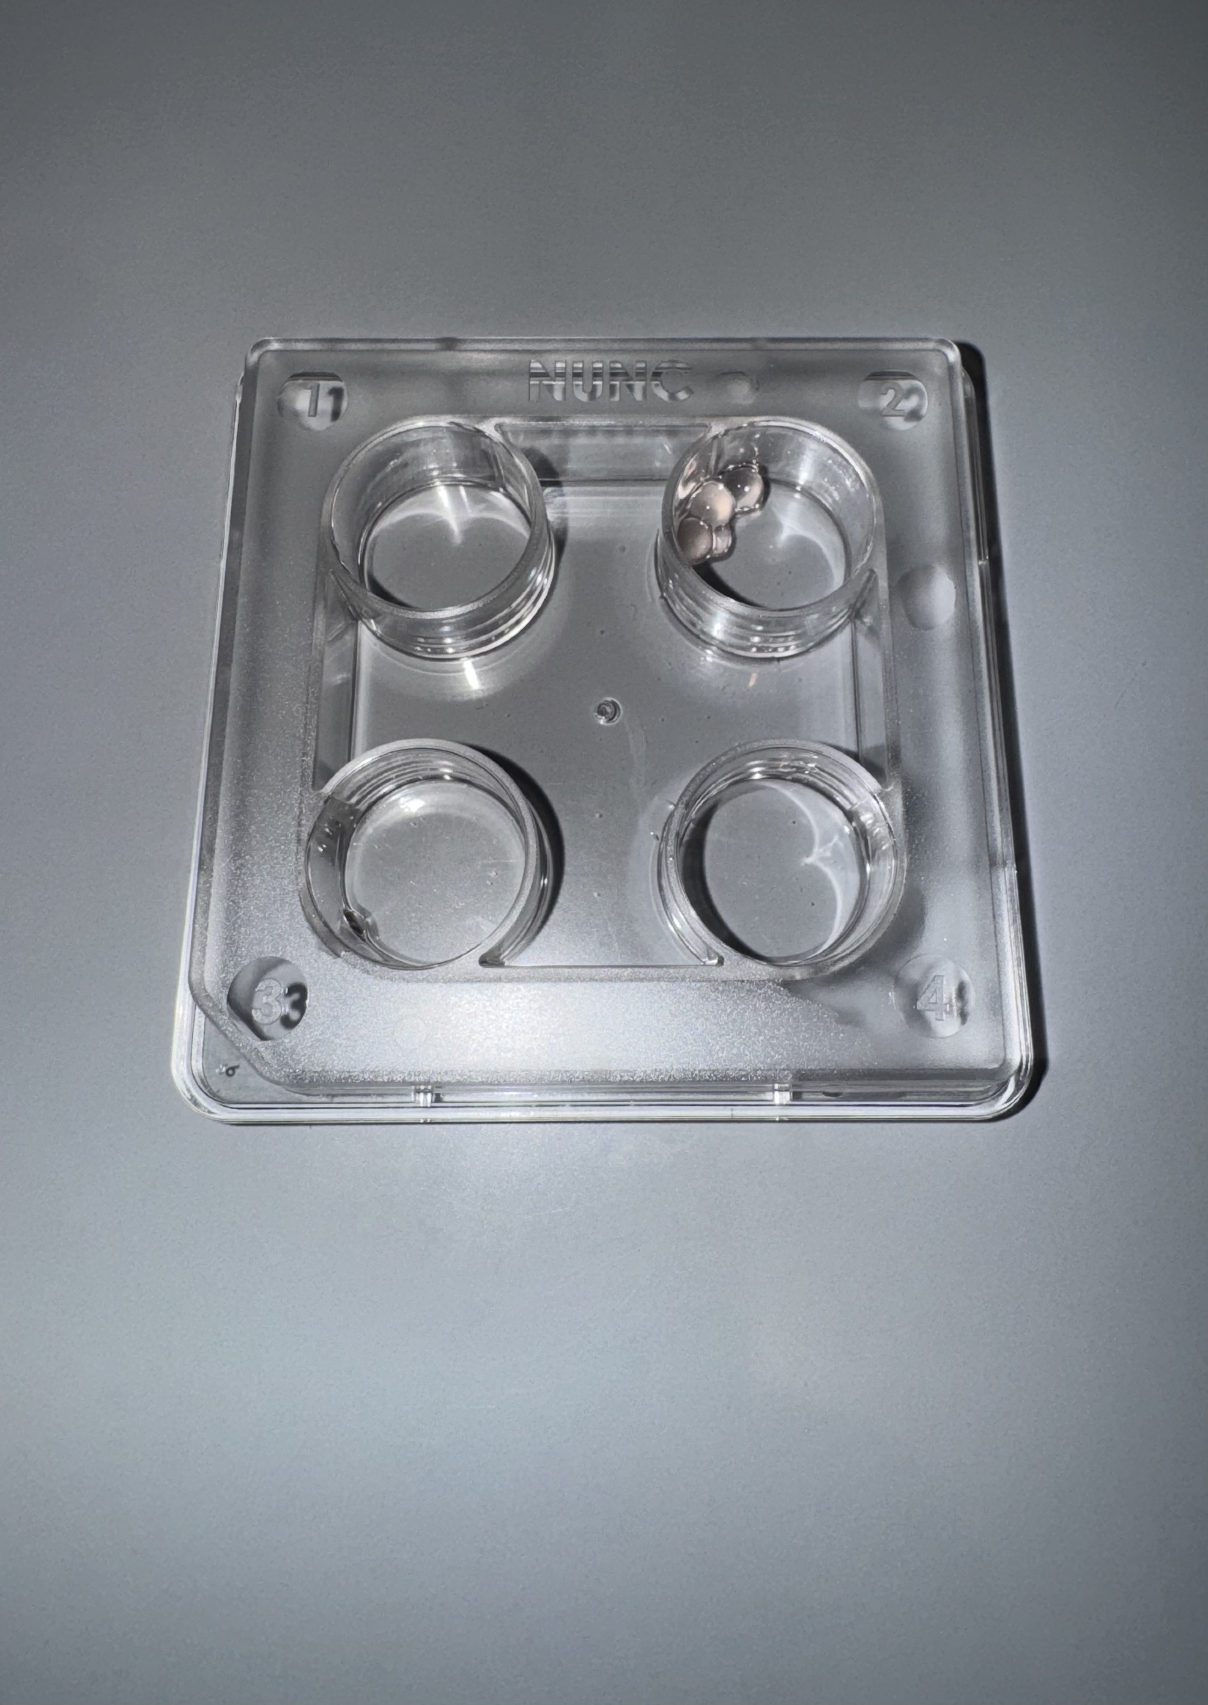
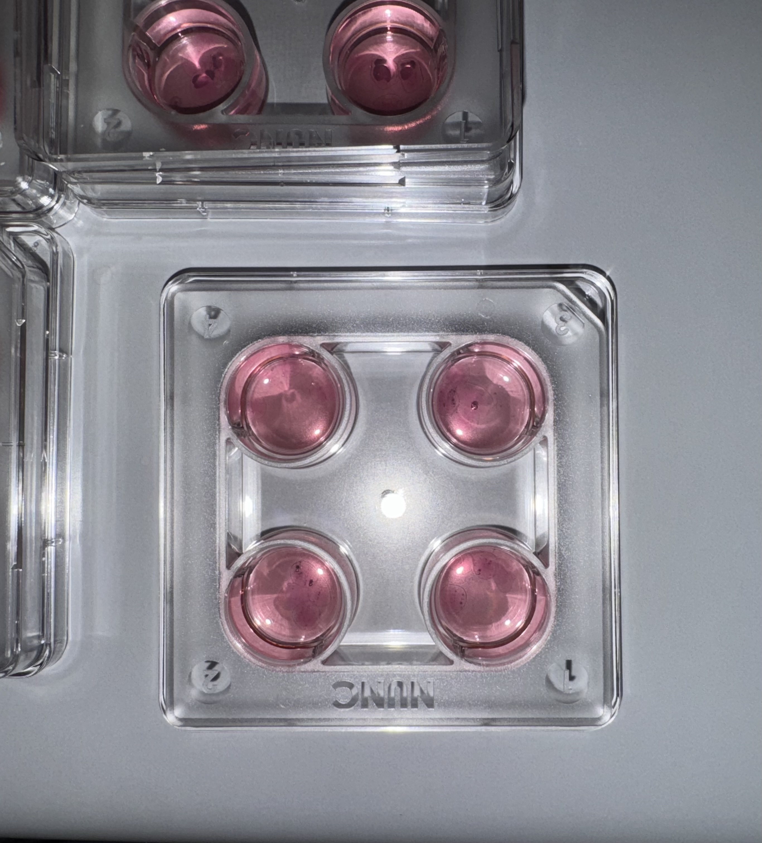
Notes:
4-6 spheres are placed in multiple 4 well plates and then covered with media as shown here

Slide 14
Differentiation Media
𝛼-MEM Medium (D2-11​)
DMEM/F12 Medium #1 (D12-17​)
DMEM/F12 Medium #2 (D18-23​)
𝛼-MEM
Glial cell derived neurotrophic factor
Basic fibroblast growth factor
Retinoic Acid
Stearic Acid
Putrescine
Palmitoleic acid
Linoleic Acid
Oleic Acid
Transferrin
L-glutamine
β-mercaptoethanol
Bovine serum albumin
Penicillin/streptomycin
Retinoic acid
Stem cell factor
Fetal Bovine Serum
Glial cell derived neurotrophic factor
Glial cell derived neurotrophic factor
Testosterone
Recombinant human FSH
Vitamin C
Vitamin A
Vitamin E
Media preparation based on: Xu, H., Yang, M., Tian, R. et al. Derivation and propagation of spermatogonial stem cells from human pluripotent cells. Stem Cell Res Ther 11, 408 (2020)
Notes:
Media preparation and protocol was based on Xu et al.
(click) Alpha mem media was combined with other nutrients to facilitate the production of primordial germ cells
(click) Media was switched to a media containing retinoic acid and stem cell factor which promotes proliferation of primordial germ cells
(click) On day 18, media was supplemented with glial cell derived neurotrophic factor, various vitamins, and hormones including testosterone and recombinant FSH for 6 days, which provide a testicular niche to promote primordial germ cells to differentiate into spermatogonia.

Slide 15
Differentiation Media
hSSC Maintenance Medium (D24-25)
DMEM/F12 #3 Medium (D26 - 55)
StemPro-34 SFM medium
Fetal bovine serum
Bovine serum albumin
D-glucose
Biotin
Vitamin C
Sodium pyruvate
Glutamine
β-mercaptoethanol
Vitamin E
Non-essential amino acid
D.L-lactate
Glial cell derived neurotrophic factor
Basic fibroblast growth factor
Epidermal factor
Stem cell factor
Testosterone
Knockout serum replacement
Glial cell derived neurotrophic factor
Vitamin C
Retinoic acid
Bovine serum albumin
Media preparation based on: Xu, H., Yang, M., Tian, R. et al. Derivation and propagation of spermatogonial stem cells from human pluripotent cells. Stem Cell Res Ther 11, 408 (2020)
Notes:
Cells were further maintained with various nutrients and growth factors to develop
Maintenance media - allows formation of grape like clusters

Slide 16
Spermatogonial Biomarkers
Markers for spermatogonia and primary spermatocytes
Marker of undifferentiated cells
Marker of primordial germ cells (PGCs)
Markers for secondary spermatocytes
Markers for spermatids
𝛂-MEM
media
Stage 1
DMEM/F12
Media #1
Stage 2
DMEM/F12
Media #2
Stage 3
hSSC Maintenance Media
DMEM/F12 Media #3
Stage 4
OCT4
VASA
GFRA1
VASA
BOULE
VASA
ACROSIN
VASA
Adapted from Zhao et al. Nature Communications. 2021
Notes:
Biomarkers were analyzed via immunofluorescence to assess the progression of male gamete differentiation.
This included using biomarkers for:
(click) undifferentiated cells
(click) primordial germ cells
(click) spermatogonia and primary spermatocytes
(click)secondary spermatocytes
(click) and lastly mature spermatids
Oct4 - early stages of male germ cell, pluripotent
GFRA1 spermatogonium Just SSC not Type A or B
UCHL1 spermatogonium BROAD USE SSC/ A or B
Vasa - later germ cell/primary spermatocytes
Boule - secondary spermatocyte
Acrosin- spermatids

Slide 17
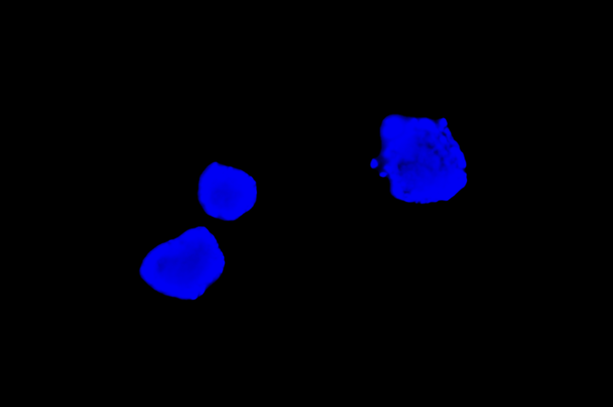
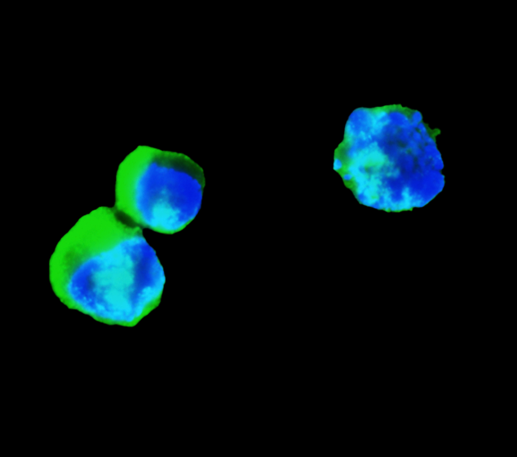
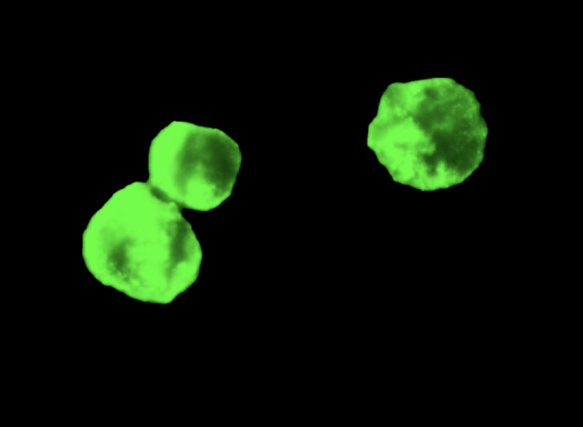
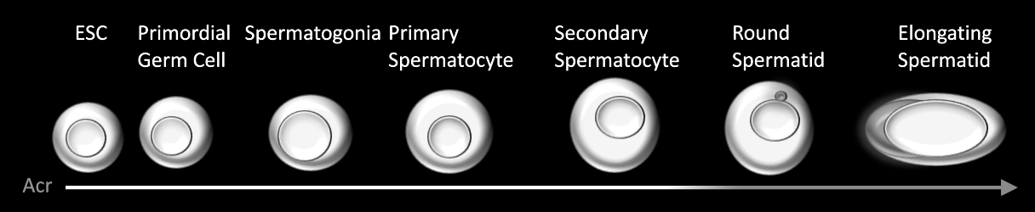
OCT4
Pluripotent Stem Cell
DAPI
OCT4
Merge
OCT4
Notes:
I will now show results of immunofluorescent staining .
OCT4 is a nucleocytoplasmic shuttling protein that is associated with pluripotent stem cells (click)
(click) DAPI is a flourescent dye used to stain for DNA and nuclei. Positive staining confirms the presence of a cell.
This image shows HESCs from day 0, staining positive for OCT4 and confirming presence of pluripotent cells.
Mainly in the nucleus
DAPI - cell staining (supposed to be nuclear)

Slide 18
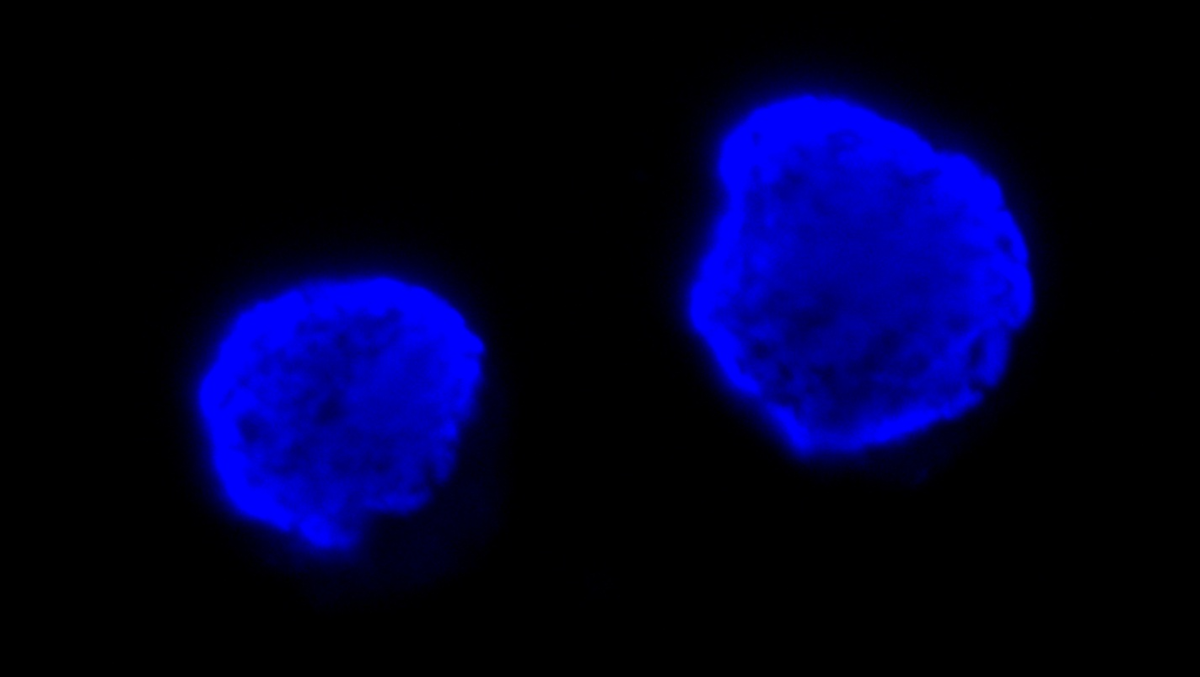
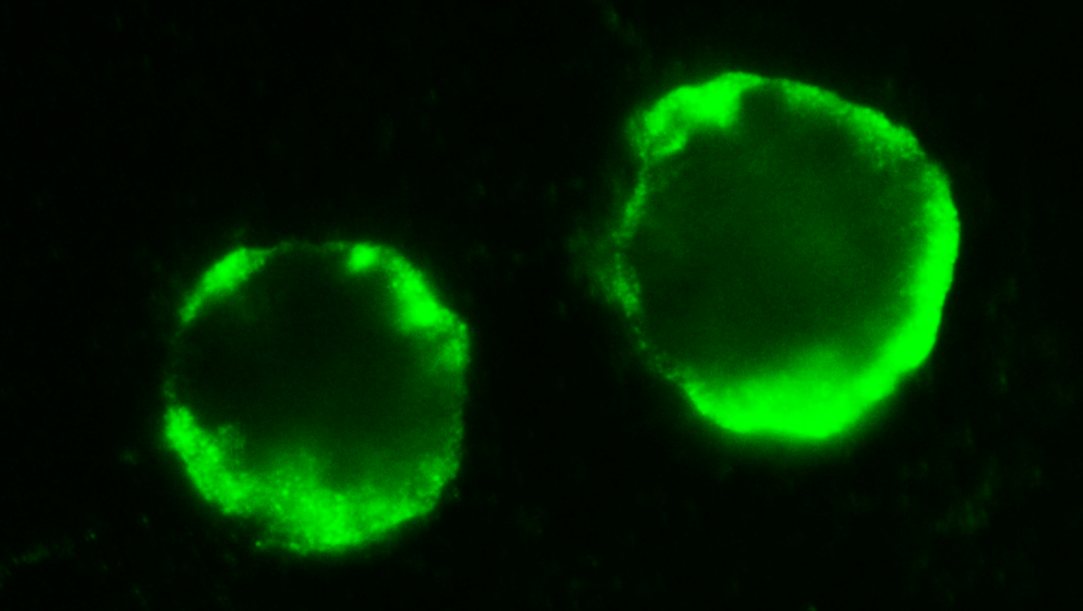
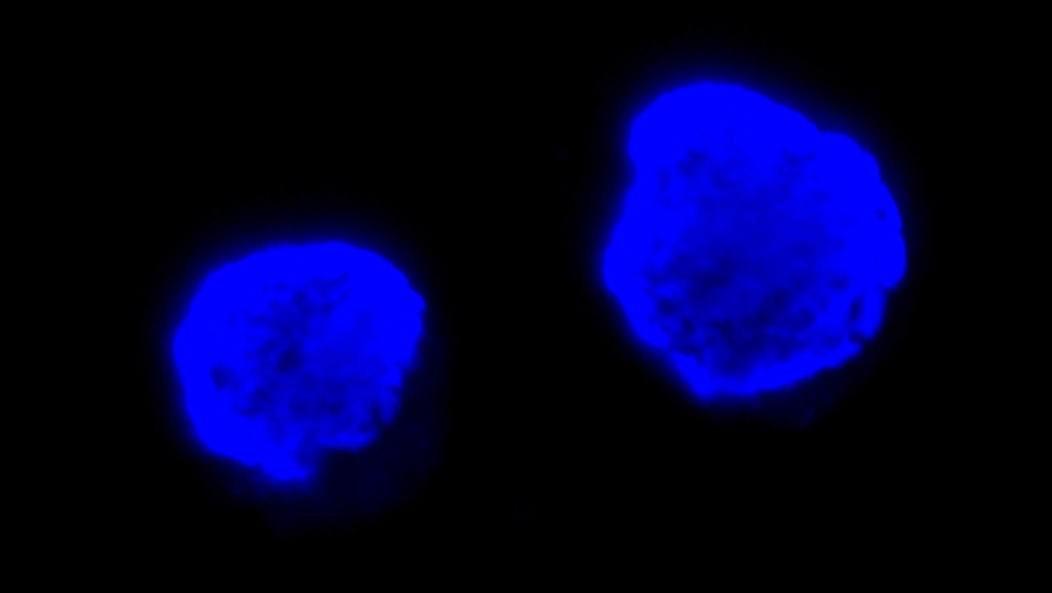
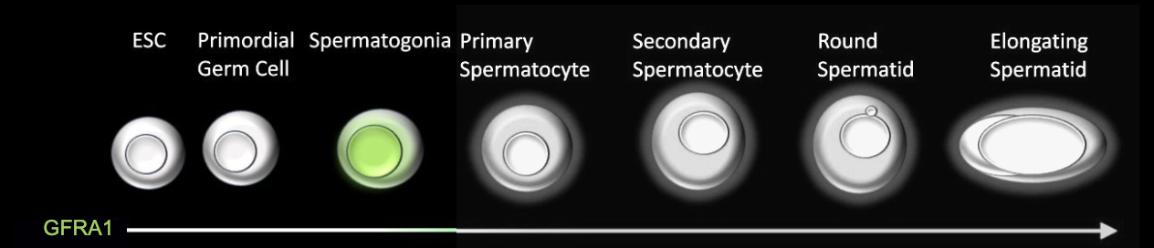
GFRA1
Spermatogonial Stem Cell
DAPI
GFRA1
Merge
Notes:
Next we stained for GFRA1 which is associated with spermatogonial stem cells (click)
(click) We began to find positive staining for this biomarker on Day 7.
Spermatogonial Stem Cells (SSCs) (GFRA1⁺): These are the most primitive sperm precursor cells, residing on the basal membrane
Best Use: Most specific marker for identifying true SSCs in human testes.
Can be bothnucleus/cytoplasm
or glial cell–derived neurotrophic factor receptor alpha 1
Most specific in the membrane of the cell.
seminiferous tubules. They self-renew and produce progenitor spermatogonia.

Slide 19
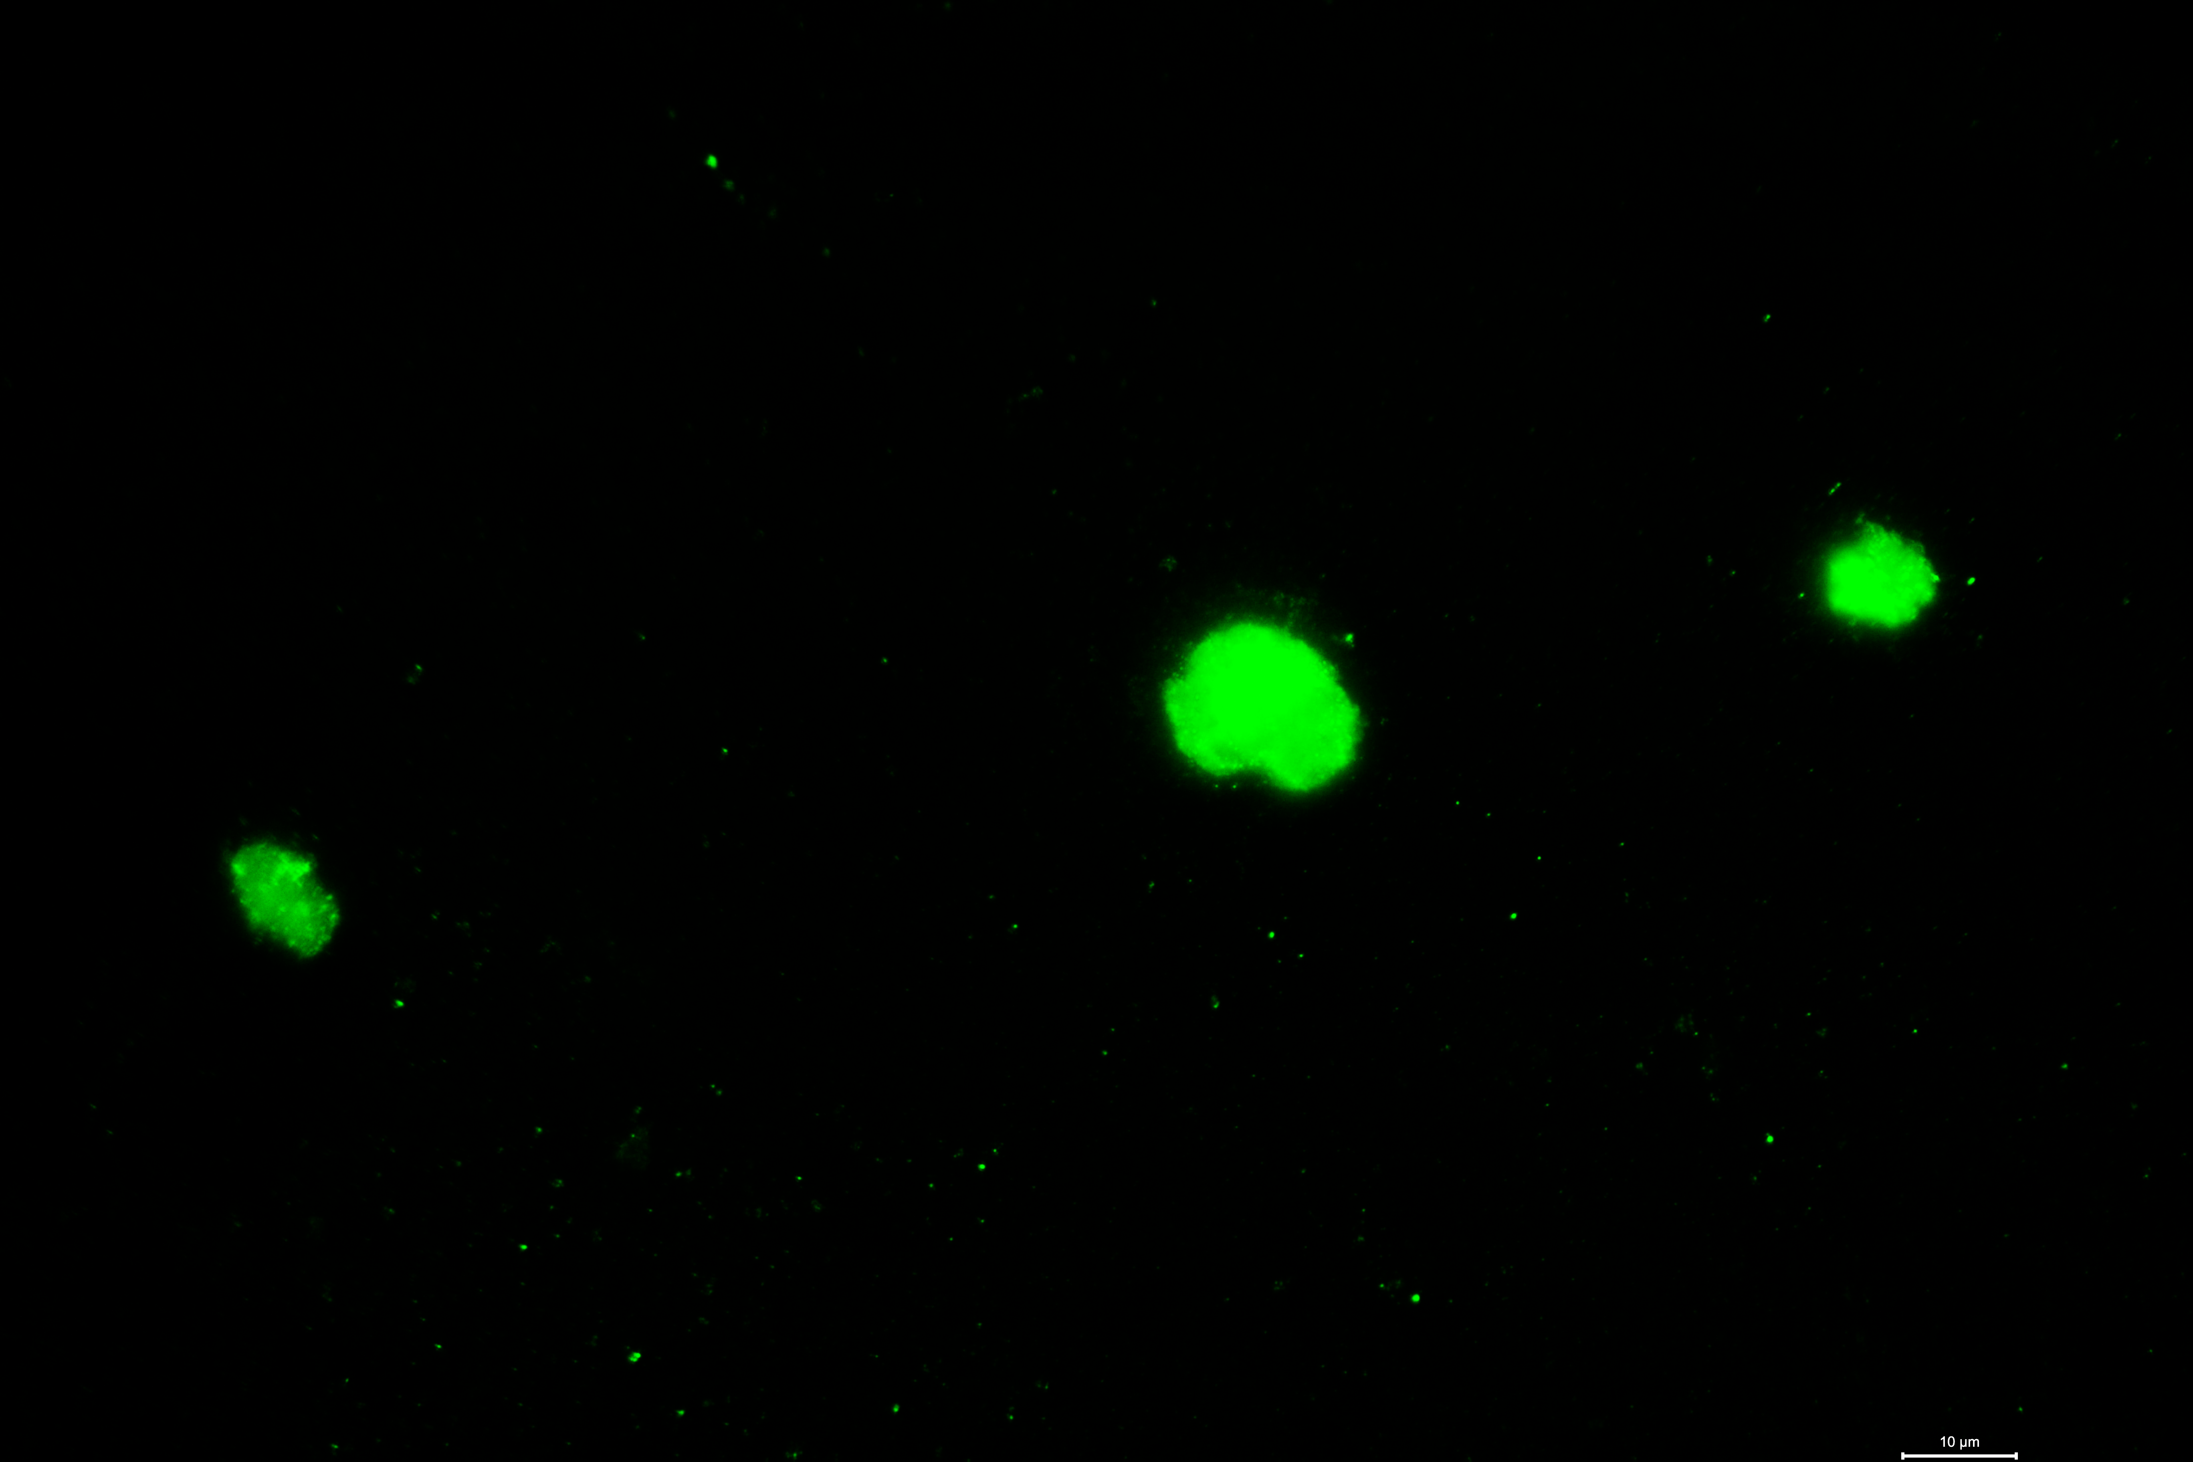
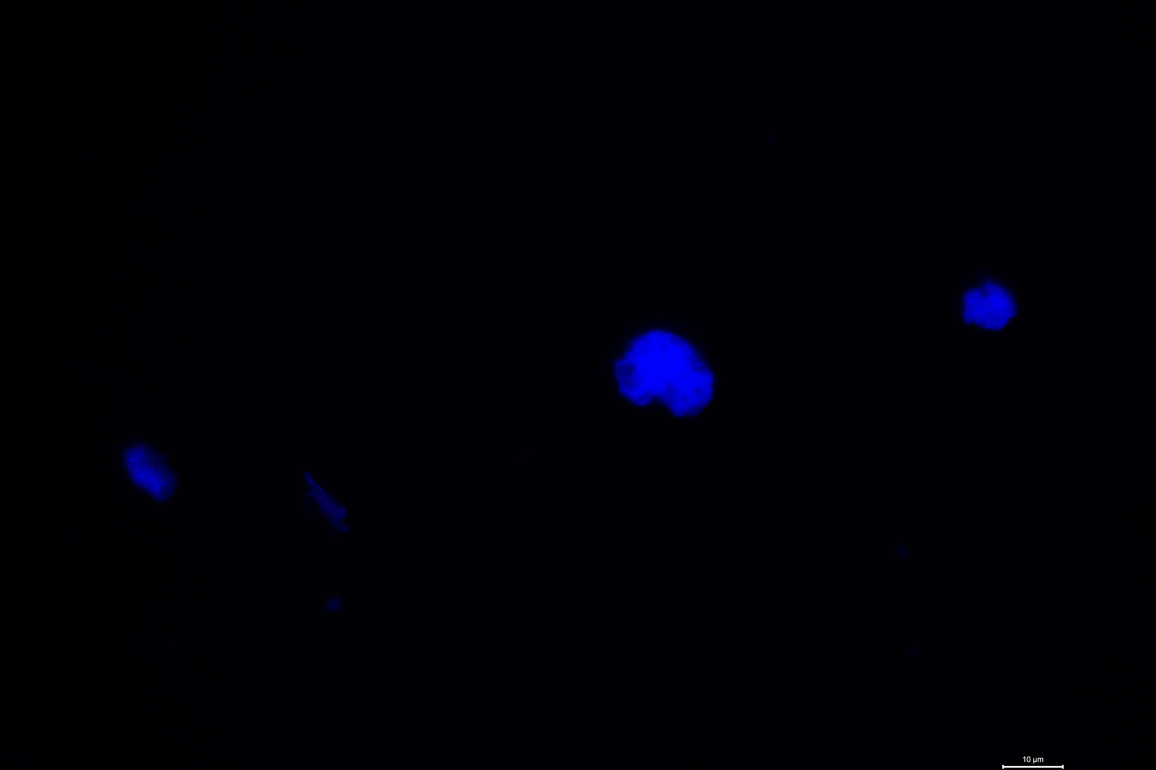
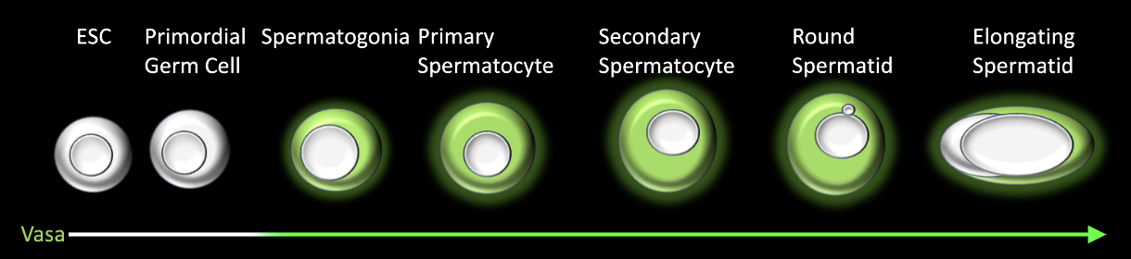
VASA
Spermatogenic Cell
DAPI
Vasa
Merge
VASA
Notes:
VASA is a gene that is specific for germ cell lineage. And is found in spermatogenic cells (click)
(click) These images show positive staining on day 14
D14 HESC

Slide 20
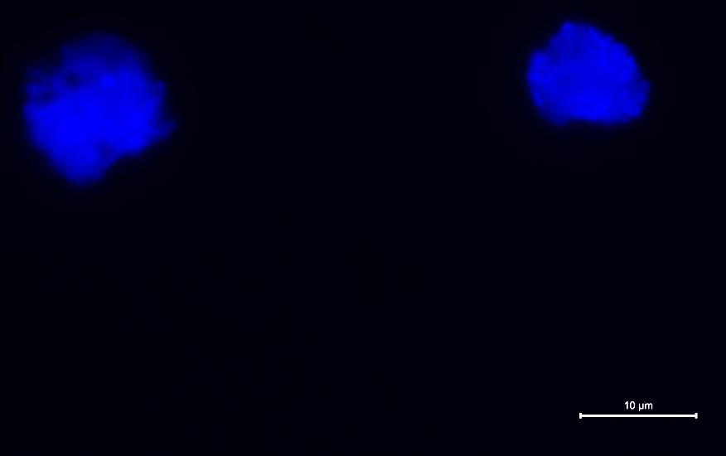
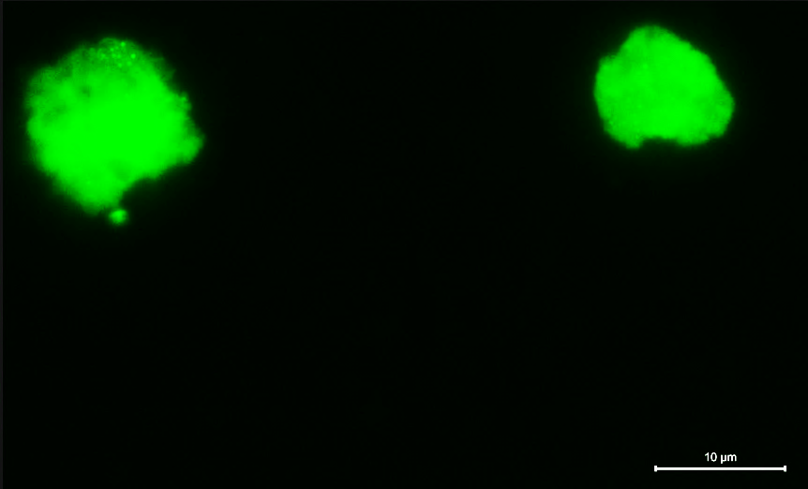
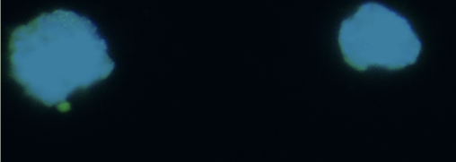
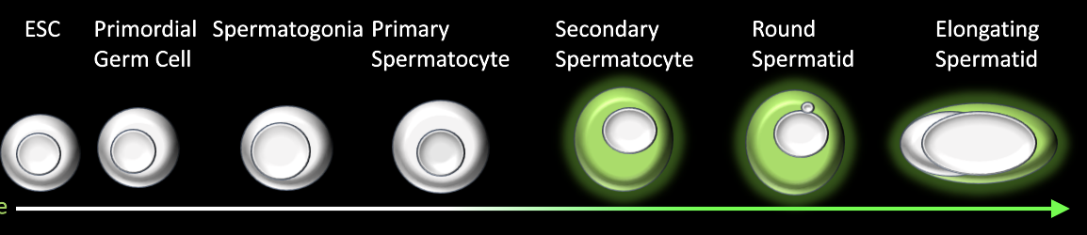
BOULE
Secondary Spermatocyte (Pre-Meiosis II)
DAPI
BOULE
Merge
BOULE
Notes:
BOULE is a protein that plays a role in meiosis and spermatogenesis (click)
Staining is positive at the secondary spermatocyte stage through development of a spermatid
(click) This image is from day 14

Slide 21
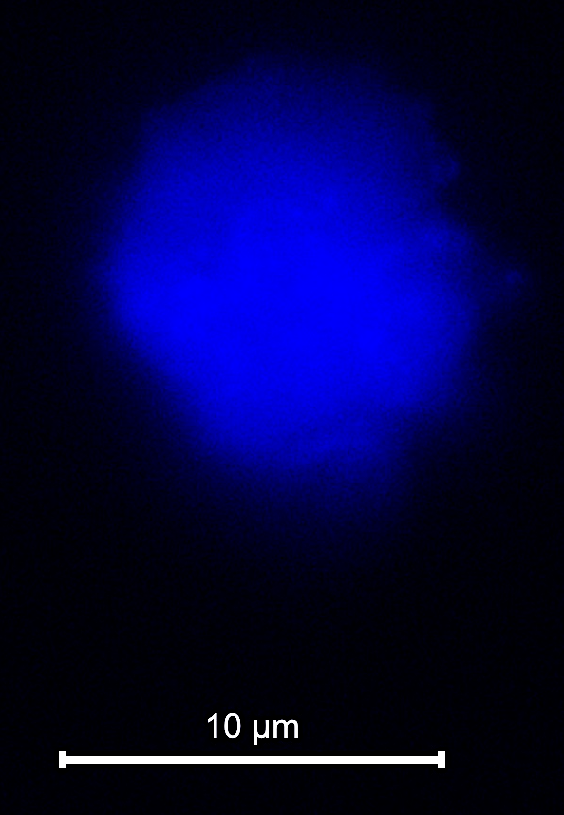
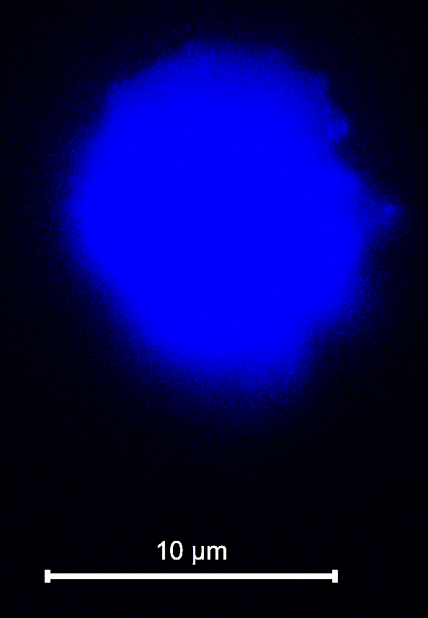
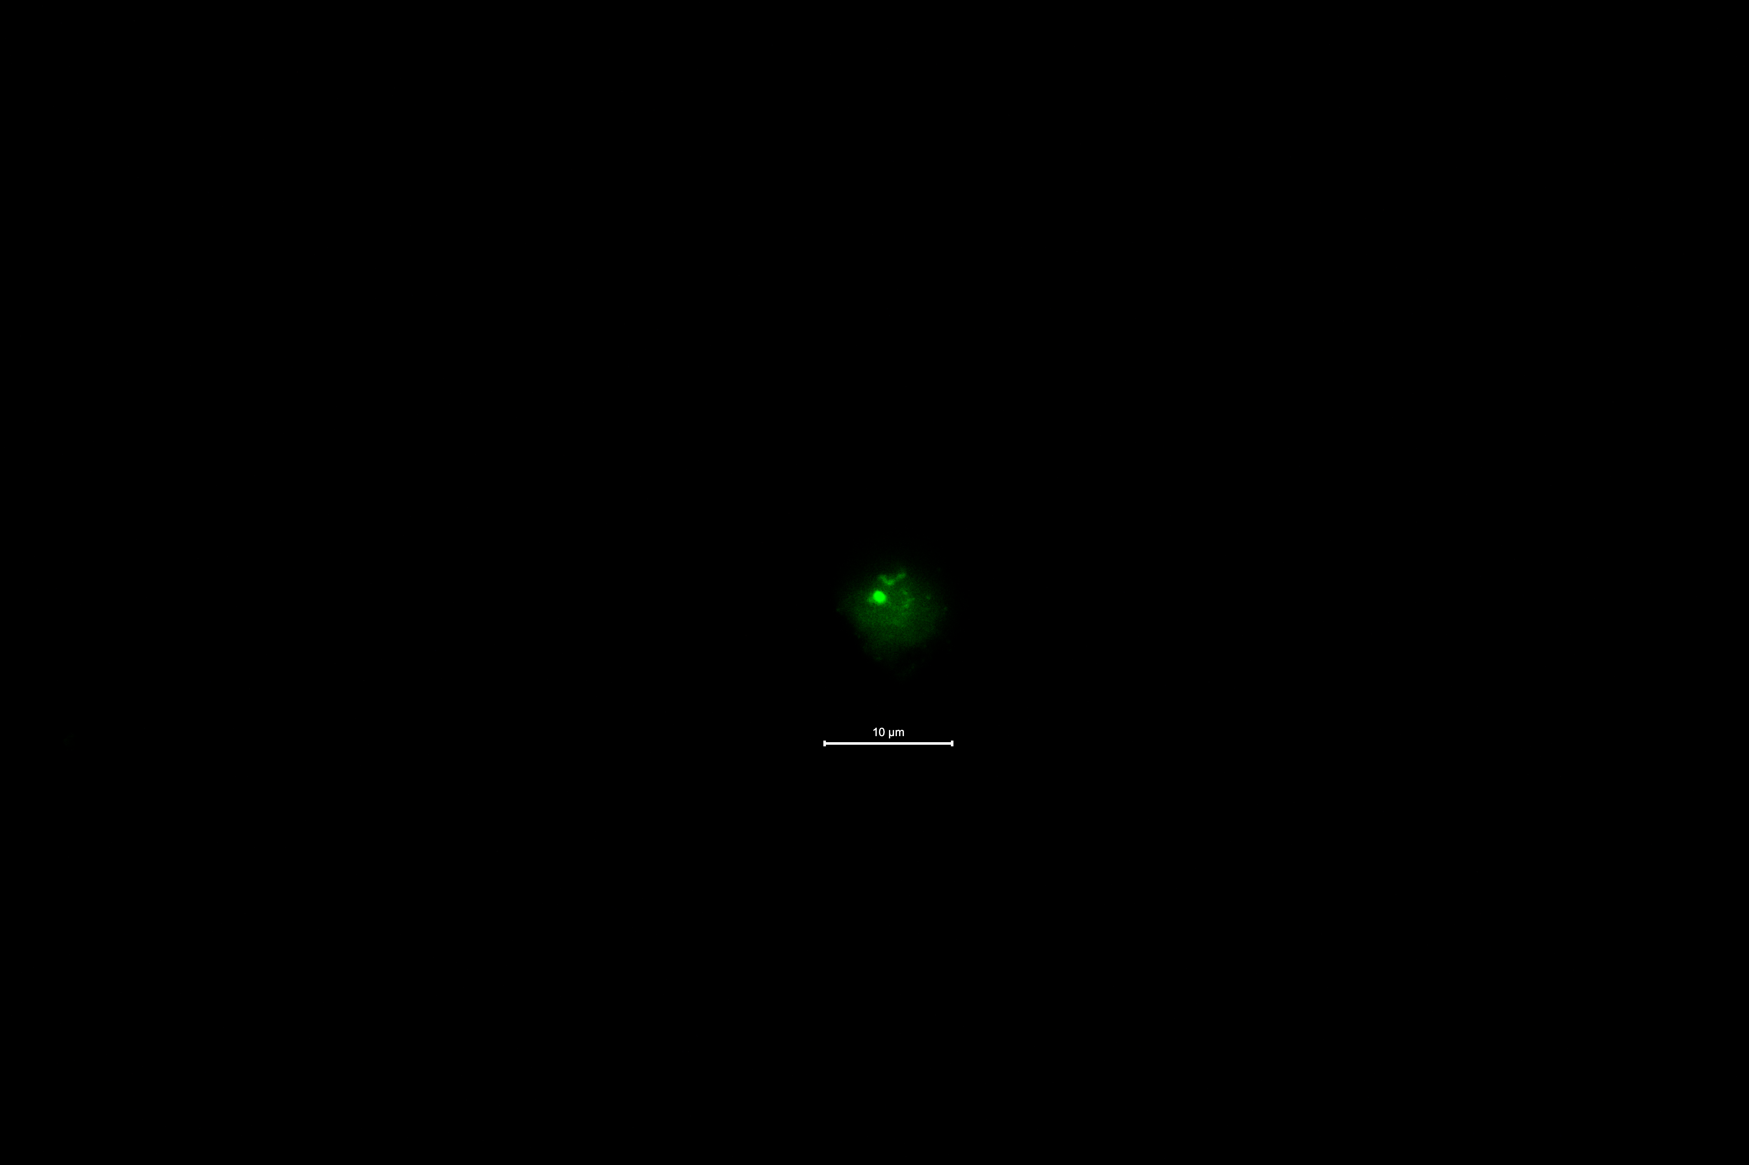
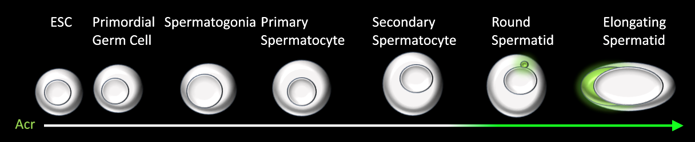
ACROSIN
Spermatid (Post-Meiotic Stage)
DAPI
Acrosin
Merge
ACROSIN
Notes:
Acrosin is a protein essential for sperm penetration of the zona pellucida and is found in spermatids
It is primarily located in the anterior acrosome of mature spermatozoa (click)
(click) These images show localization of acrosin on day 21
and is localized to the inner acrosomal membrane

Slide 22
In Vitro Spermatogenesis - HESCs
Notes:
Here is a graphical depiction of in vitro spermatogenesis in HESCs. ​
(click) We can see that OCT4 decreases with progression of spermatogenesis as pluripotent stem cells differentiate and therefore decrease in number​
(click) Spermatogonia and primary and secondary spermatocytes (shown by GFRA1, VASA and boule) peak around day 7 ​and 14 and then plateau
(click) And lastly we see a small percentage of haploid cells begin to develop around day 21, as shown by ACROSIN​

Slide 23
In Vitro Spermatogenesis – HiPSCs
Notes:
We see similar findings in the HiPSCs group

Slide 24
Progression of Spermatogenesis Between Stem Cell Origins
 | Day 0 |  |  | Day 7 |  |  | Day 14 |  |  | Day 21
 | HESC | HiPSC | P-value | HESC | HiPSC | P-value | HESC | HiPSC | P-value | HESC | HiPSC | P-value
OCT4 % | 93.6 | 91.8 | 0.5 | 77.6 | 61.4 | 0.0001 | 57.9 | 43.5 | 0.02 | 18.6 | 39.4 | 0.0012
GFRA1 % | -- | -- |  | 32.4 | 18.6 | 0.02 | 30.6 | 25.6 | 0.8 | 13.3 | 26.0 | 0.34
VASA % | -- | -- |  | 51.9 | 40.4 | 0.17 | 45.1 | 46.4 | 0.7 | 43.6 | 55.7 | 0.44
BOULE % | -- | -- |  | 19.4 | 14.0 | 0.2 | 33.6 | 31.8 | 0.7 | 24.7 | 25.9 | 0.9
ACROSIN % | -- | -- |  | 0.3 | 0.7 | 0.6 | 1.5 | 1.1 | 0.8 | 2.0 | 3.1 | 0.65
Notes:
This table compares the progression of spermatogenesis between stem cell origins .
Overall there was not much difference between stem cells when comparing biomarker expression.
There was no difference on day 0 with a high percentage of OCT4 in both cells
On day 7, There was a higher percentage of cells that expressed biomarkers consistent with spermatogonium in HESC compared to HiPSC however this became similar as the days progressed
On day 14 and 21, overall the expression of spermatogenesis biomarkers were similar between the two stem cell origins

Slide 25
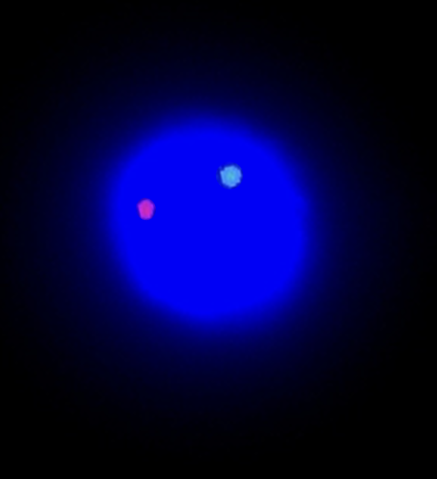
Day 28 FISH Results
HESC:
25% haploid (5/20)
  10% X (2/20)
  15% Y (3/20)
HiPSC:
56% haploid (65/117)
  56% X (65/117)
  0% Y (0/117)
X 18
Y 18
X 18
Notes:
On day 28, we tested the functionality of our differentiated cells.
FISH was performed on both stem cell types on day 28 to confirm haploidy of generated gametes.
Chromosomes included in the FISH analysis were X, Y and 18
FISH results confirmed the presence of haploid cells on day 28 as shown by the presence of fluorescent signals, in one of each color
Of the haploid cells, we found both X and Y chromosomes in the HESCs and only X chromosomes in HiPSCs
This is consistent with other studies that have demonstrated haploidy in vitro at 30 days.

Slide 26
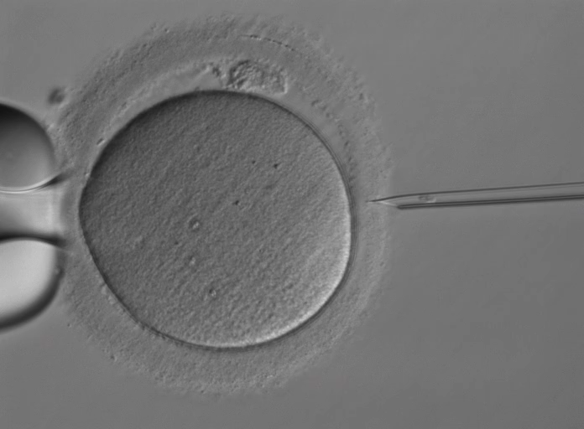
Putative Spermatid Injection
Notes:
On day 28, we performed an injection of differentiated cells into thawed donated human oocytes of a 32 year old patient who had disposition for research use.
On day of injection, cells were evaluated for possible injection.
There was a mixture of various appearing cells.
For example, some cells had sperm like appearance as shown on the left. Other cells were spherical and varied in size. Smaller cells that shared similarities to sperm such as having a sperm like head, were selected for injection. (click)
Here is a video of our injection into a MII oocyte (play)
artificial oocyte activation was also performed using 50mM Calcium ionophore to further assist with fertilization

Slide 27
Day 28 Fertilization Results
 | Control ICSI | HESC injection | HiPSC injection
Injected | 2 | 7 | 3
Survived (%) | 1 (50) | 6 (85.7) | 2 (67)
Activated (%) | 1 (100) | 4 (66.7) | 2 (100)
Fertilization (%) | 1 (100) | 1* (16.7) | 0 (0)
Blastocyst (%) | 1 (100) | 0 (0) | 0 (0)
* Arrested at 2-cell stage
Notes:
This table shows the fertilization results from day 28.
We allocated 2 oocytes as a control group which was injected with donor sperm. This resulted in one blastocyst and confirms that the oocyte is capable of pre-implantation embryo development.
7 oocytes were allocated to the HESC.
4/6 oocytes were activated with expulsion of a 2nd polar body. There were 3 1PN and 1 2PN zygotes.
the 2PN zygote however arrested at the 2-cell stage.
3 oocytes were allocated to HiPSCs resulting in 2 1PN zygotes

Slide 28
Conclusions
Goal to assist NOA men with spermatogenic arrest or germ cell aplasia
We attempted translational research on the basis of our animal model using HESCs or HiPSCs
  Spherification created a 3D niche
  Human in vitro spermatogenesis completed post-meiosis to yield haploid cells
Cryopreserved donated human oocytes are a suitable model
Currently have preliminary results
Aim at achieving full pre-implantation development and embryo ploidy assessment
Notes:
In conclusion, the goal of our project involves in vitro spermatogenesis to assist NOA men with spermatogenic arrest or germ cell aplasia.
(click) We attempted translational research on the basis of our animal model, now using HESCs and HiPSCs
Our Spherification model is easily reproducible and created a 3D niche which allowed for Human in vitro spermatogenesis to complete post-meiosis and yield haploid cells
(click) We found that cryopreserved donated human oocytes are a ideal model to test functionality of our de novo gametes
(click) We currently have preliminary results and will be performing more spermatogenic biomarker analysis and injections as the cells continue to be maintained within the spheres
(click) the goal is to achieve pre-implantation development and embryo ploidy assessment

Slide 29
Next Steps
Finetuning the techniques:
  Cell extraction
  More biomarkers
  Modify cell micromanipulation to optimize syngamy
Full pre-implantation development by time-lapse
DNAseq of the conceptus
Notes:
Next steps include ways to finetune techniques to improve fertilization outcomes.
First is focusing on cell extraction and improving viability of stem cells
We also plan on using more biomarkers to better characterize progression of spermatogenesis.
And plan to improve our injection technique by:
selecting spherical appearing cells for injection
assisting with fusion of cellular membranes (syngamy- fusion of two cells, or of their nuclei, in reproduction)
Use PLC𝜁 for artificial oocyte activation
Ultimately we plan on observing full pre-implantation development by time lapse and the performing DNA sequencing on the embryos to confirm epigenetics.
where we plan to break down the spheres without using trypsin in order to improve viability of stem cells
Trypsin may damage the membrane of the cells leading to poor viability

Slide 30
Acknowledgements
Ferring Pharmaceuticals
PCRS
Notes:
I again want to thank Ferring for supporting this project and PCRS for the opportunity to present my research

Slide 31
Acknowledgements
Gianpiero Palermo, MD PhD
Andrology Lab
Eros Lari
Philip Xie
Stephanie Cheung
Lily Ng
Angela DeJesus
Olena Kocur
Kevin Zu
Belinda Zhang
Zev Rosenwaks, MD
Rodriq Stubbs, NP
Embryology Lab
Notes:
And I want to acknowledge my supportive team at Cornell, especially the mentorship of Dr. Palermo

Slide 32
References
Ng L, Kocur OM, Xie P, Cheung S, Schlegel P, Rosenwaks Z, et al. Timing of Testicular Biopsy in Relation to Oocyte Retrieval and the Outcomes of Intracytoplasmic Sperm Injection. Journal of Urology [Internet]. 2024
Richer G, Vanhaecke T, Rogiers V, Goossens E, Baert Y. Mouse In Vitro Spermatogenesis on 3D Bioprinted Scaffolds. Methods Mol Biol. 2024;2770:135-149
Zhang D, Jin W, Cui Y, He Z. Establishment and Characterization of Testis Organoids with Proliferation and Differentiation of Spermatogonial Stem Cells into Spermatocytes and Spermatids. Cells. 2024 Oct 2;13(19):1642
Xu, H., Yang, M., Tian, R. et al. Derivation and propagation of spermatogonial stem cells from human pluripotent cells. Stem Cell Res Ther 11, 408 (2020)
Sharma, R., Agarwal, A. (2011). Spermatogenesis: An Overview. In: Zini, A., Agarwal, A. (eds) Sperm Chromatin. Springer, New York, NY
Yuan Y, Li L, Cheng Q, Diao F, Zeng Q, Yang X, Wu Y, Zhang H, Huang M, Chen J, Zhou Q, Zhu Y, Hua R, Tian J, Wang X, Zhou Z, Hao J, Yu J, Hua D, Liu J, Guo X, Zhou Q, Sha J. In vitro testicular organogenesis from human fetal gonads produces fertilization-competent spermatids. Cell Res. 2020 Mar;30(3):244-255
McKnight M, Lawrence S, Xie P, Rosenwaks Z, Palermo G. Male haploid cells through direct spherification. Fertil Steril. 2023 Apr;119(4):701-702
Argarwal AA, Baskaran S, Parekh N, Cho CL, Henkel R, Vij S, Mohamed A, Manesh Kumar PS, Shah R. Male Infertility. 2021. The Lancet, 397 (10271) 319 –333
Kobori Y, Suzuki K, Iwahata T, Shin T, Sato R, Nishio K, Yagi H, Arai G, Soh S, Okada H. Induction of spermatogenesis by rhFSH for azoospermia due to spermatogenic dysfunction with maturation arrest: five case series. Syst Biol Reprod Med. 2015 Jun;61(3):168-70.
Hussein A, Ozgok Y, Ross L, Rao P, Niederberger C. Optimization of spermatogenesis-regulating hormones in patients with non-obstructive azoospermia and its impact on sperm retrieval: a multicentre study. BJU Int. 2013 Mar;111(3 Pt B):E110-4.

Slide 33
Thank you!

