Slide 1
OVARIAN STIMULATION OUTCOMES IN INDIVIDUALS WITH PATHOGENIC VARIANTS ASSOCIATED WITH INCREASED RISK OF HEREDITARY GYNECOLOGICAL CANCER SYNDROMES
Greysha Rivera-Cruz MD, Leeann Bui MD, Elizabeth Sherwin MPH, Robyn Service NP, Anna Sokalska MD

Slide 2
Disclosure
Nothing to disclose

Slide 3
Background
Most malignancies are due to sporadic events
10% of cancers are associated with a hereditary predisposition syndrome
Breast cancer is the most common cancer of adolescents and young adults (AYA)
50% of AYA harbor a pathogenic/likely pathogenic (P/LP) variants in BRCA1 or BRCA2 gene
Dias-Nunes et al., Int. J. Mol. Sci., 2024, Cathcart-Rake et al., JCO Oncol 2021
Notes:
Around 10% of cancers are associated with a hereditary predisposition syndrome affecting women in reproductive ages
Cathcart-Rake EJ, Ruddy KJ, Bleyer A, Johnson RH. Breast Cancer in Adolescent and Young Adult Women Under the Age of 40 Years. JCO Oncol Pract. 2021 Jun;17(6):305-313. doi: 10.1200/OP.20.00793. Epub 2021 Jan 15. PMID: 33449828.
Dias Nunes J, Demeestere I, Devos M. BRCA Mutations and Fertility Preservation. International Journal of Molecular Sciences. 2024; 25(1):204. https://doi.org/10.3390/ijms25010204

Slide 4
Background
Pathogenic and likely pathogenic (P/LP) variants in genes involved in the double stranded DNA repair pathway:
Alter the ovarian function by impairing DNA repair
Accumulation of DNA double strand breaks
Oocyte apoptosis and early ovarian aging
Increase the risk of diminished ovarian reserve (DOR)
Porcu et al., JARG 2020, Denis-Laroque et al., Breast 2021, Dias-Nunes et al., Int. J. Mol. Sci., 2024
Notes:
ARROW DOWN
Previous studies suggest that disease-causing variants in the BRCA1/2 pathway alter ovarian function by impairing DNA repair, leading to oocyte apoptosis, early ovarian aging and increased risk of diminished ovarian reserve (1, 2). The effects of other hereditary cancer gene variants are not well studied. We hypothesize that patients with pathogenic germline variants in the genes associated with an increased risk of ovarian, endometrial or breast cancers may have reduced oocyte yield and maturation rates during controlled ovarian stimulation. Understanding this possible association is crucial for improving patient counseling and fertility outcomes in women at risk.
1.Porcu E, Cillo GM, Cipriani L, Sacilotto F, Notarangelo L, Damiano G, Dirodi M, Roncarati I. Impact of BRCA1 and BRCA2 mutations on ovarian reserve and fertility preservation outcomes in young women with breast cancer. J Assist Reprod Genet. 2020 Mar;37(3):709-715. doi: 10.1007/s10815-019-01658-9. Epub 2019 Dec 24. PMID: 31872386; PMCID: PMC7125060.
2.Wang ET, Pisarska MD, Bresee C, Chen YD, Lester J, Afshar Y, Alexander C, Karlan BY. BRCA1 germline mutations may be associated with reduced ovarian reserve. Fertil Steril. 2014 Dec;102(6):1723-8. doi: 10.1016/j.fertnstert.2014.08.014. Epub 2014 Sep 23. PMID: 25256924; PMCID: PMC4372188.

Slide 5
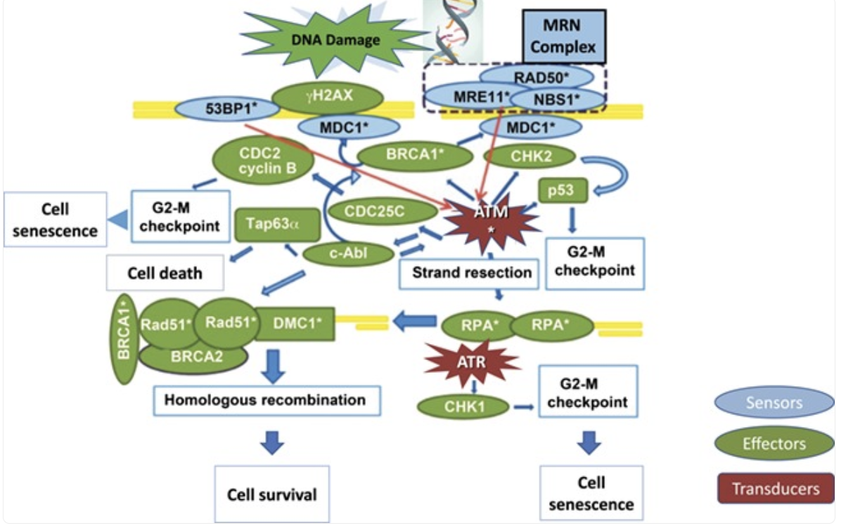
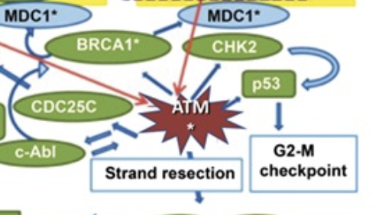
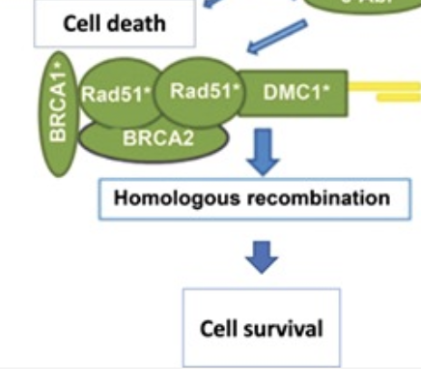
Background
Turan et al., 2020 Hum Reprod Update
Notes:
These genes are cell cycle gatekeepers, acts a tumor suppressor genes
Some are important for cell cycle arrest G2-M and others are part of the DNA repair system wich starts with strand resection in order to do homologous recombination and cell survival.
WHEN YOU HAVE PATHOGENIC VARIANTS THAT LOSS OF Fx THEIR FUNCTION,N you have an DEFICIENT PATHWAY
MECHANISM OF ACTION IS LOSS OF FX
BRCA1 also plays a role in cell cycle checkpoint activation.
Its interaction with BARD1 promotes the phosphorylation of p53 by ATM, leading
to the transcription of p21 and cell cycle arrest in the G1 phase.
BRCA2 is mainly involved in DNA repair through HR but is also involved in intrastrand
crosslinks (ICLs) [46] and programmed DSBs during meiosis. Moreover, it has also
been shown that BRCA2 is
Notably,
reduced expression of Brca1 was observed in metaphase II (MII)-arrested eggs from old
mice compared to younger ones [81]. Similarly, a decrease in BRCA1 expression and its
activated state, p-BRCA1, was observed
WHEN YOU HAVE PATHOGENIC VARIANTS THAT ALTER THEIR FUNCTUION you have an DEFICIENT PATHWAY
Turan V, Oktay K. BRCA-related ATM-mediated DNA double-strand break repair and ovarian aging. Hum Reprod Update. 2020 Jan 1;26(1):43-57. doi: 10.1093/humupd/dmz043. PMID: 31822904; PMCID: PMC6935693.

Slide 6
Background
Reproductive data are conflicted on the association between gynecological associated cancer risk genes and DOR
BRCA1 > BRCA2 P/LP carriers*
Lower AMH levels and less mature oocytes
Comparable AMH, controlled stimulation response and number of mature oocytes in patients with/without history of malignancy**
*Wang et al., Fertil Steril 2014, Oktay et al., J Clin Oncol 2010
**Shapira et al., Fertil Steril 2015, Grynberg et al., Hum Reprod 2019, Gunnala et al., Fertil Steril 2019
Notes:
CONFLICTING DATA ON WHETHER BRCA1/2 ALTER FERTILITY AND THERFORE REPRODUCTIVE OUTCOMES
-research question is too much text , take out the adjustment , alternatively you can just present the hypothesis if want to save time

Slide 7
Background
Reproductive outcomes of individuals with other hereditary cancer risk genes have not been studied
Patient counseling
Managing expectations
Outcomes in individuals at risk
Notes:
EXPLORATORY STUDIES LIKE THIS ARE REQUIRED TO ASSESS POSSIBLE ASSOCIATIONS

Slide 8
Hypothesis
Individuals with P/LP variants in risk genes* associated with gynecological cancers may have reduced oocyte yield and maturity during controlled ovarian stimulation
*Genes of interest: BRCA1, BRCA2, BRIP1, PALB2, RAD51C, RAD51D, MLH1, EPCAM/MSH2, MSH6, PMS2, ATM, BARD1, CDH1, CDKN2A, CHEK2, NF1, PTEN, STK11 and TP53
Notes:
GYNECOLOGICAL CANCERS INCLUDING braest ovarian and endometrial cancer
Are there any differences observed in patients with personal history of cancer vs. no history of cancer?
Do BRCA1/2 pathogenic variant carriers have lower oocyte and maturation yield?

Slide 9
Methods
Retrospective cohort study conducted in a single academic institution between 2018 and 2025
Patient with P/LP genetic variants (N=26) and controls (N=52)
Primary outcome: Total dose of gonadotropins, stimulation days and mature oocytes
Comparison was done using Wilcoxon rank sum test
Significance level of alpha=0.05
Multivariable regression models were conducted adjusting for age and AMH
Notes:
Linear regression was used for the continuous outcome of gonadotropin dose
Poisson regression with robust standard errors was used for all other count outcomes.
Analyses were conducted in R version 4.4.1.

Slide 10
Results
Genes | Number of cases (N=26)
BRCA1 | 7
BRCA2 | 5
Lynch syndrome (MSH2, PMS2 MLH1, MSH6) | 4
PALB2 | 4
CHEK2 | 2
TP53 | 1
BRIP1 | 1
NF1 | 1
ATM | 1
Notes:
OUR COHORT IS COMPOSED PRIMARILY WITH PATINET WITH BRCA1, FOLLOWED BY BRCA2 AND LYNCH, PALB2
PRELIMINARY ABSTRACT WITH FEWER PATIENTS SHOWED STATISTICAL SIGNIFICANT IN TOTAL OF GONADOTROPIN DOSE

Slide 11
Results
Table 1. Ovarian stimulation outcomes among individuals with P/LP variants
 | P/LP variants (N = 26) Median (Q1, Q3) | Controls (N = 52) Median (Q1, Q3) | p-value
Age | 35 (32, 39) | 35 (32, 38) | 0.852
AMH | 1.88 (0.82, 2.86) | 2.09 (1.21, 4.03) | 0.393
AFC | 11 (7, 17) | 12 (8, 18) | 0.504
Total days of stimulation | 11 (10, 12) | 10 (9, 11) | 0.076
Total dose of gonadotropins | 3,900 (3,319, 4,500) | 3,600 (2,625, 4,125) | 0.200
Total number of oocyte retrieved | 11 (7, 19) | 12 (8, 21) | 0.541
Total number of MIIs | 8 (5, 16) | 10 (6, 17) | 0.429
Notes:
PRELIMINARY DATA FEWER PATIENTS, AND STATISTICAL SIGNIFICANT
ALTHOUGH NON TATISTICAL SIGNICANT WE SAW SOME TRENDS, NOT CLINICALLY RELEVANT ONE MORE DAY OF MEDICATION S
IN ORDER TO OBTAIN THE A COMPARABLE NUMBER OF MATURE OOCYTES CASES- PATIENT WITH PATH VARIANTS
REQUIRED FSH ~300 UNITS MORE UNITS AND TOOK ONE DAY LONGER

Slide 12
Results
Table 2. Ovarian stimulation outcomes among individuals P/LP variants and personal history of cancer (Cancer) compared to those without history of cancer (No cancer)
 | Cancer (N = 11) Median (Q1, Q3) | No Cancer (N = 15) Median (Q1, Q3) | p-value
Age | 35 (33, 39) | 33 (32, 39) | 0.714
AMH | 1.74 (1.24, 3.42) | 1.93 (0.60, 2.71) | 0.568
AFC | 10 (7, 17) | 11 (7, 17) | 0.835
Total days of stimulation | 11 (10, 12) | 10 (10, 11) | 0.438
Total dose of gonadotropins | 4,050 (3,375, 4,950) | 3,600 (3,338, 4,275) | 0.450
Total number of oocyte retrieved | 9 (8, 25) | 11 (8, 16) | 0.755
Total number of MIIs | 8 (4, 15) | 8 (6, 15) | 0.775
Notes:
Not clinical significant
Among the patients with pathogenic variant, the cases.
POTENTIALLY-
450 units 11 days and M2s were comparable
Cancer patients- survival vs. after chemo or before chemo
Cancer survivors
Secondary to prior chemotherapy

Slide 13
Results
Table 3. Ovarian stimulation outcomes among individuals P/LP variants and personal history of cancer (Cancer) compared to Controls
 | Cancer (N = 11) | Control (N = 52) | p-value
Age | 35 (33, 39) | 35 (32, 38) | 0.643
AMH | 1.74 (1.24, 3.42) | 2.09 (1.21, 4.03) | 0.856
AFC | 10 (7, 17) | 12 (8, 18) | 0.730
Total days of stimulation | 11 (10, 12) | 10 (9, 11) | 0.077
Total dose of gonadotropins | 4,050 (3,375, 4,950) | 3,600 (2,625, 4,125) | 0.203
Total number of oocyte retrieved | 9 (8, 25) | 12 (8, 21) | 0.877
Total number of MIIs | 8 (4, 15) | 10 (6, 17) | 0.485
Notes:
Not clinical significant
Among the patients with pathogenic variant, the cases.
POTENTIALLY-
450 units 11 days and M2s were comparable
Cancer patients- survival vs. after chemo or before chemo
Cancer survivors
Secondary to prior chemotherapy

Slide 14
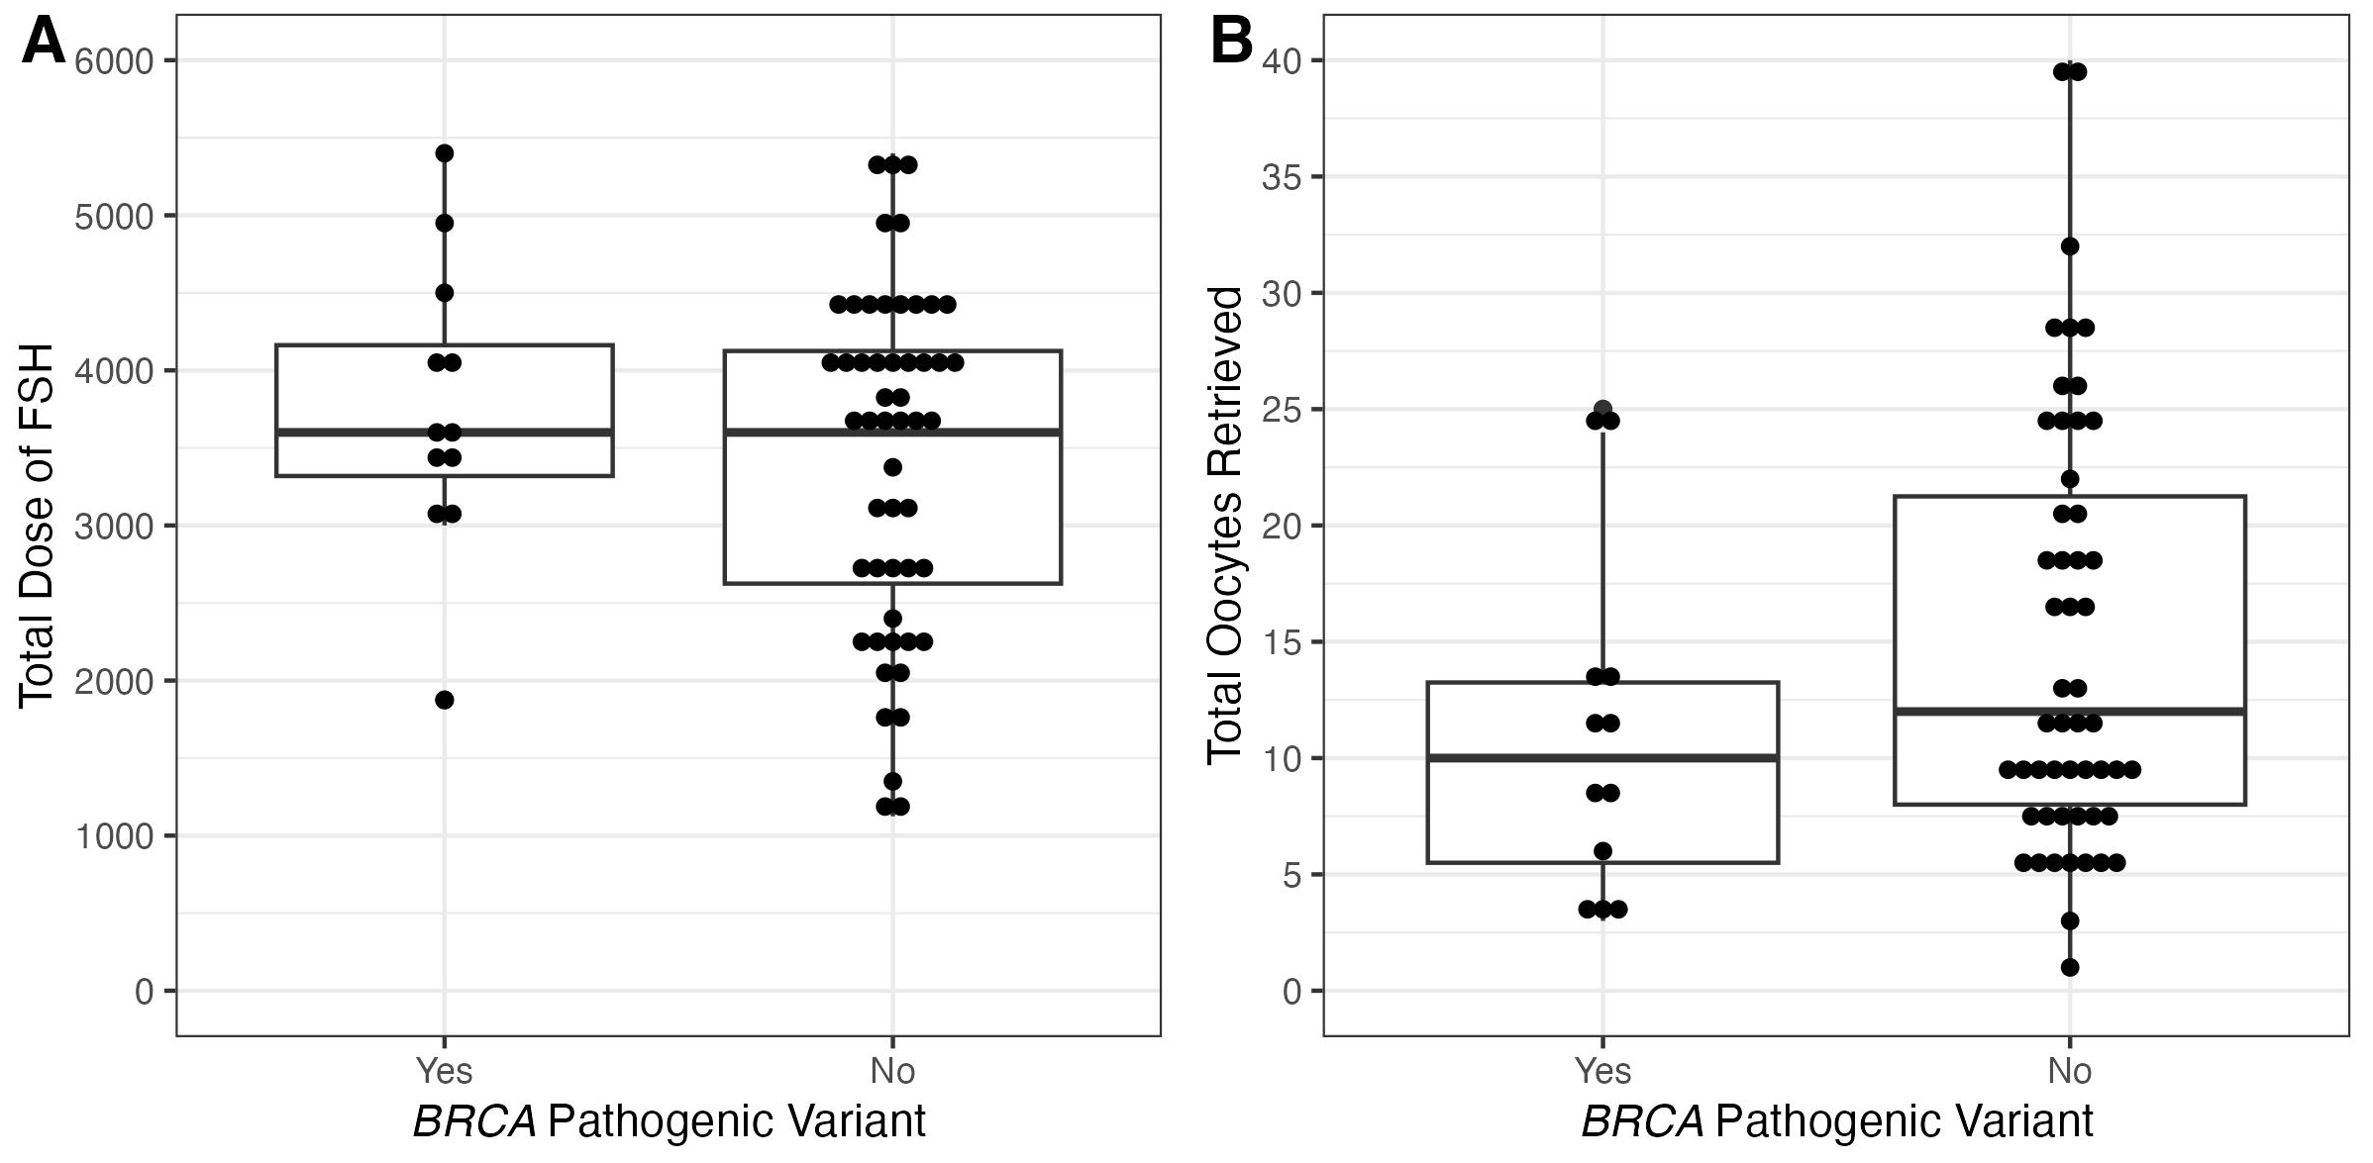
Results
Figure 1. Total Gonadotropins dose and oocytes yield in BRCA1/2 pathogenic variant carriers compared to controls
Notes:
COMPARABLE numbers

Slide 15
Conclusions
No statistically significant difference observed in the primary outcome among the two groups
Individuals with P/LP variants in gynecological may require higher doses of gonadotropins during controlled ovarian stimulation (~300 units more)
Individuals with P/LP variants and personal history of cancer may require ~450 units more of gonadotropins to achieve the same number of mature oocytes
BRCA1/2 P/LP variant carriers failed to show significant differences on total gonadotropin dose and oocyte yield when compared to controls
Notes:
WHILE IS NOT STATS SIGNIFICANT........
Results should be interpreted with caution
BRCA1/2 with and w/o history of cancer

Slide 16
Strengths
One of the few studies using controls adjusted for age and AMH
First retrospective study analyzing other genetic hereditary gynecological syndromes besides BRCA1/2 genes
Limitations
Small cohort
Single academic IVF center
Pregnancy outcomes
Future directions
Expand cohort of individuals with P/LP variants
Multicenter collaborations
Notes:
of patients to make generalizable conclusions
Aneuploidy- pregnancy? MEIOSIS ERRORS
Pregnancy outcomes that we cant talk about egg quality
FUTURE DIRECTIONS?

Slide 17
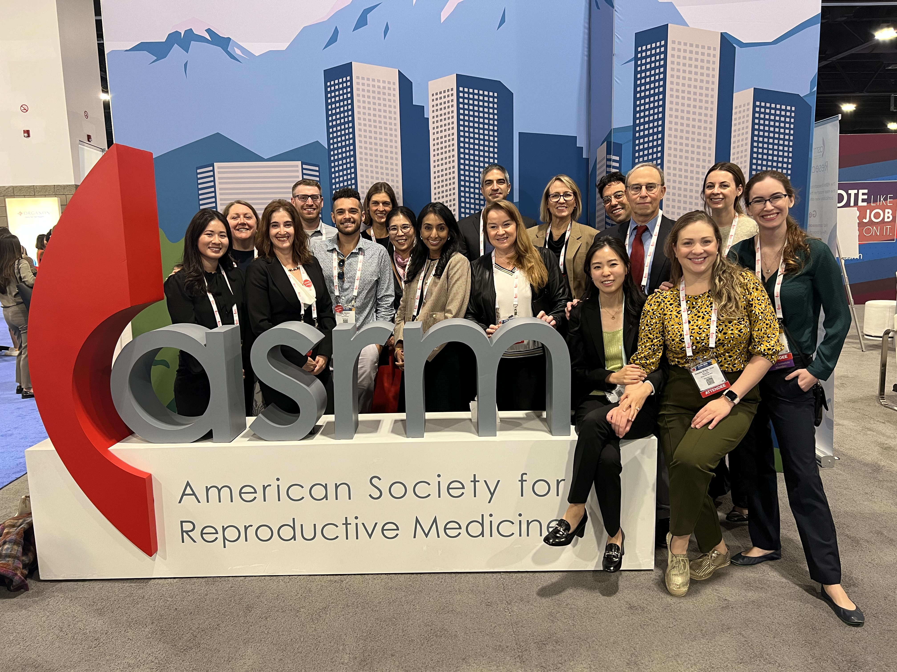
Gracias

Slide 18
References
Cathcart-Rake EJ, Ruddy KJ, Bleyer A, Johnson RH. Breast Cancer in Adolescent and Young Adult Women Under the Age of 40 Years. JCO Oncol Pract. 2021 Jun;17(6):305-313. doi: 10.1200/OP.20.00793. Epub 2021 Jan 15. PMID: 33449828.
Dias Nunes J, Demeestere I, Devos M. BRCA Mutations and Fertility Preservation. International Journal of Molecular Sciences. 2024; 25(1):204. https://doi.org/10.3390/ijms25010204
Denis-Laroque L, Drouet Y, Plotton I, Chopin N, Bonadona V, Lornage J, Salle B, Lasset C, Rousset-Jablonski C. Anti-müllerian hormone levels and antral follicle count in women with a BRCA1 or BRCA2 germline pathogenic variant: A retrospective cohort study. Breast. 2021 Oct;59:239-247. doi: 10.1016/j.breast.2021.07.010. Epub 2021 Jul 12. PMID: 34304065; PMCID: PMC8326804.
Derks-Smeets IAP, van Tilborg TC, van Montfoort A, Smits L, Torrance HL, Meijer-Hoogeveen M, Broekmans F, Dreesen JCFM, Paulussen ADC, Tjan-Heijnen VCG, Homminga I, van den Berg MMJ, Ausems MGEM, de Rycke M, de Die-Smulders CEM, Verpoest W, van Golde R. BRCA1 mutation carriers have a lower number of mature oocytes after ovarian stimulation for IVF/PGD. J Assist Reprod Genet. 2017 Nov;34(11):1475-1482. doi: 10.1007/s10815-017-1014-3. Epub 2017 Aug 22. PMID: 28831696; PMCID: PMC5699993.
Gunnala V, Fields J, Irani M, D'Angelo D, Xu K, Schattman G, Rosenwaks Z. BRCA carriers have similar reproductive potential at baseline to noncarriers: comparisons in cancer and cancer-free cohorts undergoing fertility preservation. Fertil Steril. 2019 Feb;111(2):363-371. doi: 10.1016/j.fertnstert.2018.10.014. Epub 2018 Dec 6. PMID: 30527950.
Grynberg M, Dagher Hayeck B, Papanikolaou EG, Sifer C, Sermondade N, Sonigo C. BRCA1/2 gene mutations do not affect the capacity of oocytes from breast cancer candidates for fertility preservation to mature in vitro. Hum Reprod. 2019 Feb 1;34(2):374-379. doi: 10.1093/humrep/dey358. PMID: 30561604.
Oktay K, Kim JY, Barad D, Babayev SN. Association of BRCA1 mutations with occult primary ovarian insufficiency: a possible explanation for the link between infertility and breast/ovarian cancer risks. J Clin Oncol. 2010 Jan 10;28(2):240-4. doi: 10.1200/JCO.2009.24.2057. Epub 2009 Dec 7. Erratum in: J Clin Oncol. 2010 Oct 20;28(30):4664. PMID: 19996028; PMCID: PMC3040011.
Porcu E, Cillo GM, Cipriani L, Sacilotto F, Notarangelo L, Damiano G, Dirodi M, Roncarati I. Impact of BRCA1 and BRCA2 mutations on ovarian reserve and fertility preservation outcomes in young women with breast cancer. J Assist Reprod Genet. 2020 Mar;37(3):709-715. doi: 10.1007/s10815-019-01658-9. Epub 2019 Dec 24. PMID: 31872386; PMCID: PMC7125060.
Shapira M, Raanani H, Feldman B, Srebnik N, Dereck-Haim S, Manela D, Brenghausen M, Geva-Lerner L, Friedman E, Levi-Lahad E, Goldberg D, Perri T, Eldar-Geva T, Meirow D. BRCA mutation carriers show normal ovarian response in in vitro fertilization cycles. Fertil Steril. 2015 Nov;104(5):1162-7. doi: 10.1016/j.fertnstert.2015.07.1162. Epub 2015 Aug 31. PMID: 26335130.
Turan V, Oktay K. BRCA-related ATM-mediated DNA double-strand break repair and ovarian aging. Hum Reprod Update. 2020 Jan 1;26(1):43-57. doi: 10.1093/humupd/dmz043. PMID: 31822904; PMCID: PMC6935693.
Wang ET, Pisarska MD, Bresee C, Chen YD, Lester J, Afshar Y, Alexander C, Karlan BY. BRCA1 germline mutations may be associated with reduced ovarian reserve. Fertil Steril. 2014 Dec;102(6):1723-8. doi: 10.1016/j.fertnstert.2014.08.014. Epub 2014 Sep 23. PMID: 25256924; PMCID: PMC4372188.
Notes:
Cathcart-Rake EJ, Ruddy KJ, Bleyer A, Johnson RH. Breast Cancer in Adolescent and Young Adult Women Under the Age of 40 Years. JCO Oncol Pract. 2021 Jun;17(6):305-313. doi: 10.1200/OP.20.00793. Epub 2021 Jan 15. PMID: 33449828.
1.Porcu E, Cillo GM, Cipriani L, Sacilotto F, Notarangelo L, Damiano G, Dirodi M, Roncarati I. Impact of BRCA1 and BRCA2 mutations on ovarian reserve and fertility preservation outcomes in young women with breast cancer. J Assist Reprod Genet. 2020 Mar;37(3):709-715. doi: 10.1007/s10815-019-01658-9. Epub 2019 Dec 24. PMID: 31872386; PMCID: PMC7125060.
2.Wang ET, Pisarska MD, Bresee C, Chen YD, Lester J, Afshar Y, Alexander C, Karlan BY. BRCA1 germline mutations may be associated with reduced ovarian reserve. Fertil Steril. 2014 Dec;102(6):1723-8. doi: 10.1016/j.fertnstert.2014.08.014. Epub 2014 Sep 23. PMID: 25256924; PMCID: PMC4372188.
Turan V, Oktay K. BRCA-related ATM-mediated DNA double-strand break repair and ovarian aging. Hum Reprod Update. 2020 Jan 1;26(1):43-57. doi: 10.1093/humupd/dmz043. PMID: 31822904; PMCID: PMC6935693.
Ponce J, Fernandez-Gonzalez S, Calvo I, Climent M, Peñafiel J, Feliubadaló L, Teulé A, Lázaro C, Brunet JM, Candás-Estébanez B, Durán Retamal M. Assessment of ovarian reserve and reproductive outcomes in BRCA1 or BRCA2 mutation carriers. Int J Gynecol Cancer. 2020 Jan;30(1):83-88. doi: 10.1136/ijgc-2019-000626. Epub 2019 Nov 27. PMID: 31780568.
Dias Nunes J, Demeestere I, Devos M. BRCA Mutations and Fertility Preservation. International Journal of Molecular Sciences. 2024; 25(1):204. https://doi.org/10.3390/ijms25010204

