Slide 1
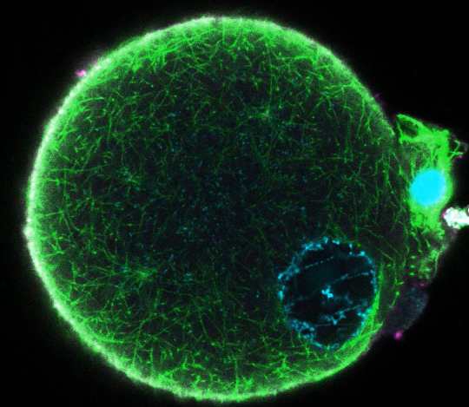
Protamine 2 deficient sperm cause abnormal embryogenesis in mice
Shannon Rainsford
Yale University
Pacific Coast Reproductive Society Meeting 2025

Slide 2
Disclosures
N/A

Slide 3
What are the molecular drivers of infertility?
World Health Organization 2023

Slide 4
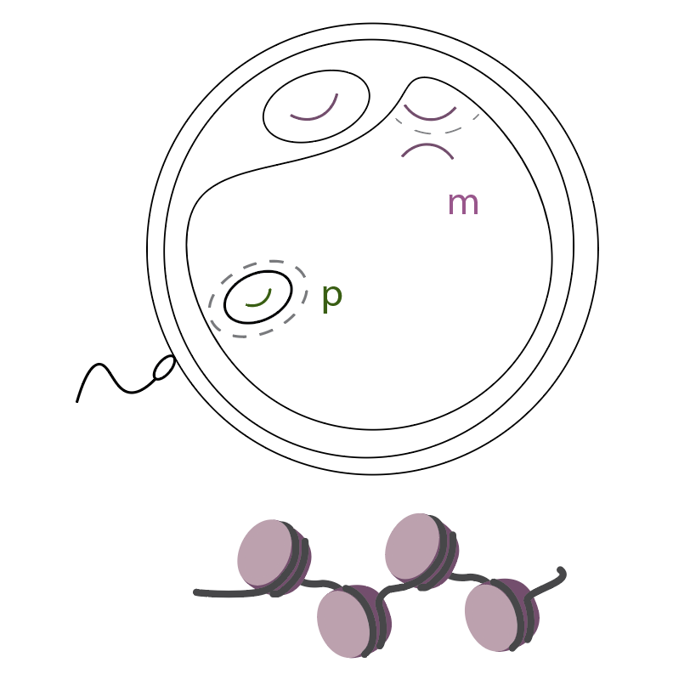
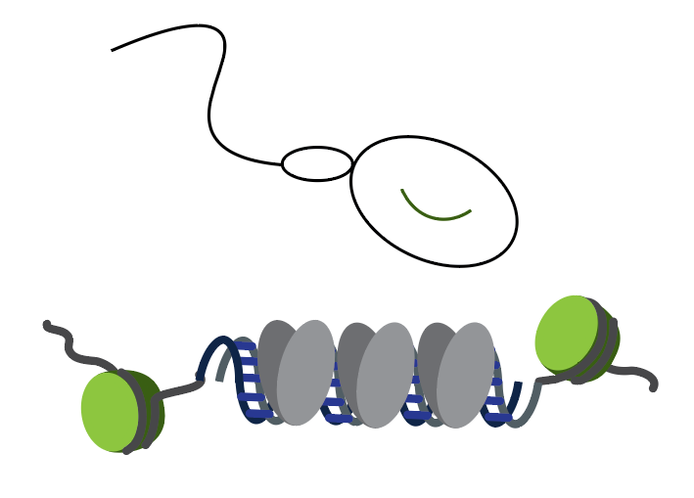
What happens when Protamine 2 is removed?
Protamines 1 and 2 organize DNA in sperm
Fertilization
?
Guo et al 2020, Inoue and Zhang 2014, Inoue and Zhang 2011, Santos et al 2005
Notes:
Protamines are transitioned back to maternally provided histones
First, histones are removed and maternally-provided histones are incorporated
Then the pronuclear assembly happens along with chromatin modifications (histone marks, methylation)

Slide 5
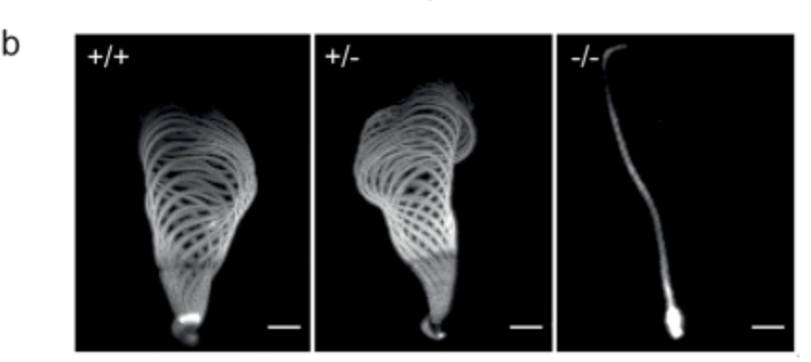
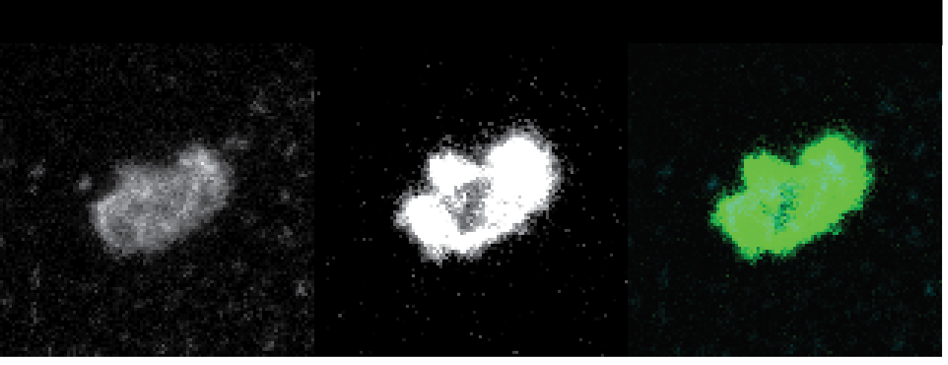
Protamine 2 deficiency in mouse sperm leads to DNA damage and immotility
DAPI
TUNEL
Composite
WT
Prm2KO
Bypass ‘infertility’ with ICSI
0.5 hpf
Takeda et al 2016, Merges et al 2022, Schneider et al 2016, Schneider et al 2020, Arévalo et al 2022
Notes:
People have done, one gene at a time
My summary of the literature
Have not been systematically done together
Motility vs embryo viability

Slide 6
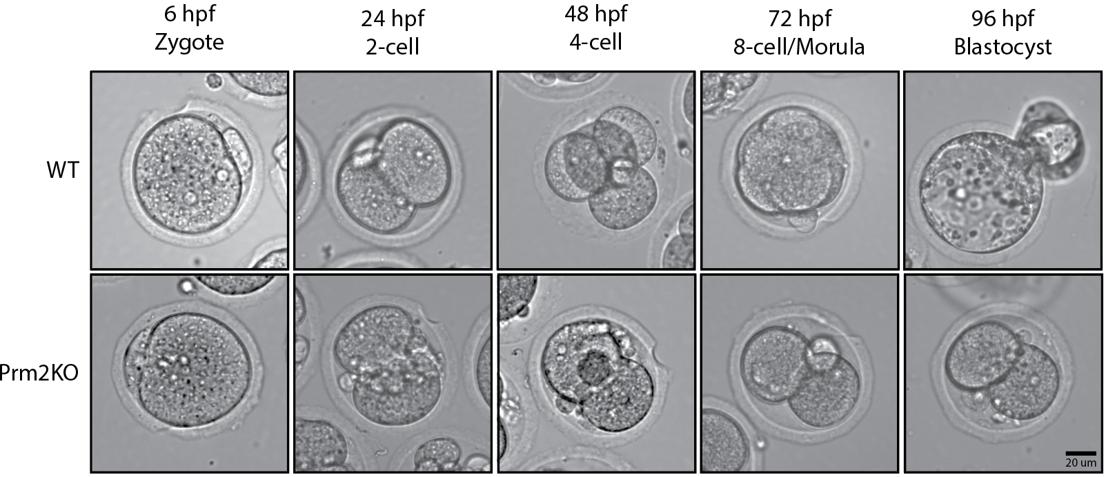
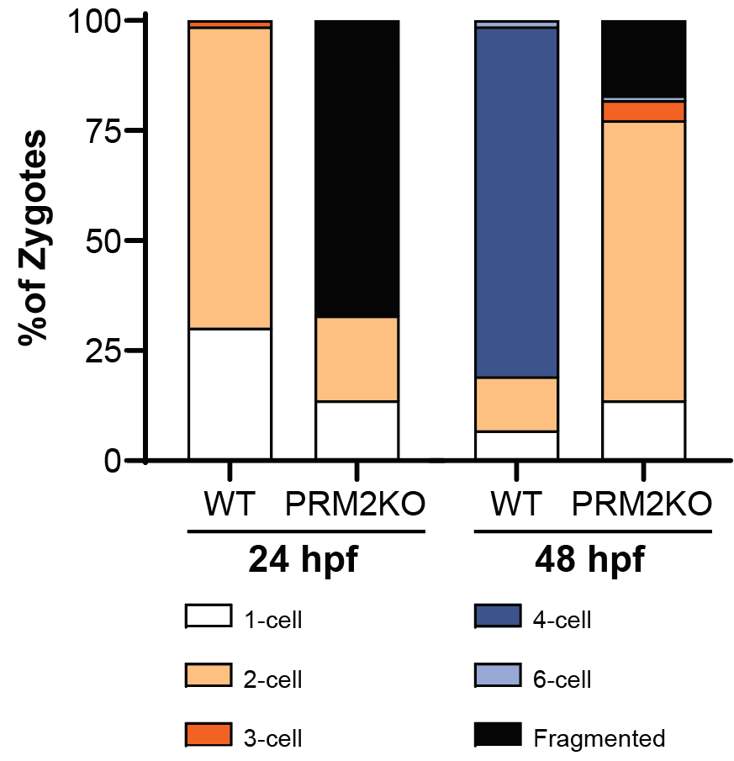
Prm2KO-derived zygotes show abnormal cleavage and arrest at the 2-cell stage
Notes:
N=3, 71 WT and 83 KO
4 experiments, 73 WT zygotes and 88 PRM2KO
71% +- 23% WT zygotes 2-cell at 24 hpf
16 +- 22% PRM2KO zygotes 2-cell at 24 hpf
72 +- 30% PRM2KO zygotes fragmented at 24 hpf
48 hpf 83 +- 7% of WT zygotes progressed to the 4-cell stage (normal)
0% of PRM2KO developed to 4-cell, 66+-7% arrested at 2-cell and 20 +- 12% remained Fragmented

Slide 7
Prm2KO-derived embryos have a disorganized first cleavage division
WT
Prm2KO

Slide 8
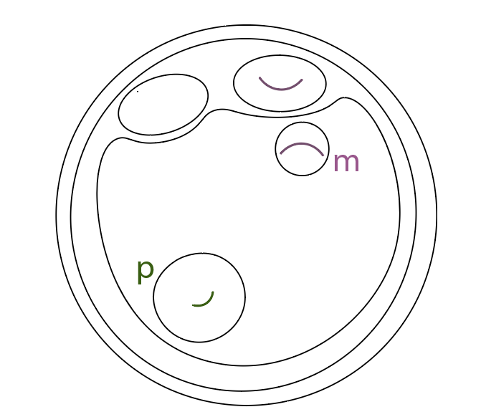
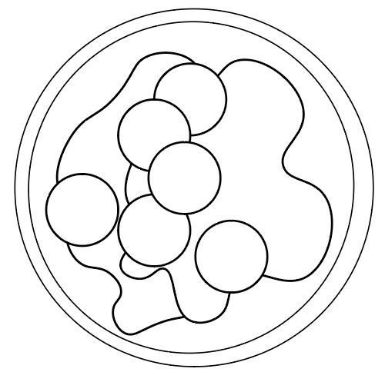
What are the molecular differences that lead to these abnormalities?
Fertilization
Pronuclear
Stage
Notes:
N=3, 71 WT and 83 KO
4 experiments, 73 WT zygotes and 88 PRM2KO
71% +- 23% WT zygotes 2-cell at 24 hpf
16 +- 22% PRM2KO zygotes 2-cell at 24 hpf
72 +- 30% PRM2KO zygotes fragmented at 24 hpf
48 hpf 83 +- 7% of WT zygotes progressed to the 4-cell stage (normal)
0% of PRM2KO developed to 4-cell, 66+-7% arrested at 2-cell and 20 +- 12% remained Fragmented

Slide 9
Prm2KO sperm degrades during maternal anaphase II
WT
PRM2KO
m
p
p
m
Live DNA dye
Tubulin-mScarlet
Notes:
GRAPH

Slide 10
Prm2KO sperm degrades during maternal anaphase II
WT
PRM2KO
m
p
p
m
Live DNA dye
Tubulin-mScarlet
Notes:
GRAPH

Slide 11
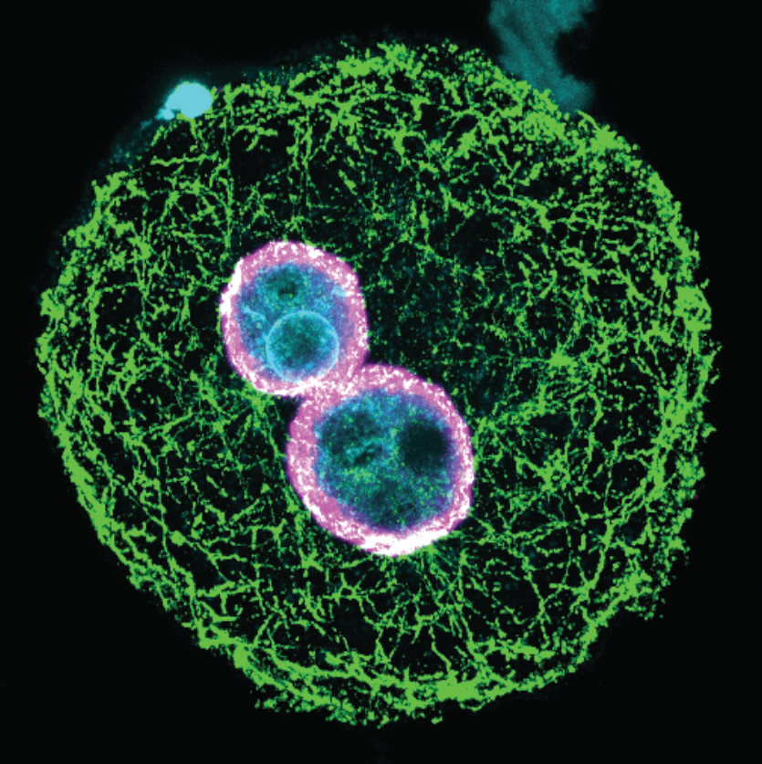
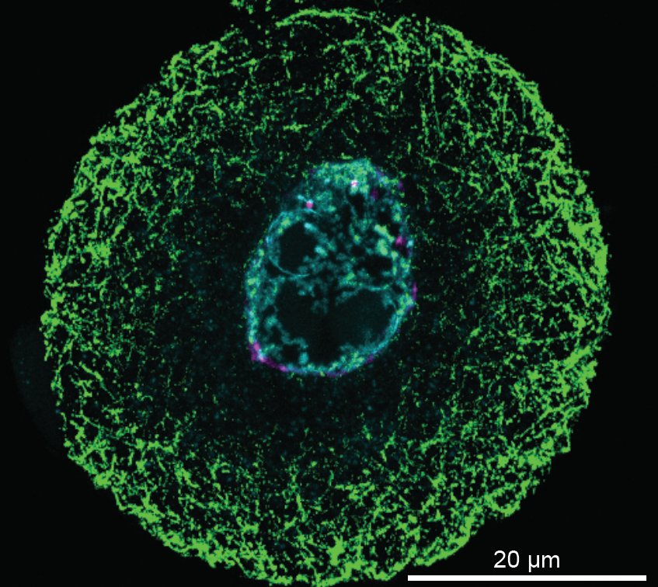
PRM2KO-derived embryos have one pronucleus with less Lamin A/C than WT-derived embryos
6 hpf
WT
Prm2KO
Hoechst
Lamin A/C
a-Tubulin
Notes:
3 repeated experiments
In process of analyzing
Visually similar

Slide 12
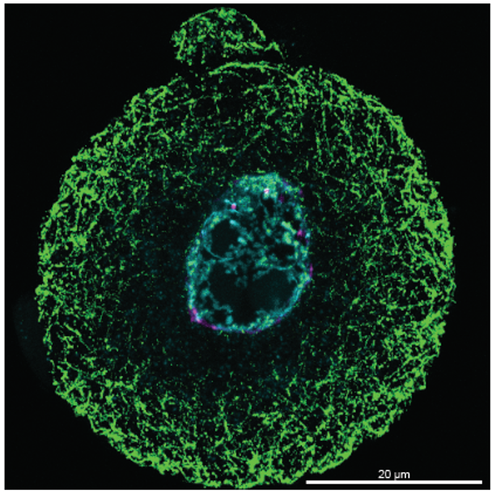
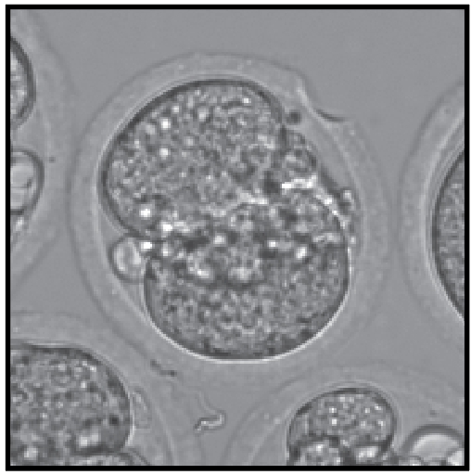
Epididymal PRM2KO sperm do not produce a functional zygote
DNA damage response triggered in embryo
Formation of an abnormal maternal pronucleus
Embryogenesis failure
High amount of DNA damage in Prm2KO sperm
Irregular shape
Decrease in Lamin A/C
Disappear during maternal anaphase II

Slide 13
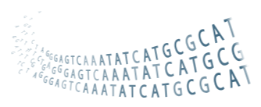
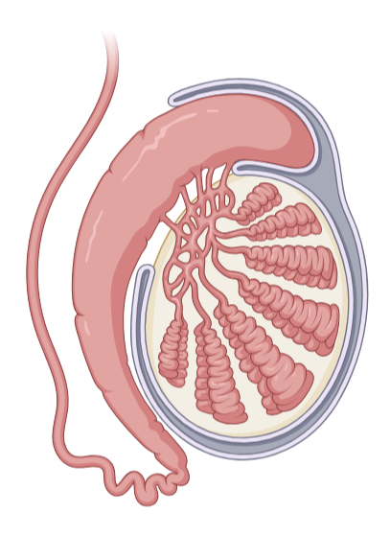
“Blue Skies” Next Steps
Diagnostic
Therapeutic
Genetic or proteomic
sequencing
Infertility
TESE or ROSI
DNA damage
DNA damage
inhibitors
Prm1
Prm2
Does this work translate to people?
Protamine ratios
Protamine
supplementation

Slide 14
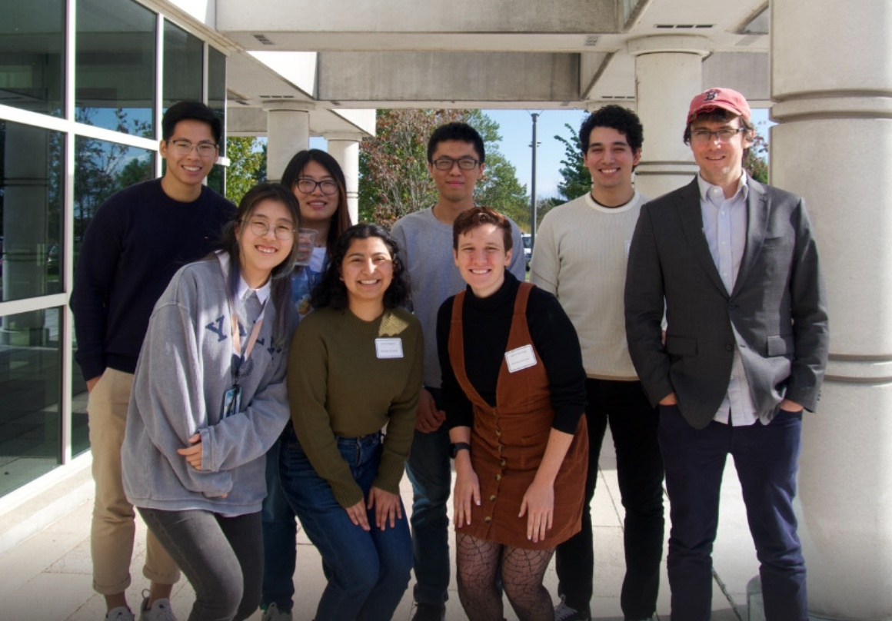
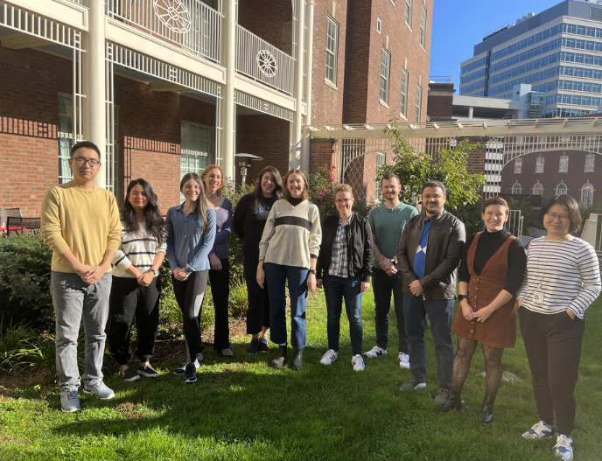
Acknowledgements
Zachary Smith and Bluma Lesch
The Smith Lab
Nicolas Dias
Kevin Tse
Jason Hou
JoAnne Villagrana
Minming Wang
Meiying Cui
Maximillian Carlino
Jennifer Wang
Thesis Committee
Lynn Cooley
Josien van Wolfswinkel
Denny Sakkas
Kaelyn Sumigray
Lilian Kabeche
Binyam Mogessie
The Lesch Lab
Kira Marshall
Delaney Farris
Ben Walters
Haoming Yu
Rachel Heuer
Shubhangini Kataruka
Yuanyuan Huang
Hannah Yin
shannon.rainsford@yale.edu

