Slide 1
Beneath The Surface: Uncovering Hidden Health Risks With Comprehensive Carrier Screening
Emily Patterson, BS; Andria Besser, MS, CGC
NYU Langone Fertility Center
March 21, 2025

Slide 2
Disclosures
Authors have nothing to disclose

Slide 3
BACKGROUND

Slide 4
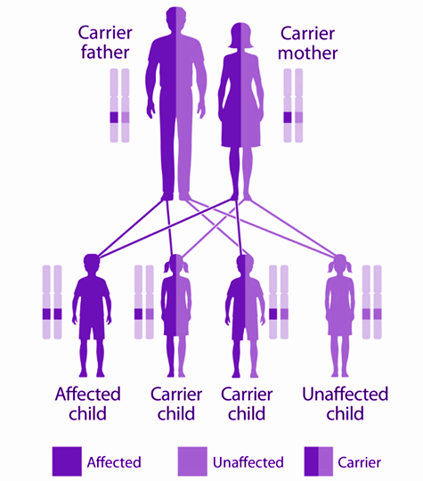
BACKGROUND
Carrier screening (CS) → genetic testing used to identify individuals at risk of producing offspring with an autosomal recessive (AR) or X-linked (XL) monogenic disorder
Traditional thinking: 1 functioning copy, 1 mutated copy = asymptomatic carrier
Manifesting carrier (MC) → Carrier presenting with mild symptoms of the associated genetic disorder or phenotype unique to carrier status
Notes:
An increasing number of recessively inherited conditions are gaining recognition for the risk of symptom manifestations in carriers, leading to blurred lines between recessive and dominant inheritance. As the scope of carrier screening (CS) panels has expanded in recent years, more individuals are receiving results with potential implications for their own health [1].
Patients can use knowledge of increased reproductive risk to make informed decisions in their care (PGT-M, sex selection, etc.)
CS was not initially intended to implicate personal health risks
Evolving test methodologies and panel sizes have led to increased identification of genes with possible carrier manifestations

Slide 5
BACKGROUND: Examples of carrier manifestations
Hypophosphatasia (ALPL) → metabolic bone disorder involving a variety of skeletal/dental symptoms
Carriers experience mildly defective bone mineralization (Beck et al. 2023) and are managed same as affected individuals (DEXA to monitor bone density)
Ataxia Telangiectasia (ATM) → neurodegenerative disorder characterized by progressive ataxia, telangiectasias, increased risk of hematological cancer
Carriers have increased risk of breast, pancreatic, prostate cancer; NCCN recommends breast MRIs for carriers in addition to routine breast screening
Gaucher disease (GBA) → lysosomal storage disease associated with bone & lung disease, hepatosplenomegaly, abnormal coagulation, neurological, cardiac issues
Carriers have increased risk of Parkinson’s disease
Notes:
Add GBA/ATM examples as well?

Slide 6
BACKGROUND
Current management recommendations
ACMG guidelines for X-linked MCs (Gregg et al. 2021)
States MC risk for AR conditions is “rare”
ASRM guidelines for gamete donation (2024)
“Donors who are carriers for recessive conditions that confer significant health risks to carriers should be considered on a case-by-case basis”
Frequency of MC risk depends on # genes tested and current knowledge
2016 (Wong et al): 108 genes, targeted genotyping (TG) → 6.2%
2023 (Clevenger et al): 90-525 genes, TG or sequencing → 9.3%
Notes:
Reports must report variants associated with symptoms in carriers
Clinicians must disclose possibility of MC findings prior to testing
No recommendations for management of identified personal health risks
ASRM does not define “significant” or what should be considered in making the case-by-case determination

Slide 7
OBJECTIVE

Slide 8
OBJECTIVE
What is the frequency and scope of MC risk among patients undergoing a large CS panel in a preconception fertility center setting?

Slide 9
MATERIALS & METHODS

Slide 10
MATERIALS AND METHODS
Retrospective review of results for all patients who had the same CS panel from the same laboratory between March-September 2024
558 genes were assessed (515 for males; X-linked genes excluded)
Full gene sequencing and/or gene-specific test methods were used
Only P/LP variants were reported by the laboratory; B/LB/VUS excluded
01.
Genes and variants with potential MC were identified based on the language provided on the laboratory report
02.
Frequencies were tallied for:
Positive >1 variant and negative results
MC risk by gene and variant
03.
Notes:
Retrospective review of all patients who underwent CS using the same gene panel between March and September 2024 was performed. For individuals reported as biologically female, testing was performed for a total of 558 genes (515 autosomal recessive and 43 X-linked). For individuals reported as biologically male, only the 515 autosomal recessive conditions were included. In accordance with professional guidelines, only variants classified by the laboratory as pathogenic (P) or likely pathogenic (LP) were reported, while variants of uncertain significance and benign or likely benign variants were not reported. Genes and variants with potential health implications for carriers were determined by the laboratory and noted on the results report. Frequencies of these genes and variants were tallied.

Slide 11
MATERIALS AND METHODS

Slide 12
RESULTS

Slide 13
RESULTS
Total patients with CS results meeting criteria
N=1577
Female 57.2%
N=902
Male 42.8%
N=675
Notes:
CS results were obtained for 1577 patients (902 female and 675 male)

Slide 14
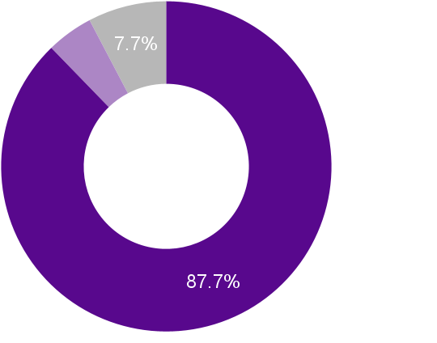
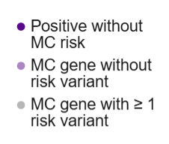
RESULTS
Frequency of genes and variants associated with MC status
4.6%
12.3% of positive genes were flagged for MC risk (51/416)
7.7% of positive genes involved variants associated with elevated personal health risk (32/416)
90.2% of positive genes flagged for MC risk follow AR inheritance (46/51)
N = 416
Notes:
At least one P/LP variant was identified in 416/558 genes among our patient cohort (79.8% of autosomal recessive conditions on the panel; 11.6% of X-linked conditions). 51/416 genes with positive results (12.3%) were noted by the laboratory to have potential health implications for carriers; of these, 5/51 (9.8%) were X-linked and 46/51 (90.2%) were autosomal recessive.
In total, 1315/1577 patients (83.4%) tested positive for at least one condition on the panel, and 423/1577 (26.8%) tested positive for at least one condition that was flagged for potential health implications in carriers. Of the 51 genes with potential manifestations, 19 were found to have only variants that were not associated with these risks. Of the remaining 32 genes, 430 variants with potential health risks were identified and collectively affected a total of 12.2% (193/1577) of patients.

Slide 15
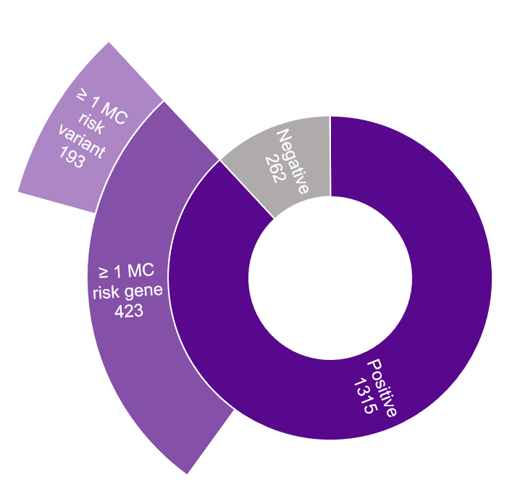
RESULTS
Frequency of patient results associated with MC status
83.4% of patients had positive CS results (1315/1577)
26.8% of patients were flagged for ≥1 gene associated with MC risk (423/1577)
12.2% of patients carried ≥1 variant associated with MC risk (193/1577)
N = 1577
Notes:
In total, 1315/1577 patients (83.4%) tested positive for at least one condition on the panel, and 423/1577 (26.8%) tested positive for at least one condition that was flagged for potential health implications in carriers. Of the 51 genes with potential manifestations, 19 were found to have only variants that were not associated with these risks. Of the remaining 32 genes, 430 variants with potential health risks were identified and collectively affected a total of 12.2% (193/1577) of patients.

Slide 16
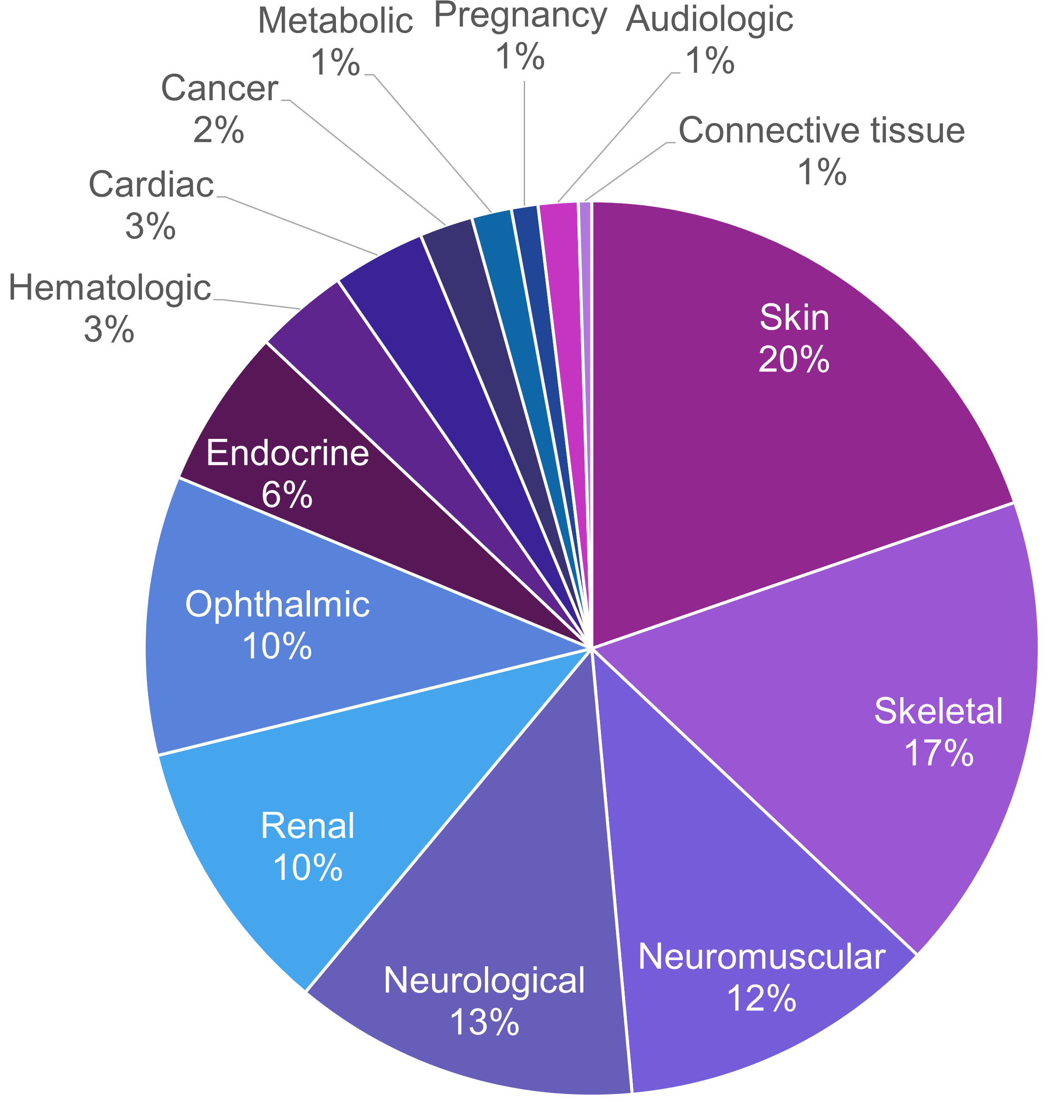
RESULTS
Types of MC risks
Most variants flagged for MC status involved risks associated with integumentary, skeletal, or neuromuscular systems
Notes:
N=208
3 variants associated with multiple types of symptoms

Slide 17
RESULTS
Most common conditions identified to have variants associated with MC risk
Condition(s) | Gene | Type of primary manifestation | Carriers (n)
Ectodermal dysplasia Isolated tooth agenesis | WNT10A | Skeletal & skin | 32
Gaucher disease | GBA | Neurological | 22
Alport syndrome | COL4A3 COL4A4 | Renal | 21
Mitochondrial DNA depletion syndrome Progressive external ophthalmoplegia | POLG | Ophthalmic | 20
Congenital myotonia | CLCN1 | Neuromuscular | 13
Notes:
All conditions with at least 10 carriers identified
Alport split evenly between the 2 genes (10 and 11)
Excludes carriers of variants in these genes that are not associated with sx

Slide 18
DISCUSSION

Slide 19
DISCUSSION
Frequency of MC risk depends on # genes tested and current knowledge
2016 (Wong et al): 108 genes, targeted genotyping (TG) → 6.2%
2023 (Clevenger et al): 90-525 genes, TG or sequencing → 9.3%
Current study: 558 genes, sequencing → 26.8% based on gene, 12.2% based on variant
Higher MC risk frequency highlights need for:
Pre/post-test counseling and consenting
Standardized management of associated personal health risks
Challenges:
Balancing pt. care and clinical burden while remaining within scope of practice
Determining appropriate management considering limited data & guidelines
Notes:
Clevenger et al. 2023: “27.6% of patients who were MCs were informed by a licensed genetic counselor during post-test counseling that carriers may develop symptoms”
Gbur et al. 2021: 64.6% of individuals did not receive pre-test counseling about personal health risks
Obtaining a list of reportable MC-associated genes aids clinics in creating SOPs, however limited by specific labs’ variant curation
Gregg et al. 2021: “The possibility of manifesting heterozygotes and their associated clinical features… should be discussed as part of pretest counseling.”
Gbur et al. 2021: 96.8% of individuals did not receive pre-test counseling about personal health risks
Burden of disclosure falls to ordering clinic while determination of reportable MC-associated genes falls to labs
Standardized language during consenting and reporting processes across lab and clinic can promote continuity of care
Barriers:
Mulhern et al. 2017: 86.7% of participants undergoing carrier screening reported that patients should be informed of MC-associated personal health risks
Thompson et al. 2018: 71% of NSGC survey participants believe that a cancer GC is the most appropriate clinician to disclose potential for elevated cancer risks for carriers, 24% believe that the prenatal/preconception GC is the most appropriate clinician
Gbur et al. 2021: 24.1% of carriers of conditions with specific referral guidelines were not referred appropriately
NCCN provides guidelines for screening of some, not all cancers associated with ATM carriers
24% of NSGC survey participants reported providing screening recommendations inconsistent with NCCN guidelines (Thompson et al. 2018)

Slide 20
STRENGTHS & LIMITATIONS

Slide 21
STRENGTHS
LIMITATIONS
Large sample size
Standardized panel
First study assessing variant-specific determination of manifesting status
Limited data collection period
Includes only genes/variants flagged for manifestation by one testing lab; may not reflect reporting decisions by other labs
Symptom presentation was not assessed; how often does MC risk translate into actual symptom presentation?
Notes:
6 month data collection

Slide 22
FUTURE DIRECTIONS
Evaluate symptoms at testing and longitudinally among pts. with MC risk
Understand pt. comprehension/perspectives re: MC risk and identify best practices for education/consenting
Assess PGT-M and prenatal diagnosis uptake for MC risk
Explore broader implications of MC risk on gamete donation
Determine necessity & best practices for medical management/surveillance of pts with MC risk
Notes:
Reports must report variants associated with symptoms in carriers
Clinicians must disclose possibility of MC findings prior to testing
No recommendations for management of identified personal health risks

Slide 23
CONCLUSIONS

Slide 24
CONCLUSIONS
MC risk status is more common than previously believed
1 out of every ~8 patients was identified to have a personal health risk
Scope of CS has increased beyond reproductive risk assessment
Current guidelines do not adequately address reporting and management protocols for MC findings
Notes:
While the primary goal of CS is the identification of high reproductive risk for autosomal recessive and X-linked conditions, the increased incidence of results bearing personal health risks and autosomal dominant inheritance challenge the traditionally understood scope of this screening tool. As current CS guidelines do not adequately address reporting or management of these findings, establishment of a standardized framework for both laboratories and clinicians is critical. The wider implications of these findings within the field of reproductive genetics warrant further exploration, particularly in the context of preimplantation genetic testing for monogenic disease, gamete donation, and prenatal diagnosis.

Slide 25
REFERENCES
Beck NM, Sagaser KG, Lawson CS, Hertenstein C, Jachens A, Forster KR, Miller KA, Jelin AC, Blakemore KJ, Hoover‐Fong J. Not just a carrier: Clinical presentation and management of patients with heterozygous disease‐causing alkaline phosphatase (ALPL) variants identified through expanded carrier screening. Molecular Genetics & Genomic Medicine. 2023 Jan;11(1):e2056.
Gregg AR, Aarabi M, Klugman S, Leach NT, Bashford MT, Goldwaser T, Chen E, Sparks TN, Reddi HV, Rajkovic A, Dungan JS; ACMG Professional Practice and Guidelines Committee. Screening for autosomal recessive and X-linked conditions during pregnancy and preconception: a practice resource of the American College of Medical Genetics and Genomics (ACMG). Genet Med. 2021 Oct;23(10):1793-1806.
Gracia C, Anderson J, Flyckt R, Hill M, Jain T, Sakkas D, Pier B, Steiner A, Tanrikut C, Yauger B, Hnsen K. Gamete and embryo donation guidance. Fertility and sterility. 2024 Nov 1;122(5):799-813.
Wong KK, Lazarin GA, Haque IS. The frequency of incidental findings in expanded carrier screening. Fertil Steril. 2016 Sep;106(3):e85.
Clevenger SK, Brandt JS, Khan SP, Shingala P, Carrick J, Aluwalia R, Heiman GA, Ashkinadze E. Rate of manifesting carriers and other unexpected findings on carrier screening. Prenat Diagn. 2023 Jan;43(1):117-125.
Gbur S, Mauney L, Gray KJ, Wilkins-Haug L, Guseh S. Counseling for personal health implications identified during reproductive genetic carrier screening. Prenat Diagn. 2021 Oct;41(11):1460-1466.
Mulhern M, Bier L, Alcalay RN, Balwani M. Patients’ opinions on genetic counseling on the increased risk of Parkinson disease among Gaucher disease carriers. Journal of genetic counseling. 2018 Jun;27:675-80.
Thompson J, Vogel Postula K, Wong K, Spencer S. Prenatal genetic counselors’ practices and confidence level when counseling on cancer risk identified on expanded carrier screening. Journal of Genetic Counseling. 2019 Aug 1;28(4):908-14.

Slide 26
QUESTIONS?

