Slide 1
Racing to Day 4: Early Blastocyst Formation Is Linked to Superior Embryo Quality and Higher Euploidy Rates
Kathleen A. Miller, Arielle Freedman, Luis R. Hoyos
IVF Florida Reproductive Associates
Margate, Florida

Slide 2
Disclosures
Genomic Prediction, Scientific Advisory Board
aLife, Scientific Advisory Board
Future Fertility, Scientific Advisory Board
Overture, Scientific Advisory Board

Slide 3
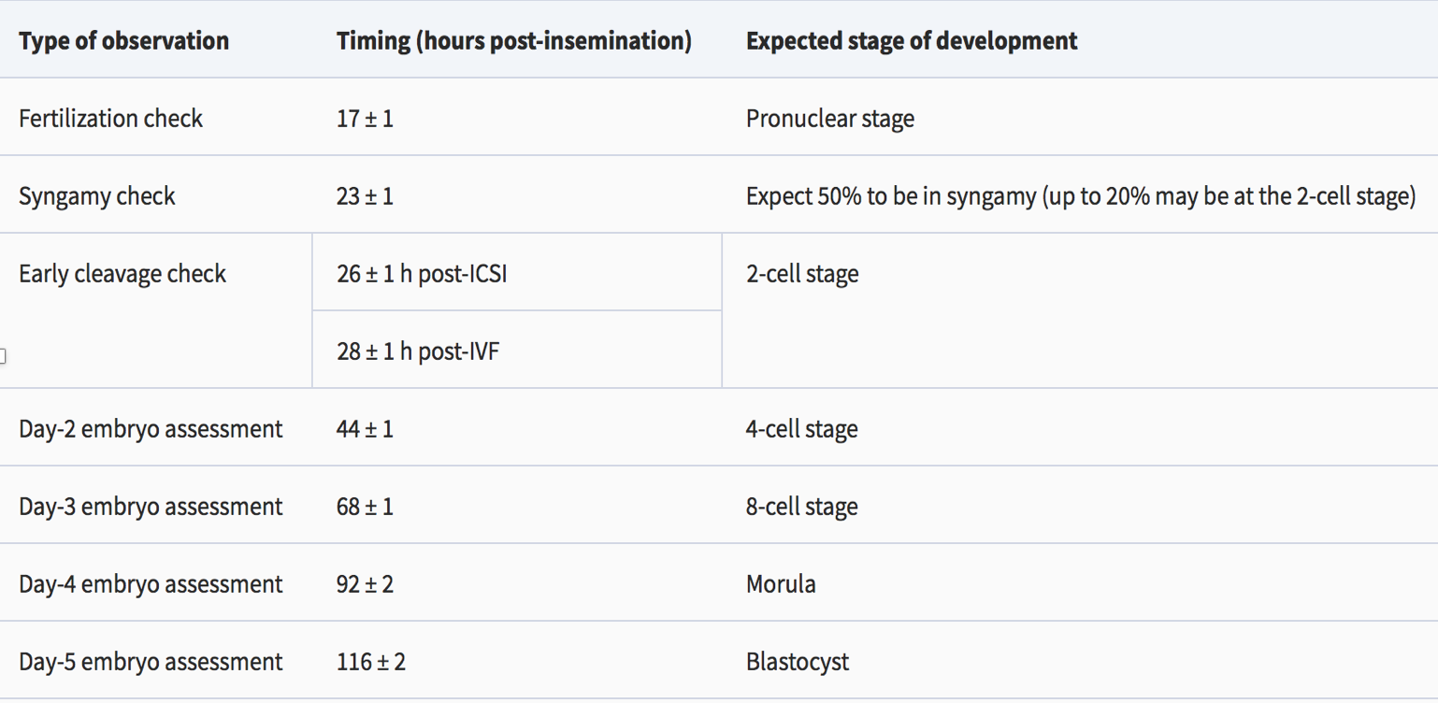
Background
Alpha Scientists in Reproductive Medicine and ESHRE Special Interest Group of Embryology Hum Reprod 2011

Slide 4
Background
Limited research exists on embryos reaching the expanded blastocyst stage by Day 4.
Most embryos reach the expanded blastocyst stage by Day 5 or 6.

Slide 5
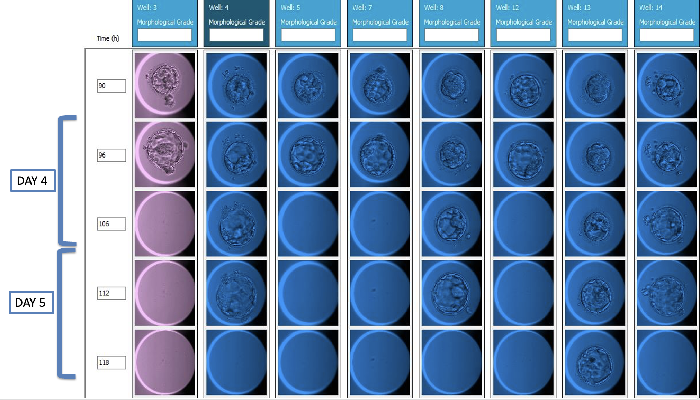
Early Day 4 expanded blastocysts are uncommon; their viability and euploidy rates require further study.

Slide 6
Objectives
This study aimed to:
Determine the proportion of embryos developing into expanded blastocysts by Day 4.
Compare their developmental quality and euploidy rates with embryos reaching the blastocyst stage on Days 5-7.

Slide 7
Materials and Methods
Retrospective study (Nov 2023 – Sep 2024) analyzing 2,839 autologous expanded blastocyst embryos.
Embryos were cultured in Global Total media system (Cooper Surgical) and incubated in Embryoscope Plus time-lapse incubators (Vitrolife) post ICSI.
Embryos were biopsied for PGT-A analyses when reaching the expanded blastocyst stage as graded by Gardner criteria.

Slide 8
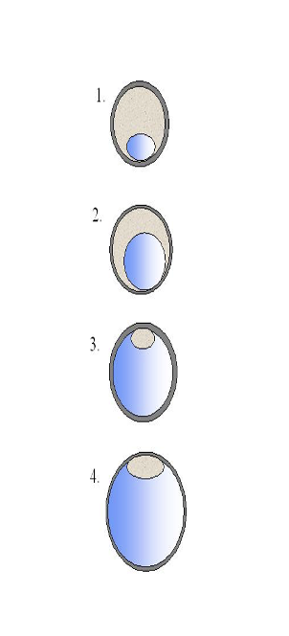
Gardner Blastocyst Grading Systems
Expansion | Grade | Characteristics
Early blastocyst | 1 | The blastocoele is < half the embryo volume
Blastocyst | 2 | Blastocoele is >= to half of the embryo volume
Full blastocyst | 3 | The blastocoele completely fills the embryo
Expanded Blastocyst | 4 | The blastocoele volume is larger than than the early embryo and the zona pellucida is thinning
Inner cell mass | A | Tightly packed, many cells
 | B | Loosely grouped, several cells
 | C | Very few cells
Trophectoderm | A | Many cells forming a tightly knit epithelium
 | B | Few cells
 | C | Very few cells forming a loose epithelium
*
*
Notes:
The majority of blastocyst grading schemes today are based on the Gardner system which introduced individual grades (A, B, C) for the inner cell mass (ICM) and trophectoderm (TE) in addition to degree of blastocyst expansion (score 1–6). The blastocyst development rate is an objective parameter, but dependent on the assessment of blastocyst morphology, which is straightforward in the case of good quality blastocysts, but can be challenging for embryos showing an attempted cavitation.
.

Slide 9
Materials and Methods
Development timings categorized into 5 groups.
Late Day 4 (D4+) 90–109 HPI
Early Day 5 (D5-) 110–119 HPI
Late Day 5 (D5+) 120–129 HPI
Early Day 6 (D6-) 130–139 HPI
Late Day 6 and Day 7 (D6+/7) 140–169 HPI
Comparisons of blastocyst development timing rates, euploidy rates and the quality of inner cell mass (ICM) and trophectoderm (TE) were statistically analyzed using a Chi-squared test and adjusted using a Bonferroni correction.

Slide 10
Blastocyst Formation Distribution

Slide 11
Table 1. Distribution rates of expanded blastocyst formation based on age
SART Age Groups | Timing |  |  |  |  | Total count
 | D4+ | D5- | D5+ | D6- | D6+/7
<35 | 13% (130)* | 43% (446) | 25% (260) | 15% (153) | 4% (37) | 1026
35-37 | 8% (61) | 39% (283) | 30% (217) | 16% (119) | 6% (42) | 722
38-40 | 5% (33) | 34% (217) | 32% (204) | 21% (135) | 8% (51) | 640
41-42 | 8% (20) | 35% (92) | 36% (95) | 17% (44) | 3% (9) | 260
>43 | 6% (11) | 33% (63) | 30% (58) | 19% (37) | 11% (22) | 191

Slide 12
Blastocyst Euploidy Rates

Slide 13
Distribution of ICM Grade based on Expansion Timing

Slide 14
Distribution of TE Grade based on Expansion Timing

Slide 15
Conclusion
This data illustrates that younger patients have a higher likelihood of earlier expanded blastocyst formation and as maternal age increases a shift toward slower expanded blastocyst formation.
Earlier blastocyst formation is linked to higher embryo quality based on ICM and TE morphology with a lower risk of chromosomal aneuploidies.
These findings highlight the potential advantages of selecting day 4 embryos over later developing embryos.

Slide 16
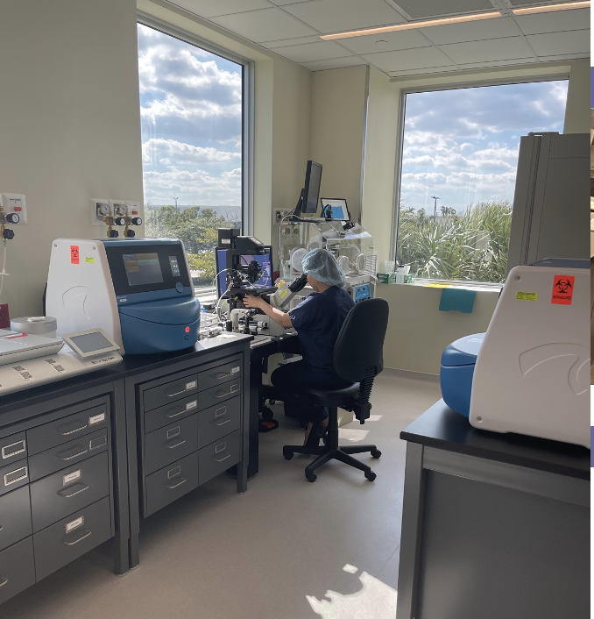
Acknowledgements

