Slide 1
Determination of a Population-Specific Anti-Mullerian Hormone Cutoff Value for Evaluation of Polycystic Ovary Syndrome
AJ Knutson, MD; Clare Lennon, MD; Timothy Dye, PhD; Dongmei Li, PhD; Ikra Razak; Carrie Irvine; Kathleen Hoeger, MD, MPH
March 20, 2025

Slide 2
Disclosures
The authors have nothing to disclose

Slide 3
Background
Polycystic Ovary Syndrome (PCOS) is common among reproductive-aged women (10-13%)¹
PCOS is characterized by endocrine, reproductive, metabolic, cardiovascular and psychological effects²
Historically diagnosed through various methodologies including 2003 Rotterdam Criteria³
New 2023 International Evidence-Based Guideline for the Assessment and Management of PCOS introduces anti-mullerian Hormone (AMH) as diagnostic adjunct
Teede et al. Fertil Steril 2023
Lizneva et al. Fertil Steril 2016
Christ et al. Diagnostics 2023
Notes:
Polycystic Ovary Syndrome, or PCOS, is a common condition affecting about 10-13% of reproductive-aged women globally. PCOS is well known to have adverse effects on endocrine, reproductive, metabolic, cardiovascular and psychological systems and is a public health concern worldwide.
Several classification systems have been utilized over the years to diagnose PCOS, with the 2003 Rotterdam Criteria being perhaps the most well-known and widely utilized.
In 2023, the International Evidence-based Guideline for the Assessment and Management of PCOS was updated to include anti-mullerian hormone (or AMH) as a diagnostic adjunct. AMH is a glycoprotein secreted by granulosa cells of the preantral and small antral follicles and has been long-known to be elevated in those with PCOS.
***
Given these ultrasound challenges, antimullerian hormone (AMH) levels have been proposed as an alternative
marker for PCOM as well as for diagnosing PCOS. Antimullerian hormone is a dimeric glycoprotein and predominantly
secreted by granulosa cells of the preantral and small antral
ovarian follicles (12). AMH inhibits the recruitment of follicles
from the primordial follicle pool. It also seems to inhibit aromatase activity, which is responsible for the conversion of androgens into estrogens. Finally, it has an inhibitory effect on
follicle-stimulating hormone-dependent follicle growth.
Therefore, increased AMH levels can contribute to ovulatory
dysfunction because of the accumulation of antral follicles
and to hyperandrogenism because of aromatase inhibition,
which are both often observed in women with PCOS (13–
15). Convincingly, it has been shown that women with
PCOS have higher levels of AMH compared with ovulatory
women without PCOS (16, 17). In addition, strong
correlations have been observed between follicle number on
ultrasound and circulating AMH levels in PCOS (16, 18).
However, significant heterogeneity exists between studies
addressing the role of AMH levels as a diagnostic marker in
PCOS, leaving the diagnostic role of this hormone unclear.
The aim of this study was to assess the diagnostic accuracy
of AMH for PCOS as well as the accuracy for the detection
of PCOM. This work was used to update the international
evidence-based PCOS guideline
Orient the audience to the problem that will be addressed. Reference should be included in an abbreviated format in small font at the bottom of the slide.
PCOS prevelance
PCOS characteristics
Diagnostic criteria and 2023 updated intl guidelines
AMH as diagnostic component to determine PCOM
Could include Intl guideline graphic of dx algorithm
For AMH and PCOS- describe AMH, what it is as a molecule, the degree of elevation in PCOS and why it’s elevated in PCOS patients (read opening paragraph of Seifert piece)
Look up metaanalysis Siefert refereces

Slide 4
2023 International Guideline Diagnostic Criteria
Teede et al. Fertil Steril 2023
Notes:
In the Rotterdam Criteria, patients are diagnosed with PCOS if they meet at least two of the three following criteria: oligo-ovulation, clinical or biochemical evidence of hyperandrogenism, or polycystic morphology on ultrasound (that is, a follicle number per ovary of at least 20, or ovarian volume of at least 10mL, in either ovary)
The 2023 International Guidelines retain these criteria, however, the recommended diagnostic approach is stepwise in nature. As you can see in the current slide, if only irregular cycles are present after assessing for clinical and biochemical hyperandrogenism, an ultrasound should be obtained in adults to assess for polycystic ovarian morphology. ALTERNATIVELY, serum AMH can also be used in lieu of ultrasonography to determine polycystic ovarian morphology.
***
- Oligo-ovulation: cycles >35 days apart or fewer than 8 menses per year
International guidelines defines irregular cycles (in adults >3 years post-menarche) as <21 or >35 days or <8 cycles per year, or >90 days in any one cycle
Clinical hyperandrogenism in adults: acne, female pattern hair loss, hirsuitism, mFG ≥4-6
- Biochemical hyperandrogenism is not reliably assessed on hormonal contraception, thus withdrawal for at least 3 months should be considered
- 20 FNPO based on TVUS with transducer frequency of at least 8MHz, was previously 12 follicles with older technologies.

Slide 5
Significance
While AMH can now be used as a diagnostic criterion for PCOM, no specific cutoff value was specified by the 2023 International Guidelines
Due to heterogeneity among patient populations and AMH assay platforms, the accuracy of a universal cutoff value is limited⁴
Therefore, the International Guidelines recommend laboratories and clinics develop their own population and assay-specific AMH cutoffs
Objective: determine an AMH cutoff value for our own clinic through methodology which can be replicated by other clinics
van der Ham et al. Fertil Steril 2024
Notes:
Within this updated diagnostic algorithm AMH can now be used to establish PCOM when ultrasound is unavailable or when patients wish to avoid a transvaginal ultrasound. However, there is no specific serum AMH value that was specified by the Guideline as a diagnostic threshold.
A large meta-analysis performed to inform these updated AMH recommendations found large heterogeneity among studies, patient populations and AMH assay platform cutoffs; thus, no universal AMH cutoff value could be recommended.
Instead, it is up to individual clinics to determine AMH cutoffs appropriate to their own unique populations. Our objective was to identify an AMH cutoff within our patient population that can appropriately select for patients with PCOS, through methodology which can be replicated by other clinics for their unique populations.
***
Highlight objective and physically state this (consider this as a separate slide, make last bullet point as separate slide), rephrase these as bullet points

Slide 6
Study design and Subjects
Single-site, retrospective cross-sectional analysis
Female patients aged 20-40 years with at least one serum AMH obtained 12/2018 and 12/2023
Initial diagnosis determined by ICD-10 codes
Comparison of 250 records of subjects diagnosed with PCOS with 250 records of regular ovulatory controls with fertility
Exclusion criteria: hyperprolactinemia, congenital adrenal hyperplasia, history of prior ovarian surgery
Notes:
Our study was a single-site, retrospective cross-sectional analysis. We focused on adult female patients aged 20-40 who had at least one serum AMH obtained between December 2018 and December 2023 at one of our clinical laboratories.
ICD-10 codes were utilized as an initial screening tool to identify subjects with specific diagnoses.
We aimed to compare subjects classified with PCOS versus those without PCOS. We therefore compared 250 records of subjects diagnosed with PCOS with 250 records of those not diagnosed with PCOS, amenorrhea, irregular menses, or female infertility. This was in an effort to exclude those from the control group who may not have been given the PCOS ICD-10 code but were given related diagnoses.
Exclusion criteria included hyperprolactenemia, congenital adrenal hyperplasia, prior ovarian cystectomy or oophorectomy
***
250 based on confounders and number needed for ROC
Controls were regular ovulatory persons with fertility with no prior surgery (exclude)
Flow sheet to go from 250 to 186 (consort diagram)

Slide 7
Methods – Subjects
PCOS and control diagnoses confirmed through medical records
PCOS defined as presence of at least 2 of the 3 Rotterdam diagnostic criteria
Elecsys® AMH Immunoassay (Roche Diagnostics) utilized for all AMH samples
All analyses were performed using R Statistical Software (v4.4.1; R Core Team 2024).
Notes:
Medical records were examined for the 250 cases with a PCOS ICD-10 code and the 250 controls without the PCOS or related diagnoses codes to verify the appropriate diagnosis and glean additional information
PCOS was defined as the presence of at least 2 of the 3 previously-discussed Rotterdam diagnostic criteria.
All AMH assays were performed with the Elecsys AMH Immunoassay produced by Roche Diagnostics, and again these were collected between December 2018 and December 2023.
All statistical analysis was performed using R statistical software.
***
Contraceptive use prior and during AMH draw was recorded. Patients on contraception were not excluded from the pool of subjects as we wanted to approximate the real-world make-up of our clinic population
Curr contraception use: 12 PCOS, 42 controls?
Either discuss contraceptive use (and why they were not excluded)
Diagnostic criteria for study: 1) physical or biochemical evidence of hyperandrogenism; 2) irregular menses; or 3) polycystic ovarian morphology.

Slide 8
Results
Assessed for eligibility
n=500
PCOS ICD-10 (E28.2)
n=250
Ovulatory controls
n=250
Excluded- insufficient or conflicting documentation
n=65
Excluded- insufficient or conflicting documentation
n=64
Diagnosis confirmed via medical records
n=185
Control status confirmed via medical records
n=186
Met two dx criteria
n=48
Met three dx criteria
n=115
Met at least two dx criteria
n=22
Notes:
500 records were initially collated; 250 associated with an ICD-10 diagnosis code for PCOS and 250 ovulatory controls not associated with diagnoses codes for PCOS, irregular menses, or amenorrhea. 65 records in the PCOS arm and 64 in the control arm were excluded due to insufficient or conflicting documentation in the medical record. Ultimately, 186 control records were confirmed and 185 PCOS records confirmed. Of these PCOS records, 48 met two Rotterdam PCOS diagnostic criteria, 115 met all three criteria, and 22 met at least two criteria, and possibly three, but could not be confirmed (for example, someone who met ovulatory and hyperandrogenism criteria but for which imaging records were not available).

Slide 9
Results
Baseline characteristics | PCOS Group (n=185) | Control Group (n=186 ) | P value
Age, years (mean ± SD) | 30.0 ± 4.5 | 32.5 ± 4.9 | <0.001
Race, N (%) White Black Asian Other Unknown | 139 (75.1) 26 (14.0) 7 (3.8) 8 (4.3) 5 (2.7) | 144 (77.0) 14 (7.5) 11 (5.9) 7 (3.8) 10 (5.4) | 0.177
Ethnicity, N (%) Hispanic Non-Hispanic Unknown | 12 (6.5) 164 (88.6) 9 (4.9) | 9 (4.8) 154 (82.8) 23 (12.4) | 0.032
Body Mass Index, kg/m² (mean ± SD) | 34.5 ± 9.3 | 27.5 ± 6.7 | <0.001
Mean AMH (ng/mL ± SD) | 6.89 ± 4.28 | 2.72 ± 2.02 | <0.001
Notes:
These are the baseline characteristics for our PCOS and Control Groups, which included 185 PCOS patients and 186 Controls following chart review. As you can see, baseline characteristics are largely similar between the two groups, although it should be noted the control group has a lower average body mass index and higher mean age. As we would anticipate, the mean AMH was higher in the PCOS group than the control group, at 6.89 versus 2.72
***

Slide 10
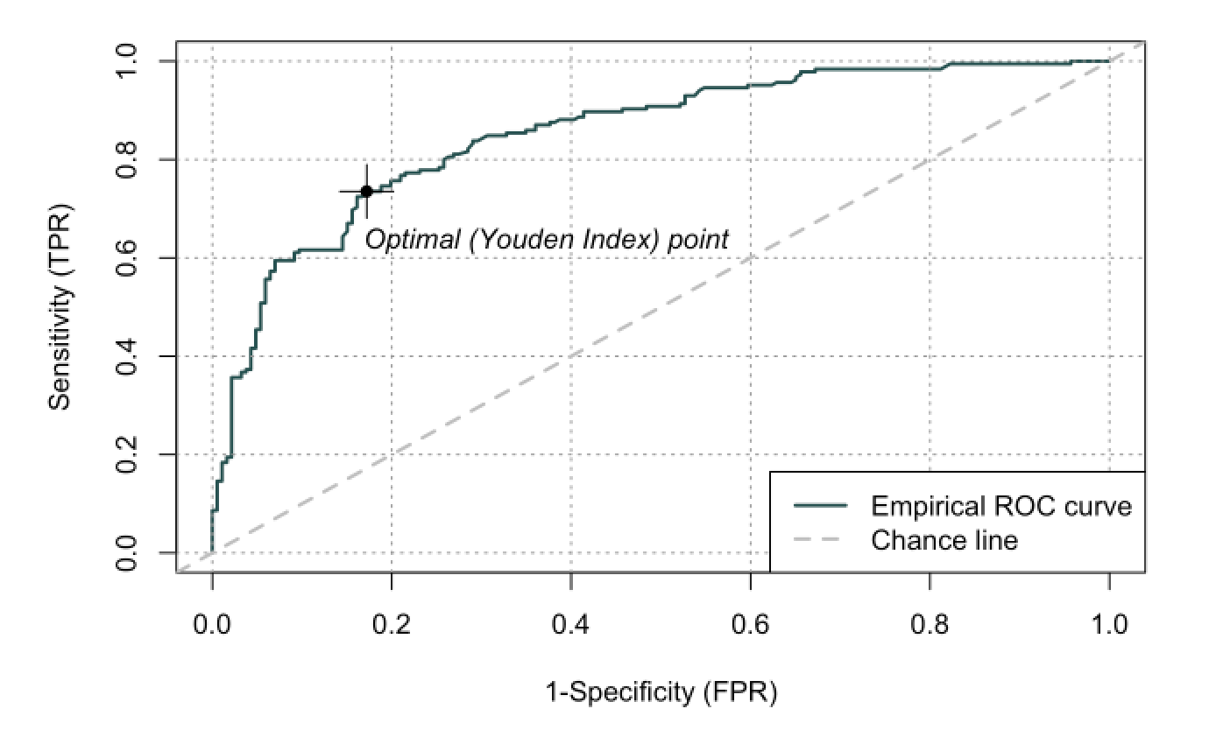
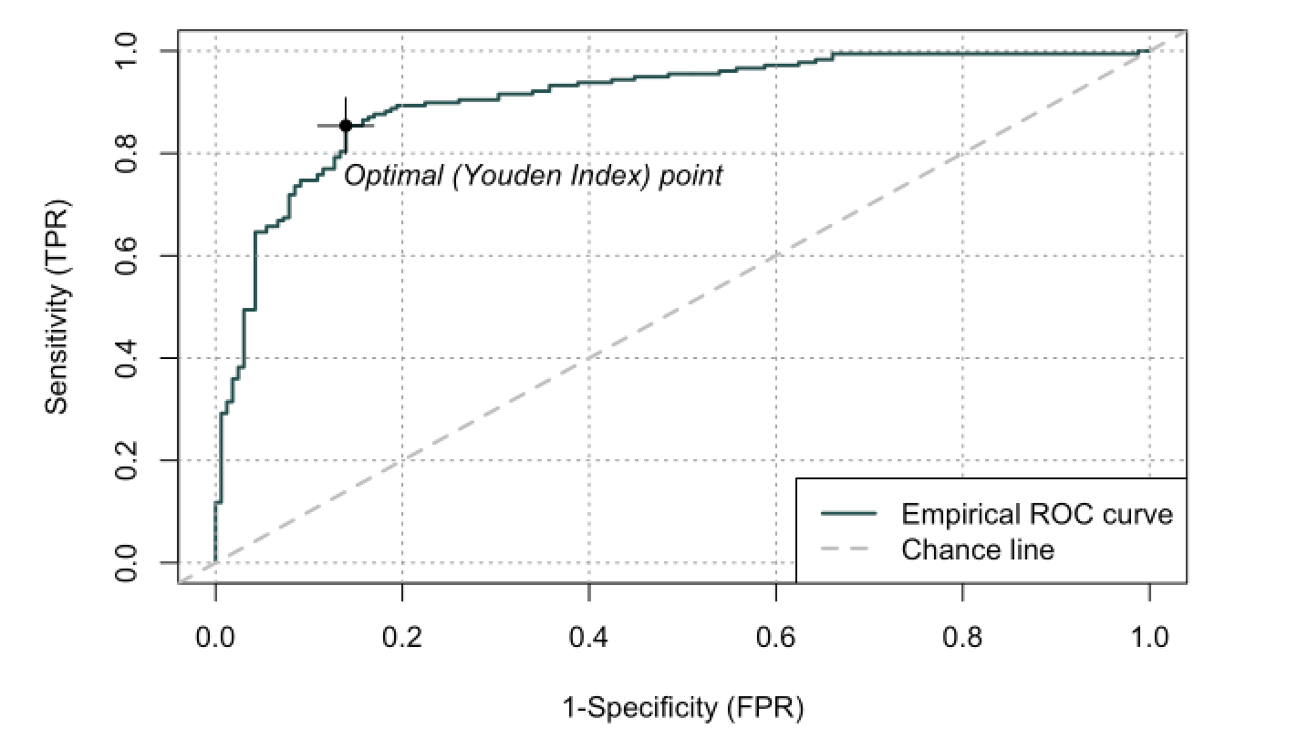
Area Under the Curve (AUC)
ROC Curve for unadjusted raw data
Area Under the Curve (AUC) | 0.8528
Optimal AMH Threshold (ng/mL) | 4.40
Sensitivity (% [95% CI]) | 73.5 [67.2, 79.9]
Specificity (% [95% CI]) | 82.8 [77.4, 88.2]
Positive Predictive Value (% [95% CI]) | 81.0 [75.0, 86.9]
Negative Predictive Value (% [95% CI]) | 75.9 [70.0, 81.7]
ROC Curve adjusted for BMI
Area Under the Curve (AUC) | 0.9076
Optimal AMH Threshold (ng/mL) | 4.16
Sensitivity (% [95% CI]) | 85.4 [80.2, 90.6]
Specificity (% [95% CI]) | 86.1 [80.8, 91.3]
Positive Predictive Value (% [95% CI]) | 86.9 [81.9, 91.9]
Negative Predictive Value (% [95% CI]) | 84.5 [79.1, 90.0]
Notes:
Receiver operating characteristic (or ROC) curves were generated in an attempt to identify an optimal threshold AMH value to distinguish between the subjects with PCOS and the control subjects. **click for animation** An initial ROC curve was generated on the unadjusted dataset to identify an optimal AMH threshold value of 4.40 ng/mL, with an area under the curve (AUC) of 0.8525. Sensitivity, specificity, positive predictive value and negative predictive value are also listed in the top left table.
However, mutlivariate regression analysis identified BMI as a significant confounder, so a new curve was generated after multivariate regression analysis adjusted for BMI. **click for animation** This curve identified an optimal AMH threshold value of 4.16 ng/mL, with an area under the curve of 0.9076. Sensitivity, specificity positive predictive value and negative predictive value were all improved after adjusting for BMI compared to the unadjusted curve.
***
RED BOXES ARE ANIMATIONS, click through while speaking
Do not need to say sensitivity, specificity, PPV, NPV. In fact, could take out these parameters and have them available\
Sensitivity was 85.4%, specificity was 86.1%, positive predictive value was 86.9% and negative predictive value was 84.5%. These values were all improved after adjusting for BMI compared to the unadjusted curve.

Slide 11
Results: Subjects meeting 2 vs 3 PCOS Criteria
Outcome | 2 Criteria (n=48) | 3 Criteria (n=115)
Area Under the Curve (AUC) | 0.8639 | 0.9223
Optimal AMH Threshold (ng/mL) | 4.48 | 4.10
Sensitivity (% [95% CI]) | 74.8 [66.8, 82.7] | 89.5 [83.8, 95.1]
Specificity (% [95% CI]) | 83.9 [78.6, 89.2] | 84.8 [79.4, 90.3]
Positive Predictive Value (% [95% CI]) | 74.1 [66.2, 82.1] | 80.3 [73.4, 87.2]
Negative Predictive Value (% [95% CI]) | 84.3 [79.1, 89.6] | 92.1 [87.8, 96.4]
Notes:
Next, we wondered whether these ROC curve parameters would differ depending on whether subjects met only 2 or all 3 of the diagnostic criteria. Here you can see that among those who met two criteria, the AUC was 0.8892 while it improved to 0.9223 among those meeting all 3 criteria. The optimal AMH threshold was higher among those meeting just 2 criteria compared to those who met all 3 criteria, at 4.48 ng/mL versus 4.10 ng/mL, respectively. Sensitivity, specificity, positive predictive value and negative predictive value were all improved among those who met all 3 criteria.
***
N for 2 criteria: 48
N for 3 criteria: 115
Remaining 22 met at least two criteria but documentation unclear as to whether they met 2 or all 3 criteria

Slide 12
Conclusions
Identified a serum AMH cutoff value to distinguish between subjects with PCOS and controls within our clinic population
Clinic-specific cutoff values can be used in place of ultrasound for PCOM component of PCOS diagnosis
Higher AMH cutoff needed when fewer distinguishing features present
Methodology can be used by others to determine AMH cutoffs in their own local populations.
Notes:
To conclude:
With use of ROC curves, a serum AMH cutoff value was identified that accurately distinguished between subjects with and without PCOS among our local health system population.
According to the most recent International Guidelines, such clinic-specific cutoff values can be used in place of ultrasound for the PCOM component of PCOS diagnosis if necessary
When fewer clinically distinguishing features were present (2 PCOS diagnostic criteria vs. 3) a higher optimal AMH cutoff value was needed to accurately predict PCOS status
This methodology can be used by other clinicians and health systems to determine AMH cutoffs to aid in PCOS diagnosis in their own local populations.
***
Consider putting findings as separate

Slide 13
Strengths and Limitations
Strengths:
Based on local clinic population from one health system
Replicable by other clinics for their own populations
Consistent AMH Assay utilized for all data points
Limitations:
Results specific to region and clinic
AMH cutoff not stratified by age
Higher BMI among PCOS group
Notes:
Our strengths included:
We used local clinic population data as a snapshot of our particular region
Methodology could be replicated in straightforward manner by other clinics to use for their own populations
Our analysis was based on data from one consistent AMH Assay (Elecsys), improving consistency of the lab values themselves
Limitations include:
Results not generalizable: region and clinic-specific population and AMH assay system
AMH cutoff not stratified by age- could be a next step
Higher BMI among PCOS patients than controls (controlled for with regression analysis)
***
looking into contraception with larger study, included these patients on contraception for this study which were small in number, we were trying to replicate a real-world clinic population but numbers are known
third point- consistent AMH assay run by Roche
Really stress to patients that this is only one component of PCOS diagnosis, specifically PCOM. Our population was specifically picked because they met guidelines

Slide 14
Acknowledgements
Wendy Vitek, MD
Snigdha Alur-Gupta, MD
Adam Evans, MD
Notes:
Here I would like to acknowledge a few more mentors and colleagues who helped me develop this project.

Slide 15
References
Teede HJ, Tay CT, Laven JJE, Dokras A, Moran LJ, Piltonen TT, Costello MF, Boivin J, Redman LM, Boyle JA, Norman RJ, Mousa A, Joham AE; International PCOS Network. Recommendations from the 2023 international evidence-based guideline for the assessment and management of polycystic ovary syndrome. Eur J Endocrinol. 2023 Aug 2;189(2):G43-G64. doi: 10.1093/ejendo/lvad096. PMID: 37580861.
Lizneva D, Suturina L, Walker W, Brakta S, Gavrilova-Jordan L, Azziz R. Criteria, prevalence, and phenotypes of polycystic ovary syndrome. Fertil Steril. 2016 Jul;106(1):6-15. doi: 10.1016/j.fertnstert.2016.05.003. Epub 2016 May 24. PMID: 27233760.
Christ JP, Cedars MI. Current Guidelines for Diagnosing PCOS. Diagnostics (Basel). 2023 Mar 15;13(6):1113. doi: 10.3390/diagnostics13061113. PMID: 36980421; PMCID: PMC10047373.
van der Ham K, Laven JSE, Tay CT, Mousa A, Teede H, Louwers YV. Anti-mullerian hormone as a diagnostic biomarker for polycystic ovary syndrome and polycystic ovarian morphology: a systematic review and meta-analysis. Fertil Steril. 2024;122(4):727-39.
First author et al. Journal Year

Slide 16
Notes:
PCRS 2025 presentation requirements:
Precisely 10 minutes to speak
PCRS recommends MAXIMUM 15 slides
Must be submitted to PCRS by 3/3
First or second slide must disclose any association, funding or financial/substantive relationships with commercial entitites that may be COI
Otherwise must state I have nothing to disclose

