Slide 1
Microwave drying and storage of human oocytes (microdry)
Ariel Dunn, MD
Notes:
Good morning, my name is Ariel Dunn and I am one of the third year fellows at the NIH. Thank you for allowing me to present my research today entitled:

Slide 2
Disclosures
Funding: Smithsonian’s discretionary funds (supplies, reagents)
The expressed views are those of the authors and do not reflect the official policy of the National Institutes of Health, Department of Defense, or the U.S. Government.
Notes:
These are my disclosures

Slide 3
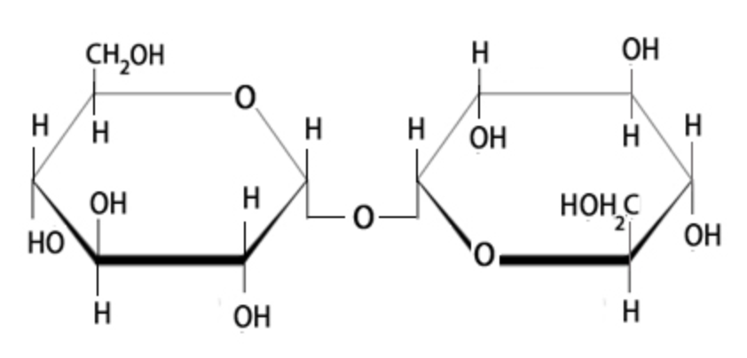
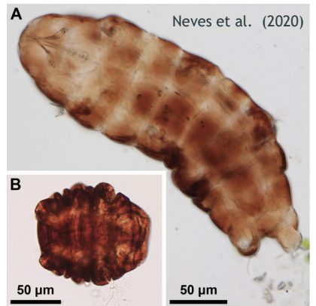
INTRODUCTION
Dry preservation is being developed to allow storage of gametes at non-cryogenic temperatures.
Trehalose increases dehydration tolerance of cells, prevents collapse or aggregation of cellular structures, and stabilizes cellular components in amorphous trehalose glass formed after dehydration.
DNA integrity can be maintained after drying and storage of domestic cat oocytes and spermatozoa using trehalose.
Notes:
First bullet: Dry preservation is being developed to allow storage of gametes at non-cryogenic temperatures, eliminating reliance on liquid nitrogen and decreasing expenses of storage.
Second bullet: Trehalose is a non-reducing disaccharide sugar and is found naturally in small organisms, such as insects (anhydrobiotic organisms = without water). It increases dehydration tolerance of cells by maintaining three-dimensional conformation of macromolecules. It prevents collapse or aggregation of cellular structures and stabilizes cellular components in amorphous trehalose glass formed after dehydration.
Third bullet: It has been shown in our lab that DNA integrity can be maintained after drying and storage of domestic cat oocytes and spermatozoa using trehalose.
Thus, our objective was to: Determine whether introduction of trehalose, microwave drying, and storage at non-freezing temperatures adversely affects the DNA integrity of immature human oocytes with the ultimate goal of making IVF more economical and accessible.

Slide 4
Materials & methods
IRB-approved translational study
March 2024 to November 2024
Unidentified, fresh oocytes after routine IVF treatment designated for discard secondary to immaturity were pooled and collected 24 hours after retrieval
161 patients consented (mean age of 35.6 [SD 4.3]; range of 21-45 years old)
552 oocytes collected
Notes:
492 analyzed (552 in total collected, 492 includes the losses during processing)

Slide 5
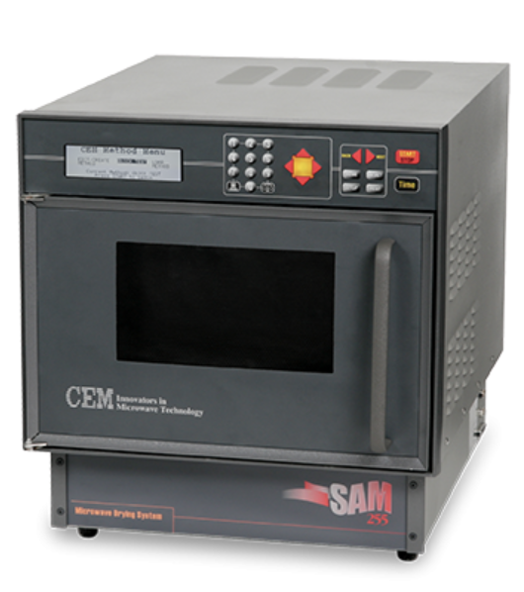
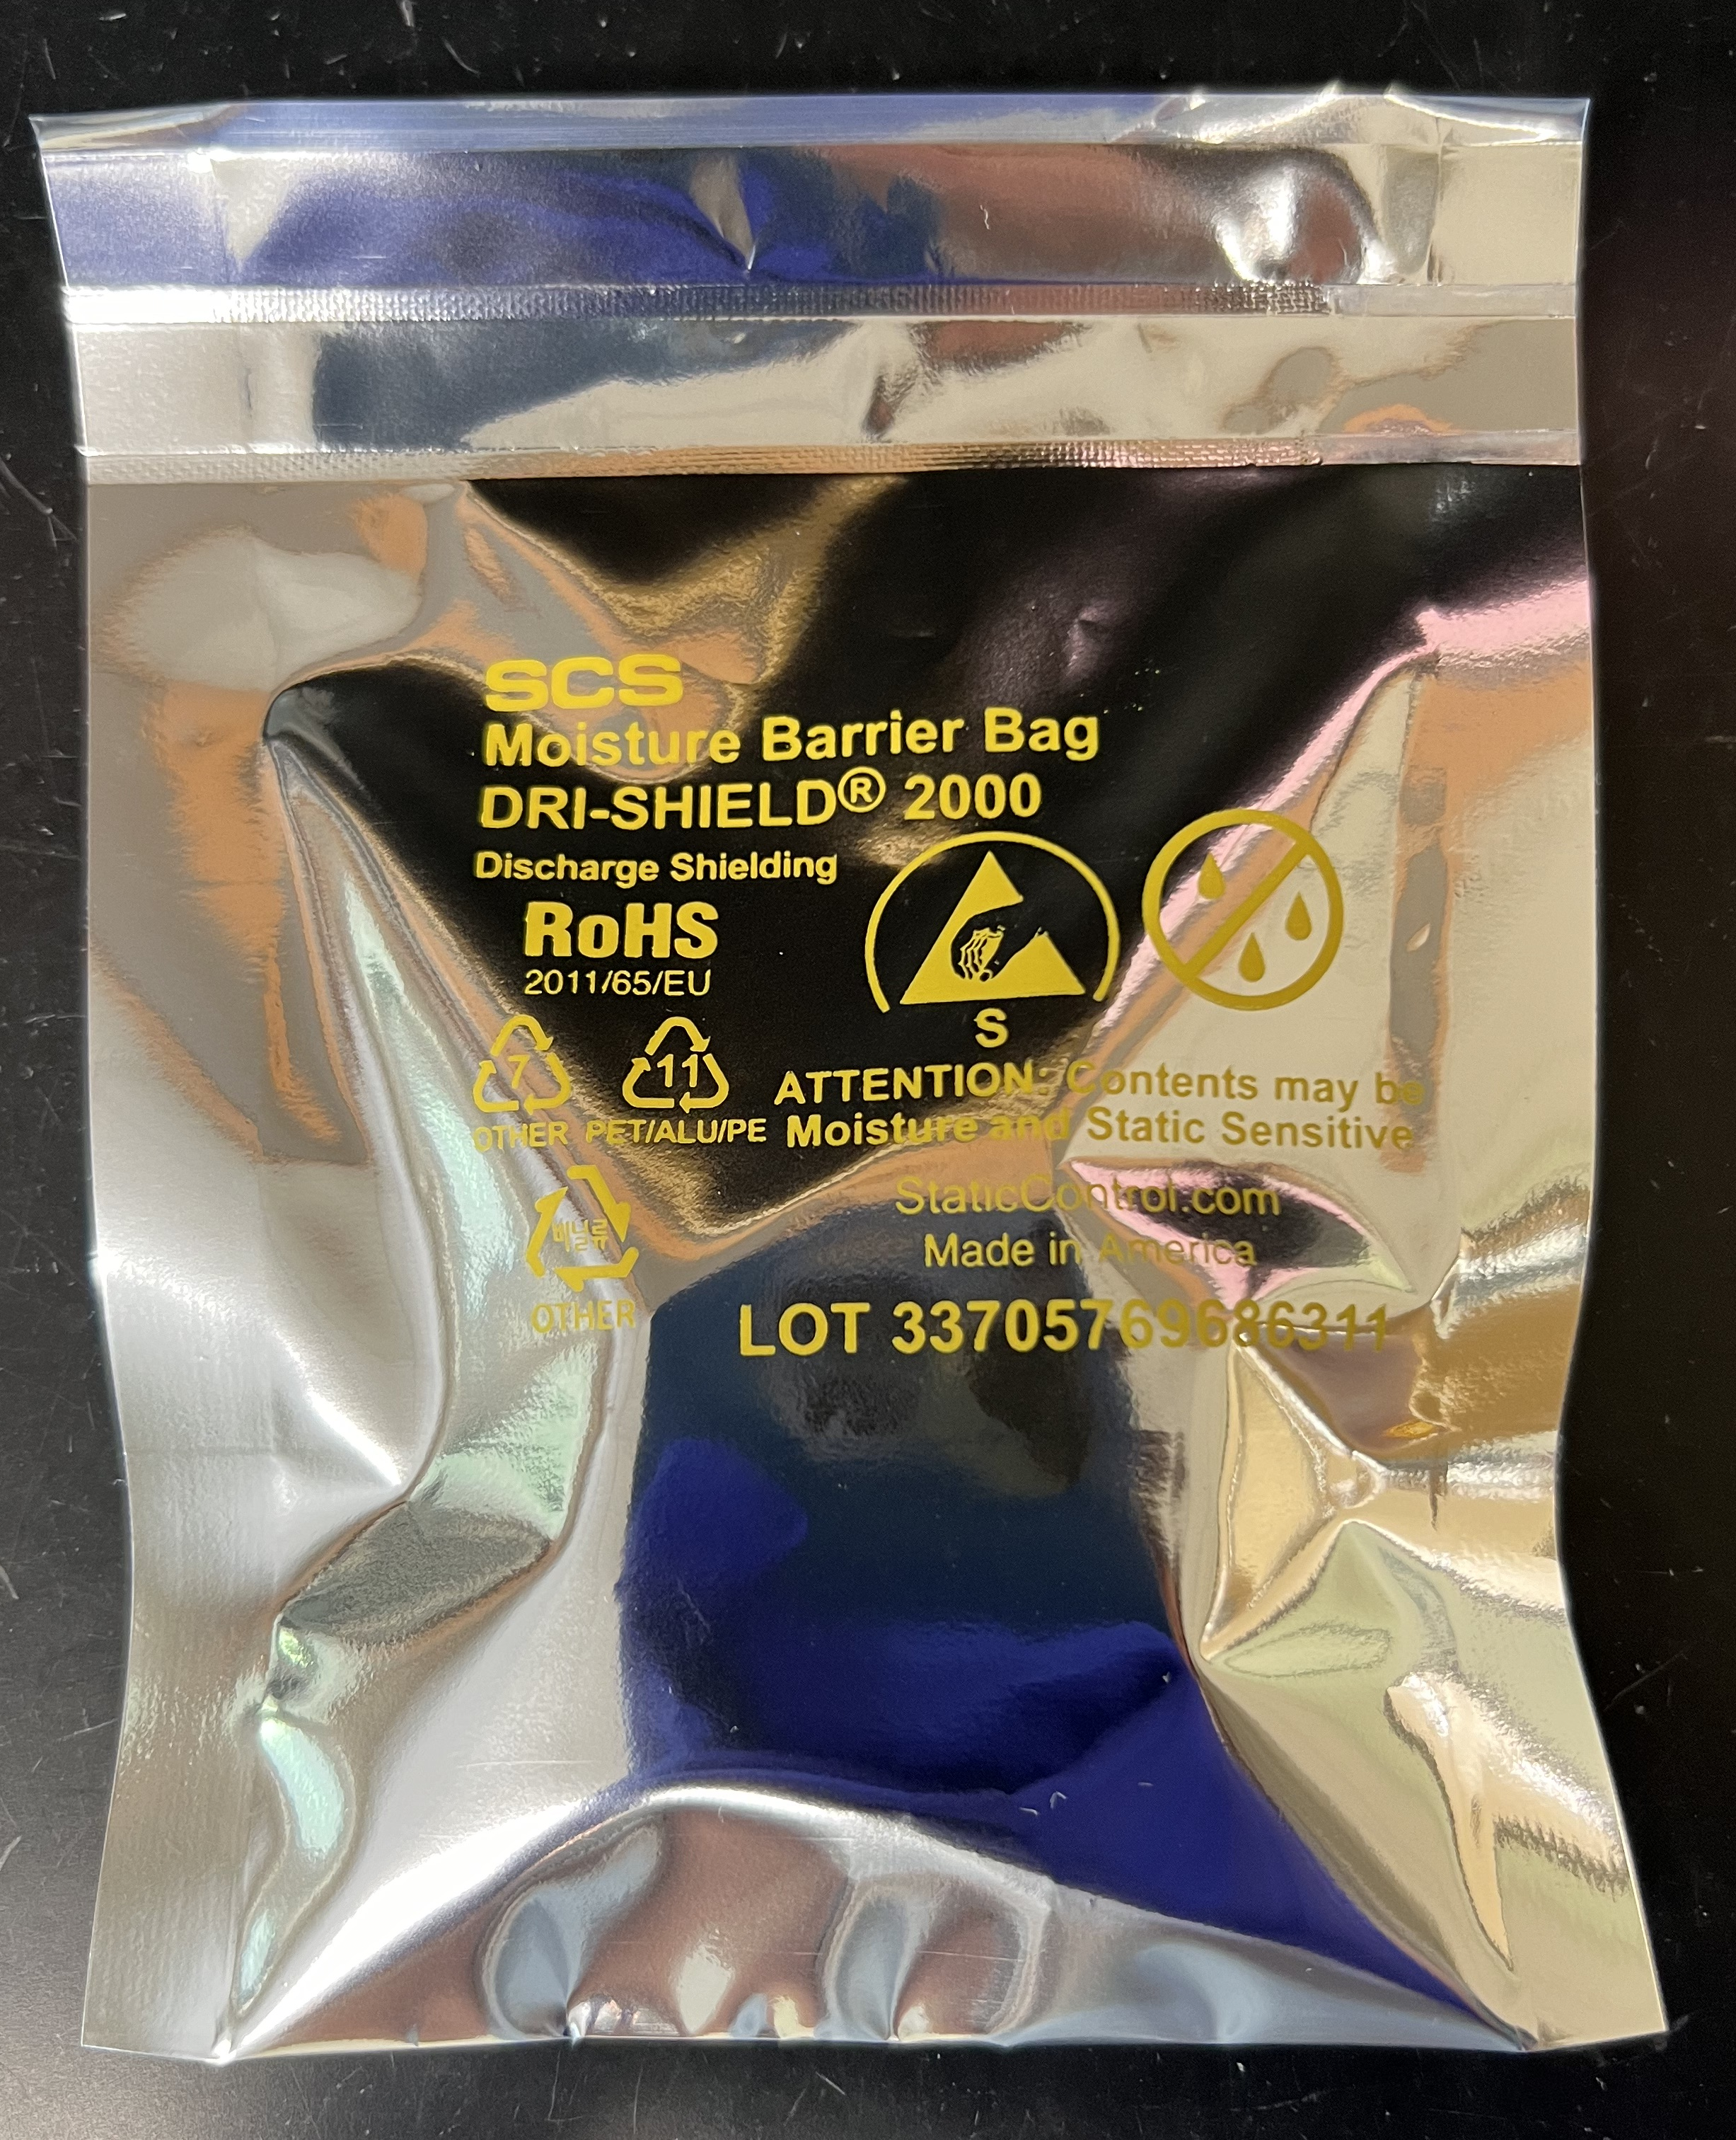
Terminal Deoxynucleotidyl Transferase Nick End Labeling (TUNEL) analysis
Fresh controls fixed in 4% paraformaldehyde
Rehydration and fixation in 4% paraformaldehyde
7 days (d) at 4˚C
7d at room temperature (RT)
28d at 4˚C
28d at RT
Fresh oocytes
Permeabilize membrane in hemolysin
Microwave drying
Trehalose glass formation
Trehalose loading
Storage
Storage
Notes:
1) Fresh oocytes were collected from a large infertility practice each day, approx. 24 hours following retrieval. These oocytes had been stripped of cumulus cells and kept in culture media overnight to allow for maturation. If they were deemed immature and planned for discard, then they were pooled and transported in an Eppendorf tube filled with culture media in a 38.5˚C aluminum block to maintain physiologic temperatures.
2) Oocytes were split into fresh controls and drying. The controls were immediately fixed in 4% PFA and stored at 4˚.
3) The oocytes designated for drying were transferred into fresh, warmed culture media (38.5˚C). They were then placed in a hemolysin solution at 38.5˚C for 15 minutes to allow for membrane permeabilization.
4) Oocytes were washed of hemolysin and then placed in a 1.1M trehalose droplet and incubated for 10 minutes at room temperature.
5) The oocytes were loaded into a stripper pipette and deposited onto weigh paper with 40 microliters of trehalose solution. They were placed in a SAM 255 microwave system for 30 minutes at 40˚C.
6) This picture shows the trehalose glass formed after drying. The dried oocytes were either immediately rehydrated or placed into storage groups. The samples were stored in the petri dishes, covered in parafilm, and sealed in a moisture barrier bag.
Immediate rehydration was used to determine ease of oocyte recovery at the beginning stages of the experiment as well as to determine whether the microwave process itself affected the DNA integrity of the cells.
For the storage groups, oocytes were stored for 7 days at 4˚C (refrigeration), 7 days at room temperature, 28d at 4˚C, or 28d at RT. We expected the DNA to be more stable at lower temperatures (i.e. refrigeration), but we included a RT group to see how high of a temperature they could tolerate.
7) The oocytes were then rehydrated and fixed in PFA. All oocytes, controls and experimental, were then evaluated for DNA integrity using terminal deoxynucleotidyl transferase nick end labeling (TUNEL) analysis with fluorescence microscopy, which I will review in more detail now.

Slide 6
dapi
TUNEL
composite
Notes:
The first column of photos is DAPI (4′,6-diamidino-2-phenylindole) staining. DAPI is a blue-fluorescent DNA stain that exhibits fluorescence upon binding to AT regions of dsDNA.
The second column is the TUNEL staining, which is a green-fluorescent DNA stain that stains for DNA breaks.
The third column is a composite of the DAPI and TUNEL staining photos.
As you can see in the first row, the oocyte is a GV *CLICK* with no positive TUNEL staining *CLICK*. In the second row, the oocyte is difficult to stage, but the DNA is located *CLICK* here (the other areas of fluorescence are remaining cumulus cells). As you can see in the TUNEL staining, there is green stain in the area in which the DNA is located on the DAPI slide *CLICK*. If DNA damage is extensive, it may not dye as well with the DAPI, but will show on the TUNEL analysis and is depicted here and better seen in the composite picture *CLICK* where you can see the additional green staining with no overlap of blue.
Fluorescence signal intensity measurements for analysis of TUNEL staining was performed using ImageJ. Background subtraction was performed using a neighboring equal-size and DNA-free cytoplasmic region. The signal intensity measurements were then normalized to the control oocytes that were collected and stained on the same date.
Pei-Chih comment: distinguish maternal chromatin and CC
Comparisons of signal intensity were performed using Wilcoxon rank sum tests. P-values < 0.05 were considered significant.

Slide 7
Results
Average Recovery
 | Desiccated | Recovered | Percent Recovery
Overall | 381 | 361 | 94.8%
Immediately Rehydrated (IR) | 65 | 64 | 98.5%
7 days at 4˚C | 81 | 74 | 91.4%
7 days at room temperature (RT) | 88 | 84 | 95.5%
28 days at 4˚C | 77 | 72 | 93.5%
28 days at RT | 70 | 67 | 95.7%
Notes:
This slide shows oocyte recovery, meaning how many were retrieved after rehydration; with freezing, the term survival is used. As you can see, we had almost 95% recovery overall of all groups and over 90% recovery in each individual group.

Slide 8
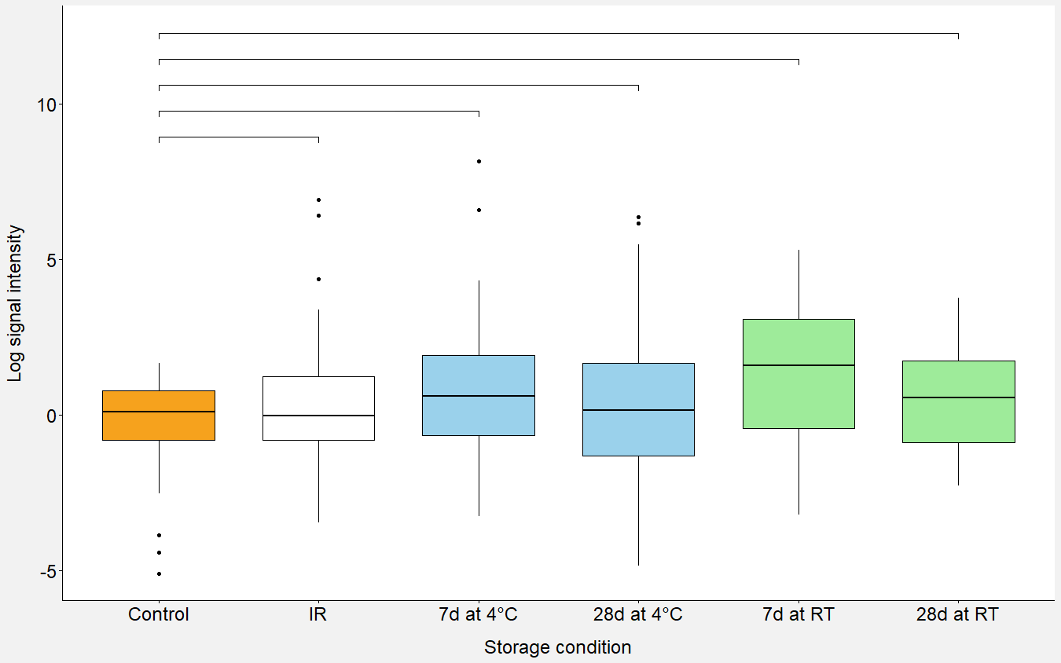
Comparison of all Drying groups to Fresh Controls
p = 0.04
p <0.001
p = 0.81
p = 0.02
p = 0.30
Log TUNEL Signal Intensity
Notes:
Signal intensity medians were calculated for all groups and transformed to log scale to account for outliers. Comparisons of signal intensity between the controls and treatment groups were performed using Wilcoxon rank sum tests and p-value < 0.05 was considered significant.
Comparing all conditions to the control:
Orange is control
White is immediate rehydration
Blue is 4˚C storage groups
Green is RT groups
Control to IR – no difference
7d at 4deg – elevated DNA damage with 1.7 fold change
28d at 4deg – no difference
7d at RT – elevated DNA damage with 4.5 fold change
28d at RT – elevated DNA damage with 1.6 fold change

Slide 9
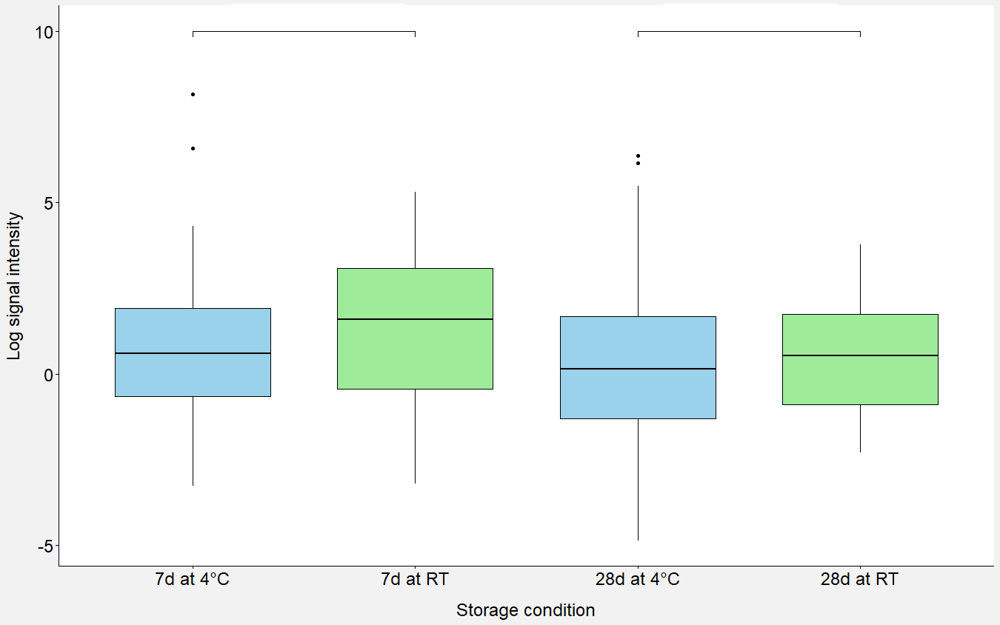
Comparison of Drying groups by storage temperature
p = 0.12
p = 0.50
Log TUNEL Signal Intensity
Notes:
Comparing conditions by storage temperature. No difference comparing 7d at 4deg versus RT on the left or 28d at 4deg and RT on the right.

Slide 10
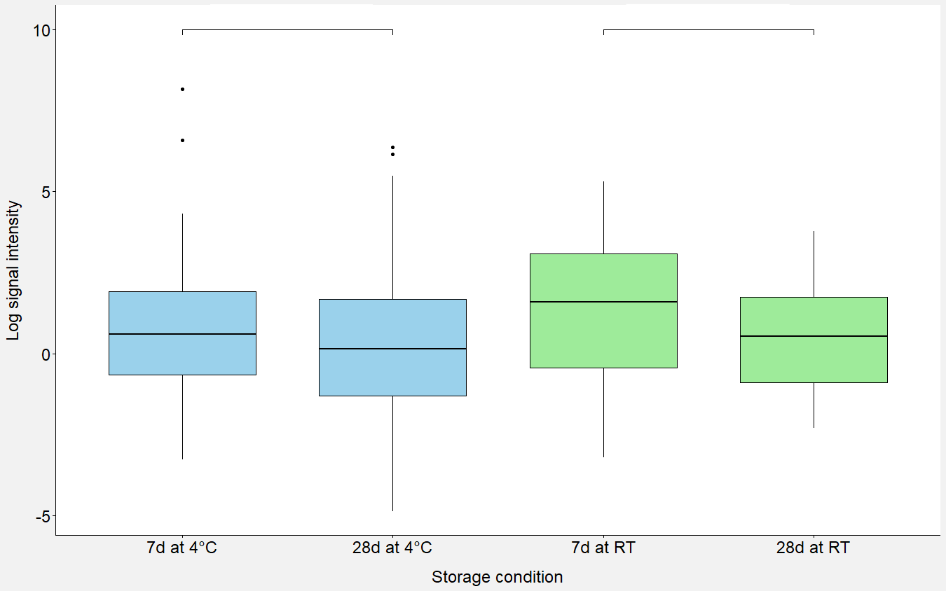
Comparison of Drying groups by storage duration
p = 0.34
p = 0.07
Log TUNEL Signal Intensity
Notes:
Comparing condition by storage time. No difference between 7d at 4deg versus 28d at 4deg on the left. Additionally no difference between 7d at RT versus 28d at RT on the right.

Slide 11
Discussion
Strengths
Limitations
First study applying this technology to human gametes
Large pool of human oocytes for analysis
DNA is more resilient to dehydration stress
Oocytes deemed for discard
Oocytes not separated by patient/age
No freezing comparison group(s)
Loss of membrane integrity
Oocytes deemed for discard
Notes:
Strengths:
First study applying this technology to human gametes
large pool of human oocytes for analysis
Showed that DNA integrity was not affected by dehydration itself (IR group), thus DNA is more resilient to dehydration stress
Oocytes deemed for discard – not “wasting” good human samples (perfect material for the first investigation of this technology in human gametes).
Limitations:
pooled, not separated by patient age or patient themselves (limited by small numbers from each patient) which could have affected the results if one patient has inherently more damaged oocytes compared to another
No comparison storage groups using freezing technology; this was a limitation purely due to numbers of oocytes collected each day and concern for too small of aliquots to have a meaningful analysis. However, this group could be added now and potentially compare it to a refrigeration group.
Loss of membrane integrity with hemolysin → could try cold responsive nanoparticles (which was the original plan, unable to currently due to lack of supply) or electroporation (high risk for cell death).
inherently abnormal oocytes that were difficult to stage or could not progress to M2 stage so there’s a possibility the DNA damage shown was inherent to the cells themselves as opposed to the manipulations in the lab

Slide 12
Conclusions
DNA integrity in the oocytes was maintained after dehydration with immediate rehydration
DNA damage was increased after 7 days of storage at both 4˚C and room temperature, with increased damage noted in the room temperature group (1.7 fold increase versus 4.5 fold increase).
Damage was also increased in the 28 day at room temperature storage group with 1.6 fold increase, but this was not seen at 4˚C.
Notes:
Overall, DNA integrity in the oocytes was maintained after dehydration with immediate rehydration.
DNA damage was increased in both 7d storage groups, with increased damage noted in the RT group with 4.5 fold increase.
Damage was also increased in the 28 day group at room temperature with 1.6 fold increase; this was not seen, however, in the 28 days at 4˚C group.
The differences in DNA damage in the storage groups may be secondary to inherent characteristics of the oocytes on day of collection such as poorer quality, high variation of patient ages, and limited number of samples each day for comparison. Conversely, the lack of differences in the 28-day group at 4 deg may have been masked due to such variation in oocytes by day of collection.

Slide 13
Conclusions and Future Directions
Microwave-drying of human oocytes may not adversely affect DNA integrity of the cells.
Provides proof of concept for possibility of drying and storing human oocytes at non-freezing temperatures. Sample stability was better maintained at 4˚C compared to room temperature.
Further study is needed to assess effects on good quality oocytes, longer storage times, and assessment of oocyte competence with fertilization.
Notes:
Microwave-drying of human oocytes may not adversely affect DNA integrity of the cells.
Our study provides a proof of concept for the possibility of drying and storing human oocytes at non-freezing temperatures. Sample stability was better maintained at 4˚C compared to RT.
Further study is needed to assess effects on good quality oocytes (such as donated M2s), longer storage times, as well as assess oocyte competence with fertilization.
Possible questions:
If membrane integrity is poor, how can you use the oocyte? → Ideally, we could use the cold responsive nanoparticles which maintains the membrane integrity and therefore the cell could potentially be used. However, if the membrane is not intact, the goal is to maintain the nucleus for transfer to fresh cytoplasm (GV nuclear transfer). So you could use a donor oocyte and transfer the patient’s genetic material. This is being discussed in animals to help with ”genetically valuable individuals” (i.e. endangered)
Why not do IVM of GVs to assess competence? → few to no cumulus cells to allow for IVM, but this was discussed. Also had very few GVs in total; most oocytes were difficult to stage, but were clearly not M2s
Why not compare the IR group to the storage groups? → we are in the process of evaluating that and will plan to include it in thesis defense/manuscript.

Slide 14
References
Comizzoli P, He X, Lee PC. Long-term preservation of germ cells and gonadal tissues at ambient temperatures. Reprod Fertil. 2022 Mar 21;3(2):R42-R50. doi: 10.1530/RAF-22-0008.
Lee PC, Stewart S, Amelkina O, Sylvester H, He X, Comizzoli P. Trehalose delivered by cold-responsive nanoparticles improves tolerance of cumulus-oocyte complexes to microwave drying. J Assist Reprod Genet. 2023 Aug;40(8):1817-1828.
Hibshman JD, Clegg JS, Goldstein B. Mechanisms of Desiccation Tolerance: Themes and Variations in Brine Shrimp, Roundworms, and Tardigrades. Front Physiol. 2020 Oct 23;11:592016.
Comizzoli P, Amelkina O, Lee PC. Damages and stress responses in sperm cells and other germplasms during dehydration and storage at nonfreezing temperatures for fertility preservation. Mol Reprod Dev. 2022 Dec;89(12):565-578.
Patrick JL, Elliott GD, Comizzoli P. Structural integrity and developmental potential of spermatozoa following microwave-assisted drying in the domestic cat model. Theriogenology. 2017 Nov;103:36-43.
Elliott GD, Lee PC, Paramore E, Van Vorst M, Comizzoli P. Resilience of oocyte germinal vesicles to microwave-assisted drying in the domestic cat model. Biopreserv Biobank. 2015 Jun;13(3):164-71.
Lee PC, Comizzoli P. Desiccation and supra-zero temperature storage of cat germinal vesicles lead to less structural damage and similar epigenetic alterations compared to cryopreservation. Mol Reprod Dev. 2019 Dec;86(12):1822-1831.
Lee PC, Zahmel J, Jewgenow K, Comizzoli P. Desiccated cat spermatozoa retain DNA integrity and developmental potential after prolonged storage and shipping at non-cryogenic temperatures. J Assist Reprod Genet. 2022 Jan;39(1):141-151.

Slide 15
Acknowledgements
Howard Li, MD
Luiz Colturato, PhD
Kerry Flannagan, PhD
Kate Devine, MD
Micah Hill, DO
Pierre Comizzoli, DVM, PhD
Pei-Chih Lee, MS, PhD
Notes:
I would like to thank everyone in the lab for helping me with this project, especially Pei-Chih Lee who mentored and taught me so much. I would also like to thank everyone at Shady Grove involved with this project, especially Luiz, the embryologist who helped collect oocytes for me every day as well as all of the patients willing to donate their oocytes to research. Thank you for your time and attention and I will take any questions at this time.

