Slide 1
The Cardinal Protocol
A Low-Cost Option for Oocyte Cryopreservation,
A Prospective Non-Inferiority Cohort Study
Esther H. Chung MD, Natasha Raj-Derouin MD, Jiaqi Zhang MS, Victoria Harbour MS, Metabel Markwei MD, Arian Khorshid MD, Brindha Bavan MD MS, Lusine Aghajanova MD PhD, Ruth B. Lathi MD
03.2025
Notes:
My name is Esther Chung, 3rd year REI fellow at Stanford. Thank you to the PCRS committee for the opportunity to present today.
I will be presenting the Cardinal Protocol. We investigate this low-cost option for oocyte cryopreservation with a prospective non-inferiority cohort study.

Slide 2
Disclosures
No disclosures related to the content of this abstract
I serve as an advisor to LEVY Health
Notes:
I have no relevant disclosures.

Slide 3

“Our field needs to identify cost-effective treatments, even if their success rate is lower, that patients shut out by finances can afford.”
ASRM’s Access to Care Summit 2015
Notes:
The 2020-2025 strategic plan of ASRM prioritized equitable, affordable access to reproductive healthcare(1–3), as did their Access to Care Summit White Paper that said, “Our field needs to identify cost-effective treatments, even if their success rate is lower, that patients shut out by finances can afford.”

Slide 4
However, methods to achieve affordability without sacrificing efficacy have not been rigorously studied.
Notes:
Despite this, methods to achieve affordability without sacrificing efficacy have not been rigorously studied, and even less so for patients desiring egg cryo.

Slide 5
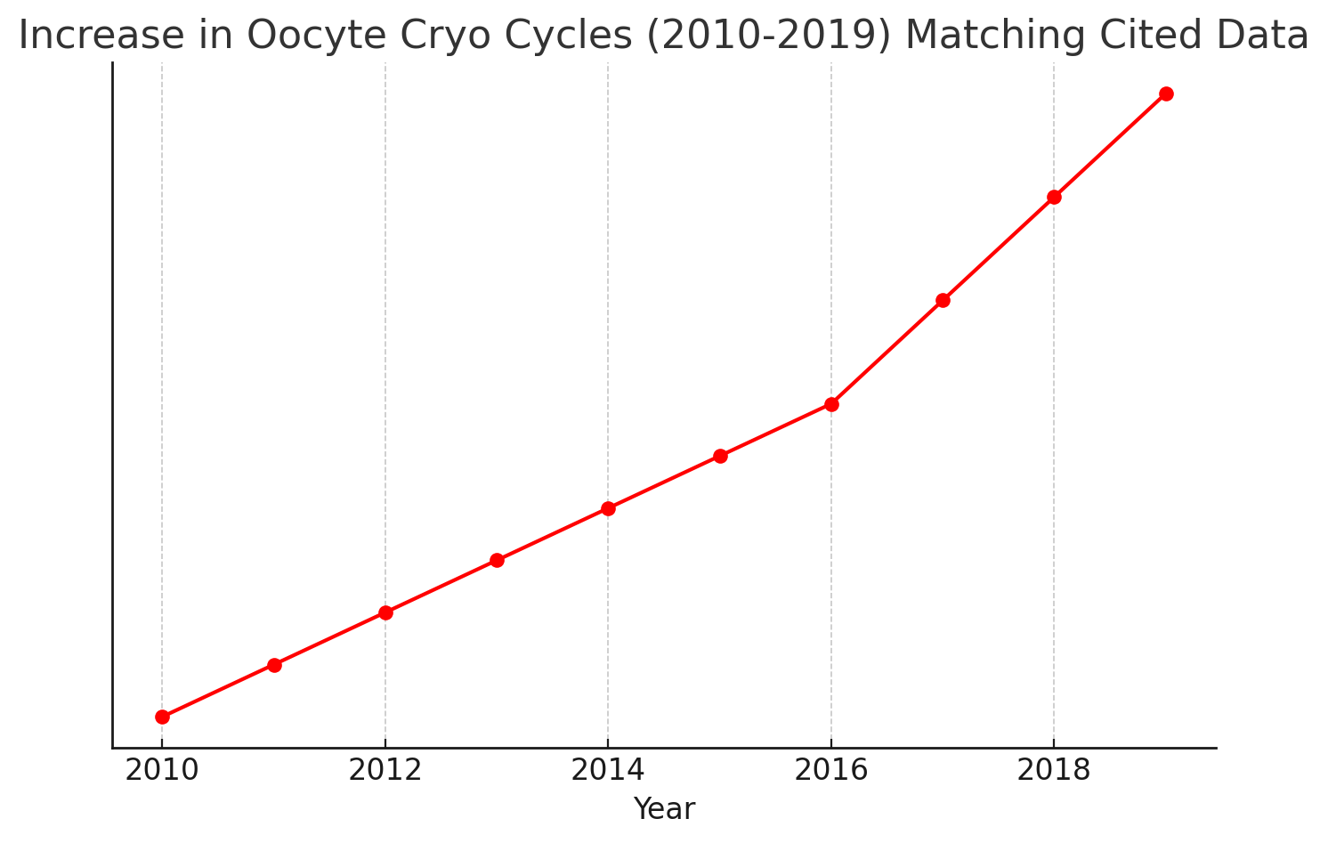
Notes:
But access-to-care to egg cryo is increasingly relevant, as seen by the nearly 2000% increase in OC cycles between 2010 and 2019. With planned OC frequently not covered by insurance and excluded by mandates, this can lead to greater disparities from the standpoint of future reproductive options and outcomes.
//
Here is the adjusted graph that matches the cited data:
2010 to 2016: 880% increase in oocyte cryopreservation cycles.
2016 to 2019: 89% increase in cycles.
2010 to 2019: Nearly 2000% increase overall. 1781%

Slide 6
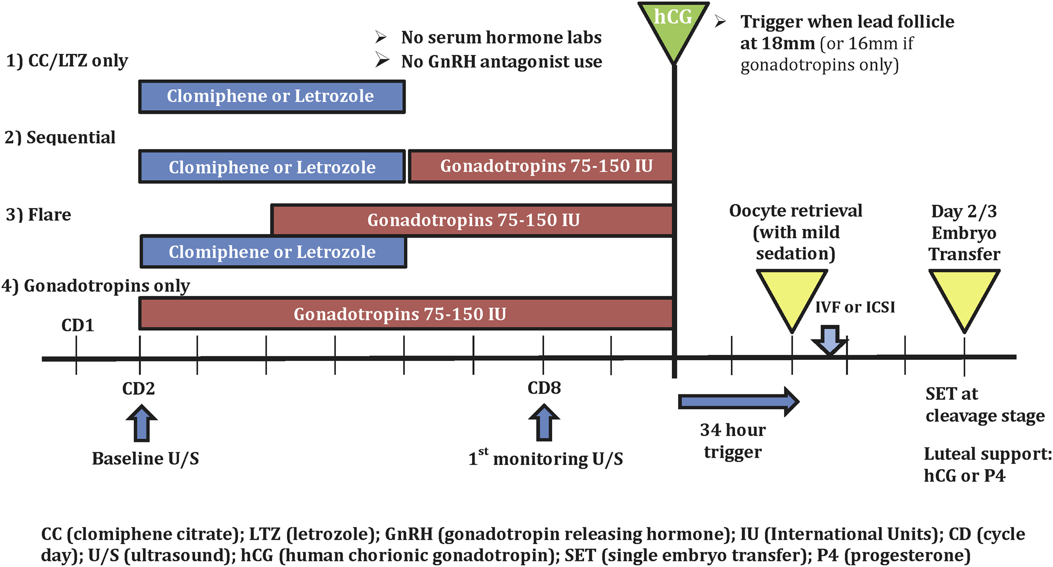
Existing published data on low-cost protocols are sparse.
 | CC/LTZ only (24) | Sequential (13) | Flare (64) | Gonadotropins only (6)
Total FSH dose, IU | NA | 501.9^{b} ± 274.5 | 846.4^{c} ± 432.8 | 1,375^{d} ± 468.8
# of oocytes retrieved | 2.3^{b} ± 2.2 | 3.7^{b,c} ± 3.3 | 4.8^{c} ± 3.0 | 5.2^{b,c} ± 4.4
Oocyte maturity, % | 80.0 ± 18.3 | 59.0 ± 43.3 | 78.2 ± 26.0 | 68.3 ± 20.7
Pregnancy rate: 44.6%
Cumulative LBR/retrieval: 29%
Cancellation rate prior to retrieval: 33.5%
Notes:
Despite increased attention in our field to broaden access to care, even with ASRM encouraging modification of current practices, methods to achieve affordability without significantly sacrificing efficacy haven’t been rigorously studied in the literature. One study by Herndon et al. in 2017 demonstrated a low-cost IVF program at UCSF using oral OI agents in conjunction with low-dose gonadotropins, limited US monitoring (2 scans), and no labs, to provide infertility treatment to 65 patients from low socioeconomic communities. They achieved a 29% cumulative LBR per retrieval. An obvious imitation of this study included its very small sample size, which anecdotally, we have heard is reflective of its current usage at UCSF as well.
4 different mild stimulation protocols:
Clomiphene/letrozole alone
2 CC/LZ based protocols involving sequential or flare addition of low-dose gonadotropins (75-150) or flare addition of low-dose gonadotropins
Low-dose gonadotropins alone
Clinical fellows managed all aspects of cycle prep, monitoring, retrieval and ET
Retrieval undertaken w/o admin of deep anesthesia
Lab interventions minimized
All ETs performed at cleavage stage
Results: 2010-2016, 65 patients who initiated 161 stimulation IVF cycles, 33.5% cycles cancelled before retrieval, 13% due to premature ovulation, Cumulative LBR per retrieval including subsequent use of frozen embryos: 29%; 44.6% of patients enrolled achieved pregnancy
Outcomes: treatment response, pregnancy outcomes

Slide 7
Current options to lower cost of IVF: a comprehensive review
OPTIONS TO
LOWER COSTS
OF IVF
HMG only (no rFSH)
Provera instead of Antag
Mini-Stim
US only (no labs)
Notes:
There was a recent F&S review written by one of our rotating residents Dr. Austin Gardner, who reviewed current options to lower the cost of IVF. Mini-stim was reviewed with the use of oral OI agents +/- low-dose injectables, which does decrease cost and lower OHSS risk but does result in lower #s of oocytes and cryopreserved embryos, creating the potential need for more treatment cycles and similar to lower cumulative preg rates. In the category of decreasing lab and medication costs for patients, studies comparing US monitoring alone versus US & Bloodwork demonstrated no major differences in stim duration, embryo quality, and clinical pregnancy rates. Comparing HMG alone versus with recombinant FSH, HMG only protocols were noted to be more cost-effective with no differences in outcomes. Last but not least, there is growing RCT and cohort studies suggesting the use of Provera or medroxyprogesterone acetate (MPA) as cost-effective over GnRH Antagonist use with no significant differences in outcome for freeze-all cycles.
//
The use of oral progestins for prevention of premature luteinisation was originally introduced in China as a less costly and more patient-friendly method (Kuang et al., 2015). In a recent study evaluating the cost-effectiveness of ovulation suppression with progestins compared with GnRH analogues in ART cycles, progestins were found to be cost-effective in elective freeze-all cycles (Evans et al., 2019).

Slide 8
How much does an OC cycle cost?
Notes:
So how much does an OC cycle cost?

Slide 9
Cost estimates range from $12-24K
Notes:
Outstandingly, current cost estimates for 1 OC cycle, including meds, range from $12-24,000 based on the literature and institutional pricing(2,7).

Slide 10
Cardinal Protocol
Notes:
In response to this, we designed the novel Cardinal protocol—a cost-conscious, simplified version of our routine, high-cost protocols.

Slide 11
standardized gonadotropin dosing
use of progestin
limited ultrasound visits (2)
no bloodwork (0)
Notes:
Its simplification derives from standardized gonadotropin dosing, use of progestin in place of antagonist, limited ultrasound visits, and no bloodwork.

Slide 12
Objective
Could the novel low-cost Cardinal protocol achieve non-inferior clinical outcomes in OC cycles compared to routine high-cost protocols?
Notes:
The objective of our study was to determine whether this Cardinal protocol could achieve non-inferior clinical outcomes in OC cycles compared to our clinic’s routinely used autologous protocols.

Slide 13
 | Cardinal Protocol | Routine Protocol - Antagonist
# of Ultrasounds | 2* (Baseline + SD9) | ~4-7 per provider discretion
Bloodwork | None* | ~4-7 per provider discretion
Gonadotropin doses | 225 IU if AMH > 4 300 IU if AMH < 4 | Up to 450 IU; dose adjustments during cycle per provider discretion
Prevent premature surge timing | Start standardized on SD 6 (AM) | Individualized based on follicle size + E2
Medicine to prevent premature surge | Oral Provera 10mg | Antagonist injections
Trigger timing | At least 3 follicles projected >18mm (Auto-trigger on SD9) | Provider discretion based on scans + bloodwork
Trigger choice/dose | 5K hCG + 4mg Lupron; Adjust hCG dose or Lupron-only trigger per provider discretion | 5K hCG + 4mg Lupron; Adjust hCG dose or Lupron-only trigger per provider discretion
*provider can add scans/bloodwork when deemed medically necessary
Notes:
The two protocols and their differences are outlined side-by-side here.
The Cardinal Protocol includes 2 US (Baseline and SD9), no bloodwork, standardized FSH dosing (AMH <4: 300 IU, AMH >4: 225 IU), scheduled progestin start (Provera 10mg starting morning of SD6), and auto-trigger on SD9 (when >3 follicles are projected >18mm). A dual trigger of hCG 5K and Lupron 4mg was the standard, but providers could modify the trigger dose and consider Lupron-only if concern for OHSS.
For the Cardinal protocol, providers were still allowed to add additional ultrasounds and/or bloodwork, when deemed medically necessary or for the patient’s safety.
--
On the other hand, routine clinic protocols include up to max-dose (450 IU) gonadotropins and generally 5-7 ultrasounds, and generally 3-5 blood draws. The most used clinic protocol is the antagonist protocol, and the second is the microdose Lupron flare protocol. Gonadotropin dose changes are allowed per provider discretion. The antagonist injection is started flexibly, depending on follicle size >14 mm or E2 >500 pg/mL per provider discretion. Patients are triggered on the night of their last ultrasound, with triggers and their dosing decided by their physician.
This included estradiol (E2) levels if there was a cyst noted on a baseline scan or if there was high concern for moderate-severe OHSS on SD9. Additional scans were ordered if a patient had a levonorgestrel IUD in place to help place them in their menstrual cycle, as well as if the physician found it difficult to predict the best day for auto-trigger if lead follicles on SD9 were <14 mm.

Slide 14
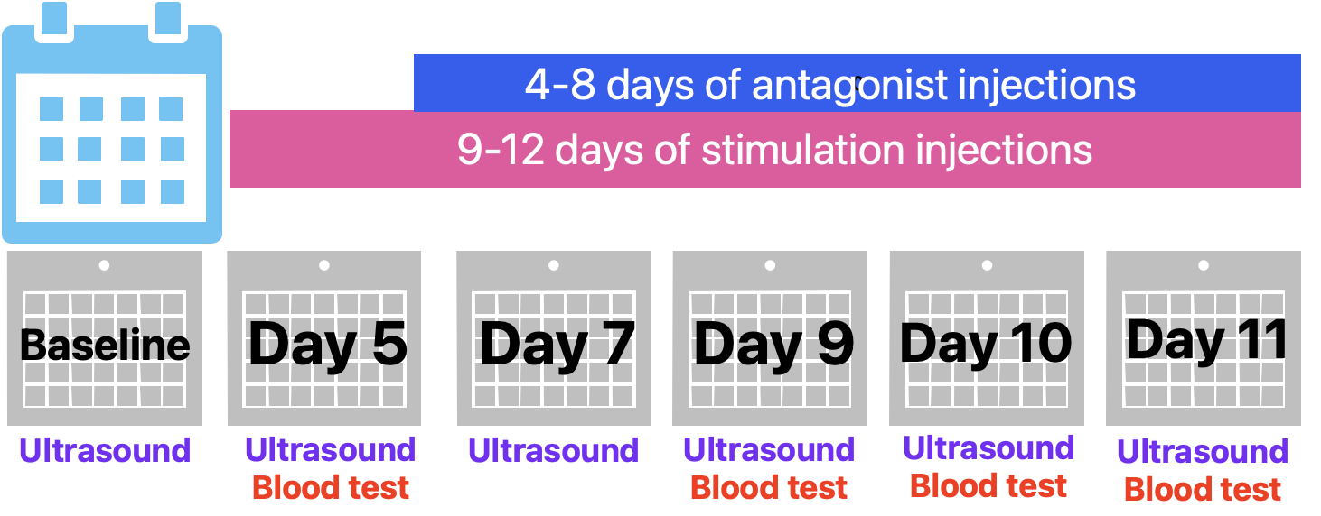
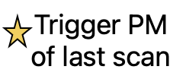
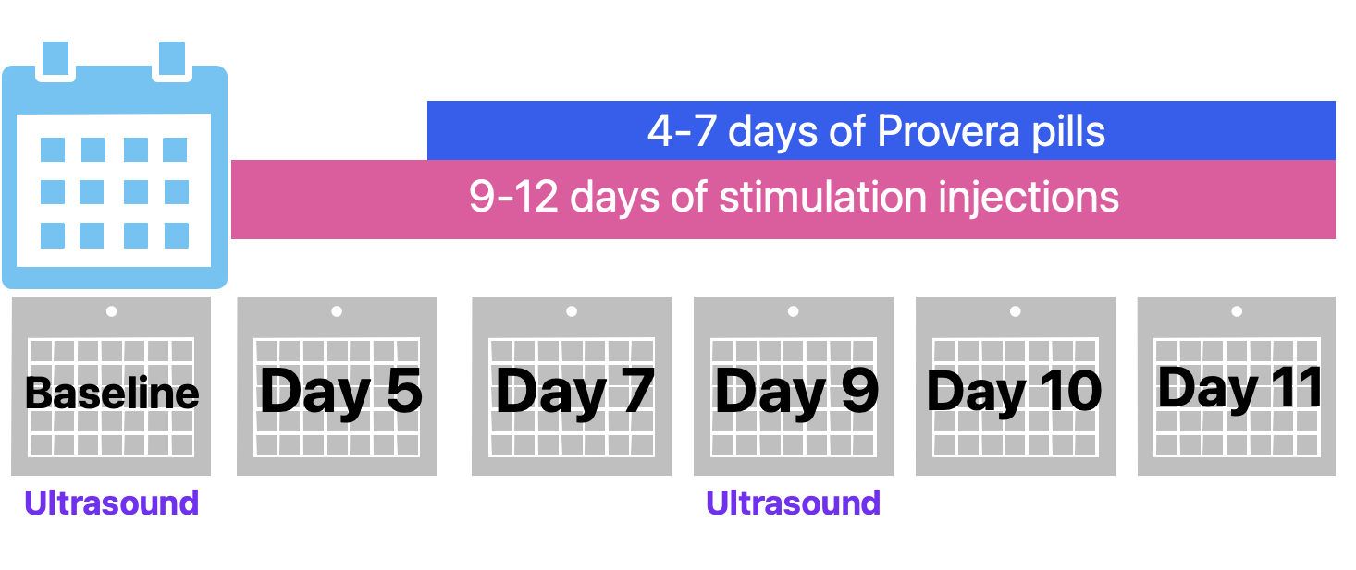
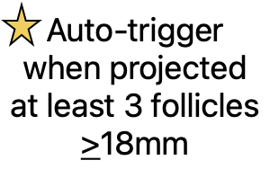
Routine (Antagonist) Protocol
9-12 days of up to max dose injections
adjustable dosing
4-8 daily antagonist injections
4-7 ultrasounds
3-4 blood draws
triggered on last scan
$$$
Cardinal Protocol
9-12 days of standardized dose injections
4-7 days of Provera pills
2 ultrasounds (baseline + SD9)
0 blood draws
auto-trigger on SD9
$ (average cost savings: ~$5K)
Notes:
Sample schedules of these two protocols are presented here.

Slide 15
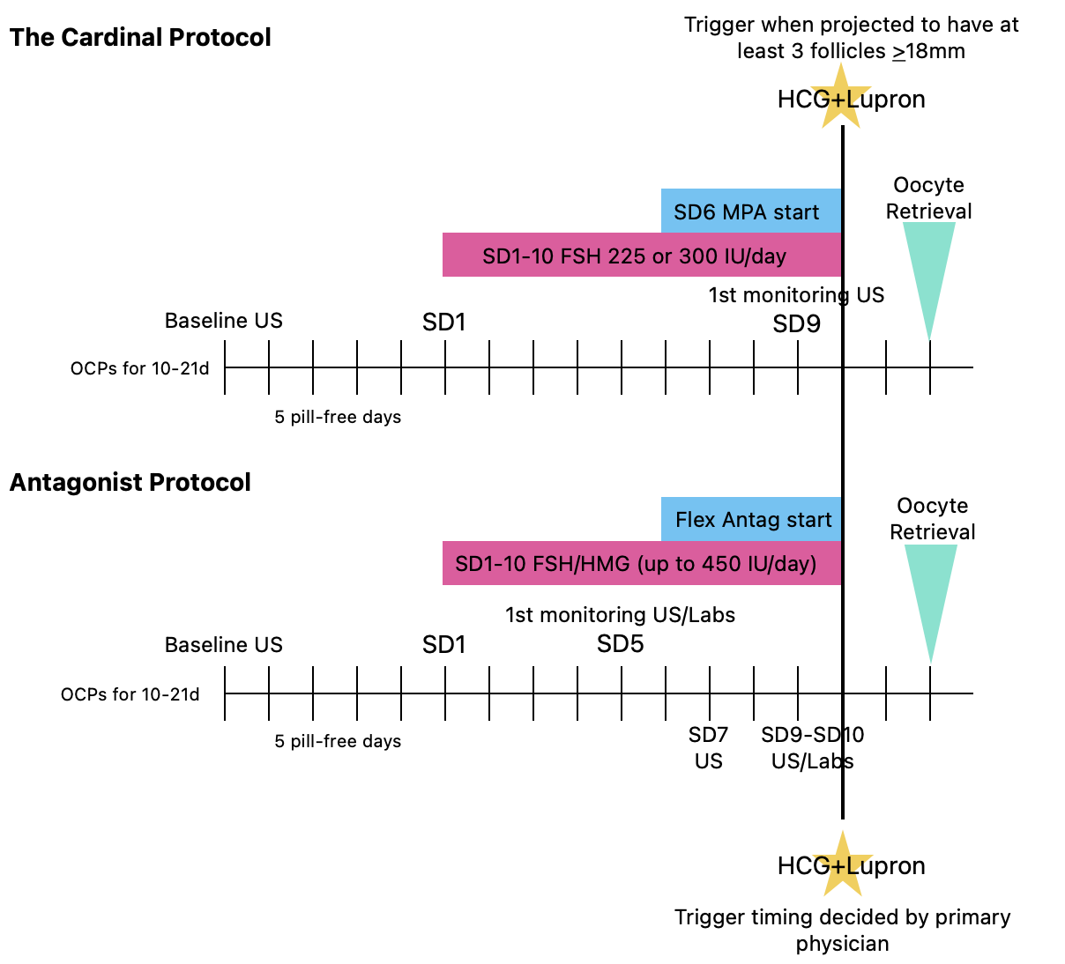

Slide 16
Hypothesis
The Cardinal protocol would offer non-inferior clinical outcomes for patients with respect to the number of MIIs retrieved and decrease costs.
Notes:
We hypothesized that the Cardinal protocol would offer non-inferior clinical outcomes with respect to the number of mature oocytes retrieved, as well as decrease costs.

Slide 17
Design
Prospective non-inferiority cohort study
Approved by Stanford University IRB
ClinicalTrials.gov ID NCT05842070
Notes:
This prospective study was approved by the Stanford IRB

Slide 18
Subject Eligibility
Inclusion Criteria
Ovary-bearing individuals aged 18-40, interested in pursuing OC from July 2023 -Aug 2024
AMH > 0.3 ng/mL
AMH < 7 ng/mL
Exclusion Criteria
AMH > 7 ng/mL or physician concern for risk of developing severe OHSS
Severe diminished ovarian reserve (DOR) def. as AMH < 0.3 ng/mL or FSH > 15
BMI > 45
Contraindications to ovarian stimulation or outpatient oocyte retrieval under anesthesia
Recent diagnosis of malignancy or disease requiring immediate OC prior to starting gonadotoxic therapy
Notes:
Patients undergoing planned OC were prospectively recruited between July 2023 and Aug-2024
Inclusion criteria were kept purposefully broad to enable access-to-care for our patient population. So ovary-bearing individuals aged 18-40, with an AMH b/w 0.3 and 7
Exclusion criteria included: AMH >7 ng/mL or physician concern for risk of developing severe OHSS, severe DOR defined as AMH <0.3 ng/mL, a BMI >45, Contraindications to stim or outpatient egg retrieval under anesthesia, and oncofertility patients

Slide 19
Exposure
Participants were allowed to choose between the routine high-cost protocols vs. the low-cost Cardinal protocol.
Notes:
Participants were allowed to choose between the routine protocols as chosen by their physician vs. the low-cost Cardinal protocol.

Slide 20
Main Outcome Measures
Primary Outcome: # of MIIs retrieved.
Secondary Outcomes:
Total # of oocytes retrieved
Total # of MIIs and MI-MIIs retrieved
Total # of oocytes cryopreserved
Premature ovulation
Cycle cancellation
OHSS
Post-retrieval surgical complications
Total charges (including cost of medications)
Notes:
The primary outcome was the number of MIIs retrieved. Related secondary outcomes were the total # of oocytes retrieved and total # of MIIs and MI-MIIs retrieved. Other clinically important secondary outcomes included premature ovulation, cycle cancellation, OHSS, post-retrieval surgical complications. Total charges (including medications) were also noted.

Slide 21
Statistical Methods
Hypothesis Testing
Null hypothesis (H₀): The Cardinal protocol is inferior to routine by >5 MIIs
Non-inferiority margin: -5 MIIs
Sample Size Calculation:
Total participants: 52 (26 per group)
Power: 80%
Primary Statistical Analysis:
Multivariable linear regression with Generalized Estimating Equations
Model adjusts for age, BMI, race, ethnicity, AFC, and AMH
Robust (sandwich) variance estimator to construct CI
Notes:
The study uses a non-inferiority framework to evaluate whether the Cardinal yields an average number of MIIs not inferior to that obtained through routine protocols. A non-inferiority margin of -5 MIIs per retrieval was selected based on existing literature, which reports approximately 45% variability in stimulation response(12–14). To achieve 80% power, 52 participants (26 per group) would be required.
For the primary analysis, multivariable linear regression using Generalized Estimating Equations was employed to account for within-group correlations. The model adjusted for age, BMI, race, ethnicity, antral follicle count (AFC), and anti-Müllerian hormone (AMH).
//
Comparisons between groups were conducted using the Wilcoxon rank sum test for continuous variables, while categorical variables were analyzed using Pearson’s Chi-square test or Fisher’s Exact test, as appropriate.
A non-inferiority margin of -5 MIIs per retrieval was selected based on existing literature on planned OC, which reports expected average yield of 9-13 MIIs with approximately 45% variability in stimulation response(12–14). To achieve 80% power to detect non-inferiority, a total of 52 participants (26 per group) would be required.
The sample size calculation assumes a mean difference of 0 MIIs, a common standard deviation (SD) of 7.07, and a one-sided, two-sample t-test assuming equal variance. >

Slide 22
Results
Patient Characteristics
Of 118 total participants, 60 enrolled in Cardinal and 58 opted for routine.
17 patients did 2+ cycles
6 patients switched protocols from both Cardinal to routine and vice-versa.
Notes:
118 total participants completed at least 1 cycle by January 2025. Of these, 60 chose the Cardinal and 58 opted for routine. Seventeen participants did a second cycle, of whom 6 switched protocols for their 2nd cycle from both Cardinal to routine and vice-versa.

Slide 23
Results
Table 1: Patient Clinical Characteristics
 | Cardinal | Routine
Participants | 60 | 58 | --
Median Age | 33 (32, 35) | 32 (31, 34) | p=0.067
Median AFC | 15 (11, 19) | 17 (12, 23) | p=0.093
Median AMH (ng/ml) | 2.56 (1.54, 3.55) | 3.30 (1.86, 4.68) | p=0.055
Cycles | 70 | 67 | --
Median BMI | 23.7 (21.6, 25.9) | 23.3 (21.7, 26.3) | p=0.716
Notes:
No significant differences in baseline clinical characteristics existed between groups. Median age was 33 in Cardinal and 32 in routine. and median AFC was 15 in Cardinal vs. 17 in routine. Median AMH was 2.56 in Cardinal vs. 3.30 in routine

Slide 24
Results
Table 2: Cycle Characteristics
 | Cardinal | Routine
Cycles | 70 | 66 | --
Median starting FSH dose (IU) | 300 (300, 300) | 375 (300, 450) | p<0.001
Median total FSH dose (IU) | 2400 (2400, 3000) | 3075 (2525, 4106) | p<0.001
Median starting LH dose (IU) | 75 (75, 75) | 150 (75, 150) | p<0.001
Median # of US visits | 2 (2,3) | 5 (5, 6) | p<0.001
Median # of total labs drawn | 0 (0,2) | 5 (4, 8) | p<0.001
Median Trigger Day (SD#) | 10 (9,11) | 10 (9,11) | p=0.341
Notes:
A total of 137 cycles were initiated. There was 1 cycle cancellation in the routine group due to limited ovarian response. So, 70 Cardinal cycles and 66 routine cycles were ultimately compared.
As per protocol, the median starting FSH doses were significantly lower in the Cardinal group, compared to the routine group (300 IU vs. 375 IU). Total FSH dose used during the cycle was also significantly lower in the Cardinal group (2400 IU vs. 3075 IU.

Slide 25
Results
Table 2: Cycle Characteristics
 | Cardinal | Routine
Cycles | 70 | 66 | --
Median starting FSH dose (IU) | 300 (300, 300) | 375 (300, 450) | p<0.001
Median total FSH dose (IU) | 2400 (2400, 3000) | 3075 (2525, 4106) | p<0.001
Median starting LH dose (IU) | 75 (75, 75) | 150 (75, 150) | p<0.001
Median # of US visits | 2 (2,3) | 5 (5, 6) | p<0.001
Median # of total labs drawn | 0 (0,2) | 5 (4, 8) | p<0.001
Median Trigger Day (SD#) | 10 (9,11) | 10 (9,11) | p=0.341
Notes:
The Cardinal group required fewer ultrasound visits ( 2 vs. 5), and fewer total labs drawn ( 0 vs. 5).
There was no significant difference in median day of trigger between the two groups

Slide 26
Results
Supplementary Table 1: Unadjusted Outcomes
 | Cardinal | Routine
Cycles | 70 | 67 | --
Median # of oocytes retrieved | 12 (8, 20) | 16 (11, 24) | p=0.087
Median # of MIIs retrieved | 10 (6, 15) | 11 (7, 16) | p=0.4
Median # of MIIs and MI-MIIs | 10 (7, 15) | 12 (8, 17) | p=0.4
Median total cryopreserved | 10 (7, 16) | 12 (8, 17) | p=0.4

Slide 27
Results
Table 3: Cycle Primary Outcomes
 | *Adj. Mean Difference | 95% CI | Cardinal is non-inferior to Routine
# of oocytes retrieved | Cardinal – Routine = +0.71 | (-1.94, 3.4) | True
# of MIIs retrieved | Cardinal – Routine = +1.08 | (-1.1, 3.27) | True
# of MIIs and MI-MII | Cardinal – Routine = +1.03 | (-1.26, 3.31) | True
# of oocytes frozen | Cardinal – Routine = +1 | (-1.21, 3.22) | True
* Adjusted for age, BMI, race, ethnicity, AFC and AMH
Notes:
The adjusted mean difference in the number of MIIs retrieved between groups (μ_# of MIIs for Cardinal - μ_Routine) was +1.08 (95% CI -1.1, 3.27). The CI did not cross the non-inferiority margin, demonstrating non-inferiority of the Cardinal protocol to the routine protocols. Non-inferiority was demonstrated in all other oocyte number relevant outcomes.
__
The median number of oocytes retrieved were 13 (IQR 8-20) and 16 (IQR 11-24). The median number of MIIs retrieved was 10 (IQR 7-15) and 11 (IQR 7-16), respectively.

Slide 28
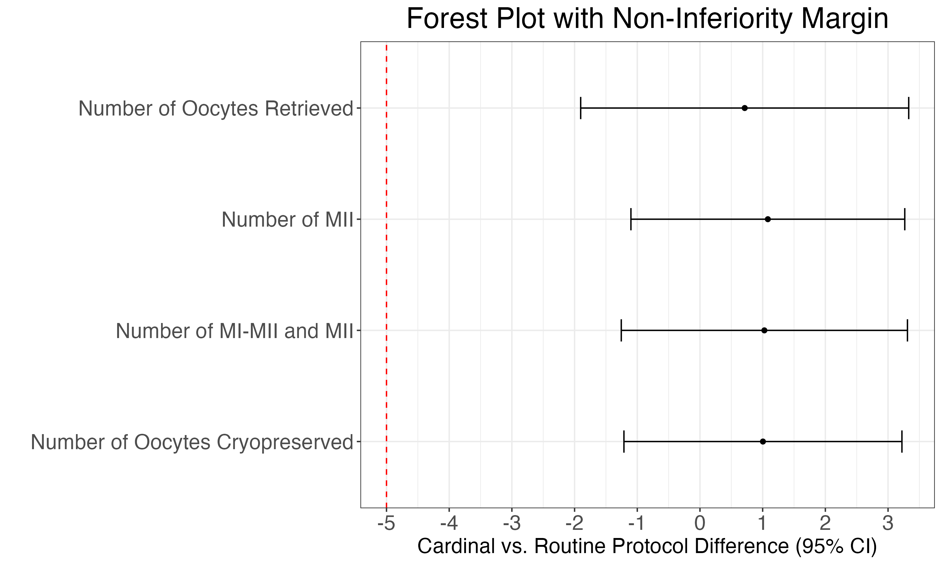
Figure 1: Cycle Primary Outcomes
Notes:
This is a visual demonstration of the last table demonstrating again that the mean differences in # of oocytes and the CIs did not cross the pre-established non-inferiority margin of negative 5

Slide 29
Results
Table 4: Cycle Secondary Outcomes
 | Cardinal | Routine
OHSS | 2 (2.9%) | 15 (23%) | p<0.001
Moderate or severe OHSS | 1 | 4 | p=0.515
Cycle Cancellation | 0 | 1 (1.5%) | p=0.489
Premature Ovulation | 0 (0%) | 0 (0%) | /
Ovarian torsion | 0 (0%) | 0 (0%) | /
Surgical complications | 0 (0%) | 0 (0%) | /
Post-op clinic visit | 1 (1.5%) | 4 (6.1%) | 0.199
Post-op ED visit | 0 (0%) | 2 (3.0%) | 0.234
Notes:
Regarding the other secondary clinical outcomes, there were significantly fewer occurrences of OHSS in the Cardinal group (2.9% vs. 23%). But no significant difference was noted when mild OHSS cases were excluded.

Slide 30
Results
Table 4: Cycle Secondary Outcomes
 | Cardinal | Routine
OHSS | 2 (2.9%) | 15 (23%) | p<0.001
Moderate or severe OHSS | 1 | 4 | p=0.515
Cycle Cancellation | 0 | 1 (1.5%) | p=0.489
Premature Ovulation | 0 (0%) | 0 (0%) | /
Ovarian torsion | 0 (0%) | 0 (0%) | /
Surgical complications | 0 (0%) | 0 (0%) | /
Post-op clinic visit | 1 (1.5%) | 4 (6.1%) | 0.199
Post-op ED visit | 0 (0%) | 2 (3.0%) | 0.234
Notes:
As mentioned, there was 1 cycle cancellation in the routine group due to limited ovarian response.

Slide 31
Results
Table 4: Cycle Secondary Outcomes
 | Cardinal | Routine
OHSS | 2 (2.9%) | 15 (23%) | p<0.001
Moderate or severe OHSS | 1 | 4 | p=0.515
Cycle Cancellation | 0 | 1 (1.5%) | p=0.489
Premature Ovulation | 0 (0%) | 0 (0%) | /
Ovarian torsion | 0 (0%) | 0 (0%) | /
Surgical complications | 0 (0%) | 0 (0%) | /
Post-op clinic visit | 1 (1.5%) | 4 (6.1%) | 0.199
Post-op ED visit | 0 (0%) | 2 (3.0%) | 0.234
Notes:
And reassuringly, premature ovulation did not occur in either group.

Slide 32
Results
Table 4: Cycle Secondary Outcomes
 | Cardinal | Routine
OHSS | 2 (2.9%) | 15 (23%) | p<0.001
Moderate or severe OHSS | 1 | 4 | p=0.515
Cycle Cancellation | 0 | 1 (1.5%) | p=0.489
Premature Ovulation | 0 (0%) | 0 (0%) | /
Ovarian torsion | 0 (0%) | 0 (0%) | /
Surgical complications | 0 (0%) | 0 (0%) | /
Post-op clinic visit | 1 (1.5%) | 4 (6.1%) | 0.199
Post-op ED visit | 0 (0%) | 2 (3.0%) | 0.234
Notes:
Post-retrieval, there were no identified cases of torsion or surgical complications. However, there were more post-operative clinic and emergency room visits in the routine group, but not statistically significantly different.

Slide 33
Results
Table 5 Cycle Total Charges Outcomes (including Rx)
Difference in median charges | Cardinal – Routine = -$5,004 | p<0.001
This reflects a 20% decrease in charges.
Notes:
The median total charges (not costs) for Cardinal cycles was $5,004 dollars less than that of the routine protocols. This reflects a 20% decrease in total charges by using the Cardinal protocol.

Slide 34
$ $$ $$$ $$$ $$$$
Notes:
This figure demonstrates there is clear cost-savings without a decrease in MIIs retrieved. As expected, with a standardized cost-conscious protocol in place, the variability in total charges for cycles completed using the Cardinal protocol was much smaller compared to the routine high-cost protocols.

Slide 35
Conclusions
The Cardinal protocol is a non-inferior option to the routine high-cost protocols in terms of mature oocytes retrieved
Limits the number of monitoring visits, ultrasounds, blood draws/labs, and injections, to the minimum deemed medically necessary
Considerably reduces charges by $5,000 and decreased cost variability, making it a cost-conscious protocol that should be seriously considered for OC cycles
Notes:
The Cardinal protocol is a non-inferior option to the routine high-cost protocols in terms of mature oocytes retrieved. It minimizes the number of monitoring visits, ultrasounds, blood draws/labs, and injections, to what is deemed medically necessary. It also considerably reduces total charges by about $5,000, making it a cost-conscious protocol that should be seriously considered for oocyte cryopreservation cycles.

Slide 36
Future Directions
Investigate patient satisfaction, cost/convenience factors, hours needed off-work
What sociodemographic factors influence patient choice between protocols?
distance traveled
occupation/work
insurance coverage
annual household income
race/ethnicity
sexual orientation and gender identity (SOGI)
Can the Cardinal protocol be used for embryo cryopreservation for fertility preservation? What about for freeze-all IVF cycles for infertility patients?
Notes:
We also have been collecting data through post-cycle surveys to further investigate patient satisfaction, out of pocket costs, distance traveled, and hours needed off-work. We also are examining occupation, insurance coverage, annual household incomes, race/ethnicity, sexual orientation and gender identity.
In the future, can the Cardinal protocol be applied for embryo cryopreservation for fertility preservation? Or for freeze-all IVF cycles? At our own clinic, our providers’ experience and familiarity with using the Cardinal has led to a more seamless adoption of progestin protocols for freeze-all IVF cycles as a cost-conscious approach. Moving forward, well-designed studies should continue to evaluate strategies that hopefully maintain similar clinical efficacy while reducing cost, optimizing patient experience, as well as increasing provider comfort with less intensively monitored IVF cycles.
--
Ultimately, we believe that the inclusive nature of our study facilitated broader access to fertility preservation, particularly for patients with demanding work schedules (i.e. medical trainees), limited insurance coverage, and those planning to undergo multiple cycle. Additionally, our findings highlight the practical benefits of the Cardinal protocol in addressing other logistical barriers. The ability to access OC despite notable geographic distances from the clinic as far as nearly 3000 miles away, underscores its potential to reduce care disparities for geographically underserved areas or “fertility deserts.” Moreover, for trans-men patients who may experience gender dysphoria due to frequent transvaginal ultrasounds(34), minimizing monitoring vistis with the Cardinal protocol was a clear advantage. Similarly, for those with needle phobia(35), reducing the injection burden from three to two daily injections can incrementally improve the patient experience.

Slide 37
References
1. 2020-25 Strategic Plan: Goals and Strategies [Internet]. [cited 2023 Mar 17];Available from: https://www.asrm.org/about-us/initiatives/Strategic-Plan/
2. Disparities in access to effective treatment for infertility in the United States: an Ethics Committee opinion. Fertility and Sterility [Internet] 2021 [cited 2023 Jan 11];116(1):54–63. Available from: https://linkinghub.elsevier.com/retrieve/pii/S0015028221001370
3. ASRM. White Paper: Access to Care Summit [Internet]. 2015 [cited 2023 Jan 11];Available from: https://www.asrm.org/globalassets/asrm/asrm-content/news-and-publications/news-and-research/press-releases-and-bulletins/pdf/atcwhitepaper.pdf
4. Gardner A, Smith KL, Huuki E, Luizzi J, Gunn DD, Campbell SB, et al. Current options to lower the cost of in vitro fertilization: a comprehensive review. F&S Reviews [Internet] 2022 [cited 2023 Jan 15];Available from: https://www.sciencedirect.com/science/article/pii/S2666571922000159
5. Herndon CN, Anaya Y, Noel M, Cakmak H, Cedars MI. Outcomes from a university-based low-cost in vitro fertilization program providing access to care for a low-resource socioculturally diverse urban community. Fertility and Sterility [Internet] 2017 [cited 2023 Jan 14];108(4):642-649.e4. Available from: https://www.sciencedirect.com/science/article/pii/S0015028217304946
6. Han E, Seifer DB. Oocyte Cryopreservation for Medical and Planned Indications: A Practical Guide and Overview. Journal of Clinical Medicine [Internet] 2023 [cited 2025 Feb 17];12(10):3542. Available from: https://www.mdpi.com/2077-0383/12/10/3542
7. Bakkensen JB, Flannagan KSJ, Mumford SL, Hutchinson AP, Cheung EO, Moreno PI, et al. A SART data cost-effectiveness analysis of planned oocyte cryopreservation versus in vitro fertilization with preimplantation genetic testing for aneuploidy considering ideal family size. Fertility and Sterility [Internet] 2022 [cited 2023 Jan 14];118(5):875–84. Available from: https://www.fertstert.org/article/S0015-0282(22)00478-2/fulltext#appsec1
8. Ata B, Kalafat E. Progestin-primed ovarian stimulation: for whom, when and how? Reproductive BioMedicine Online [Internet] 2024 [cited 2025 Feb 17];48(2). Available from: https://www.rbmojournal.com/article/S1472-6483(23)00738-1/fulltext
9. Ata B, Capuzzo M, Turkgeldi E, Yildiz S, La Marca A. Progestins for pituitary suppression during ovarian stimulation for ART: a comprehensive and systematic review including meta-analyses. Human Reproduction Update [Internet] 2021 [cited 2023 Jan 15];27(1):48–66. Available from: https://doi.org/10.1093/humupd/dmaa040
10. Lathi RB. The Stanford Egg Freezing Study: Investigating a Low-Cost, Low-Intensity Oocyte Cryopreservation Protocol [Internet]. clinicaltrials.gov; 2025 [cited 2025 Feb 17]. Available from: https://clinicaltrials.gov/study/NCT05842070
11. REDCap [Internet]. [cited 2025 Feb 18];Available from: https://redcap.stanford.edu/
12. Walker Z, Lanes A, Ginsburg E. Oocyte cryopreservation review: outcomes of medical oocyte cryopreservation and planned oocyte cryopreservation. Reprod Biol Endocrinol 2022;20(1):10.
13. Rustamov O, Wilkinson J, La Marca A, Fitzgerald C, Roberts SA. How much variation in oocyte yield after controlled ovarian stimulation can be explained? A multilevel modelling study. Hum Reprod Open [Internet] 2017 [cited 2024 Sep 20];2017(3):hox018. Available from: https://www.ncbi.nlm.nih.gov/pmc/articles/PMC6276674/
14. Goldman RH, Racowsky C, Farland LV, Munné S, Ribustello L, Fox JH. Predicting the likelihood of live birth for elective oocyte cryopreservation: a counseling tool for physicians and patients. Hum Reprod 2017;32(4):853–9.
15. Kuang Y, Chen Q, Fu Y, Wang Y, Hong Q, Lyu Q, et al. Medroxyprogesterone acetate is an effective oral alternative for preventing premature luteinizing hormone surges in women undergoing controlled ovarian hyperstimulation for in vitro fertilization. Fertility and Sterility [Internet] 2015 [cited 2023 Jan 15];104(1):62-70.e3. Available from: https://www.sciencedirect.com/science/article/pii/S0015028215002277
17. Giles J, Alama P, Gamiz P, Vidal C, Badia P, Pellicer A, et al. Medroxyprogesterone acetate is a useful alternative to a gonadotropin-releasing hormone antagonist in oocyte donation: a randomized, controlled trial. Fertil Steril 2021;116(2):404–12.
21. M. del Mar Vidal. Ovarian response and embryo ploidy following oral micronized progesterone-primed ovarian stimulation versus GnRH antagonist protocol. A prospective study with repeated ovarian stimulation cycles | Human Reproduction | Oxford Academic. Human Reproduction [Internet] [cited 2025 Feb 27];Available from: https://academic.oup.com/humrep/article-abstract/39/5/1098/7631262
22. van Tilborg TC, Eijkemans MJ, Laven JS, Koks CA, de Bruin JP, Scheffer GJ, et al. The OPTIMIST study: optimisation of cost effectiveness through individualised FSH stimulation dosages for IVF treatment. A randomised controlled trial. BMC Womens Health [Internet] 2012 [cited 2025 Feb 27];12:29. Available from: https://www.ncbi.nlm.nih.gov/pmc/articles/PMC3460731/
24. Sterrenburg MD, Veltman-Verhulst SM, Eijkemans MJC, Hughes EG, Macklon NS, Broekmans FJ, et al. Clinical outcomes in relation to the daily dose of recombinant follicle-stimulating hormone for ovarian stimulation in in vitro fertilization in presumed normal responders younger than 39 years: a meta-analysis. Human Reproduction Update [Internet] 2011 [cited 2025 Feb 27];17(2):184–96. Available from: https://doi.org/10.1093/humupd/dmq041
29. Chung EH, Khorshid A, Bavan B, Lathi RB. A cost analysis of hCG trigger alone versus dual trigger for achieving live birth following in vitro fertilization. Reprod Fertil 2025;6(1):e240095.

Slide 38
Thank you to my Stanford REI team!
Dr. Lathi, Dr. Aghajanova, Dr. Bavan, Dr. Nakajima, Dr. Sokalska, Dr. Milki, Dr. Yu, and Dr. Monseur for all their guidance and wisdom
My amazing co-fellows: Dr. Rambhatla, Dr. Khorshid, Dr. Rivera-Cruz, Dr. Strug, Dr. Nguyen, Dr. Naert, and Dr. Bui
Stanford REI RNs who helped me bring Cardinal Protocol to life
Thank you to Dr. Alvero for generously supporting this project
Notes:
Thank you :)

Slide 39
?
Notes:
Questions?

