Slide 1
Comparable live birth and clinical outcomes from blastocysts vitrified with a shortened protocol versus a standard method
Christopher Ke Arkfeld, MD
Reproductive Endocrinology and Infertility Fellow
Massachusetts General Hospital

Slide 2
Disclosures
None

Slide 3
Agenda
Impact of Vitrification Method
Standard and Fast Vitrification
Impact of of Warming Method
Fast Vitrification and Fast Warming

Slide 4
Vitrification
Notes:
The influence of the freeze thaw process on the microscopic level has influenced critical innovation in the field of REI over the past decades. Most notably, the transition from the slow freeze process for embryos and oocytes to the vitrification process.
Vitrification has minimized this risk with drastic increases in freeze thaw survival rates.
What is less understood is the optimal protocol for embryo vitrification.

Slide 5
Equilibration Solution: 12 min 3 min
Notes:
Animal models have described successful use of fast vitrification processes
Decreasing the time in the equilibration solution with no impact on embryo survival rate

Slide 6
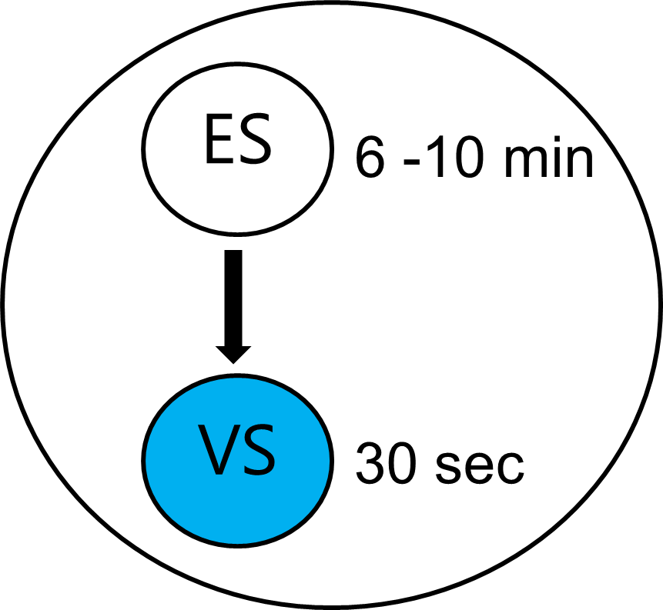
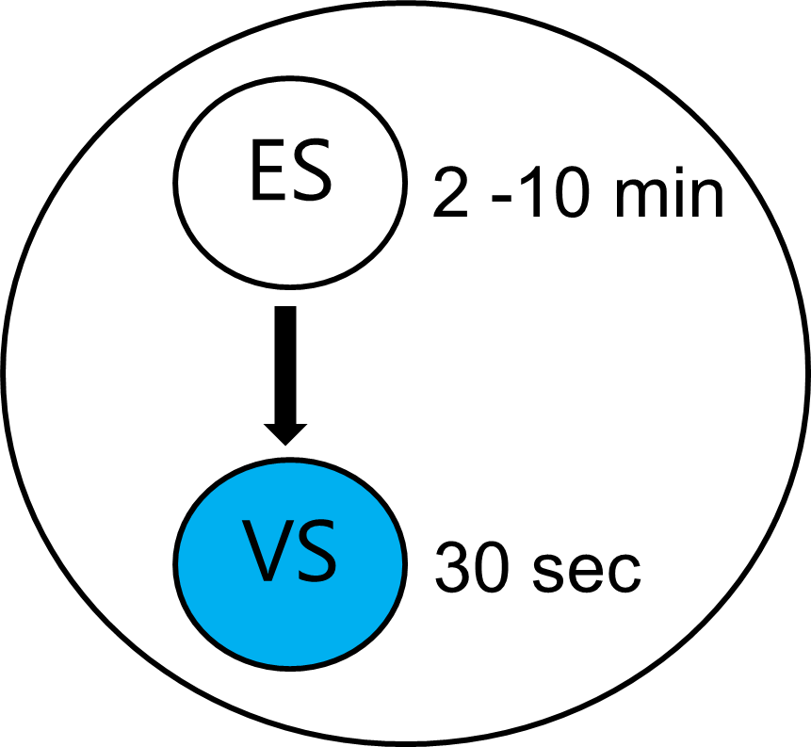
Fast Vitrification Protocol
Standard Vit
Fast Vit
Load and plunge cryo device within 80 sec after exposure to VS
Notes:
The process of vitrification requires multiple steps including exposing embryos to an equilibration solution followed by the vitrification solution.
The aim of the equilibrium solution is to slowly acclimate the embryo to the osmotic changes needed to be vitrified. The vitrification solution is much more concentrated.
Standard protocol involved exposing blastocysts to equilibration solution (ES) for 6-10 minutes, followed by a 30-60 second exposure to vitrification solution (VS) before vitrification.
The "Fast vitrification” protocol reduced the ES exposure to 2 minutes, with subsequent exposure to VS for 30-60 seconds prior to vitrification.

Slide 7
Hypothesis: Impact of Fast Vitrification
The primary objective of this study is to compare the clinical outcomes of patients undergoing a frozen embryo transfer (FET) cycle when a blastocyst was fast vitrified.
Vitrification Criteria: ≥ 3BC or 3CB (no CC or D grades)
Study Parameters:
All FET cycles were single blastocyst transfers
All blastocysts were vitrified and warmed at MGH
Retrievals performed between November 2015 and November 2024
FETs were performed between January 2022 and December 2024
Notes:
The primary objective of this study is to compare the clinical outcomes of patients undergoing a frozen embryo transfer (FET) cycle when a blastocyst was fast vitrified and fast warmed.
Of note, our clinic has adopted a fast warming process as well. Our analysis aimed to evaluate the fast vitrification method against standard methods and the new fast warming process.

Slide 8
Methods: Impact of Fast Vitrification
Three Regimens:
Standard Vitrification - Standard Warming (Standard_Standard)
Standard Vitrification - Fast Warming (Standard_Fast)
Fast Vitrification - Fast Warming (Fast_Fast)
Outcome Measures:
Positive HCG
Miscarriage (SAB)
Clinical Pregnancy
Live Birth
Notes:
Our analysis aimed to evaluate the fast vitrification method against standard methods and the new fast warming process.
The outcome measures reported in this presentation are + HCG, miscarriage, clinical pregnancy, and live birth rate

Slide 9
Clinical Outcomes: Fast vs Standard Vitrification
N = 1520 FETs
Outcome | Fast Vitrification Group N = 426 | Standard Vitrification Group N = 1094 | p-value
Positive β-HCG Rate | 59.4% | 58.4% | 0.824
Biochemical Pregnancy Rate | 9.4% | 8% | 0.562
Clinical Pregnancy Rate | 48.6% | 50.2% | 0.709
Live Birth Rate | 42.8% | 42.4% | 0.931
Notes:
Standard protocol involved exposing blastocysts to equilibration solution (ES) for 6-10 minutes, followed by a 30-60 second exposure to vitrification solution (VS) before vitrification.
The newly implemented Fast protocol reduced the ES exposure to 2 minutes, with subsequent exposure to VS for 30-60 seconds prior to vitrification.
Powered for a 4% difference at 90% confidence level (N 426).
No difference in HCG, clinical pregnancy, or live birth rate across these two groups.

Slide 10
Clinical Outcomes: Fast vs Standard Vitrification
N = 1520 (426 fast vit, 1094 standard)
*Adjusted for PGT status, Day of transfer, FET prep, oocyte age, infertility diagnosis
Outcome | Unadjusted OR (95% CI) | Adjusted OR (95% CI)*
Positive β-HCG Rate | 1.042 (0.726, 1.497) | 0.939 (0.646, 1.365)
Biochemical Pregnancy Rate | 1.199 (0.649, 2.217) | 0.999 (0.520, 1.918)
Clinical Pregnancy Rate | 0.934 (0.655, 1.334) | 0.882 (0.609, 1.276)
Miscarriage (SAB) | 0.738 (0.349, 1.564) | 0.737 (0.339, 1.599)
Live Birth Rate | 1.016 (0.709, 1.456) | 0.953 (0.653, 1.390)
Notes:
We performed a logistic regression accounting for PGT status, day of transfer, FET preparation, oocyte age, and infertility diagnosis.
As you can see both the unadjusted and adjusted odds ratios remained non-significant.

Slide 11
Dish Setup for Multi Embryo Vitrification
Minutes in ES Solution
2
3
4
5
6
7
8
9
10
ES
ES
ES
ES
ES
ES
ES
ES
ES
1
2
3
4
5
6
7
8
9
Embryo ID Number
VS
VS
VS
VS
VS
VS
VS
VS
VS
Notes:
When evaluating these outcomes it is important to recognize that under the fast vitrification method
Every embryo in a cohort is exposed to slightly different amounts of equilibrium solution.
Here is a representative dish with 9 embryos
As you can see, the embryos spend progressively longer amounts of time in the equilibrium solution as they are being sequentially vitrified.

Slide 12
Clinical Outcomes: Equilibration Medium Exposure
N = 970 FET
Embryo specific data regarding equilibration media exposure
Time in ES Solution | # FET | Positive hCG | Biochemical | Clinical | SAB | Live Birth
2MIN | 130 | 60% | 8% | 51% | 15% | 42%
3MIN | 38 | 66% | 11% | 55% | 10% | 47%
4MIN | 26 | 65% | 19% | 46% | 0% | 46%
5MIN | 9 | 56% | 11% | 44% | 0% | 44%
6-9MIN | 13 | 77% | 0% | 77% | 10% | 69%
10MIN | 754 | 58% | 7% | 50% | 14% | 43%
No statistically significant difference identified between groups
Notes:
Here, we stratified our data by time spent in ES. It is not surprising that the majority of FETs are from a 2 min exposure group.
As you can imagine, to meet the 6-10 min group there would be ~5 embryos in a cohort.
The 10min exposure group is more representative of the FETs following the standard vitrification protocol.
Across all embryos we had similar clinical pregnancy rates and live birth rates.
Of note, the ability to draw significant conclusions from this data is limited by the smaller number of FETs.

Slide 13
Warming
Notes:
The other critical aspect to the ART process is the warming of cryopreserved embryos.

Slide 14
Notes:
Prompted by research presented at PCRS in 2023 by Dr. Manns, we investigated the impact of single step warming and found no change in live birth rates.

Slide 15
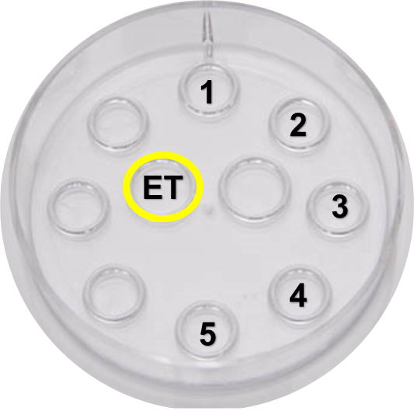
Standard Blastocyst Warming Protocol
Thaw
Dilution/Wash
Culture
1 Minute
37ºC
12 Minutes
Room Temperature
~1 Minute Rinse
37ºC
Total Time: ~ 14 minutes
Notes:
Briefly to review, the standard warming protocol requires exposure to a thaw solution, followed by sequential dilution and wash solutions, lastly a rinse in media.
The total time for this process is approximately 14 minutes.

Slide 16
Standard Blastocyst Warming Protocol
Thaw
Dilution/Wash
Culture
1 Minute
37ºC
12 Minutes
Room Temperature
~1 Minute Rinse
37ºC
Total Time: ~ 14 minutes
Notes:
The fast process moves from the thaw solution directly to the culture, removing dilution, wash, and rinse steps.

Slide 17
Fast Blastocyst Warming Protocol
Thaw
Culture
1 Minute
37ºC
~1 Minute Rinse
37ºC
Total Time: ~ 2 minutes
Notes:
So, the new fast warming protocol decreases the total time from 14 minutes down to 2 minutes

Slide 18
Fast Vitrification + Fast Warming
Notes:
As we adopted both of these fast warming and fast vitrification processes, we had seen positive results in isolation, but we wanted to see the impact of the combined protocols.

Slide 19
Clinical Reports of Fast Vitrification + Fast Warming
Fertility and Sterility, Volume 120, Issue 4, e143
Notes:
Clinical reports of of various fast vitrification and fast warming protocols have shown promising results, but have not reported pregnancy outcomes.

Slide 20
Clinical Outcomes: Vitrification and Warming Method
N = 1520 FET
Vitrification-Warming Regimen | # FET | Positive hCG | Biochemical | Clinical
Standard_Standard | 148 | 61% | 7% | 53%
Standard_Fast | 946 | 57% | 7% | 50%
Fast_Fast | 426 | 63% | 9% | 54%
Total | 1520 | 59% | 8% | 51%
No statistically significant difference identified between groups
Notes:
Here we compared various vitrification and warming regimens: standard vitrification and standard warming, standard vitrification and fast warming, and fast vitrification with fast warming protocols
Across these three groups we had clinically similar clinical pregnancy rates, ranging from 50-54%
Powered for a 4% difference at 80% confidence.

Slide 21
Clinical Outcomes: Vitrification and Warming Method
N = 1186 FETs with pregnancy outcome data
Vitrification-Warming Regimen | # FET | Positive hCG | Biochemical | Clinical | SAB | Live Birth
Standard_Standard | 148 | 61% | 7.4% | 53% | 13% | 46%
Standard_Fast | 822 | 57% | 7.4% | 50% | 15% | 42%
Fast_Fast | 216 | 63% | 9.3% | 52% | 12% | 45%
Total | 1186 | 59% | 7.8% | 52% | 14% | 43%
No statistically significant difference identified between groups
Notes:
Next we looked at all of the FETs with which we also had their pregnancy outcome data.
Of the 1186 FETs, we noted similar ectopic, miscarriage, still birth, and importantly similar live birth rates ranging from 42% to 45%.

Slide 22
Conclusion: No difference in outcomes
No difference in live birth rate with introduction of fast vitrification compared to standard vitrification methods
Findings remained unchanged with fast vitrification and fast warming techniques
Increased opportunity for efficiency and flexibility within the embryology lab

Slide 23
Research Collaborators
MGH Embryology Lab:
Charles Bormann, PhD
Kristy Dickinson
Christine Veiga
Sarah Rice
Pragati Bhowmick
Jennifer Demick
Ping Zhou
Ashley Aldrich
Jie Liu
Lauren Bourke
Amy Crimlisk
MGH Fertility Center:
Mark Hornstein, MD
John Petrozza, MD
Mitch Rein, MD
Jan Shifren, MD
Irene Souter, MD
Irene Dimitriadis, MD
Shruthi Mahalingaiah, MD
Victoria Fitz, MD
Eden Cardozo, MD
Co-Fellows:
Evelyn Minis, MD
Alexa Sassin, MD
Stylianos Vagios, MD
Hadi Ramadan, MD Victoria Jiang, MD
References
Contact
Notes:
I’d like to thank all of my colleagues at MGH and a special thank you to Charlie Bormann who is my mentor on this project and throughout fellowship.

