Slide 1
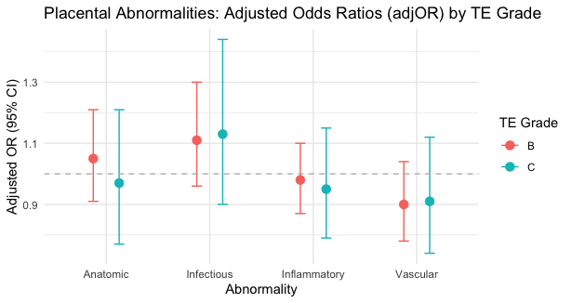
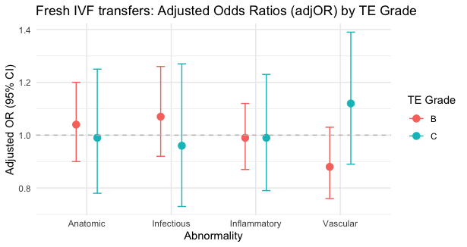
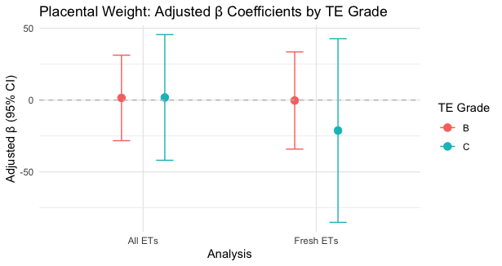
Trophectoderm (TE) Grade Is Not Associated With Placental Pathology Among In-Vitro Fertilization (IVF) Conceived Singletons
Marianthi Kavelidou¹, Minis Evelyn¹, Arkfeld Christopher¹, Cherouveim Panagiotis², Irene Dimitriadis¹, Charles L. Bormann¹, Kaitlyn James³, Drucilla Roberts⁴, Irene Souter¹
1Massachusetts General Hospital Fertility Center, Division of Reproductive Endocrinology and Infertility, Massachusetts General Hospital and Harvard Medical School.
2Deborah Kelly Center for Outcomes Research, Department of Obstetrics, Gynecology, and Reproductive Biology, Massachusetts General Hospital and Harvard Medical School.
3Department of Pathology, Massachusetts General Hospital and Harvard Medical School.
Background
Results
Results
IVF pregnancies are at increased risk for placental-mediated adverse perinatal outcomes. Factors implicated include embryo manipulation and culture conditions, as well as treatment-induced hormonal changes altering the endometrial milieu all of which may negatively impact implantation, decidualization, and trophoblast invasion processes. Nevertheless, whether the quality of the TE also impacts placental pathology remains unclear.
Population demographics are depicted in Table.
AdjOR (95%CI) showed no differences in placental abnormalities between TE quality groups A-C (Figure 1).
Similarly, when further limiting the analysis to fresh ETs only, adjOR (95%CI) revealed any difference between TE quality groups A-C (Figure 2).
Adjβ (95%CI) showed no differences in placental weight between TE groups A-C, (Figure 3).
Table. Demographics
 | TE grade A n= 120 | TE grade B n= 142 | TE grade C n= 30 | p.value
Maternal Age (years) | 33.0 (3.1) | 34.0 (3.5) | 34.8 (3.4) | 0.012
BMI (kg/m²) | 24.8 (5.0) | 24.6 (4.3) | 24.5 (4.0) | 0.952
Race White | 91 (75.8%) | 105 (73.9%) | 25 (83.3%) | 0.295
African American | 3 (2.5%) | 6 (4.2%) | 3 (10.0%)
Asian | 17 (14.2%) | 24 (16.9%) | 0 (0.0%)
Hispanic | 4 (3.3%) | 4 (2.8%) | 1 (3.3%)
Infertility Dx Male factor | 9 (7.5%) | 53 (37.3%) | 14 (46.7%) | <.001
Tubal/Endometriosis | 6 (5.0%) | 9 (6.3%) | 3 (10.0%)
Anovulatory | 5 (4.2%) | 2 (1.4%) | 0 (0.0%)
PCOS | 20 (16.7%) | 0 (0.0%) | 0 (0.0%)
Idiopathic | 8 (6.7%) | 46 (32.4%) | 8 (26.7%)
Fresh ET Frozen ET | 115 (95.8%) 5 (4.2%) | 93 (65.5%) 49 (34.5%) | 15 (50.0%) 15 (50.0%) | <.001
#embryos transferred 1 2 3 | 98 (81.7%) 22 (18.3%) 0 (0.0%) | 101 (71.1%) 39 (27.5%) 2 (1.4%) | 23 (76.7%) 5 (16.7%) 2 (6.7%) | 0.002
Figure 1
Methodology
Conclusion
Design/Patients: Retrospective cohort/ 292 IVF conceived singletons with available placental pathology. TE grade classified using Gardner’s system [Grades: A (n=120), B (n=142), and C (n=30)].
Outcomes:Anatomic, vascular, inflammatory, infectious placental abnormalities.
Statistical analysis: Logistic regression models were used to calculate odds ratios (OR) with 95%CI, after adjusting for confounders.
Subanalysis limited to fresh Ets only.
TE grade does not impact placental pathology among IVF conceived singletons.
The value of TE grading in predicting placental pathology is limited and its clinical utility should be restricted only to embryo selection processes.
Figure 2
Acknowledgements
Figure 3
We thank the pathology lab for our collaborative efforts

