Slide 1
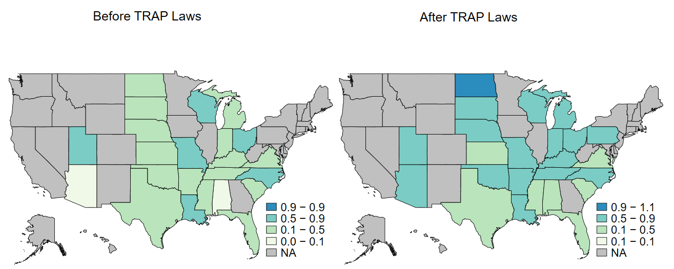
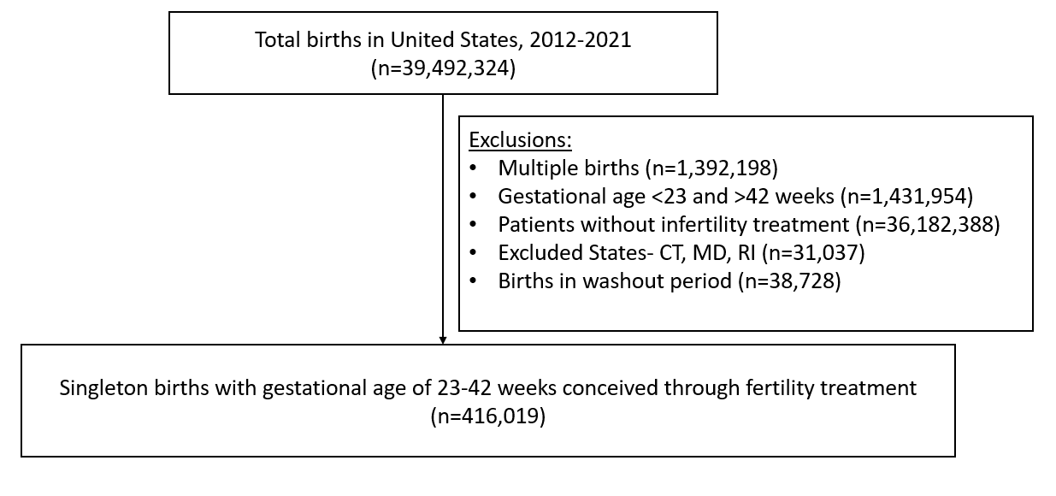
Maternal and Neonatal Effects of Targeted Regulations of Abortion Providers Laws on Pregnancies Conceived Through Fertility Treatment: A Differences in Differences Analysis
S. Melville MD¹, J. Shi MD¹, B. Garg MBBS MPH¹, A. Caughey MD PhD¹, M. Kornfield MD¹
1. Oregon Health and Science University. Portland, Oregon.
Background
TRAP laws are associated with statistically significant negative obstetric outcomes for patients conceiving through assisted reproductive technology.
Results
Legal Context: The abortion regulation landscape changed in 1992 with the Supreme Court ruling Planned Parenthood v. Casey¹, which established the constitutionality of abortion restrictions that did not represent an “undue burden”.
Practice Consequences: This decision provided the legal basis for Targeted Regulations of Abortion Providers (TRAP). TRAP laws established waiting periods, mandatory ultrasounds, and other regulations to clinics that provide surgical and medication abortion care.
Patient Outcomes: Pregnancies conceived with fertility treatment carry higher maternal and neonatal risk² that may require abortion care to manage complications. The effects of abortion restriction on pregnancies conceived through fertility treatment are unknown.
Figure 2. Percentage of Maternal Composite in States with TRAP Laws
Results
Figure 1. Final Sample After Inclusion/Exclusion Criteria
Objective
- Final sample: 416,019 singleton births conceived with fertility treatment occurring between 23-42 weeks gestation, with 174,671 from states with TRAP laws and 241,348 from states without.
Evaluate the effects of TRAP laws on maternal and neonatal outcomes among patients who conceived through fertility treatment.
Primary Outcome (maternal composite):
- Difference in differences analysis showed a more significant increase in adverse maternal outcomes within the composite in states with TRAP laws relative to states without (adjusted odds ratio 1.27; 95% CI: 1.04-1.56).
Materials & Methods
Study Design: Retrospective cohort study
Data Set: National Vital statistics system (NVSS) from 2012-2021
Population: Singleton births between 23-42 weeks gestation, conceived through infertility treatment.
Exclusions: Three states (Maryland, Rhode Island and Connecticut) included in the Guttmacher Institute list of TRAP law states were excluded due to the transient and minor nature of their respective restrictions (n=31,037).
Exposure: The Guttmacher Institute database³ was utilized to separate states into two groups: those that implemented TRAP laws and those that did not.
Primary outcome: Maternal composite of adverse outcomes (maternal blood transfusion, ICU admission, unplanned hysterectomy, and uterine rupture).
Secondary outcome: Neonatal composite (NICU admissions, APGAR scores <7 at 5 minutes, assisted ventilation, seizures and very low birth weight).
Data Analysis: Difference in differences model controlled for year of birth indicators, maternal race and ethnicity, maternal age, educational level, insurance status, gestational age and pre-pregnancy BMI.
Table 1. Adjusted Proportions of ART Pregnancies meeting criteria for Maternal & Neonatal Composite within TRAP Law States vs. non-TRAP Law States
vs.
*
 | States without TRAP laws |  |  | States with TRAP laws
 | Adjusted Pre-TRAP proportion | Adjusted Post-TRAP proportion | Adjusted % difference after vs before TRAP laws (95% CI)* | Adjusted Pre-TRAP proportion | Adjusted Post-TRAP proportion | Adjusted % difference after vs before TRAP laws (95% CI)* | Difference in difference estimator, (95% CI)* | Difference in difference adjusted odds ratio (95% CI)*
Maternal composite | 1.23% | 1.21% | -0.02% (-0.29, 0.26) | 0.80% | 1.00% | 0.20% (-0.06, 0.46) | 0.22 (0.02-0.42) | 1.24 (1.02-1.51)
Preterm birth <37 weeks | 13.76% | 12.39% | -0.12% (-0.19, -0.04) | 14.42% | 13.59% | -0.07% (-0.14, -0.002) | 0.05 (0.005, 0.10) | 1.05 (1.00-1.11)
Neonatal composite | 14.21% | 16.14% | 0.18% (0.11, 0.26) | 12.85% | 14.47% | 0.17% (0.10, 0.24) | -0.02 (-0.07, 0.04) | 0.98 (0.93, 1.04)
Non-TRAP states
TRAP states
TRAP relative to non-TRAP states
Secondary Outcome (neonatal composite):
- Difference in differences analysis showed no significant differences in the adjusted odds of the change in neonatal composite among states with TRAP laws relative to states without (adjusted odds ratio 0.98; 95% CI: 0.93-1.04).
Non-TRAP states
vs.
TRAP states
TRAP relative to non-TRAP states
*statistically significant (p<0.05)
Conclusion
In this study we describe the effects of abortion regulation on maternal and neonatal outcomes among patients utilizing fertility treatment. We found a statistically significant increase in poor maternal outcomes associated with states that passed TRAP laws relative to states that did not. We conclude that maternal outcomes of patients utilizing fertility treatment are negatively affected by restrictions on abortion access.
*Pre-TRAP, Post-TRAP, and difference –in-difference estimates obtained from generalizing estimating equation models. Models adjusted for year of birth indicators, maternal race and ethnicity, maternal age, educational level, insurance status, gestational age and pre-pregnancy BMI.
Citations:
1. Planned Parenthood of Southeastern Pa. v. Casey. U.S. 505, 833 (1992).
2. Society for Maternal-Fetal Medicine (SMFM). Electronic address: pubs@smfm.org, Ghidini A, Gandhi M, McCoy J, Kuller JA, Publications Committee. Society for Maternal-Fetal Medicine Consult Series #60: Management of pregnancies resulting from in vitro fertilization. Am J Obstet Gynecol. 2022;226(3):B2-B12. doi:10.1016/j.ajog.2021.11.001
3. Targeted Regulation of Abortion Providers | Guttmacher Institute. March 14, 2016. Accessed October 10, 2024. https://www.guttmacher.org/state-policy/explore/targeted-regulation-abortion-providers
Samuel Melville, Poster #P73
melvills@ohsu.edu

