Slide 1
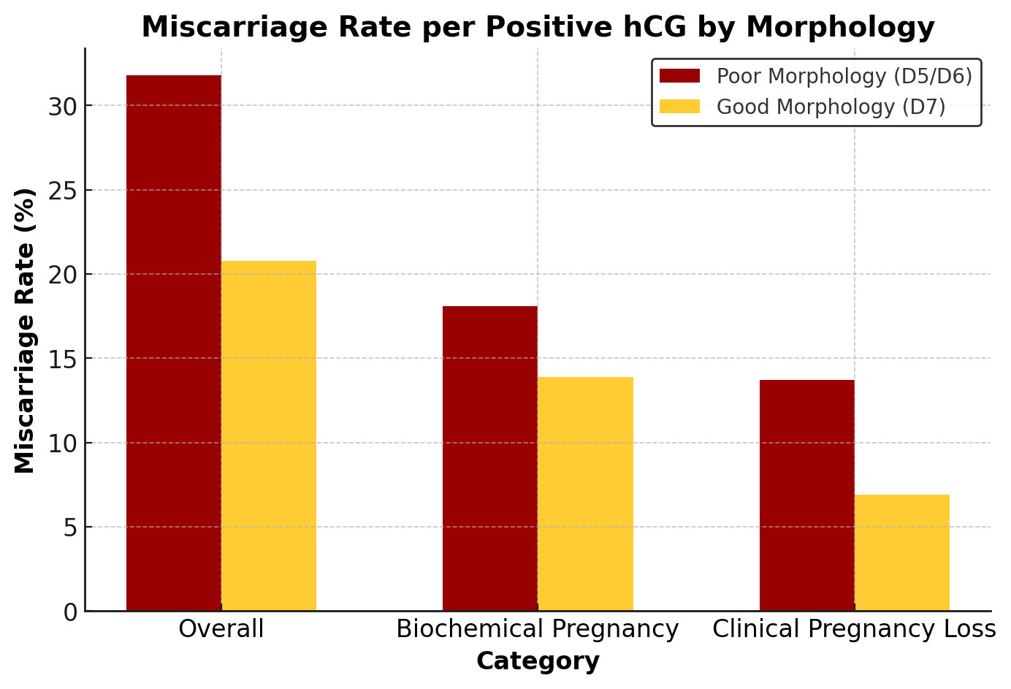
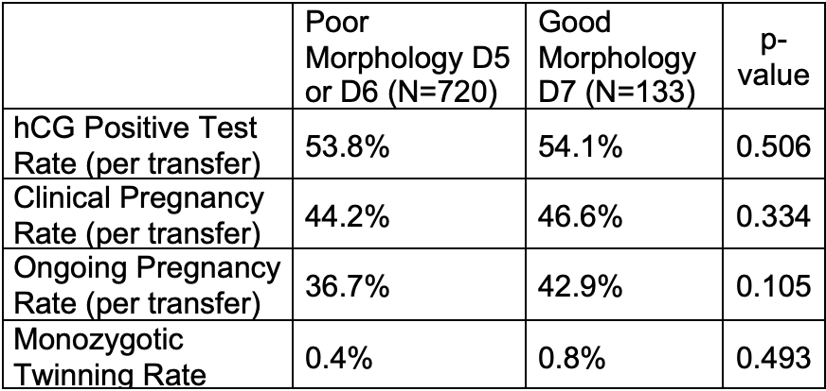
When Should We Prioritize Day 7 Embryos? A Comparison of Euploid Day 5 and Day 6 Embryos with Poor Morphologic Grading Versus Day 7 Embryos with Good Morphologic Grading
Chelsey A. Harris, MD^{1,2}; Marisa Gigg, MD^{1,2}; Intira Sriprasert MD PhD¹; Richard J. Paulson, MD^{1,2}; Rachel S. Mandelbaum, MD^{1,2}
Division of Reproductive Endocrinology and Infertility, Department of Obstetrics and Gynecology, University of Southern California, Los Angeles, CA
HRC Fertility, Pasadena, CA
Background
Outcomes
Priority for transfer of euploid blastocysts is generally based on embryo morphology and day of trophectoderm biopsy.
It is not known at what point embryo morphology may play a larger role than day of trophectoderm biopsy.
Primary outcomes: Positive hCG (> 5mIU/mL), clinical and ongoing pregnancy rate per embryo transfer, and miscarriage rate per embryo transfer (including biochemical and clinical spontaneous abortions per positive hCG).
Secondary outcome: Monozygotic twinning per transfer.
Figure 1
*
Objectives
Results
To assess how the reproductive potential of day 7 euploid embryos with good morphology compares to day 5 or 6 euploid embryos with poor morphology.
To determine if these embryos should be prioritized for transfer.
There was no statistically significant difference in positive hCG or clinical pregnancy rates.
The miscarriage rate was higher for poor morphology day 5 or 6 blastocysts as compared to good morphology day 7 blastocysts (p= 0.040).
When miscarriage rates were separated into biochemical pregnancies and clinical losses, the results did not reach statistical significance.
Sensitivity analysis (adjusting for patient age, degree of embryo expansion, use of a gestational carrier, and IVF lab) did not differ from results as presented.
Figure 2
Study Design
Retrospective cohort study including 853 single euploid frozen embryo transfers (FETs) at two HRC Fertility sites (January 2018 - September 2024).
Study groups:
Day 5 or 6 poor morphology embryos (C grading for either the inner cell mass or the trophectoderm).
Day 7 good morphology embryos (A or B grades for both the inner cell mass and trophectoderm).
Conclusions
Day 7 euploid embryos with good morphology demonstrated favorable pregnancy outcomes in this analysis.
These results suggest that when no good morphology day 5 or 6 embryos are available, day 7 good morphology embryos may be prioritized over poor morphology day 5 or 6 embryos.
Take a picture to download the poster

