Slide 1
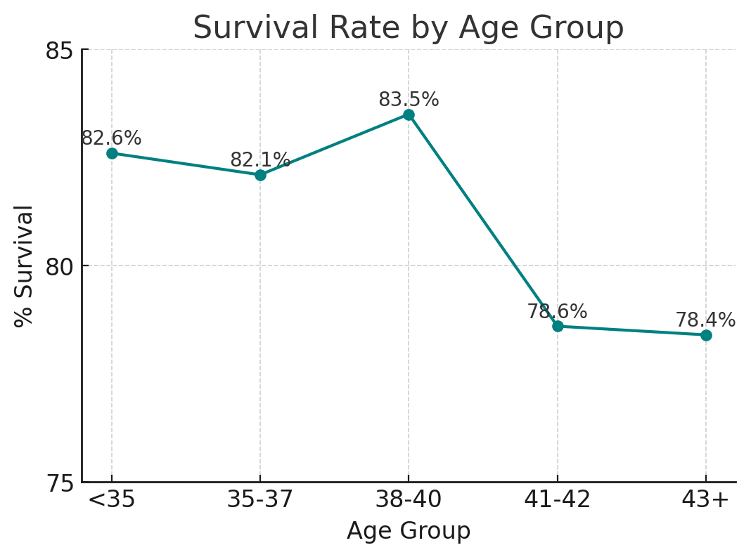
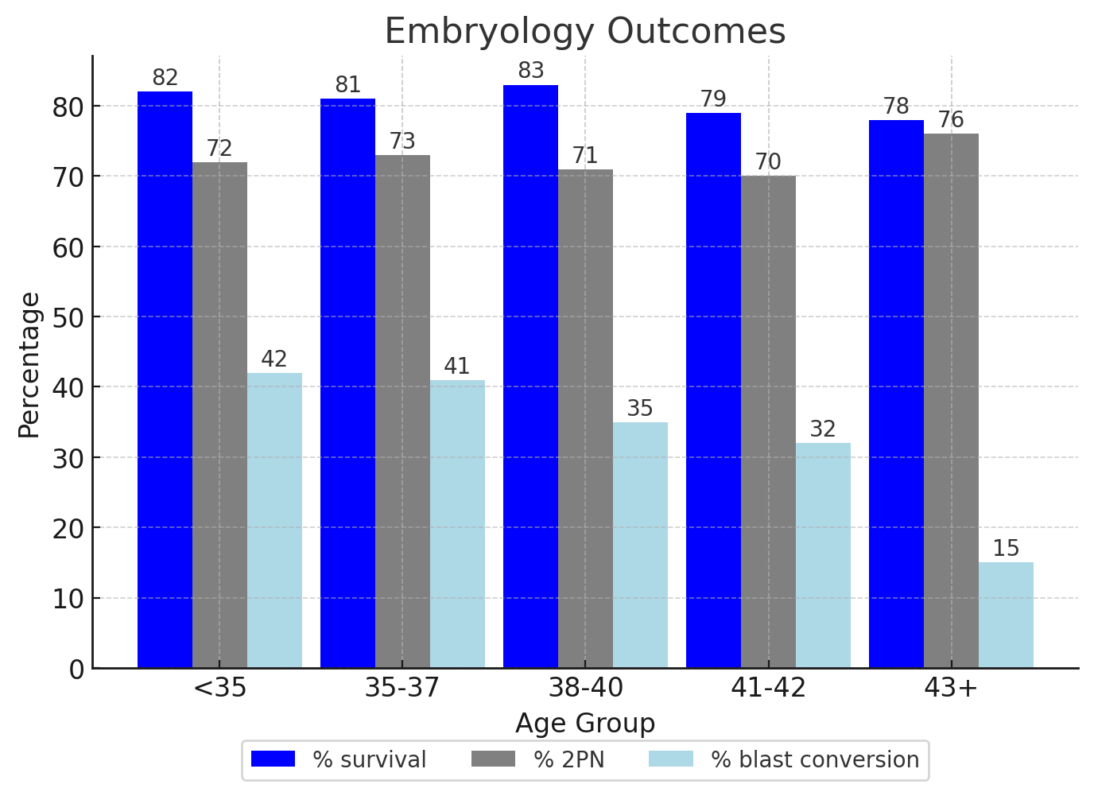
Survival Rates of Frozen-Thawed Oocytes Remain Constant as Female Age Increases
Anupama Rambhatla MD¹, Kyle Le MD², Kerry Flannagan PhD³, Jerry Wang MS³, Amalia Namath MD⁴, Allison Eubanks MD⁴, Atoosa Ghofranian MD⁵, Jensen Reckhow MD⁵, Ruth B Lathi MD¹, Phillip Romanski MD⁶, Ravi Agarwal MD⁷
1. Department of Obstetrics and Gynecology, Stanford University School of Medicine, Palo Alto, CA; 2. Shady Grove Fertility, Washington, DC; 3. US Fertility, Rockville, MD; 4. National Institutes of Health, Bethesda, MD; 5. Icahn School of Medicine at Mount Sinai, New York, NY; 6. RMA of New York, New York, NY; 7. RSC Bay Area, San Ramon, CA
INTRODUCTION
RESULTS
Vitrification has led to improved IVF outcomes using frozen-thawed oocytes
In 2013, ASRM declared planned oocyte cryopreservation (POC) as no longer experimental¹
Though the number of oocyte cryopreservation cycles increased annual since 2012, the majority of oocytes remain cryopreserved
Given the relatively short timeframe that POC has been available, there is a paucity of data on thaw outcomes, and whether age at freeze is an independent risk factor
A total of 2380 IVF cycles encompassing 21,550 thawed oocytes were evaluated
82.3% of all oocytes survived thaw
Average number of years frozen: 2.5 years
There was no difference in the survival rates between the different age groups
A total of 1049 thaw cycles were evaluated for embryology outcomes, with no difference noted in fertilization rates among different age groups (72.8% across all ages)
Average blastulation rate was 38.7%, with a significant difference noted in the 38+ age groups
 | Allcomers | < 35 | 35-37 | 38-40 | 41-42 | 43+
N, freeze cycles | 2380 | 581 | 863 | 687 | 173 | 76
Age at freeze, mean (SD) | 36.5 (3.5) | 31.9 (2.4) | 36.1 (0.8) | 38.9 (0.8) | 41.4 (0.5) | 43.5 (0.7)
Age at thaw, mean (SD) | 39.1 (3.8) | 34.5 (3.8) | 39.3 (2.3) | 41.2 (1.8) | 42.6 (1.1) | 44.1 (0.8)
Number of years frozen, mean (SD) | 2.5 (2.2) | 2.6 (2.5) | 3.2 (2.2) | 2.2 (1.8) | 1.3 (1.1) | 0.6 (0.7)
BMI at freeze, mean (SD) | 25.1 (5.1) | 24.8 (5.1) | 24.6 (4.7) | 25.5 (5.1) | 26.2 (5.4) | 26.7 (6.7)
AMH at freeze, median (IQR) | 1.8 (1, 3.5) | 2.8 (1.5, 4.9) | 1.7 (1, 3.2) | 1.6 (1, 3) | 1.3 (0.7, 2.3) | 0.8 (0.4, 2)
Race
Caucasian | 1367 (57.4) | 362 (62.3) | 510 (59.1) | 365 (53.1) | 89 (51.4) | 41 (53.9)
African American | 211 (8.9) | 41 (7.1) | 58 (6.7) | 67 (9.8) | 31 (17.9) | 14 (18.4)
Asian | 333 (14) | 76 (13.1) | 115 (13.3) | 102 (14.8) | 30 (17.3) | 10 (13.2)
Hispanic | 86 (3.6) | 17 (2.9) | 27 (3.1) | 34 (4.9) | 5 (2.9) | 3 (3.9)
Other | 109 (4.6) | 26 (4.5) | 39 (4.5) | 36 (5.2) | 7 (4) | 1 (1.3)
Unknown/refused | 274 (11.5) | 59 (10.2) | 114 (13.2) | 83 (12.1) | 11 (6.4) | 7 (9.2)
OBJECTIVE
To evaluate survival rates of previously vitrified frozen-thawed oocytes by age at freeze.
Figure 1: Survival Rate by Age Group
METHODS
Retrospective, multi-center cohort study
Inclusion criteria:
Autologous oocyte thaw cycles following POC using vitrification from January 2013 to September 2024
Women ≤45 years at the time of retrieval
Exclusion criteria:
Donor oocyte cycles
Oocytes shipped from external centers
Cycles in which metaphase I (MI) oocytes matured in vitro post-thaw
POC for gonadotoxic reasons
Primary outcome:
Oocyte survival at thaw by SART age categories
Secondary outcomes:
Fertilization rate
Blastulation rate
Only thaw cycles where oocytes originated from a single IVF freeze cycle were evaluated for embryologic outcomes
Table 1: Patient Demographics
Abbreviations: AMH = Anti-Mullerian hormone; BMI = body mass index; SD = standard deviation; IQR = inter-quartile range
Figure 2: Embryology Outcomes
DISCUSSION & CONCLUSIONS
REFERENCES
There was no difference in the survival of frozen-thawed oocytes when evaluated by age at freeze
There was no difference in fertilization rates between different age groups
There was a significant difference observed in blastulation rate, specifically in the 38+ age groups, which can be attributed to the age-related decline in oocyte quality and increasing aneuploidy rates
Caution should be used when counseling patients regarding their chance of live birth using currently accessible egg freezing models, which may overestimate survival for some ages
Individualized clinic specific survival rates should be used when counseling patients regarding their chance of success using vitrified oocytes
The Practice Committees of the American Society for Reproductive Medicine and the Society for Assisted Reproductive Technology. Mature oocyte cryopreservation: a guideline. Fertility & Sterility. 2013; 99(1): 37-43.
Blakemore JK, Grifo JA, DeVore SM Hodes-Wertz B, Berkeley AS. Planned oocyte cryopreservation – 10-15 year follow-up: return rates and cycle outcomes. Fertility & Sterility. 2021; 115(6): 1511-1520.
Cobo A, Garcia-Velasco JA, Coello A, Domingo J, Pellicer A, Remohi J. Oocyte vitrification as an efficient option for elective fertility preservation. Fertility & Sterility. 2016; 755-764.
Goldman RH, Racowsky C, Farland LV, Munne S, Ribustello L, and Fox JH. Predicting the likelihood of live birth for elective oocyte cryopreservation: a counseling tool for physicians and patients. Human Reproduction. 2017; 32(4): 853-859.
Notes:
Use Arial font
For text boxes: Do not drop below font size 28, but if you have extra space, you can up the font size until the space is full.
You can move around and customize the template to best fit your information.
Create a QR Code here: https://www.qrcode-monkey.com/ or here: https://www.qr-code-generator.com/

