Slide 1
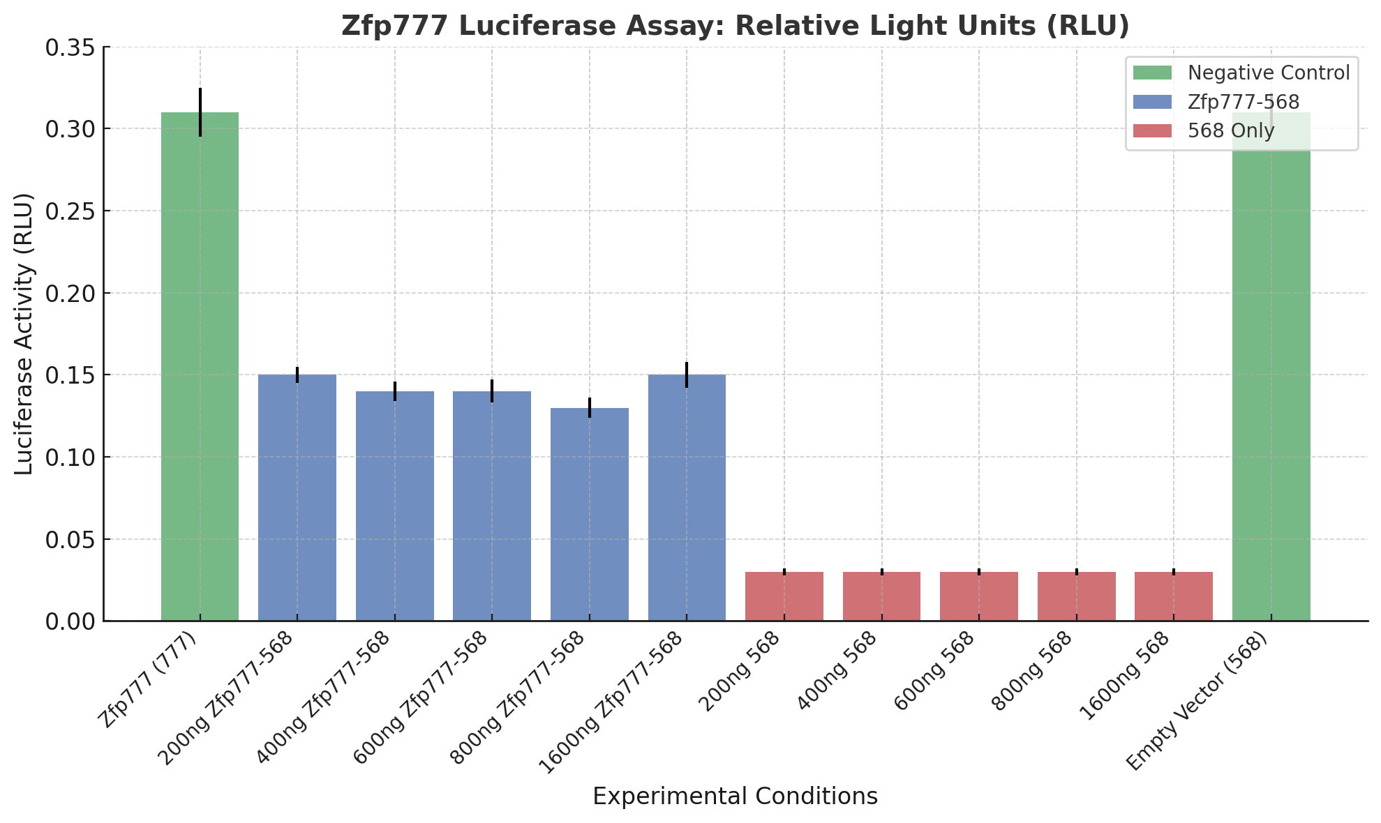
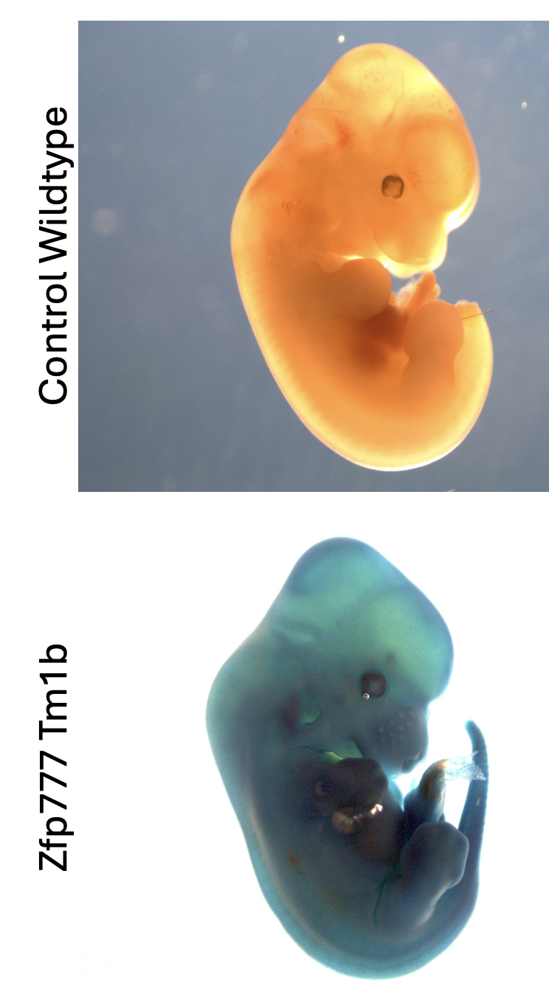
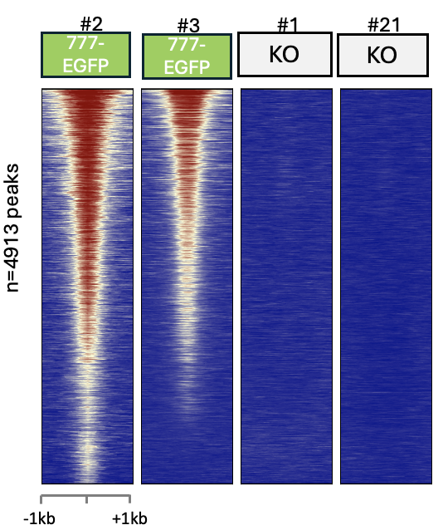
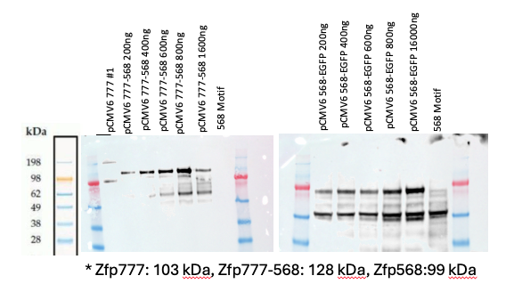
MOUSE MODELS RECAPITULATE BIRTH DEFECTS ASSOCIATED WITH ZNF777 MUTATIONS AND IDENTIFY ZNF777 AS A REPRESSOR IN HUMAN DEVELOPMENT
Peter Lindner^{1,2}, MD, Anna D Senft¹, PhD, Shelley Dolitsky¹, DO, Nick X Miller¹, Todd MacFarlan¹, PhD
1. Eunice Kennedy Shriver National Institute of Child Health and Human Development Bethesda, MD
2. Walter Reed National Military Medical Center, Bethesda MD
INTRODUCTION
RESULTS
Krüppel-associated box (KRAB) zinc finger proteins are the largest family of DNA binding factors in humans and despite being indispensable for human reproduction and embryonic survival, most remain uncharacterized
Human genetics databases list ZNF777, a 320-million-year-old KRAB zinc finger protein, as intolerant to mutations
A point mutation in ZNF777 associates with a structural birth defect, Tetralogy of Fallot, indicating ZNF777 may be relevant for human development and reproduction.
OBJECTIVE
X-gal Staining of mid-
gestational mouse embryos
The objective of this study was to use mouse models to test ZNF777’s role in embryologic development and reproduction and to characterize molecular mechanisms underlying ZNF777 function.
ChIP-Seq of Zfp777 binding in mouse embryonic stem cells
RNA-Seq of Zfp777 from mid-gestational mouse embryos
METHODS
Phenotype
Viability screening from intercrossing heterozygous mice with the Zfp777^{tm1a} null allele established by the EUCOMM consortium
Structural abnormalities upon Zfp777 loss were identified by cesarean-section followed by microCT scans and H&E cross sections obtained from embryos at E15.5
Mechanism
Embryonic expression pattern was assessed using the Zfp777^{tm1b} lacZ reporter allele
Zfp777 binding sites identified in embryonic stem cells using Chromatin Immunoprecipitation Sequencing (ChIP-seq)
Transcriptional analysis of Zfp777 targets in wildtype and KO embryos
Luciferase assays were used to assess Zfp777s as a probable repressor
Co-immunoprecipitation assays and ChIP-seq using HEK293T models were used to characterize the function of the non-canonical KRAB domain and the unique domain of unknown function (DUF3669)
Functions of genes near Zfp777 binding sites
Muscular septum development
Ascending aorta development
Interlukin-11 mediated signaling
Cardiac muscles cell proliferation
Ventricular septum morphogenesis
Odontogenesis
Heart growth
Endocardial cushion development
Ventricular septum development
Cardiac muscle tissue growth
DISCUSSION & CONCLUSIONS
Mutations in the conserved domain of unknown function in the 320-million-year-old KRAB zinc finger protein ZNF777 are associated with ventricular septal and neurodevelopmental defects in humans
Mouse newborns deficient in Zfp777, the mouse ortholog of ZNF777, exhibit ventricular septal defects and die within a day of birth
Comparing ChIP-Seq data from mouse embryonic stem cells and RNA-seq data from Zfp777 KO midgestational embryos show upregulation at 93 genes bound by Zfp777, suggesting Zfp777 acts as a repressor
Luciferase assay comparing Zfp777 protein with a control repressor KRAB zinc finger protein confirms Zfp777 has weak repressive activity
ACKNOWLEDGMENTS
Thank you to the Macfarlan Lab at NICHD and particular thanks for the support and mentorship from Anna Sent and Todd MacFarlan.
Notes:
Use Arial font
For text boxes: Do not drop below font size 28, but if you have extra space, you can up the font size until the space is full.
You can move around and customize the template to best fit your information.
Create a QR Code here: https://www.qrcode-monkey.com/ or here: https://www.qr-code-generator.com/

