Slide 1

Mail-in semen analysis breaks down racial, educational, and income barriers to test completion
Alisha Tara Tolani MD
March 22, 2024
Co-authors: Stacey A. Kenfield ScD, Andre Belarmino MD, Daniel Civello BS, Joshua A. Halpern MD MS, Jerrine R. Morris MD MPH, Yanett Anaya MD, James F. Smith MD MS

Slide 2








Our research team
Stacey Kenfield ScD
University of California – San Francisco
Fellow Health
Andre Belarmino MD
University of California -
Los Angeles
Fellow Health
Daniel Civello
Fellow Health
Dan Nolte
Fellow Health
Joshua Halpern MD MS
Posterity Health
Jerrine R. Morris MD MPH
Shady Grove Fertility
Yanett Anaya MD
University of California-
San Francisco
James Smith MD
University of California-
San Francisco
Fellow Health

Slide 3
Disclosures
Stacey A. Kenfield ScD, Consultant, Fellow Health
Andre Belarmino MD, Clinical Education Manager, Fellow Health
Daniel Civello, Data Scientist, Fellow Health
Dan Nolte, Data Scientist, Fellow Health
James F. Smith MD MS, Chief Medical Officer, Fellow Health

Slide 4
Background
Semen analysis (SA) is an essential component of the infertility evaluation and post-vasectomy care,¹⁻³ yet 50-70% of patients needing SA do not complete them⁴⁻⁷
Limited studies have evaluated barriers to completion⁵ and report the following:
  Low health literacy
  Cost
  Availability of testing centers
  Distance
  Time constraints
  Forgetfulness
SA non-completion limits patients’ ability to proceed with fertility care
The purpose of this study was to determine whether mail-in SA addresses barriers to completion
Notes:
We expected barriers/disparities based on what we saw in EXPLORE.

Slide 5
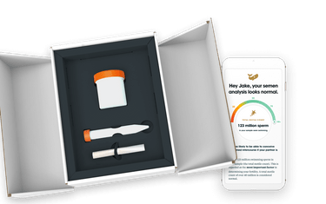
Methods
The Fellow Health mail-in SA platform was used for the study
  Published validation data ⁸
  Performs > 50,000 SA annually
Temperature controlled kits were sold direct-to-consumer (online order) and via clinicians (in-office or by referral code)
Kits were tracked and patients were sent text reminders
Patients produced samples and then returned completed kits by mail to their CLIA-certified centralized lab in San Leandro, California
  PVSA – 10 days to return, UPS Ground
  FSA – 1 day to return, UPS Next-Day Shipping
PVSA = post-vasectomy SA
FSA = full SA
Notes:
UPS by 3PM for next day shipping
M-Thursday
---
Rarely, specimen comes in Monday morning because greater than 52 hours
PVSA > have 10 days to. Get to the lab.
GROUND SHIPPING

Slide 6
Methods
--- Text reminders---
Median duration
PVSA: 84 days
FSA:16 days
----Shipping ----
Median duration
PVSA: 5 days
FSA: 1 day
Kit Activation
Kit Registration
Kit Accessioning
Occurs at time of clinic purchase or online order (with referral code)
Basic contact information collected
Patient record is created
Patient is ready to produce the sample and imminently plans to mail the kit to the lab
Patient is invited to participate in survey research
Sample received by lab for processing
“Kit Return Rate”
“Completion Rate”

Slide 7
Results
11,717 patients activated their kit and completed the survey
85% of patients purchased kits directly from a clinic ( in-person vs. referral code)
15% of patients purchased kits online
Kit Activation
Kit Registration
Kit Accessioning
“Kit Return Rate”
= 94%
“Completion Rate”
= 88%

Slide 8
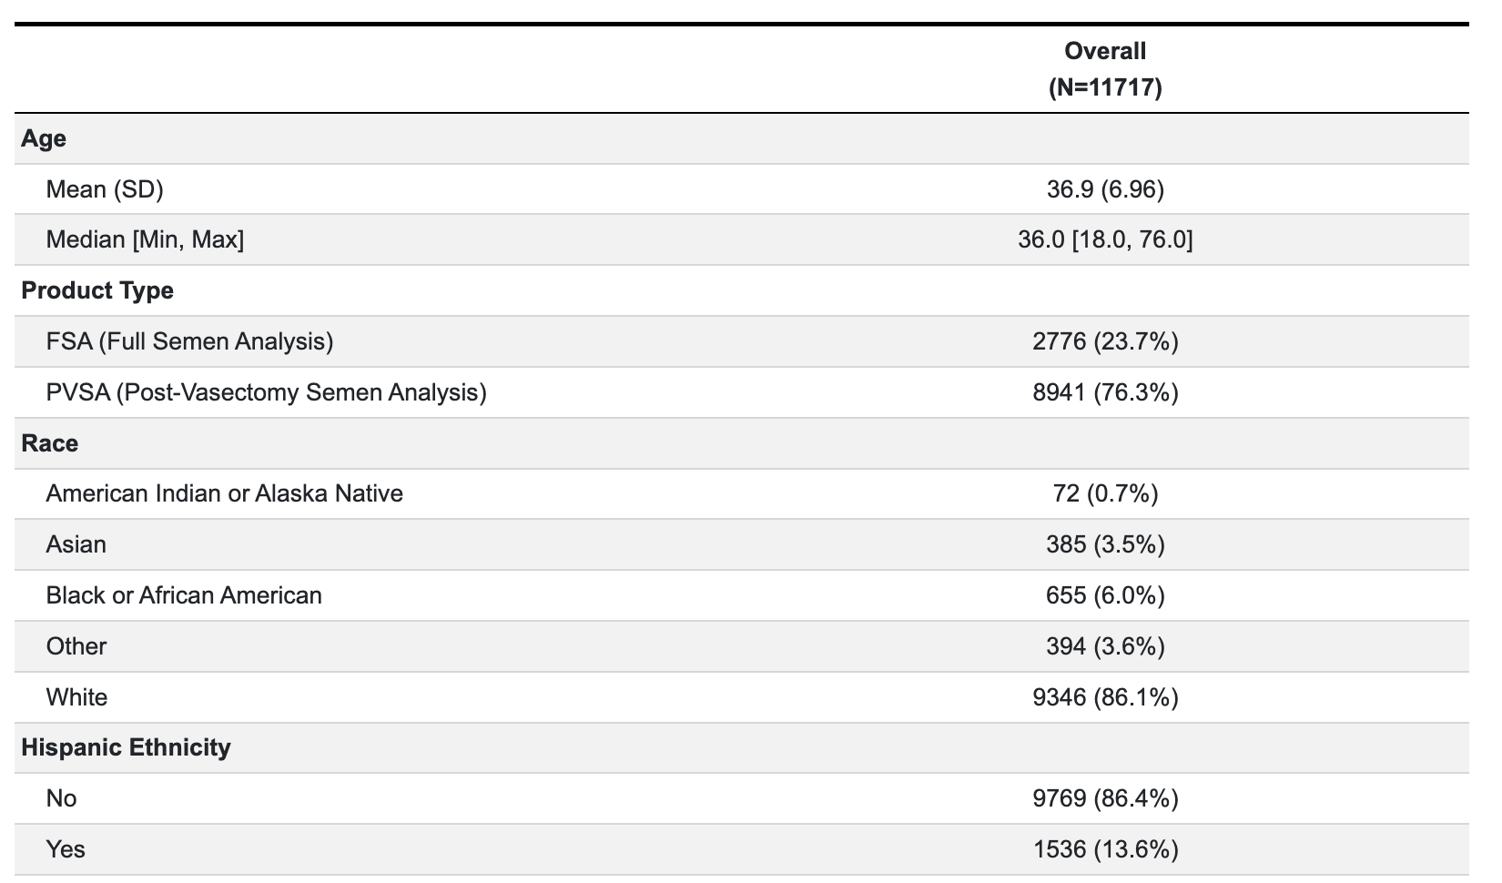
Demographics
Notes:
With respect to the cohort, the mean age was 37 years.
76% ordered post-vasectomy semen analysis kits, and 24% ordered full semen analysis kits
The cohort was racially and ethnically diverse.
Though 86% of the cohort identified as white and non-Hispanic, the absolute numbers of racial and ethnic minority groups are high.

Slide 9
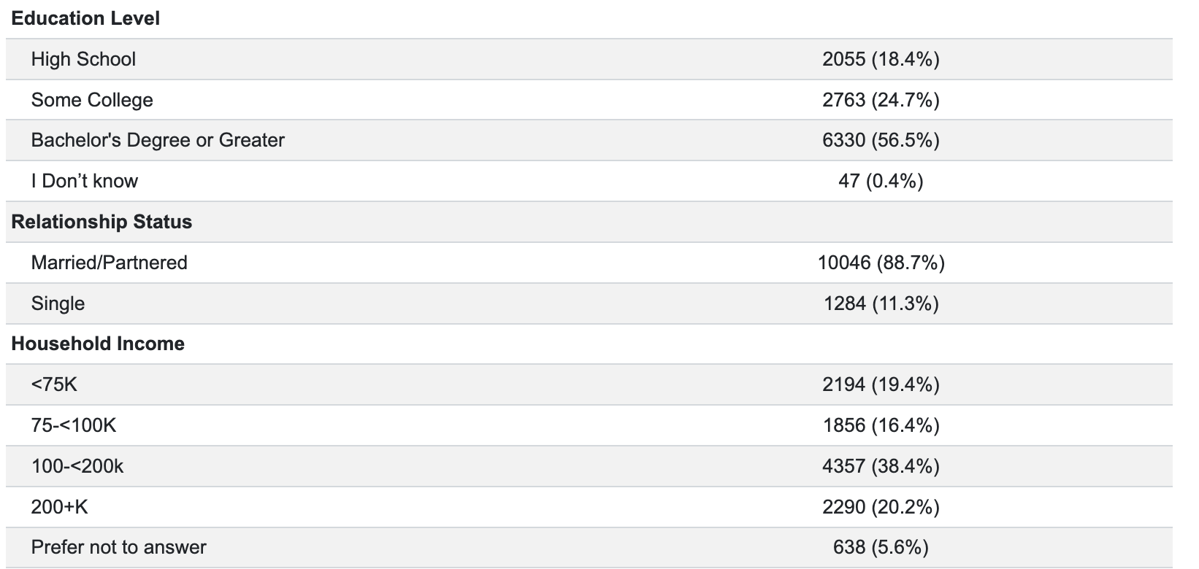
Demographics
Notes:
The cohort was diverse with respect to education level, relationship status, and household income.
For education, the largest subgroups reported some college or a bachelor’s degree or greater.
The cohort was

Slide 10
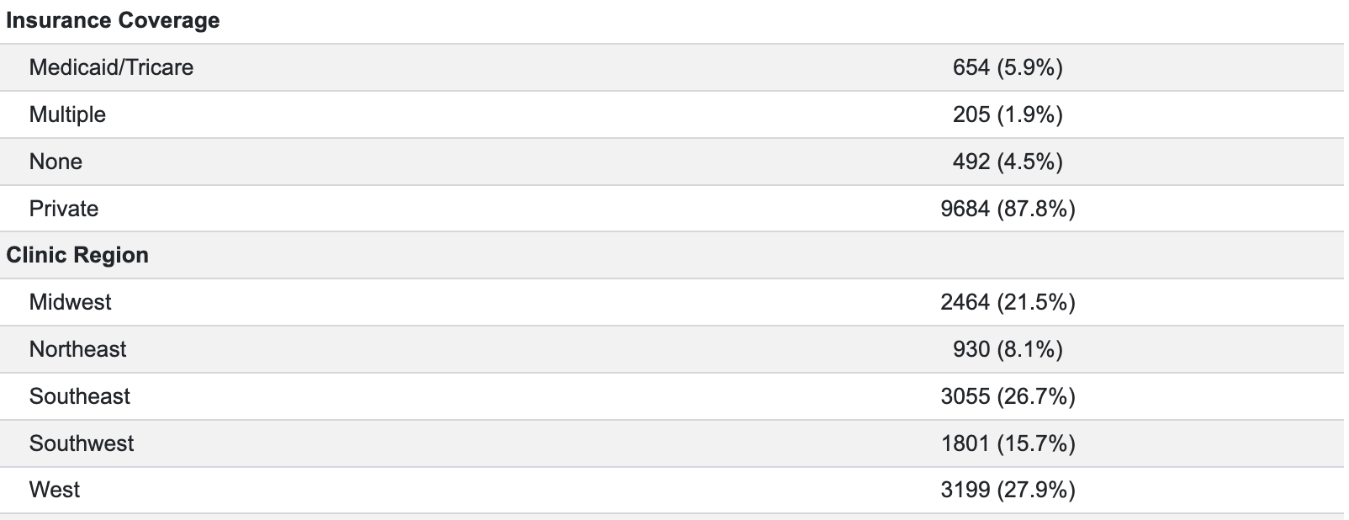
Demographics

Slide 11
Kit return rate – PVSA vs. FSA
97%
93%
P < 0.0001
Kit return rate (%)

Slide 12
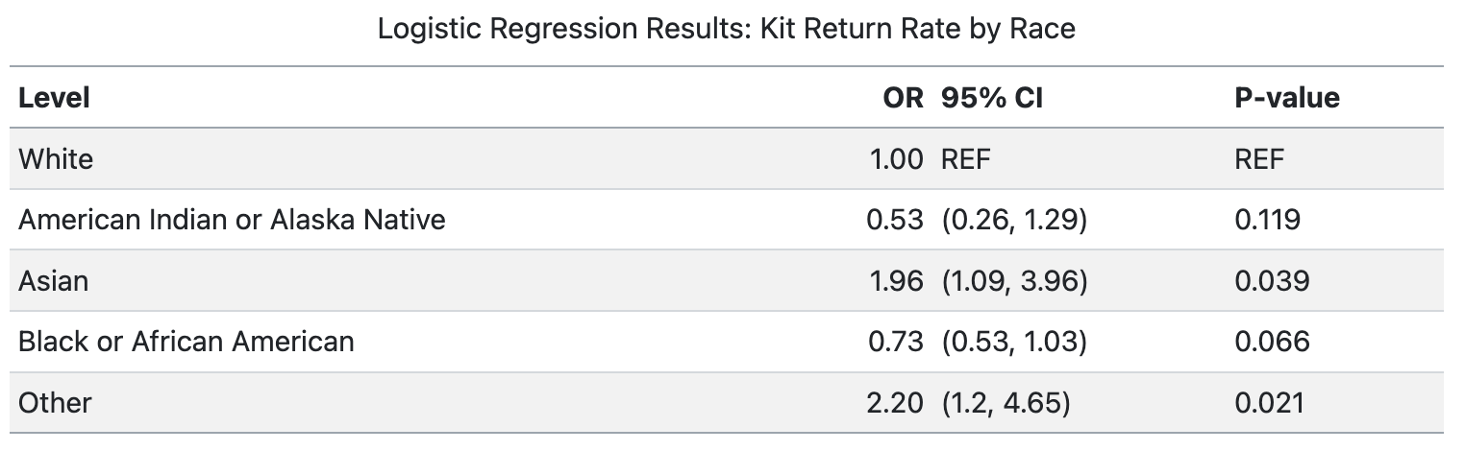
Kit return rate by race
P = 0.002
Kit return rate (%)

Slide 13
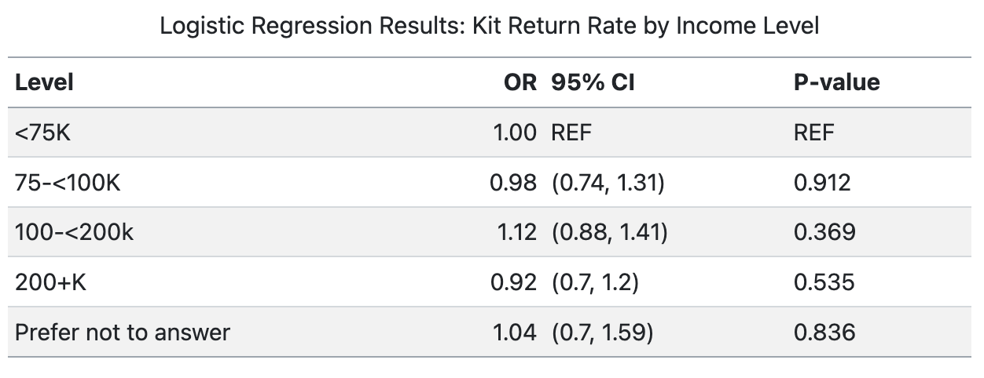
Kit return rate by income
93.8%
93.7%
94.4%
93.3%
94.0%
P = 0.588
Kit return rate (%)

Slide 14
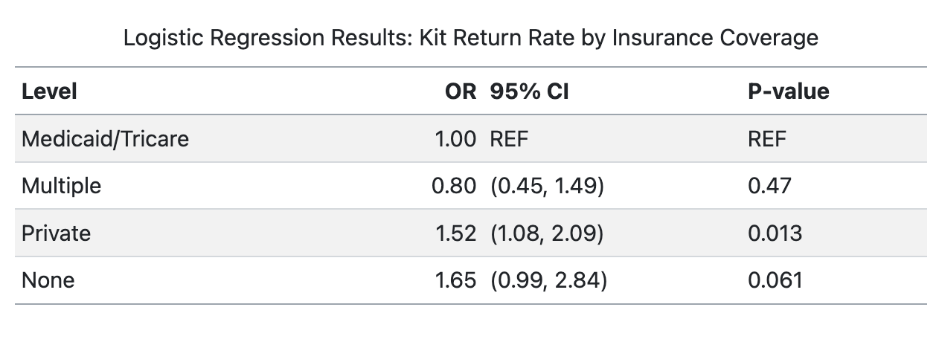
Kit return rate by insurance type
91.5%
94.2%
89.6%
94.7%
P=0.007
Kit return rate (%)

Slide 15
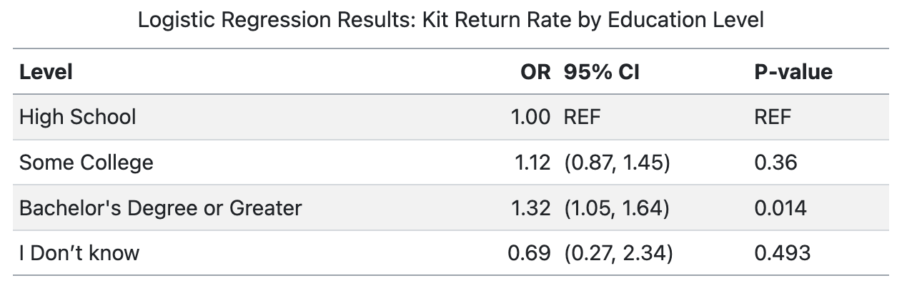
Kit return rate by education
92.9%
93.6%
94.5 %
90.0 %
P=0.053
Kit return rate (%)

Slide 16
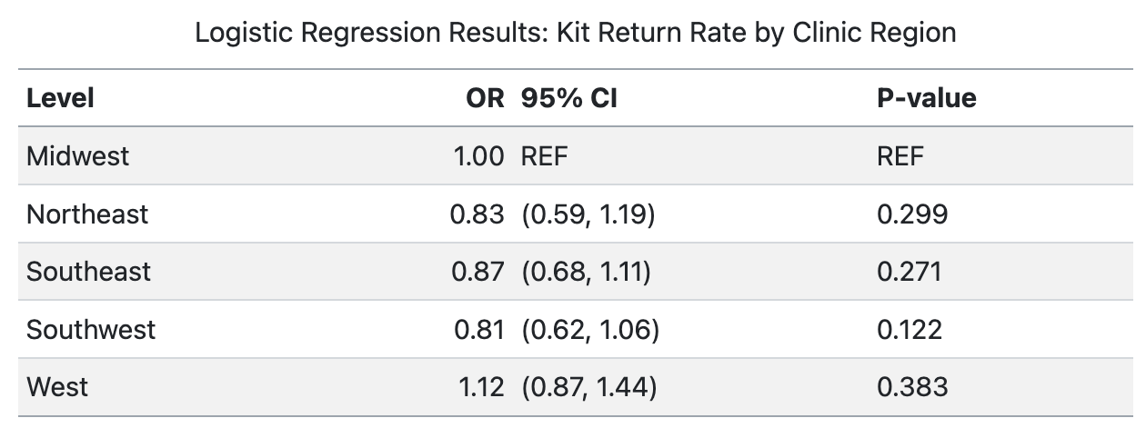
Kit return rate by clinic region
P = 0.082
Kit return rate (%)

Slide 17
Conclusions
94% of mail-in SA patients returned their kits – substantially higher than the 30-50% published completion rates with conventional clinic-based testing ⁴⁻⁶
This may be due to the following factors:
  No referral paperwork needed
  Limited travel time and time off work
  Ease of use
  Low cost
  Private and less embarrassment with home collection
  Robust activation, tracking, and patient reminder system
* These completion rates reflect the Fellow experience and are not generalizable to mail-in testing more broadly

Slide 18
Conclusions
Kit return rates did not clinically differ by race/ethnicity, income, educational background, marital status, or insurance type
Even though there were statistical differences in kit return rate by insurance type and race, the return rates were still very high across all racial and ethnic groups, irrespective of insurance type, suggesting that Fellow mail-in semen analysis system addresses barriers to completion

Slide 19
References
Penzias, Alan, Ricardo Azziz, Kristin Bendikson, Marcelle Cedars, Tommaso Falcone, Karl Hansen, Micah Hill, et al. “Fertility Evaluation of Infertile Women: A Committee Opinion.” Fertility and Sterility 116, no. 5 (November 2021): 1255–65. https://doi.org/10.1016/j.fertnstert.2021.08.038.
Schlegel, Peter N., Mark Sigman, Barbara Collura, Christopher J. De Jonge, Michael L. Eisenberg, Dolores J. Lamb, John P. Mulhall, et al. “Diagnosis and Treatment of Infertility in Men: AUA/ASRM Guideline Part I.” Fertility and Sterility 115, no. 1 (January 2021): 54–61. https://doi.org/10.1016/j.fertnstert.2020.11.015.
Schlegel, Peter N., Mark Sigman, Barbara Collura, Christopher J. De Jonge, Michael L. Eisenberg, Dolores J. Lamb, John P. Mulhall, et al. “Diagnosis and Treatment of Infertility in Men: AUA/ASRM Guideline Part II.” Fertility and Sterility 115, no. 1 (January 2021): 62–69. https://doi.org/10.1016/j.fertnstert.2020.11.016.
Eisenberg, Michael L., Ruth B. Lathi, Valerie L. Baker, Lynn M. Westphal, Amin A. Milki, and Ajay K. Nangia. “Frequency of the Male Infertility Evaluation: Data from the National Survey of Family Growth.” Journal of Urology 189, no. 3 (March 2013): 1030–34. https://doi.org/10.1016/j.juro.2012.08.239.
Bradshaw, Aaron, Eric Ballon-Landa, Richmond Owusu, and Tung-Chin Hsieh. “Poor Compliance With Postvasectomy Semen Testing: Analysis of Factors and Barriers.” Urology 136 (February 2020): 146–51. https://doi.org/10.1016/j.urology.2019.10.026.
Ernandez, John et al. “Predictors of Post-Vasectomy Semen Analysis Completion.” BMJ sexual & reproductive health 49.3 (2023): 228–229. Web.
J Zipkin, B Lin, D Patel, C Welliver. Risk Factors for Post-Vasectomy Semen Analysis Non-Adherence in Home-based and Local Lab-based Testing. The Journal of Sexual Medicine, Volume 19, Issue 4, Supplement 1,2022, S67-S68.
Samplaski, Mary K et al. “Development and Validation of a Novel Mail-in Semen Analysis System and the Correlation Between One Hour and Delayed Semen Analysis Testing.” Fertil Steril 115.4 (2021): 922–929. Web.

Slide 20
Thank you!
Contact information:
Alisha Tolani MD
Alisha.Tolani@ucsf.edu

