Slide 1

Kristin Brogaard, PhD
Co-Founder and CSO kristin@inherentbio.com
A NOVEL EPIGENETIC-BASED TEST TO PREDICT SPERM EXTRACTION OUTCOMES

Slide 2
Disclosures
  Co-founder and equity-holder at Inherent Biosciences

Slide 3
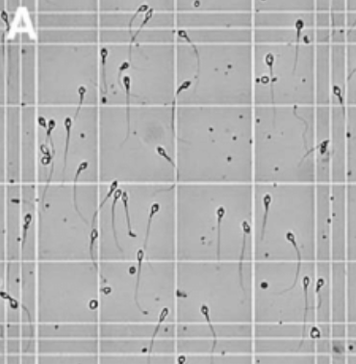
MISSION
Raise the standard of care for
male reproductive health

Slide 4
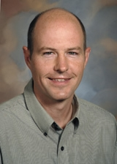
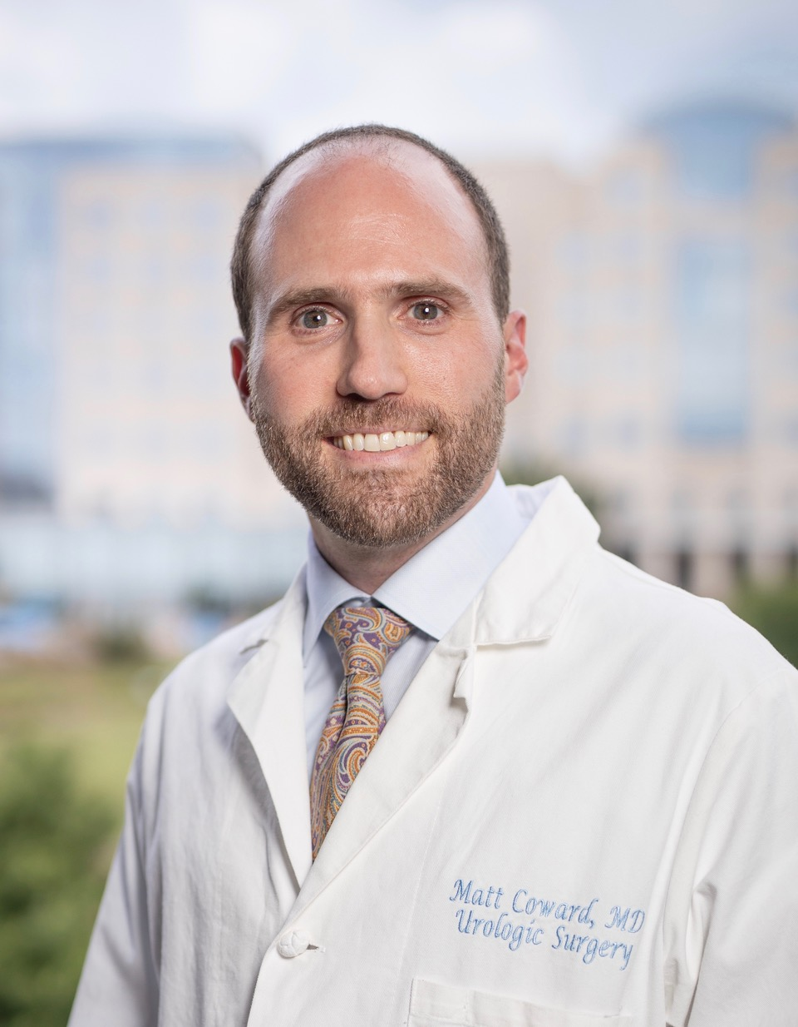
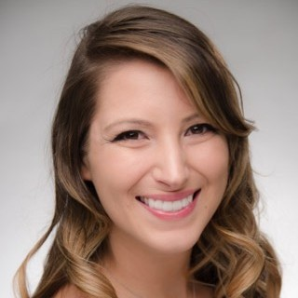
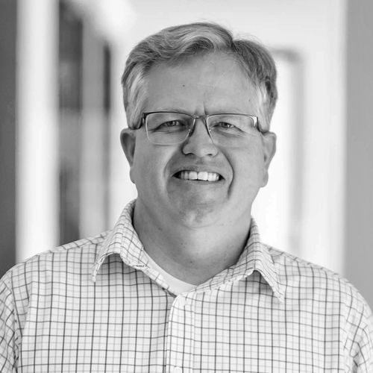

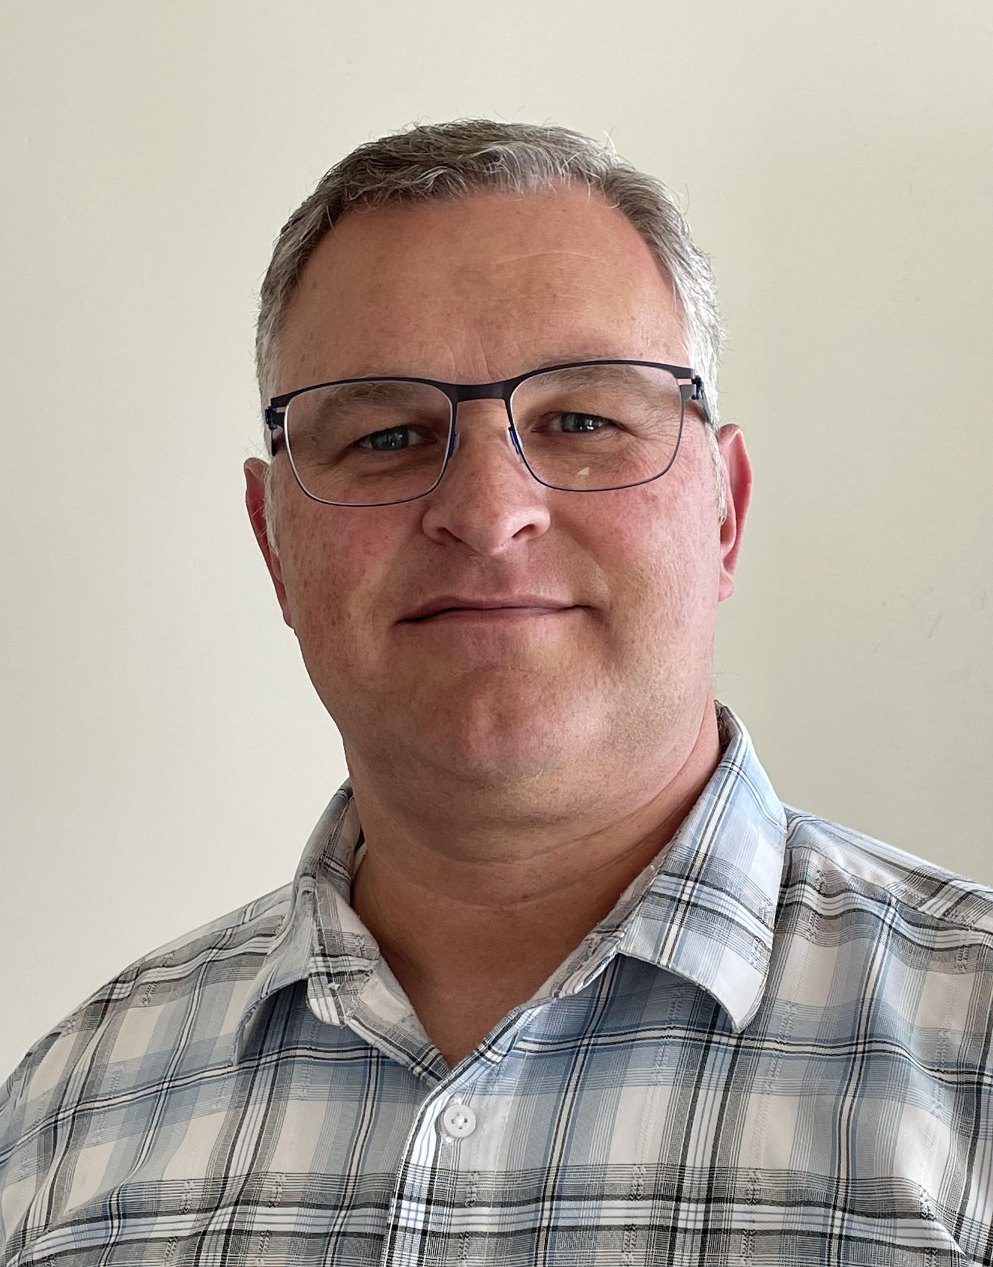

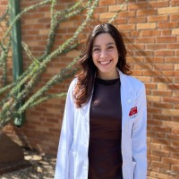

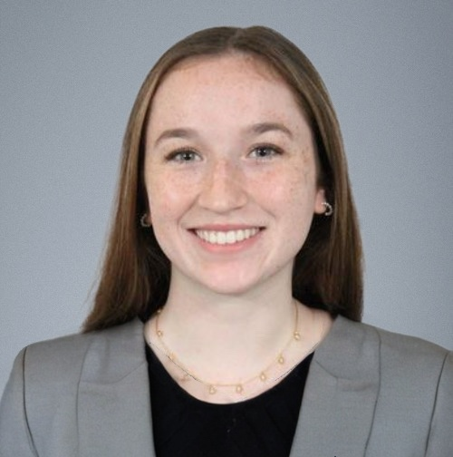

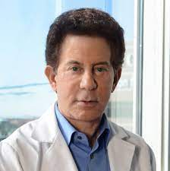
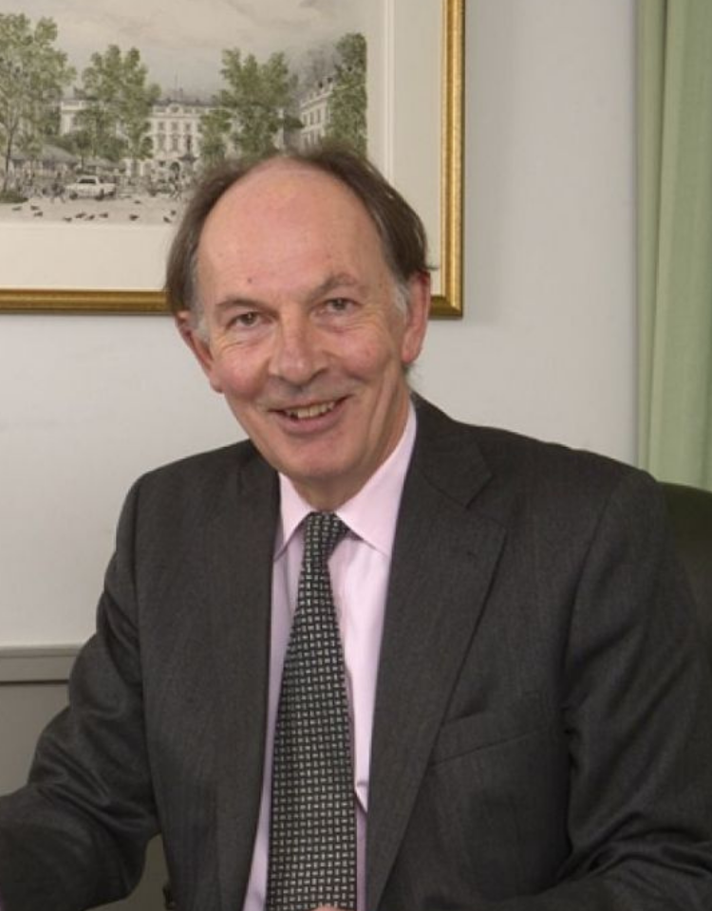
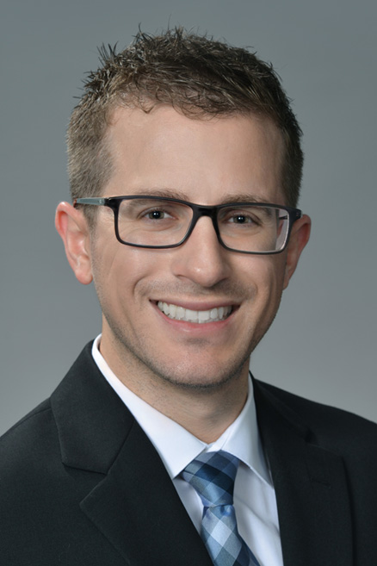


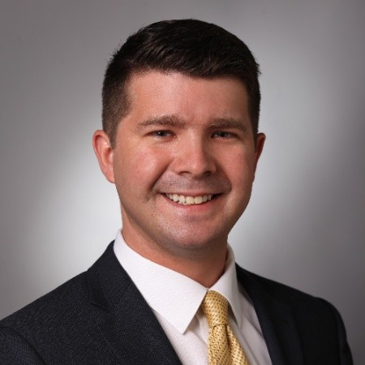


A Multi-Center Collaboration
Tim Jenkins, PhD
Ryan Barney, PhD
Larry Lipshultz, MD
Ryan Miller, MS

Slide 5
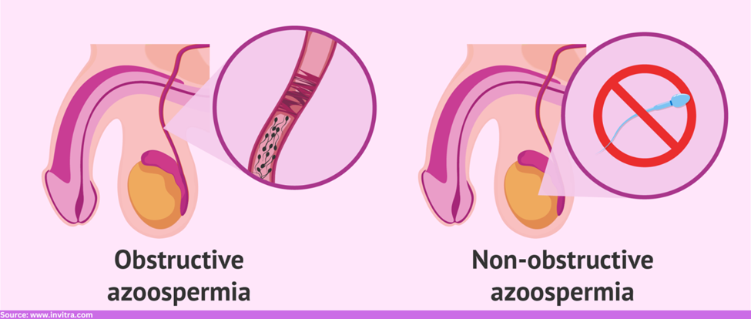
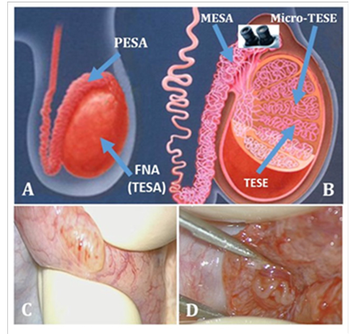

Non-Obstructive Azoospermia (NOA)
& Testicular Sperm Extraction
Defining NOA For this Project
  No sperm in the ejaculate with no known obstruction
1% of all men (10-15% of all infertile men)
Amazing technologies developed to find Sperm in the testicle allowing chances for ICSI success
  TESA, TESE, FNA, mTESE
Javed, Murid et al. Fertility and Sterility. 108.
Notes:
Different line to put in block?

Slide 6
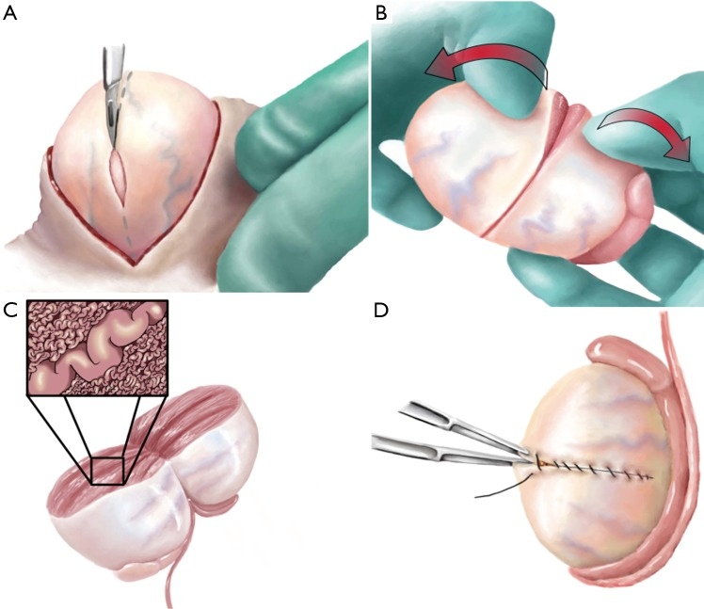
Current Limitations
When there is no sperm in the semen:
  Limited technologies to determine the likelihood of sperm extraction success
  ~50% mTESE success
  Invasive and expensive
Flannigan R, Bach PV, Schlegel PN. Microdissection testicular sperm extraction. Translational Andrology and Urology. 2017 Aug;6(4):745-752.

Slide 7
Objective
Can we develop a non-invasive, cost-effective and highly sensitive assay to predict the presence of absence sperm in the testicles?

Slide 8
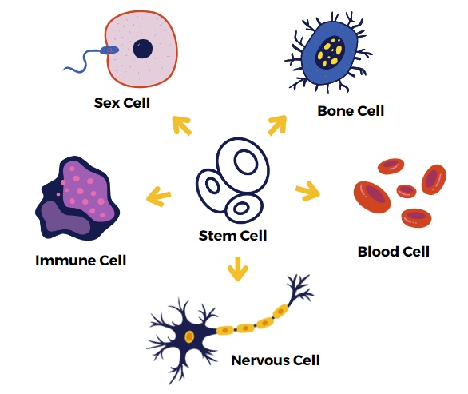
Utilizing Epigenetics & DNA Methylation
Epigenetics is the control of DNA and gene expression that is independent of the DNA sequence itself
Notes:
Different line to put in block?

Slide 9
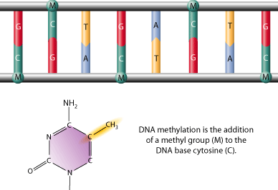
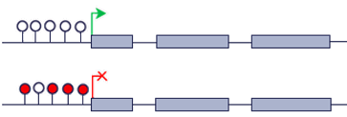
DNA methylation is the addition of a methyl group (M) to the DNA base cytosine (C).
Utilizing Epigenetics & DNA Methylation
Gene Promoter
Gene Body
http://helicase.pbworks.com/
Notes:
Different line to put in block?

Slide 10
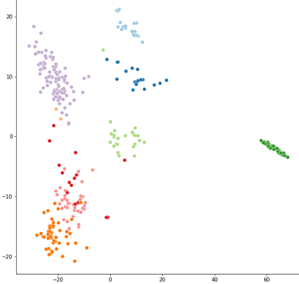
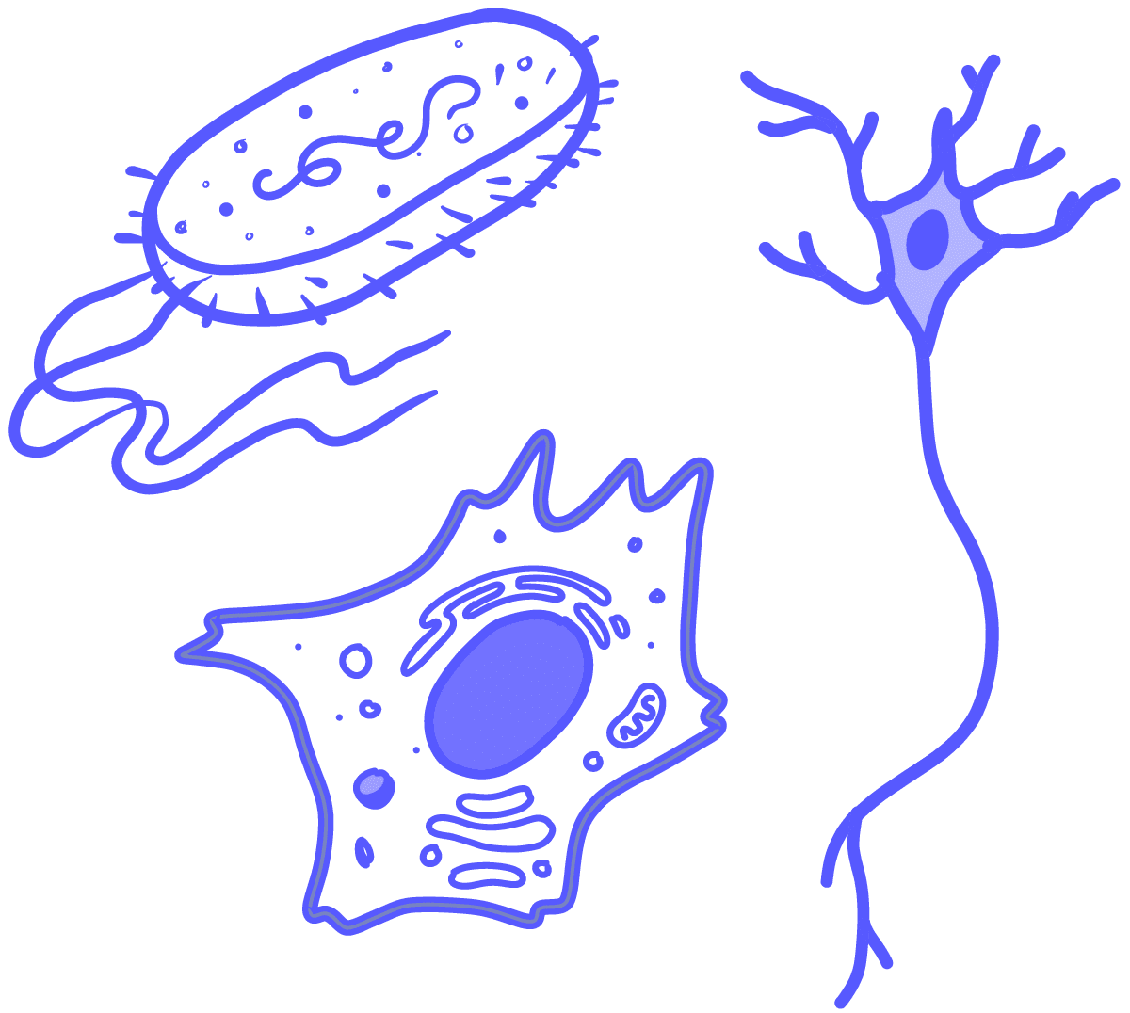

Sperm DNA Methylation is Different from Somatic Cells
PCA Plot DNA Methylation from Nine Tissue Types
Skin
Lung
Brain 1
Sperm
Colon
Esophagus
Brain 2
Liver
Breast
Somatic Cells
Sperm

Slide 11
Sperm or Not Sperm?
DNA Methylation can distinguish if DNA originated from sperm or NOT from sperm.
Methylation Sites
Chance of sperm origin
Blood
A
B
Sperm Sample
Unmethylated
Methylated
DNA 1
0%
85.1%
100%
DNA 2
0%
7.24%
100%
DNA 3
0.12%
6.87%
99.02%
DNA 4
99.88%
0.79%
0.78%

Slide 12
Objective
Can we develop a non-invasive, cost-effective and highly sensitive assay to predict the presence or absence sperm in the testicles?
Utilizing:
Unique DNA methylation profile of Sperm
Cell-Free DNA in seminal plasma

Slide 13
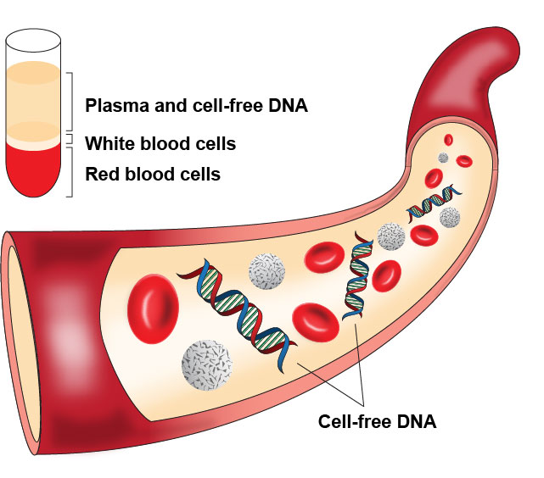
cfDNA releases into the multiple body fluids
cfDNA is released from both healthy and diseased cell death
The Hindu- cfDNA cancer screening

Slide 14
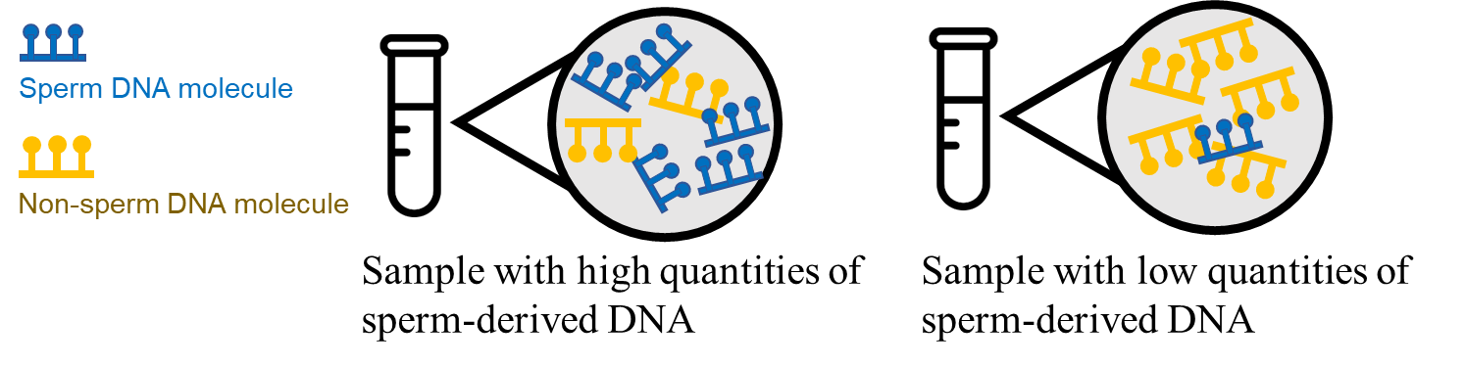
Hypothesis
Looking at the Seminal Plasma from NOA Patient
cfDNA
HIGH chances of successful sperm extraction
LOW chances of successful sperm extraction

Slide 15
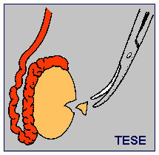
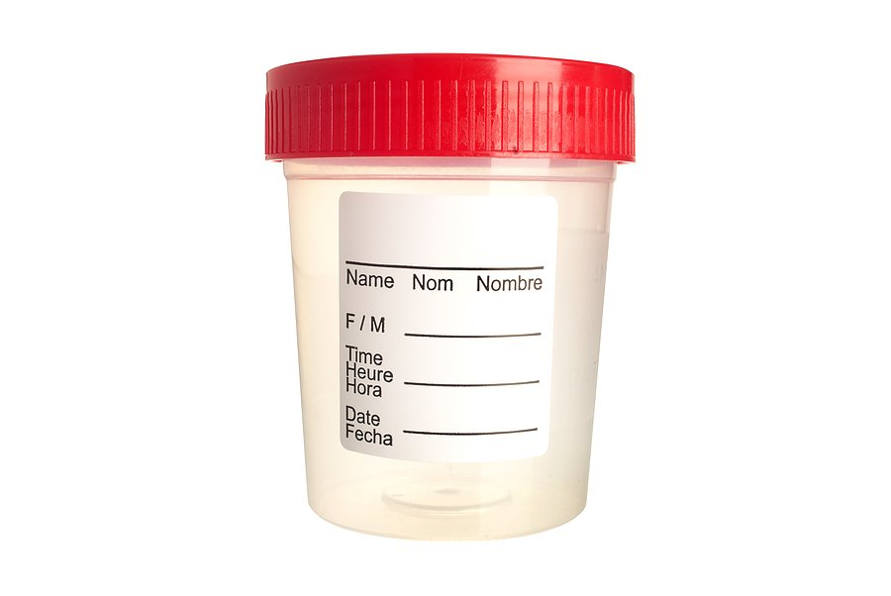
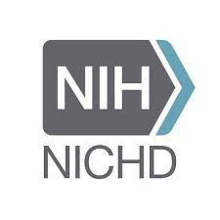
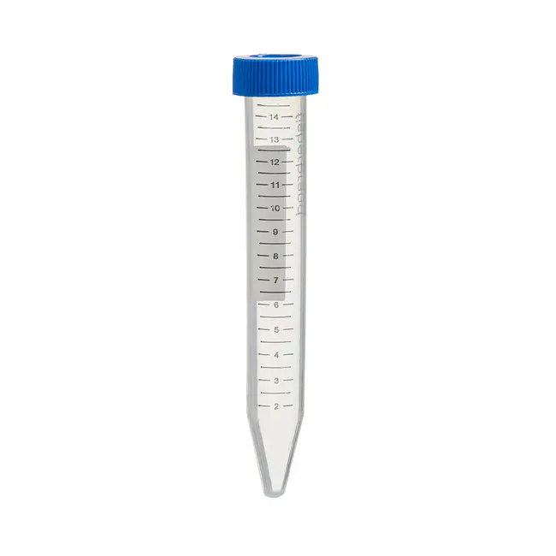
PROOF OF CONCEPT in Biopsies:
Can we predict biopsy results analyzing sperm-specific DNA in the tissue?
Research Strategy
VALIDATION of detectable cfDNA in seminal plasma
Is sperm-specific cfDNA an accessible analyte in seminal plasma?
Semen Sample
CLINICAL UTILITY with NOA semen:
Do levels of sperm-specific DNA in NOA seminal plasma correlate with sperm-extraction results?
NOA Seminal Plasma
http://helicase.pbworks.com/
Notes:
Different line to put in block?

Slide 16
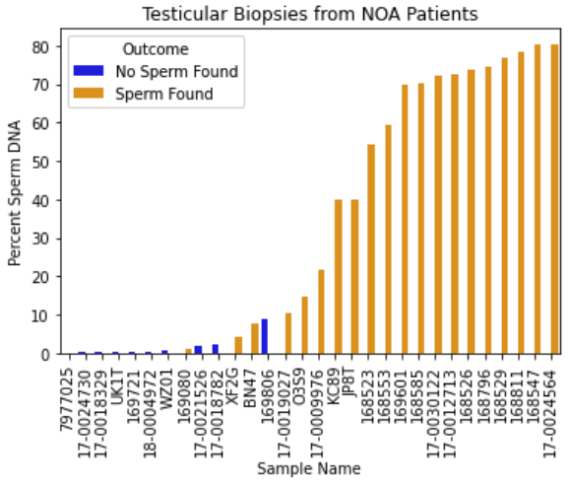
Sperm-specific DNA concentrations in biopsies associated with TESE and mTESE results
Testicular Biopsy Analyses
Biopsy Outcome
No Sperm found in biopsy
Sperm found
% Sperm DNA
Biopsy Samples
PROOF OF CONCEPT in Biopsies
http://helicase.pbworks.com/

Slide 17
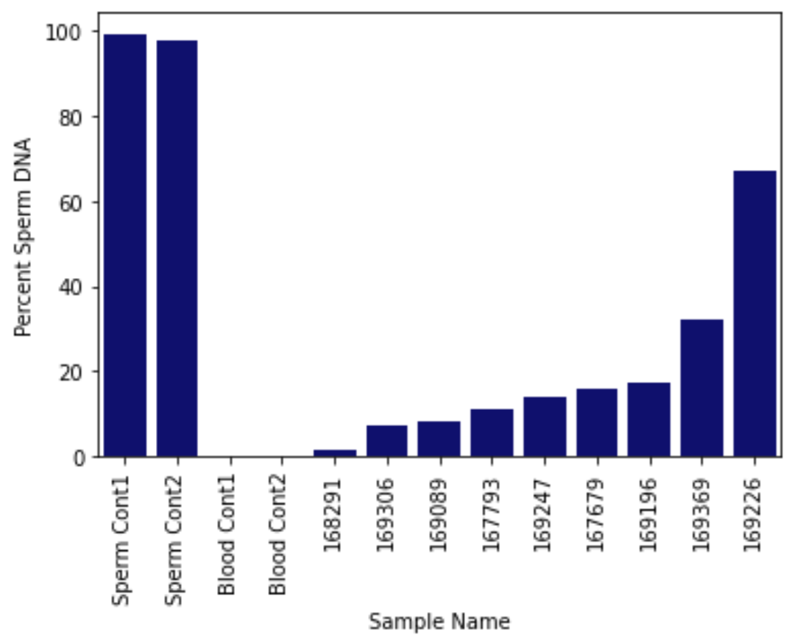
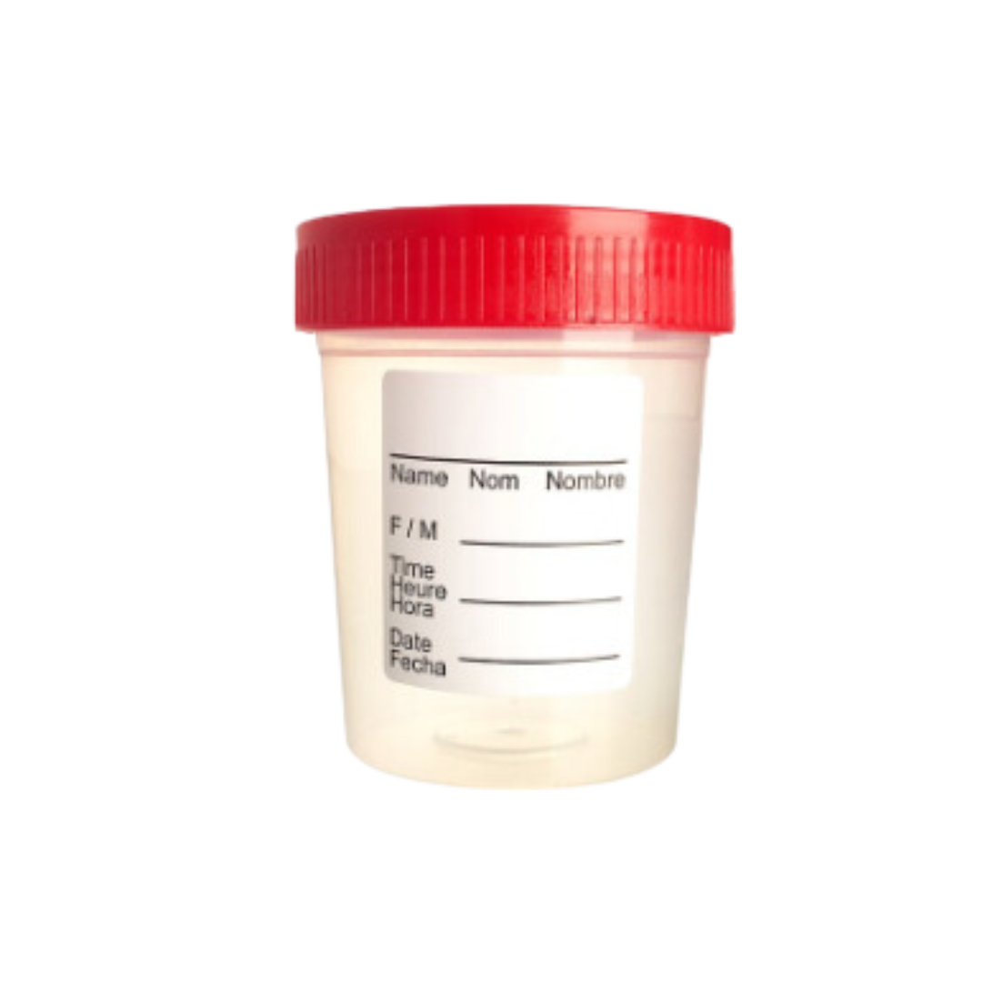
Sperm-specific cfDNA can be captured and analyzed in seminal plasma.
cfDNA can be isolated from seminal plasma
% Sperm DNA
Semen Sample
VALIDATION: cfDNA in semen
Semen Samples

Slide 18
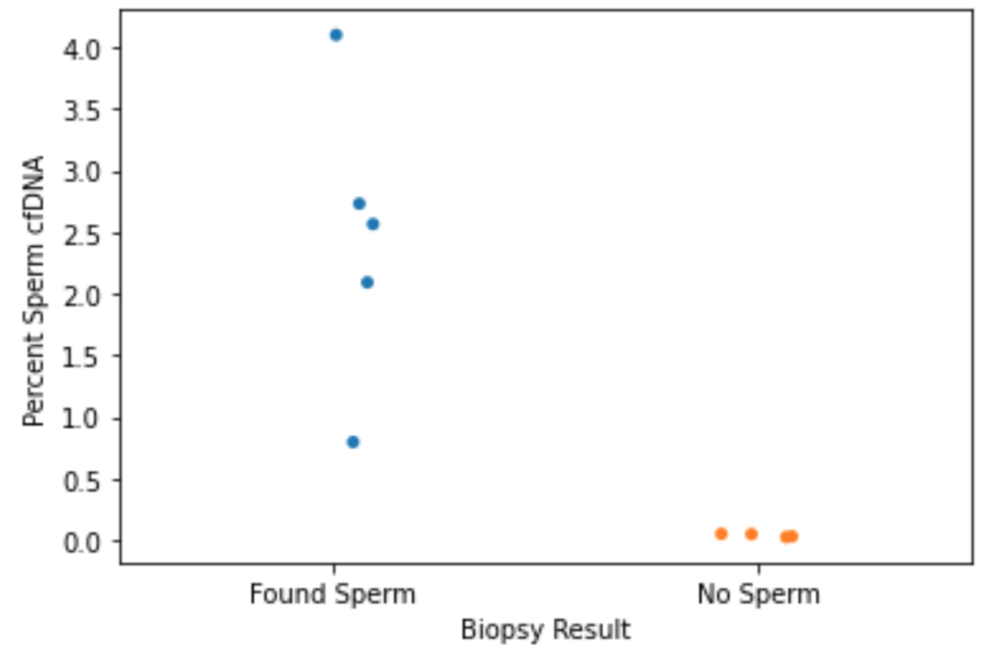
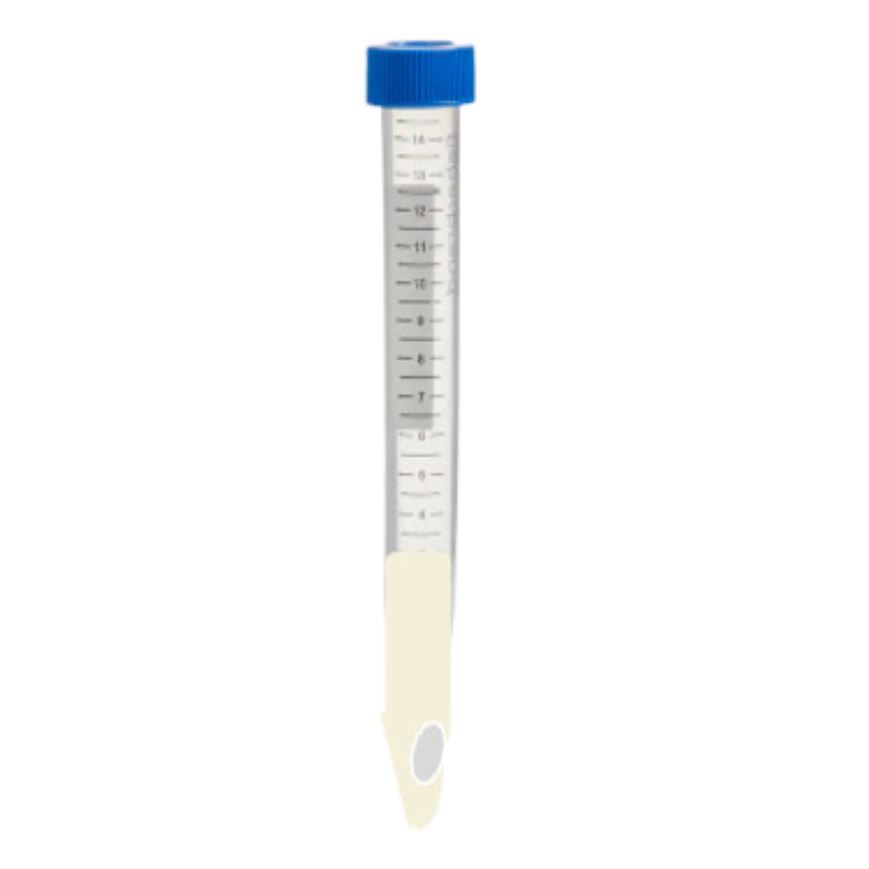
% cfDNA in NOA seminal plasma so far associated with sperm-extraction outcomes
% Sperm cfDNA vs. Extraction Results
p= 0.005**
% Sperm DNA
NOA Seminal Plasma
Found Sperm
No Sperm
Biopsy Result
CLINICAL UTILITY with NOA semen

Slide 19
Next Steps and Challenges
We need more samples and data!
  IRB approved protocol for the study
Assessment of maturation arrest
Not all clinics/labs are made equal
  Our data is only as good as the clinical labs’ ability to identify sperm
Changes in spermatogenesis with therapeutics

Slide 20
Thank You!
Please connect if you are interested in being a part of this research!
kristin@inherentbio.com

