Slide 1
EFFECT OF LENGTH OF TIME POST-MORTEM ON QUALITY AND FREEZING CAPACITY OF HUMAN TESTICULAR SPERMATOZOA
Joginder Bidhan¹, Joshua Bitran¹, Jamie Thomas¹, Ranjith Ramasamy¹
¹Desai Sethi Urology Institute, University of Miami, Miami, FL, USA

Slide 2
DISCLOSURE
“I have nothing to disclose.”​

Slide 3
BACKGROUND
Post-mortem sperm retrieval (PMSR) is used to collect viable sperm from a recently deceased man for future use in assisted reproductive technology (ART)¹
Often used in situations of an unexpected death or when a patient has expressed desire to have children after death²
Some countries ban the procedure, while Israel has an opt-in for PMSR when enlisting in the military in Israel. Even within the US, laws vary by state³
We hypothesize that sperm viability and freezing capacity is more robust than previously reported in the literature.
¹Zinkel AR, Ankel FK, Milbank AJ, Casey CI, Sundheim JJ. Postmortem Sperm Retrieval in the Emergency Department: A Case Report and Review of Available Guidelines. Clin Pract Cases Emerg Med 2019;3:405-8.
²Belker AM, Swanson ML, Cook CL, Carrillo AJ, Yoffe SC. Live birth after sperm retrieval from a moribund man. Fertil Steril 2001;76:841-3.
³ Cristina Richie, Post-mortem Sperm Retrieval and Posthumous Grandparenthood in the United States and Internationally.

Slide 4
OBJECTIVE
The objective of this study was to report sperm motility and viability based on extraction time post-mortem.

Slide 5
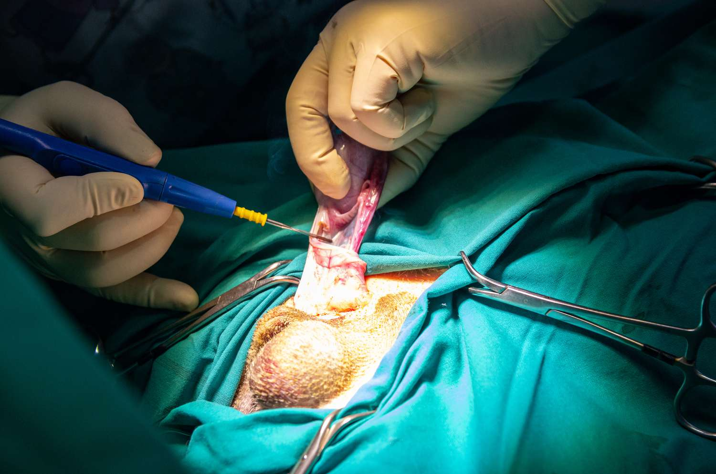
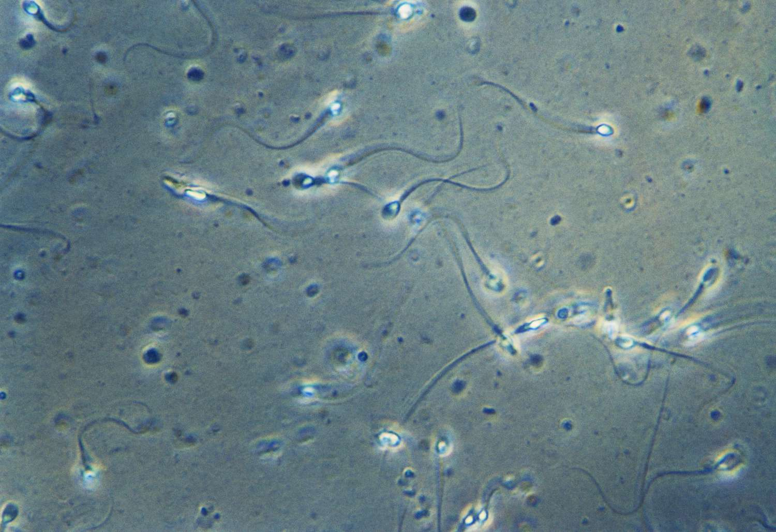
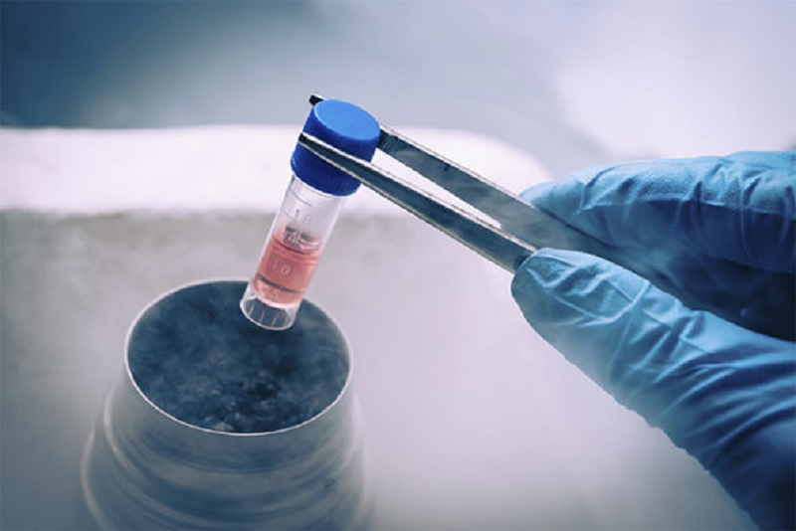
MATERIALS AND METHODS
Patient listed from the Miami-Dade County Medical Examiner Department
Inclusion Criteria: Male, ages of 15-60 with sudden death, no hospitalization and without comorbidities
The patient’s testicle was removed and biopsied at Morgue
Semen analysis (5th edition) conducted to determine the motility and viability of sperm
Last surgically extracted samples contained minced epididymis and vas deferens, and the testicular collected fluid were cryopreserved using the fast-freezing technique

Slide 6
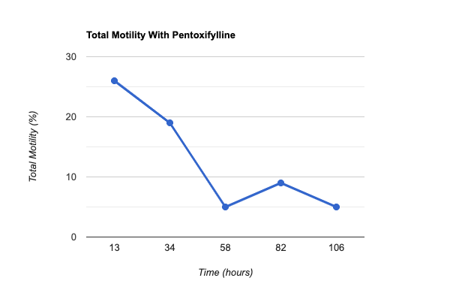
RESULTS
Post-Mortem Sperm Retrieval Total Motility with Pentoxifylline
Total motility with pentoxifylline was reported at 26%, 19%, 7%, 11%, and 5% at each biopsy intervals

Slide 7
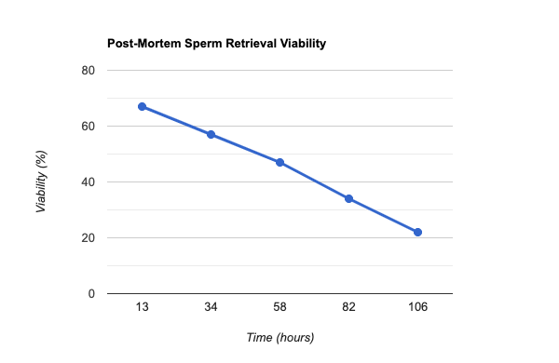
RESULTS
Post-Mortem Sperm Retrieval Viability
Sperm viability was found to be 67%, 57%, 47%, 34%, and 22% respectively at these intervals

Slide 8
RESULTS
Post-thaw analysis after 24 hours of cryopreservation on the last testicular extracted post-mortem sample found the sperm viability and motility with pentoxifylline 5% and 1% respectively.

Slide 9
DISCUSSION
Our study demonstrated that there are motile and viable sperm from human testes even 100 hours postmortem
This may have implications on the timeframe that post-mortem sperm retrieval can be performed successfully several days after death.

Slide 10
CONCLUSION
Analyzing the viability and cryopreservation of posthumous sperm will provide an opportunity to offer patients and their families greater insight to help inform decisions on whether to pursue this option in specific cases.

Slide 11
@JoginderBidhan8
@joginder_bidhan
@ranjithramamd
@ramasamymd

