Slide 1
CAUSAL INFERENCE INDICATES THAT POOR RESPONDERS GOING THROUGH A REPEAT CYCLE HAVE COMPARABLE OUTCOMES WITH ANTAGONIST PROTOCOL COMPARED TO FLARE
Fernanda Murillo, M.S, Michael Fanton PhD¹, Valerie Baker MD², Kevin Loewke PhD¹
¹Alife Health, Inc., San Francisco, CA
²Johns Hopkins University School of Medicine, Baltimore, Maryland

Slide 2
Disclosures
Employee of Alife Health

Slide 3
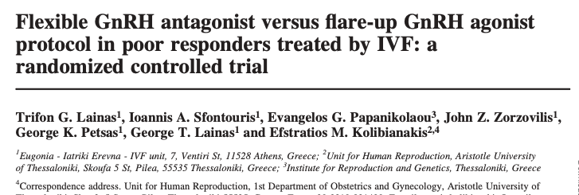
Background
The Flare protocol is often used for poor responders → thought that stimulating endogenous production of FSH with a low dose of Lupron can increase the responsiveness of the ovaries
However, studies have reported conflicting results, and it remains unclear whether Flare provides better outcomes for poor responders compared to Antagonist
Some studies have provided evidence for better outcomes with Antagonist showing higher ongoing pregnancy rates compared to Flare
Other studies have provided evidence that pregnancy rates are comparable between Flare and Antagonist, but with Flare providing higher numbers of mature oocytes and top-quality embryos and lower cycle cancellation rates

Slide 4
Background
Variability in outcomes likely caused by several factors:
Most prospective studies have been single-center with relatively small sample sizes
may not be adequately powered to detect differences in outcomes
Retrospective studies may not have properly matched patients between the groups to account for physician bias in the selection of which protocol to use
Studies have shown considerable variability in the definition of a poor responder
One meta-analysis of randomized trials reported 41 different definitions among 47 randomized trials
There is a need to further investigate the question of which protocol is best for poor responders

Slide 5
Dataset and methods
Society for Assisted Reproductive Technology
Study Goal: To use causal inference to investigate whether Flare protocol or Antagonist protocol is better for poor responders going through controlled ovarian stimulation
Analyzed recent data from 2014-2019 filtering for autologous IVF cycles and linked frozen transfers
Referenced the Bologna criteria developed by the ESHRE consensus
Patients going through a second cycle that had a poor response on their first cycle (<4 oocytes retrieved)

Slide 6
Propensity matching
A way to account for confounding variables in a retrospective analysis
For a given treatment option (e.g. receiving Antagonist on first cycle, then switching to Flare):
Identify confounding variables that are likely to influence that decision
Patient age, AMH, day 3 FSH, BMI, cycle year, gravidity, prior full term births, prior gonadotropin cycles, and diagnoses, as well as parameters related to the first cycle including total FSH dose, cycle days, oocytes retrieved, 2PNs, fertilization rate, ovarian sensitivity index
Train a logistic regression model to predict the probability of receiving treatment
Sample patients from both groups that have equal probability of receiving treatment
Population with varying characteristics
Propensity-matched comparison groups
Notes:
This matching technique produces a pair of patients that have equal probability of receiving the treatment-A protocol, but one was actually given the treatment-A protocol and the other was given the treatment-B protocol

Slide 7
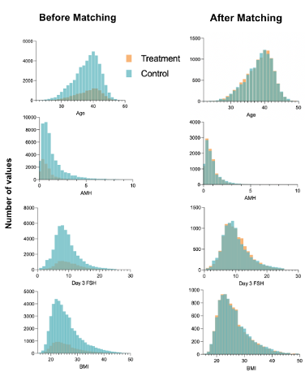
Propensity score matching
Matching helps to balance each covariate between the groups
Therefore we can confidently compare outcomes between groups

Slide 8
Bootstrapping for robust propensity matching
Used a bootstrapping method for robust propensity matching patient treatment to control groups
Propensity match patient groups
Calculate mean outcomes
Repeat n times
Calculate 95% CI
Treatment-A group
Population group
Propensity Match
Mean outcome
Treatment-B group
repeat n times
Mean outcome

Slide 9
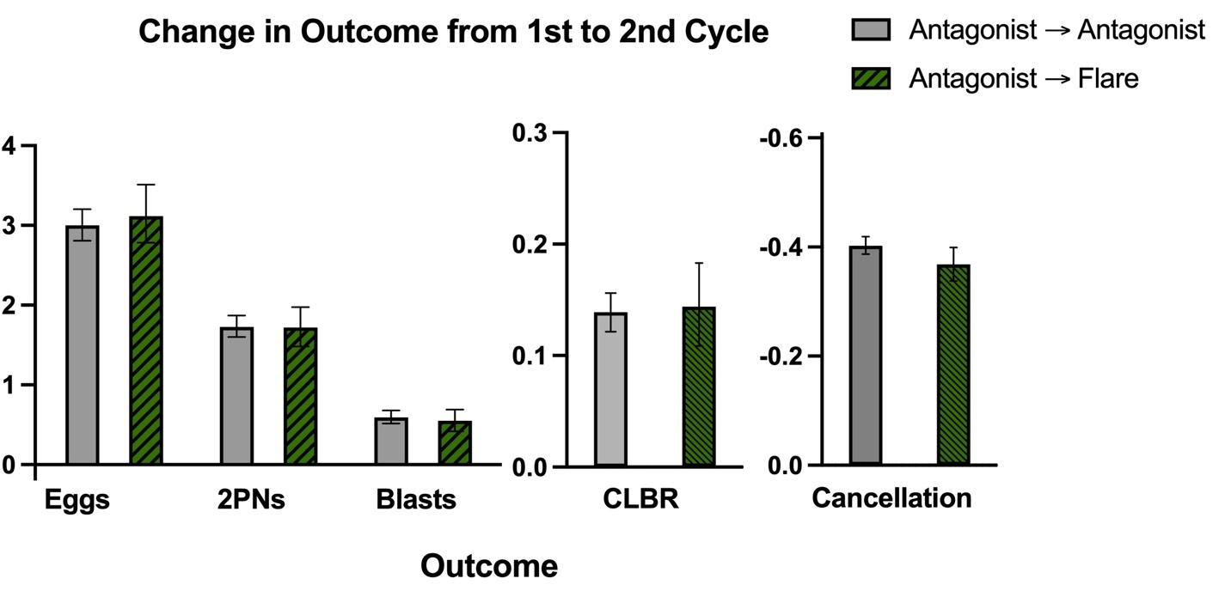
Comparison of change in outcomes between first and second cycle using PSM
Treatment-A group is Antagonist-to-Antagonist, and the Treatment-B group is Antagonist-to-Flare
Overall improvement on second cycles relative to the first regardless of protocol
For patients with less than 4 oocytes retrieved on their first Antagonist cycle, switching to Flare (N=952) does not show an improvement compared to staying on Antagonist (N=2,354).
Notes:
Talk about individual results (eggs, 2PNs, blasts)

Slide 10
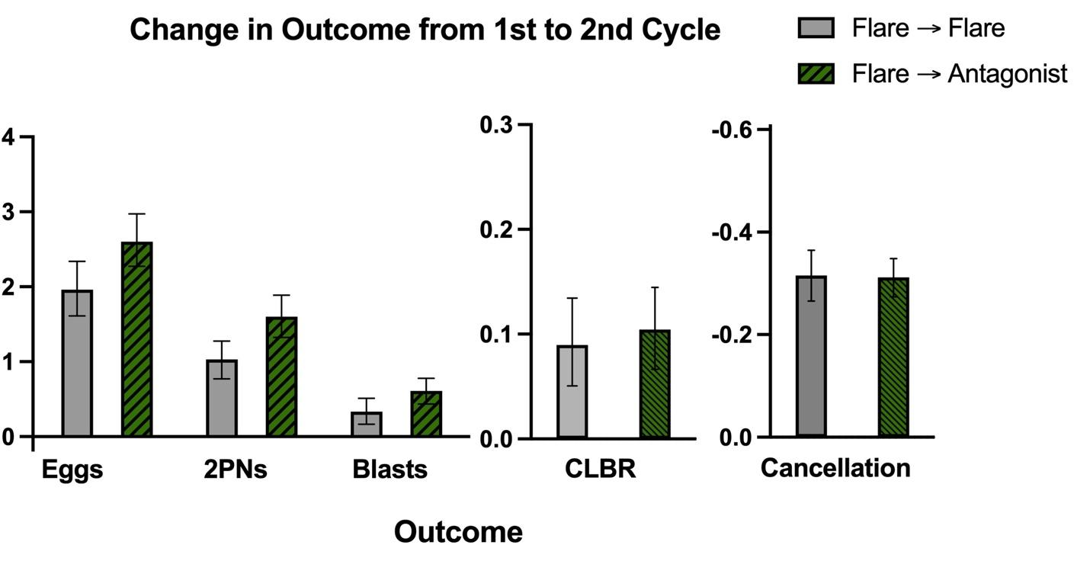
Comparison of change in outcomes between first and second cycle using PSM
Treatment-A group is Flare-to-Flare, and Treatment-B group is Flare-to-Antagonist
For patients with less than 4 oocytes retrieved on their first Flare cycle, switching to Antagonist (N=445) has similar outcomes to staying on Flare (N=409)

Slide 11
Summary
Outcomes overall improved on second cycles relative to the first regardless of protocol
May indicate that patients who underwent a second cycle were more likely to have done poorly on their first cycle
Patients in the Antagonist-to-Antagonist group had a similar improvement in outcomes between the first and second cycles compared to the Antagonist-to-Flare group
Patients in the Flare-to-Antagonist group had a similar improvement in outcomes between the first and second cycles compared to the Flare-to-Flare group
We have a manuscript coming out where we also compare first cycle outcomes between Antagonist and Flare protocol
See similar results
Together, these results demonstrate that poor responders on a repeat cycle show similar outcomes on Antagonist compared to Flare
→ Because the Antagonist protocol is simpler and requires fewer injections, it may be the preferred choice for poor responders undergoing IVF

